Slide 1

INTRODUCTION AND PROJECT PROPOSAL

Slide 2

YOUR TURN:
Scan/review the tools described in the “Universal Methods of Design”.
Which tools do you recognize from other classes or experiences?
Which tools do you like and why?
Apply three tools to a real issue.

Slide 3
WHAT IS A PROJECT?
• A project is a series of activities systematically designed and carried out with the aim of achieving clearly defined objectives or goals.
A project must fit into a larger plan. Give an example of a project you could be pursuing (you don’t have to have a final decision on the class project at this time, but, if you do, use your project) and identify the larger plan that it would fit into: ___________________________________________________________________________________________________________________________________________________________________________________________________________________________________________________________________________________________________________________________________________________________________________________________________________
•
A project is not: – Past activities that are repeated in exactly the same way on a periodic basis. – Activities with no clearly defined goals/objectives. – Ongoing (regular organizational activities (e.g. regular monitoring activities or board meetings)
Adapted material from http://s.casual.pm.s3.amazonaws.com/toolkit/Project-Proposal-Writing-by-Oji-Ogbureke.pdf
YOUR TURN:

Slide 4
IDENTIFY YOUR PROJECT CYCLE
YOUR TURN:
Describe how you will approach/what will you do at each of the cycle stages (you don’t have to have a final decision on the class project at this time, but, if you do, use your project; if you don’t, use a project you might develop) :
– Identification of issues/needs or opportunities: ___________________________________________________________________
– Conceptualization of the project idea:
___________________________________________________________________
– Designing of the project:
___________________________________________________________________
– Implementation of project activities:
___________________________________________________________________
– Monitoring and evaluation:
___________________________________________________________________
Adapted material from http://s.casual.pm.s3.amazonaws.com/toolkit/Project-Proposal-Writing-by-Oji-Ogbureke.pdf

Slide 5
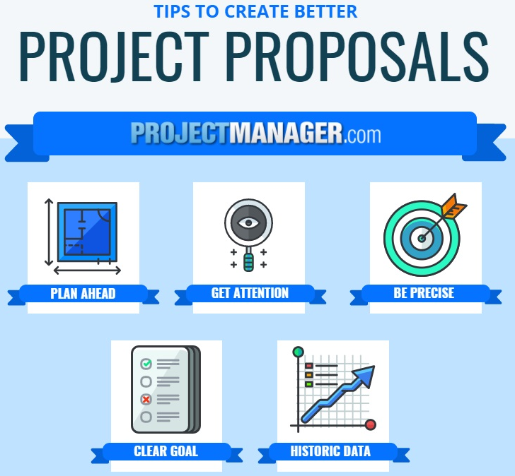
THE PROJECT PROPOSAL
YOUR TURN:
Think of an example of a project you could be pursuing (you don’t have to have a final decision on the class project at this time). Describe the following:
– Project Justification (why the project): ____________________________________________
– Project Goal and Objectives (what the project intends to achieve):
____________________________________________
– Project Activities (what must be carried out) ____________________________________________
– Project Methodology (how the project will be carried out):
____________________________________________

Slide 6
Choosing a project
YOUR TURN:
Ensure that the project aligns with your career strategy – it should give you an “edge”: e.g., gets you started with your own business idea; provide you with experience/real consulting; give you research skills to assist you with post-graduate application and work.
2. Ensure that you have project stakeholders and supporters. List them: _______________________________________________________________________________________
3. Understand the context of your project.
Who will be affected by/care about it: _______________________________________________________________________________________
Who will need to participate in it (e.g., give you data or information): _______________________________________________________________________________________
4. Ensure you have enough resources (not necessarily $$) for it. List them: ____________________________
5. Identify your parameters for success. List them: ________________________________________________

