Slide 1
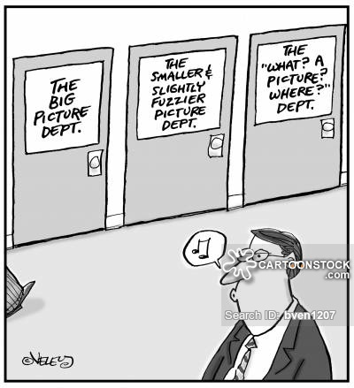
RESEARCH DESIGN AND DATA ANALYSIS

Slide 2
Data Analysis Practice
YOUR TURN:
Go to any data analysis pack you have on your device: if Excel, go to File-Options-Addins-Data Analysis ; if you don’t have any spreadsheets on your device go to myPlymouth-Services-My Software-Microsoft Office OR go to myPlymouth-Services-Google Drive-Google Sheets.
Use quantitative data that you have currently for the project OR any other REAL data (at least one series). If you do not have anything, obtain data from: https://datacatalog.worldbank.org/search?sort_by=field_wbddh_modified_date&sort_order=DESC&f%5B0%5D=field_license_wbddh%3A1335 ; https://www.bea.gov/data OR the Lamson Library Marketline database.
Run descriptive statistics (at least three).
Run 2 other data analysis tools (e.g., correlation, regression, etc.; you may need more data).
Interpret your findings.
IMPORTANT: the purpose of this activity is to give you an opportunity to experiment. “Play around” with data, check out various options for descriptive statistics and other tools. Don’t worry if your work is not perfect. Click around on various options in your program. Stop and reflect on your findings.

