Slide 1
Directory of Open Access Journal (DOAJ)
Today’s Goals
Reliably locate information in the Directory of Open Access Journals (DOAJ);
Be aware of what kinds of documents are available throughout DOAJ; and
Compare levels of access and availability of resources between DOAJ and Gale Academic Onefile

Slide 2
Learning objective- compare levels of access
In looking at the database entry screens, what strengths vs challenges can you see in DOAJ compared with Gale?

Slide 3
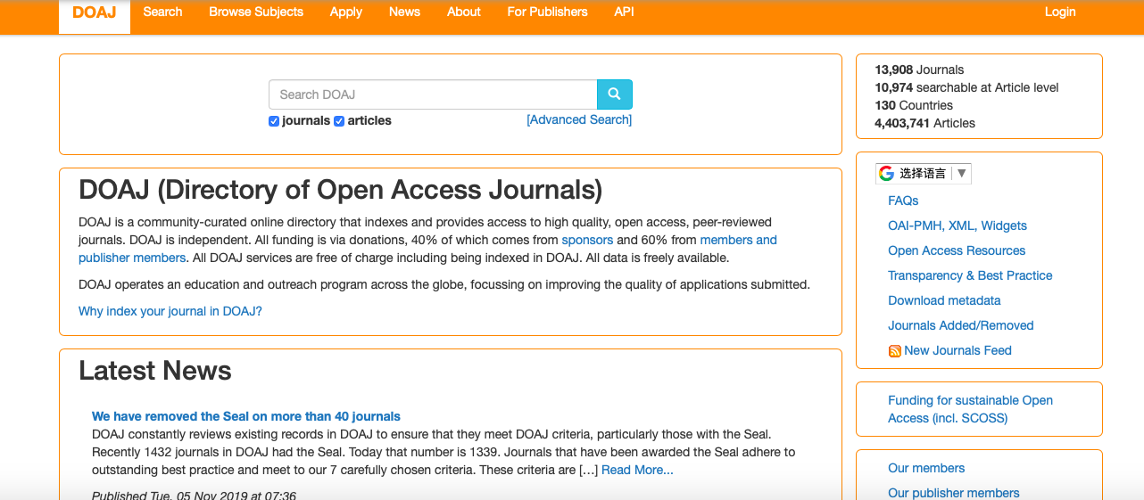

Slide 4
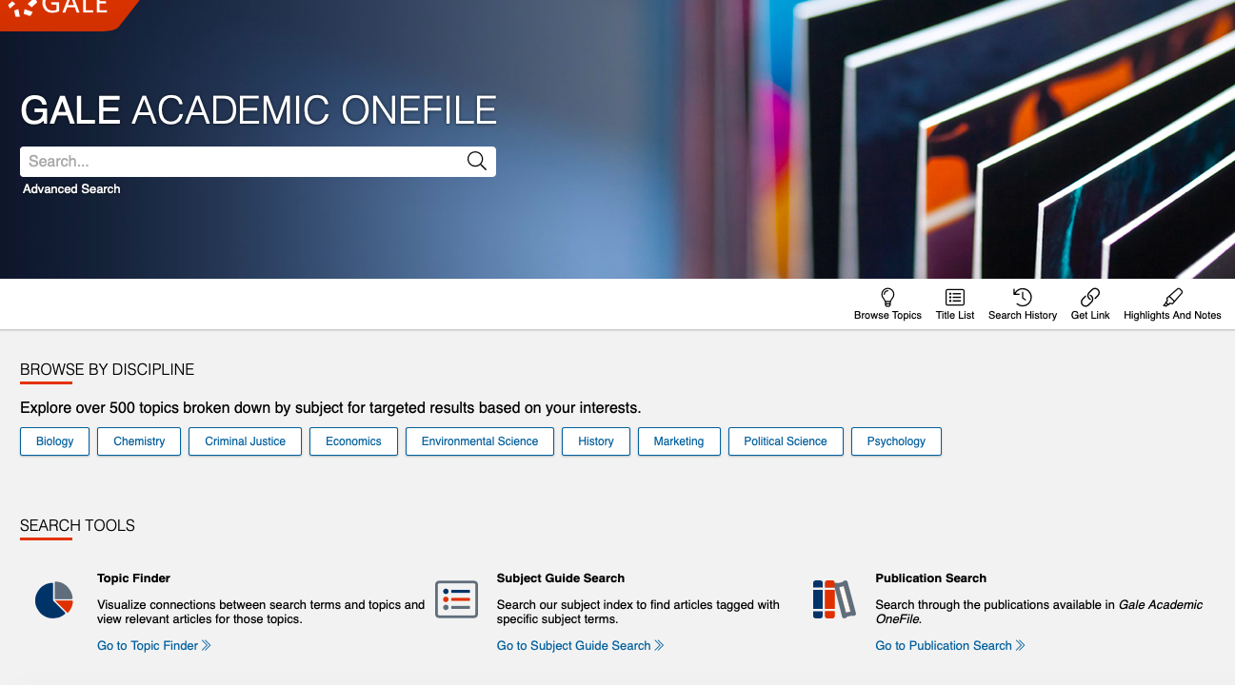

Slide 5
DOAJ | GALE
Access to translate and access in multiple languages | Access to translate and access in multiple languages
subject searching according to Library of Congress categories | Broader breakdown of subjects with multiple categories
No membership needed to access article- free for all | Membership required
Tool for those who do not have same resources or access to resources to get ability to work with academic peer reviewed sources

Slide 6
What ways does DOAJ classify resources compared with Gale?
How do the amounts of resources compare?
What stands out about the types of resources DOAJ has available?

Slide 7
DOAJ | GALE
Only open source academic journals | journals, magazines, newspapers, books, images, videos
Many different languages/sources from around world
School librarian- 291 results | School librarian approximately 20000 results

Slide 8
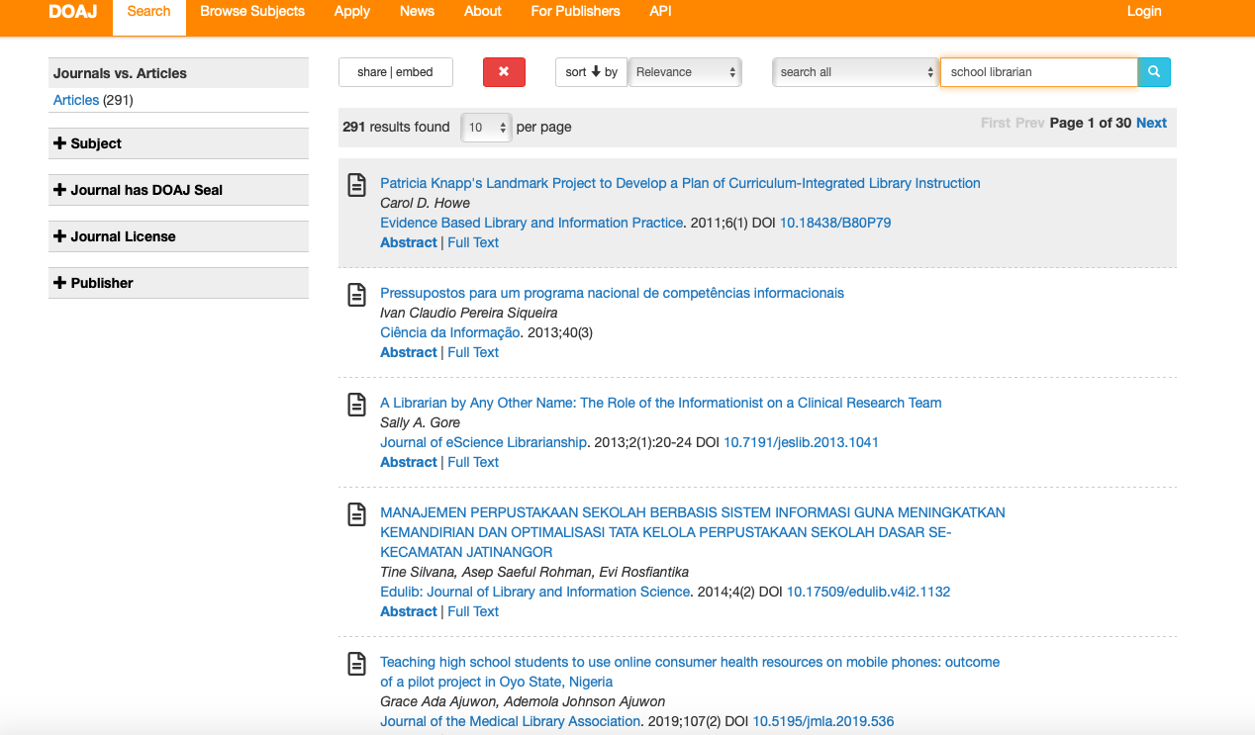


Slide 9
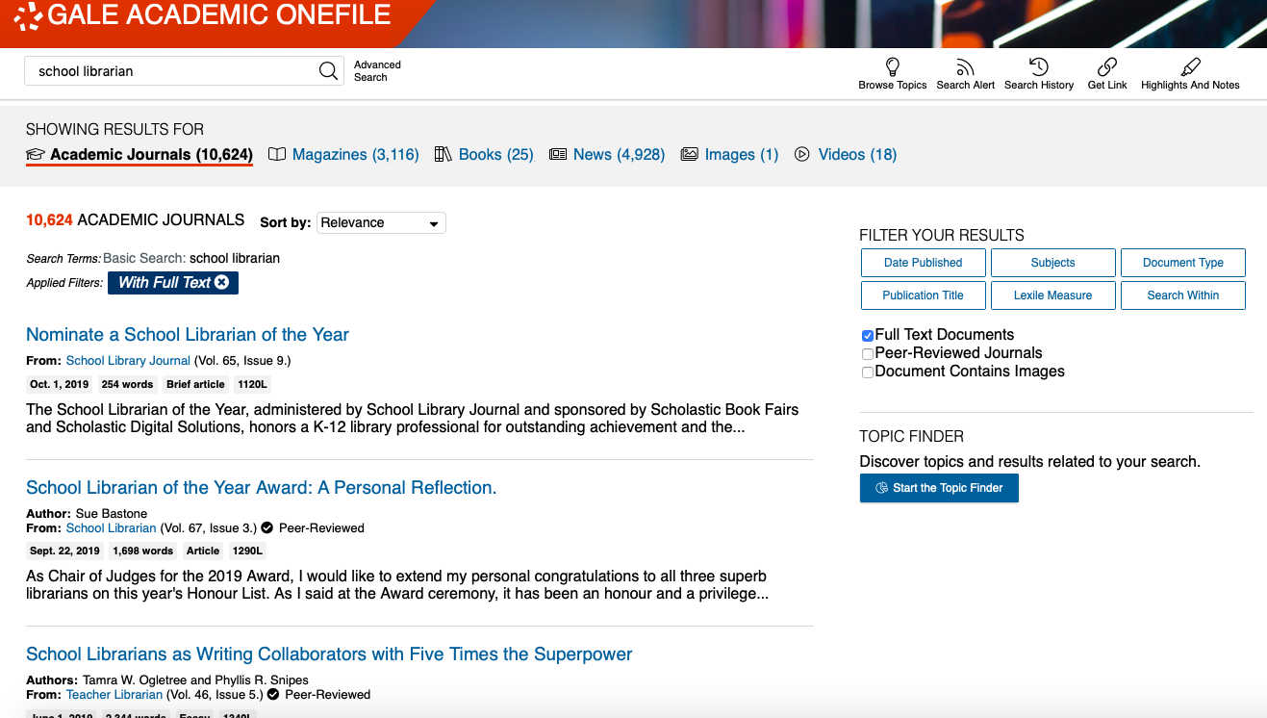

Slide 10
For the article abstracts, what are some areas that DOAJ lacks in comparison with Gale?
DOAJ | GALE
Abstract and journal background info | Abstract and journal background info
Editorial info on how article was reviewed and time of review | Reading info- lexile measure and length
 | Related articles and subjects to further expand your research

Slide 11
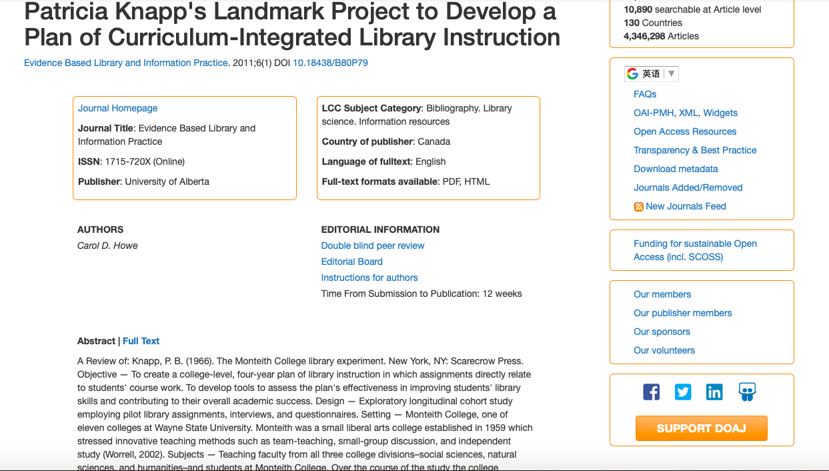
donec quis nunc

Slide 12
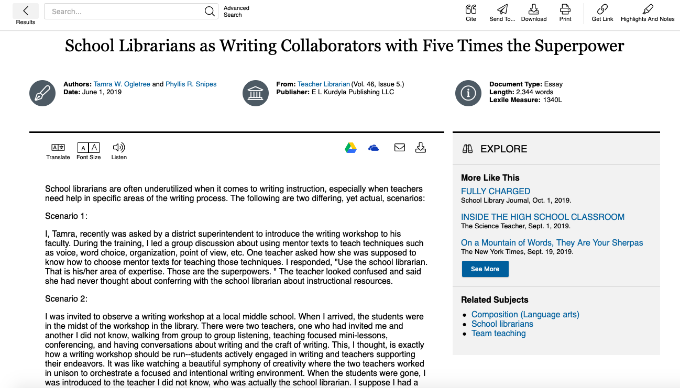

Slide 13
Overall
DOAJ is about accessibility and open access compared to paywalled databases like GALE .
It’s resources and journals are limited, but provide a valuable source and leave with the question:
Should information be open or should it be behind paywalls?
While information isn’t free to organize and put together, does that mean it should be limited to those who have access?

