Slide 1
Directory of Open Access Journal (DOAJ)

Slide 2
In looking at the database entry screens, what strengths vs challenges can you see in DOAJ compared with Gale?
Translation feature vs options of searching

Slide 3
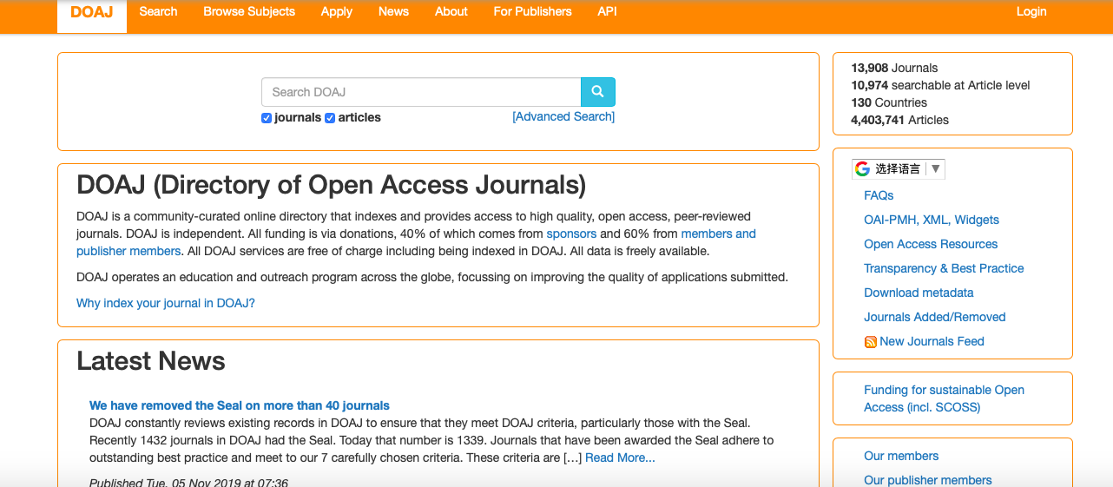

Slide 4
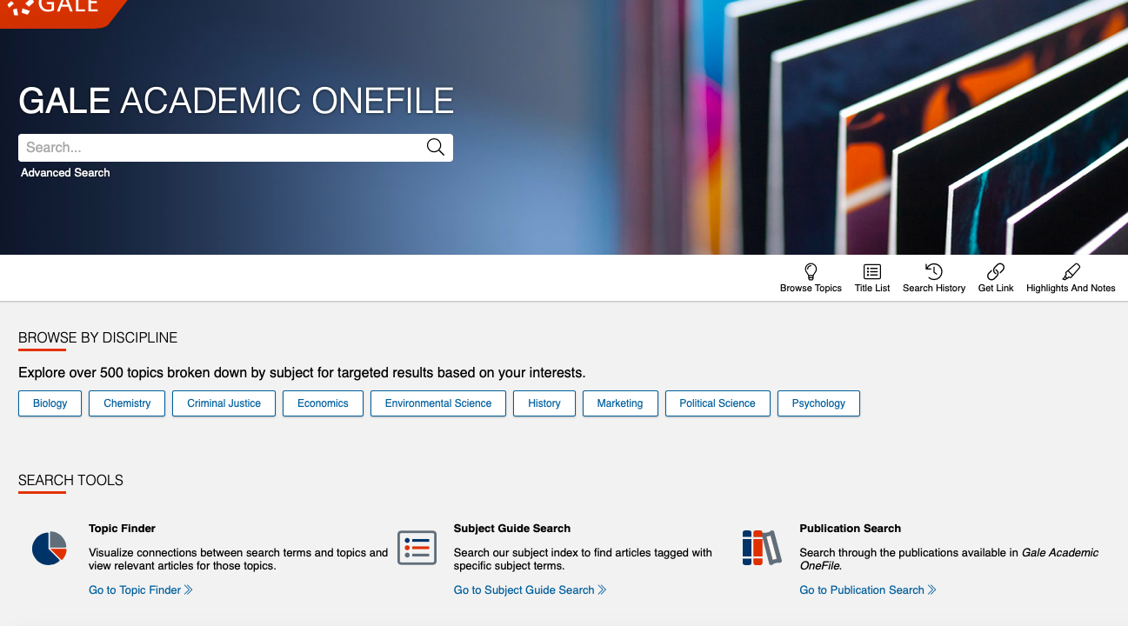
donec quis nunc

Slide 5
What ways does DOAJ classify resources compared with Gale?
How do the amounts of resources compare?
What stands out about the types of resources DOAJ has available?
multi-language, vast differences in search results, gale many types of documents vs few in DOAJ

Slide 6
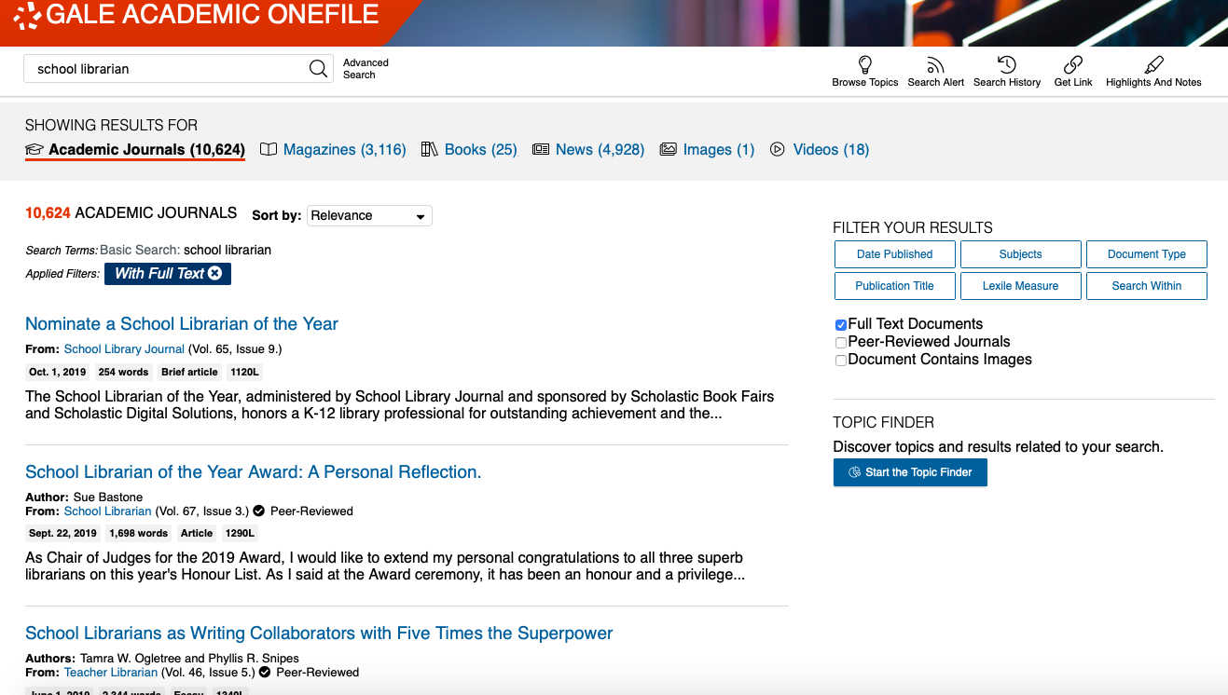
donec quis nunc

Slide 7
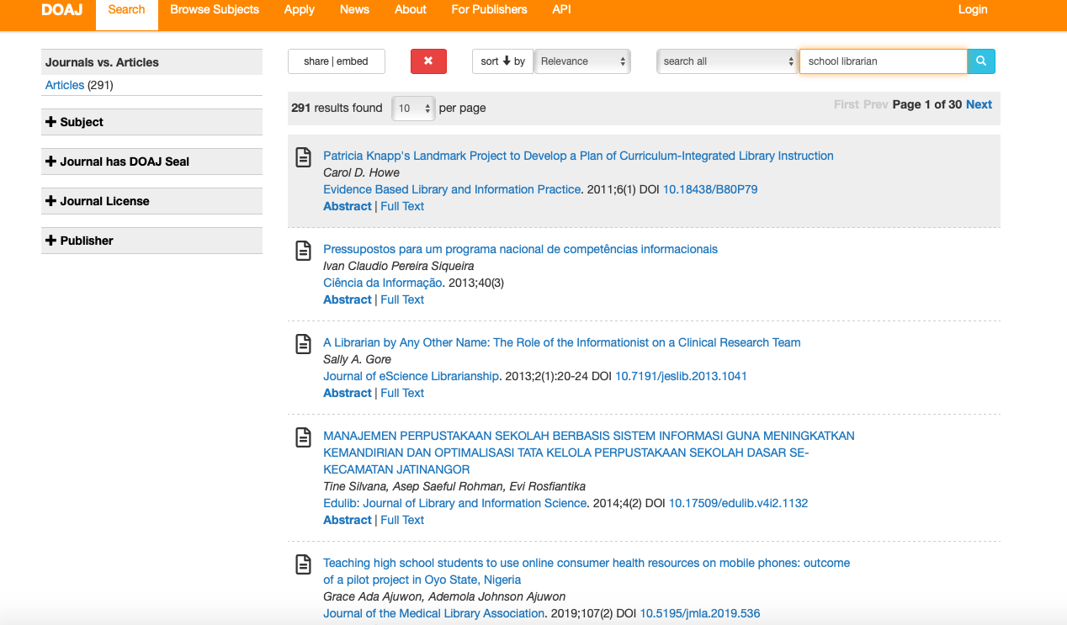

Slide 8
For the article abstracts, what are some areas that DOAJ lacks in comparison with Gale?
Gale more resources to search, more information

Slide 9
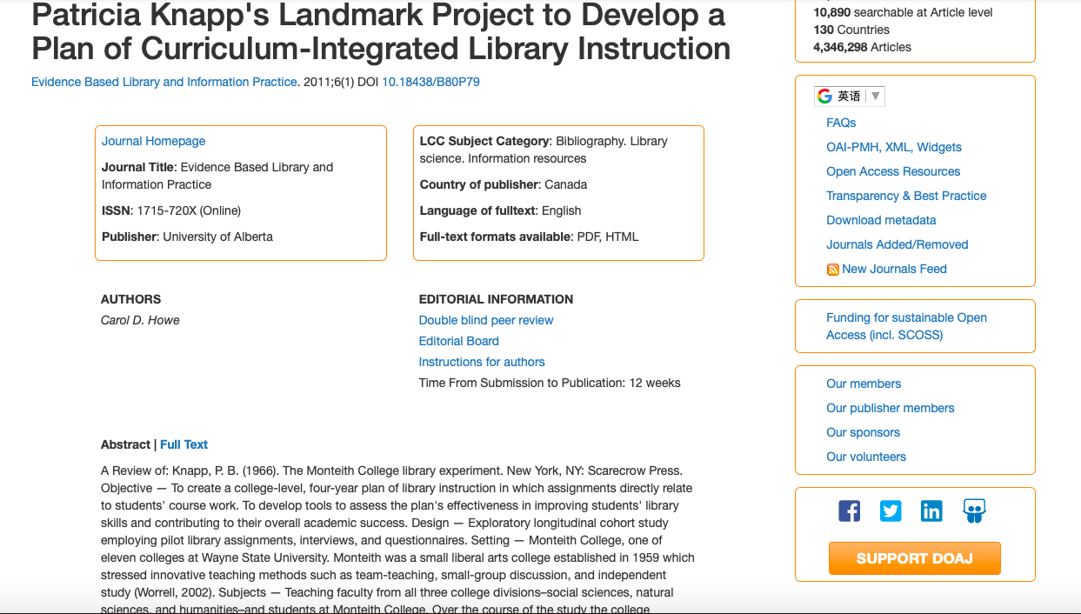
donec quis nunc

Slide 10
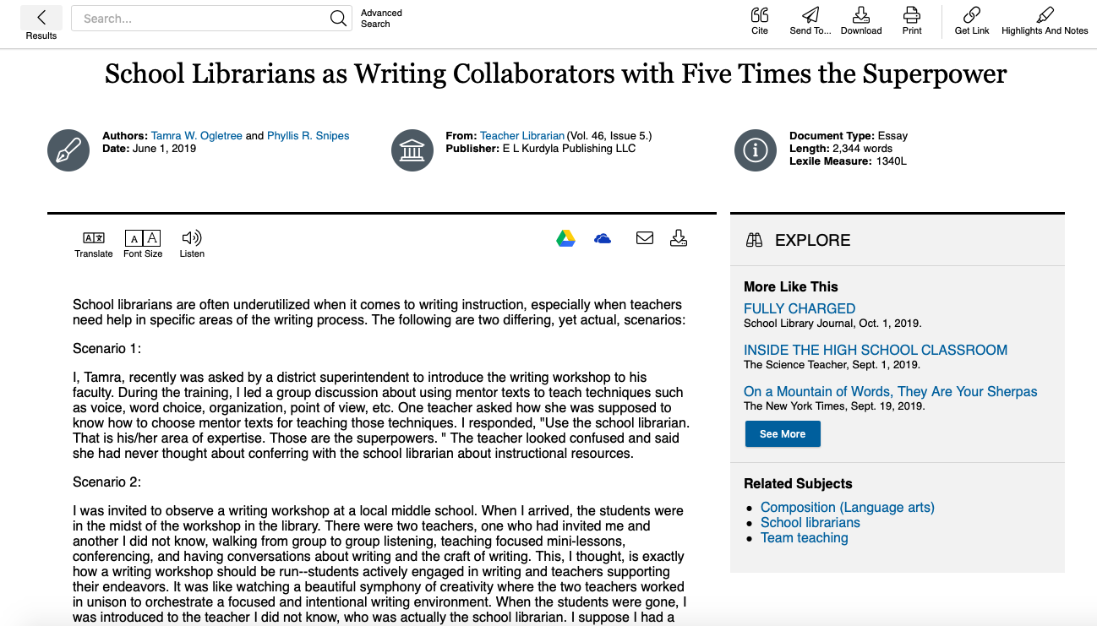
donec quis nunc

Slide 11
How does a more precise search change the results in each database?
donec quis nunc

Slide 13
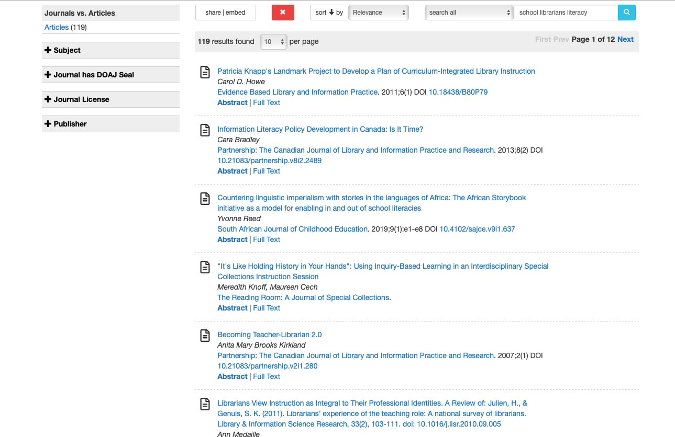
donec quis nunc

Slide 14
donec quis nunc

Slide 15
