Slide 1
Food industry & obesity: is balance possible?
Kelci Katterhenry

Slide 2
Problem Statement
Obesity is a highly prevalent chronic disease involving an excess amount of body fat or distribution of body fat that presents risk to other health conditions. The food and beverage industry promotes obesity with large portions, ultra-processed foods, skilled marketing, and convenience. On the other hand, purchasing food from all over the world is made possible because of the food industry. How do we, as nutrition professionals, work with the food industry to reduce their role in obesity but still promote access to food?

Slide 3
introduction
Adults
  Overweight: BMI 25.0-29.9 kg/m^2
  Obese: BMI ≥ 30 kg/m^2
Food industry includes restaurants, fast-food service, prepackaged items, pre-made meals, grocery stores, convenience stores, etc.
Biggest drives for food choice
  Taste
  Environment
  Social life
  Knowledge
Advertisement
Time, convenience, cost
Habits
Emotions

Slide 4
History

Slide 5
Timeline: Food Industry
<1900
1920
1940
Late 1800’s: first bakery opened, allowing people the option to not bake bread at home
1920s: a wave of small chain, counter service grocery stores
1924: Ye Market opened, a U-shaped shopping complex
1924: frozen food in grocery stores
1940: Introduction of the shopping cart
1947: Orla Wilson
1948: Pillsbury pie crust and cake mix debut; Reddi Whip (Toops, 2022)
1910
1930
1914: window displays
1915: Astor Market opened
1916: Piggly Wiggly opened (first-ever self-service grocery)
1930: King Kullen, the first supermarket
1937: Clarence Saunders introduced self-checkout, the Keedoozle, at Piggly Wiggly (failed)
(Good House Keeping, 2022)
(Tridad, 2020)
Notes:
1915: Astor Market
First market to ever sell groceries, meat, produce, and flowers
A head of its time and closed in two years
Consumer preferred small shops
1916: Piggly Wiggly
Clarence Saunders
Before this, people would come in with a list and the store clerk would gather their items
Wanted them to walk around the store and grab more than they came in for
Clarence noticed how customers shopped and strategically arranged to store
Put children items on the bottom shelf
1920: small counter service grocery stores
Kroger
1924: Ye Market
California, the households with cars kept growing
Similar to department shopping
23 separate stores in a U-shape with the parking lot in the center
Allowed people to drop items off in their car
1924: frozen foods were available in grocery stores
1930: King Kullen
First ever supermarket
Different products (meats, dairy, bakery, dry goods)
One store for all their goods
1937: self checkout
- Clarence
never worked, but the concept was there
1940: shopping cart
Noticed how people stopped shopping once their handheld baskets were full
Invented so people could keep shopping and buy more food
Men were embarrassed to go grocery shopping with the cart because they felt emasculine for not being able to carry all the groceries
1947: child’s seat
Orla Wilson
Attached the child seat to the grocery cart
1948: items
Pillsbury pie crust, boxed cake mix, redid whip
Women loved the products because they saved time

Slide 6
1960
1980
1960s: customer loyalty trading systems; aluminum cans
1967: Trader Joe's; easy open front ring pull tab
1980: Whole Foods opens and markets “organic”
1982: Diet Pepsi is introduced
1983: Sam's Club opened
1987: Snapple introduces first bottled tea
1989: Peapod was the first online grocery service
1950
1970
1950: Expansion of international foods in supermarkets
1950: Conveyer belt, plastic film for meat packaging
1952: Concept of the barcode, later named UPC. Technology to scan was unsuccessful
1953: Kraft's Cheez Wiz
1954: Frozen T.V. dinner
1970: Orville Redenbacher, Starbucks
1972: Introduction of 24/7 operation
1974: A price scanner introduced for scanning UPC
1976: Costco Wholesale opened; fortified cereal
(Good House Keeping, 2022)
(Toops, 2022)
(Trinidad, 2020)
Notes:
1950: international foods
After World War II, there was a growth in international foods from men who included more diverse food in their diet when serving abroad.
Before this point in history, international food in the American supermarkets was limited to canned chow mein and spaghetti with pasta sauce.
1950: conveyer belt to speed up checking out
- Plastic film for meat packaging, convenience, instead of butcher wrapping
1952: bar code was invented, but technology to scan it was unsuccessful
1950s: Swansons frozen chicken pot pie sold 5000 units its first year to 10 million its second year
1960s: customer loyalty trading systems, but government resistance
Placed taxes on them
Grocery prices raised
1967: Trader Joe’s
- Unique because private label goods
rotating items enticed customers to keep coming back
1972: 24/7 operation
More people had cars and more stores were opening
Had to compete however they could
most stores in the 1950’s were only open 9 a.m. – 5 p.m. Monday through Friday. I
By 1972, 4% of supermarkets in the United States were open 24/7.
This was a costly change for businesses, but customers enjoyed the loyalty of knowing they can run in the store at anytime of day
1974: Price Scanner
Able to scan bar codes
Wrigley’s juicy fruit gum was the first item scanned
1976: Costco
started off as a way to sell items to small businesses, but when they noticed that they were making a profit off of small businesses purchasing items in bulk, they decided to open the doors to members for familial settings.
1980: Whole Foods opens
Markets the word organic
Organic is not a regulated term until 2002
1989: peapod
- First online grocery shopping
Easy open ring introduced first on spam

Slide 7
2000
2020
2002: Organic becomes a federally regulated term
2007: Amazon Fresh introduced
2009: Great recession shifted supermarkets to focus on "value" for success
2020: Amazon launched its first full-sized, cashier-less grocery store
2020: Covid-19 hit America and supporting local businesses trends
2022: plant-based diets increased 300% compared to 15 years ago; 64% of Americans report eating in restaurants less since pre-pandemic (Woodruff, 2022)
2010
2010s: Private store brands were perceived as lower quality
2011: Hello Fresh
2012: Instacart
2013: Doordash, Target delivery
2015: Online food ordering exceeded ordering by phone call
2016: online food delivery accounted for 3% of all restaurant transactions
2017: Amazon acquires Whole Foods
2017: a jump in sales for prepared foods of 139.5% over the previous year
1990
1990: Loyalty cards
1991: Sunchips were the first multigrain Frito-Lay snack
1994: PizzaNet
(Good House Keeping, 2022)​
(Toops, 2022)​
(Trinidad, 2020)
Notes:
1994: PizzaNet
Pizza hut was the first restaurant to offer online food delivery
Opens the door for many others
2001: Papa Johns online ordering
2009: Great recession hit
Switching marketing from organic and family to “value”
Grocery and supermarkets were least affected because people still had to purchase these items
Buying generic and searching for value was not negatively thought about anymore
Baby boomers used to be embarrassed to purchase generic items

Slide 8
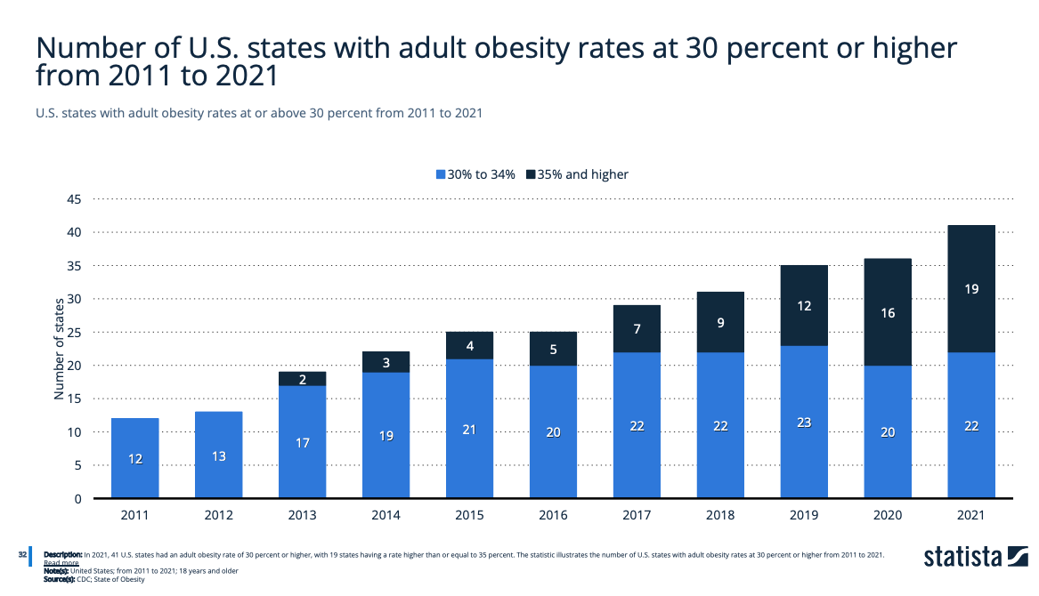

Slide 9
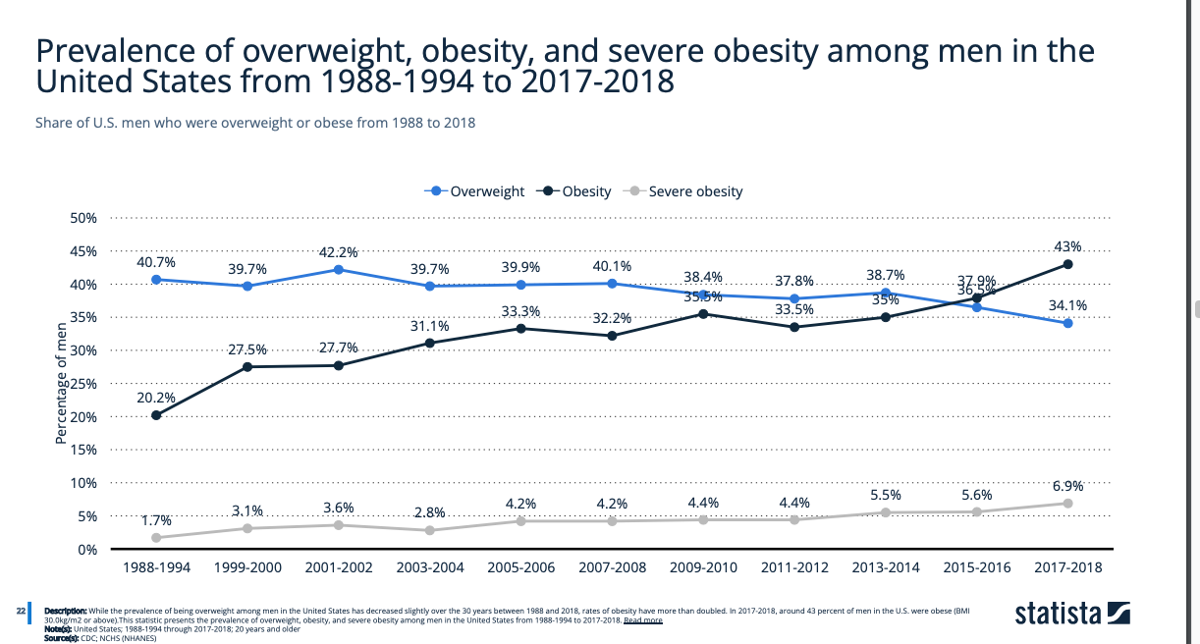
Notes:
Obesity and sever obesity rising
Perhaps people felt helpless
Overweight was overall decreasing

Slide 10
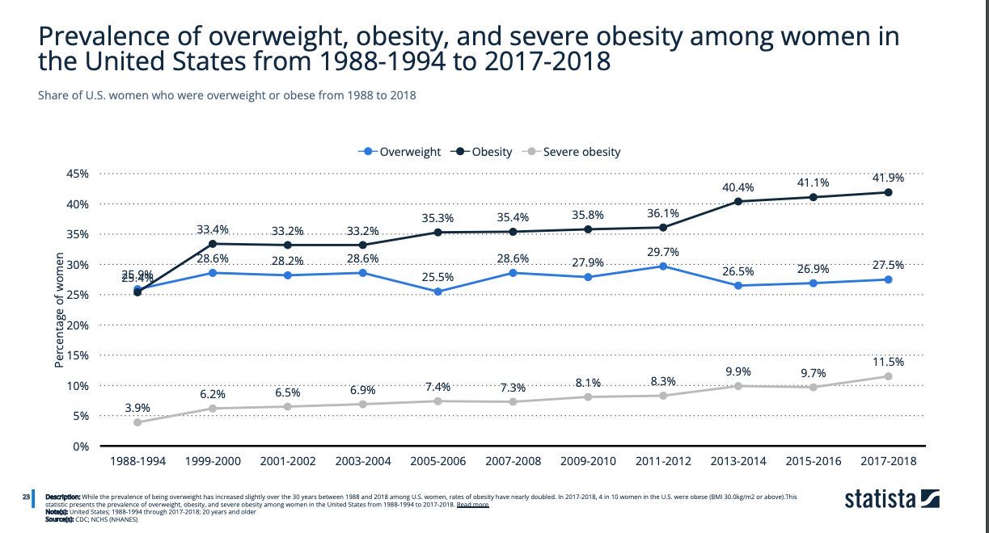
Notes:
Obesity and severe obesity rising
Overweight has been steady

Slide 11
science

Slide 12
What is energy?
Kilocalorie (kcal)
  Measuring unit for energy in food
  Amount of heat required to raise 1 L of water 1-degree Celsius
Humans derive energy from the oxidation of macronutrients
Carbohydrate | Protein | Fat | Alcohol
4 kcal/g | 4 kcal/g | 9 kcal/g | 7 kcal/g
(Nelms, 2020)
Notes:
To maintain weight, people need to maintain energy balance

Slide 13
Energy balance
The balance between energy intake and energy expenditure
Energy expenditure
  REE: Resting Energy Expenditure
  PA: Physical Activity
  TEF: Thermic Effect of Food
Energy Balance = Weight Maintenance
Intake > Expenditure = Weight Gain
Intake < Expenditure = Weight Loss
(Nelms, 2020)
Notes:
REE : amount needed to sustain life at rest
the biggest impact on someone's REE is the amount of lean body mass the individual has
Fat free mass, or lean body mass, uses more energy than fat
sex, body temperature, age, energy restriction, genetics, and endocrine system
Sex: males tend to have greater percentage of lean body mass than females, men have a naturally higher REE.
Body temp: increases, such as exercise or fever, the REE increases
Age: turns 30 years old, REE decreases about 2% every decade
Energy restriction: is one of the reasons we hit a plateau when losing weight. After energy restriction and losing weight, REE declines.
Genetics: influence REE because people can inherit a high or low REE.
Endocrine: hormones and the immune system can impact metabolic stress and energy requirements
Thermic effect of food
digest, absorb, metabolize, and store nutrients from food
energy used to eliminate by-products and waste
The most influential factor is meal composition.
Large meals will have a greater thermic effect than small ones.
protein has the highest TEF of the macronutrients – processing amino acids released from the protein in foods
(PA)
is most variable component of a person’s energy expenditure
influenced by the individual’s body weight, muscle groups used during activity, and intensity or duration of the activity
heavy people have more body mass to move, they will expend more energy than a small person.

Slide 14

Appetite
Appetite is stimulated by taste sensation
As the stomach stretches, neural signals go to hypothalamus, appetite inhibition begins
  CCK
  GLP-1
  Peptide YY
Ghrelin
  Fasted state: rise stimulate appetite
  After food intake: drop decrease appetite
(Nelms, 2020)
Notes:
Appetite and eating behaviors
influenced by a variety of neural and hormonal signals
influence the release of peptides in the hypothalamus
- The taste sensation in the mouth will stimulate appetite
- person eats, the stomach stretches, and neural signals will go to the hypothalamus to begin inhibiting appetite
hormones CCK, GLP-1, and peptide YY will decrease appetite.
Blood glucose rises following a meal, beta cells in the pancreas release insulin and amylin to decrease appetite and food intake.
During fasting, the beta cells secrete glucagon
During a fasted state, ghrelin levels will elevate
stimulate appetite
immediately after food intake, ghrelin levels will begin to drop

Slide 15

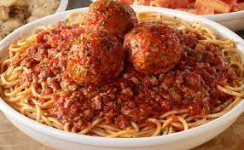
Etiology of obesity
Chronic state of higher intake than expenditure
  Not one cause
  Elusive
3 Main Causes
  Medical and psychiatric disorders
  Genetics
  Obesogenic environment
(Nelms, 2020)
Notes:
Obesity develops when the body is in a chronic state of higher energy intake than expenditure.
The etiology of obesity is elusive
there are many factors that contribute to consuming more energy than expending
The three main factors, our MNT textbook, are medical and psychiatric disorders, genetics, and obesogenic environment
Medical and psychological disorders: result in people taking medications that increase weight
Genetics: as stated earlier, can influence someone's REE
Environment: people who are susceptible to obesity and placed in an obesogenic environment will result in obesity
growth of food industry and eating out
portion sizes in and out of home have increased
increased availability of high energy dense foods and beverages
increased snacks and convenience foods
Marketing
average income has increased more than the average price of food

Slide 16
Politics

Slide 17
Food Policy
Food policy: how government actions shape the food system
All government levels can impact food systems
Examples of Federal Food Policies
  Federal Nutrition and Labeling Education Act of 1990
  Dietary Guidelines for Americans
  National Organic Program
Piloting in smaller areas serve as models for larger area
  California state menu labeling before the Affordable Care Act
  Trans fat bans
  Doubling SNAP benefits at farmer’s markets
(Food policy 101, 2019)
Notes:
All government levels
- As high as federal: International trade agreements
- As low as local: local school district policies
Examples
Federal Nutrition and Labeling Education Act 1990: gave FDA authority to regulate packaged item labels and claims
Dietary Guidelines for Americans: serve as the basis for federal food, nutrition and health programs, and government policies
National Organic Program: is ran by the USDA to develop policies and regulations for certified organic products
A lot of federal policies are in place today because of local policies
CA had state menu labeling policies before the ACA mandated them
Doubling SNAP benefits was used in some local towns before it became federally recognized

Slide 18
Food industry and portion sizes
Authorities called the food industry to reduce portion sizes in early 2000’s
Companies' response
  Decrease the size of one product but increase the size of another
  Price larger portions cheaper than smaller portions
Coca-Cola (bottles)
Burger King
2002 | 2021
8.0 fl oz 20.0 | 8.0 fl oz 8.5 12.0 16.9 20.0 24.0
2002 | 2021
Burger patty (4.4 oz) | Burger patty (3.5 oz )
Small Fry ( 2.6 oz) | Small Fry (4.5 oz )
(Young & Nestle, 2021)
Notes:
When portion size regulations begun, companies got sneaky
2 Ways companies did this:
Decrease the size of one option while increasing the size of others
Burger king
Also introduced quadruple burgers
Mcdonalds was the same way and introduced double big macs
Smaller portions often costs more
There was less than a 90cent difference between the larger and smaller big mac, so customers thought oh well might as well get the bigger one

Slide 19
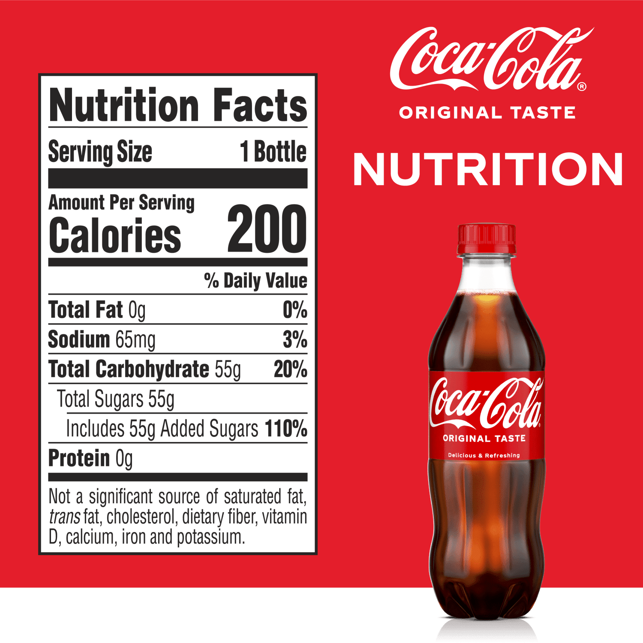
Food industry and portion sizes
Amazon and Coca-Cola
  16 pack of 8 oz bottles
  16 pack of 16 oz bottles
According to Marion Nestle, “current United States policies support the production of larger portions through subsidies of basic ingredients that promote overproduction and low prices.”
New York City Board of Health response to 2002 research
  Limit sugary beverages to 16 oz
  Beverage companies sued the city, court ruled in companies’ favor
National policy to cap portion sizes would be ideal
(Young & Nestle, 2021)
Notes:
Coca cola on amazon
8oz bottles cost 3 times as much per oz as the 16 oz
Nestles quote
some health departments around the country implanted portion control education programs
New York City’s Board of Health attempted to limit the size of sugary beverages sold to no more than 16 oz
did not last long because beverage companies sued the city.
In court, the court ruled in the beverages companies’ favor.
Voluntary approaches from the food industry to reduce portion sizes or increase incentives for healthier options is unlikely to happen
The article concludes by saying that government, food industry, and educators should collaborate to educate the public on portion control and comparing caloric intake of menu items. Placing national policy on food industry to cap the portion sizes of burgers, fries, soda, and other unhealthful items would be an ideal approach.

Slide 20
Can healthy food policies make a profit?
Health and Weight Commitment Foundation
  16 food and beverage companies collaborated on policies
  1.5 trillion calories removed from the market between 2010—2015
Food labeled “lower calories” grew by 82% in 2013
  Four times quicker than higher calorie products
  The items that grew this quickly were a part of the Foundation
Out of 15 random products that made over $50 million in 2013, 10 labeled “lower calorie”
(Roundtable on Obesity Solutions, Food and Nutrition Board, Institute of Medicine, 2014)
Notes:
Some companies recognized that they could make a difference in the obesity epidemic
- 16 companies joining together to reduce calories
CDC and NHANES both reported that people were consuming less calories during the same time these 16 major food companies were reducing the calories (by serving sizes, offering healthier varieties, or reformulation)
Shows that low calories and less unhealthy items can still make a profit

Slide 21
Obesity and policy
Corporations are the biggest hurdle governments face when making policies in response to obesity
Policies on obesity are being looked at with other organizations besides food industry
  History of shutting down any threats to their profits
  Ex: focusing on climate change and automobile admissions
Not one single cure
Individual agencies have a threshold for what they can achieve
  20 federal agencies that impact food industry and physical activity
  Collaborate and join finances
(Swinburn, 2008)
Notes:
businesses immediately shut down any threats to their profits sooo policies regarding obesity are being looked at in combination with other imperatives.
Example: to increase physical activity and reduce saturated fat intake
policies about climate change, automobile admissions, and nutrition sustainability are being promoted.
These policy combinations are seen as promoting biking, walking on sidewalks to commute, and plant-based eating.
policy makers struggle to make changes to improve the obesity epidemic because there is not one single cure
The argument is this brings more parties to the table to make the change.
For example, food industry and physical activity programs have an equal role in promoting weight management.
To prevent obesity, individual agencies have a certain threshold for what they are capable of achieving.

Slide 22
legal

Slide 23
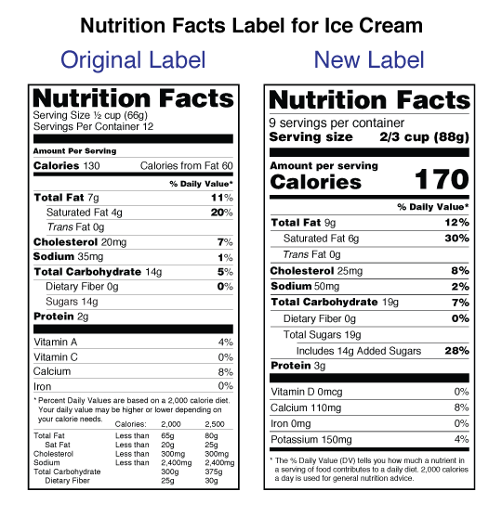
Laws in food industry
Ensures that food is safe and not falsely labeled
In 2016, serving sizes, by law, were updated to reflect the amount that people typically consume
  First legal change in 20 years
  FDA
Trans fat and PHOs
  FDA determined unsafe in 2015
  Any added to food had to be removed by January 2020
”Healthy”
  1994 law did not reflect Dietary Guidelines for Americans
  2022 law reflects Dietary Guidelines for Americans 2020-2025
(Center for Food Safety and Applied Nutrition, 2022)
Notes:
In 2016, FDA required nutrition labels to upgrade the serving sizes
- Servings sizes had to reflect the amount people typically consume
- Reasoning: ongoing research linking obesity to diet
Example: soda was 8fl oz, but is now 12 fl oz
By 2020, FDA required all trans fats to be removed from the marketplace
In response to data finding that one third of calories per day by Americans are eaten away from home, the FDA set two laws in place.
First, restaurants with 20 or more locations were required to list calorie information on menus.
Second, vending machine operators with at least 20 vending machines needed to disclose calorie information on the items sold.
FDA updated the definition of the word “healthy” for companies to be able to use
Now reflects dietary guidelines
Distinguishes desirable and undesirable fats
Must have a specific amount of Daily Value for at least one of the major food groups

Slide 24
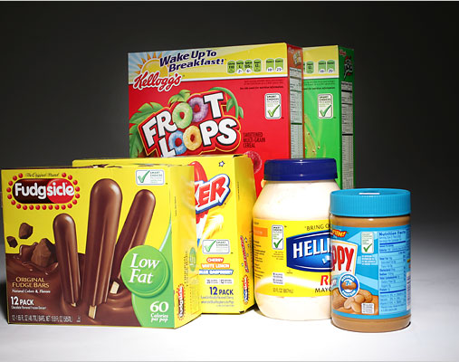
“Smart Choices”
2009
14 major food companies funded this front of package labeling program
“Healthier” could be labeled on a product if it was:
  Lower in fat, sodium, or sugar
  Higher in a vitamin or mineral
Offset the “healthier” value with a less healthy value (Endres, A. B. & Johnson, N. R., 2011)
Foods with the Smart Choices checkmark include sugar-laden cereals like Froot Loops, mayonnaise and Fudgsicle bars. (G. Paul Burnett/The New York Times)
Notes:
This little green check that indicated it was a ”healthier” item was funded by 14 companies
The FDA quickly addressed their use of the term because it did not meet DGA
Requirements to use “healthier”
Lower in fat, sodium sugar
Higher in vitamins and minerals
BUT offset with adding less healthy components
Example: this fudge popscicle was marketed to be ”low fat” but that’s because it was 60 calories, and every calorie came from one of the three added sugars that the sicle was made of
{ “You’re rushing around, you’re trying to think about healthy eating for your kids and you have a choice between a doughnut and a cereal,” Dr. Kennedy said, evoking a hypothetical parent in the supermarket. “So Froot Loops is a better choice.”
Froot Loops qualifies for the label because it meets standards set by the Smart Choices Program for fiber and Vitamins A and C, and because it does not exceed limits on fat, sodium and sugar. It contains the maximum amount of sugar allowed under the program for cereals, 12 grams per serving, which in the case of Froot Loops is 41 percent of the product, measured by weight. That is more sugar than in many popular brands of cookies }

Slide 25
U.S.A Food industry & Obesity
Pelman vs. McDonald’s
  Pelman was a group of parents that came together to sued McDonald's
  Claimed against McDonald's went against New York law
  Unable to proceed
  To this date, only lawsuit filed against McDonald's for causing obesity
South Los Angeles
  Higher rates than all other parts of Los Angeles
  City Council studied the area
    1,000 fast-food restaurants in a 30 square mile area
    30% of residents obese
  Los Angeles City Council bans construction of anymore fast-food restaurants in the area
(Endres, A. B. & Johnson, N. R., 2011)
Notes:
McDonald’s claimed that their food can be a part of anyone’s healthy daily diet
Unable to proceed because no evidence showing that McDonalds was the primary reason the children became obese and was mcd responsible for the misrepresentation or was is the consumers

Slide 26
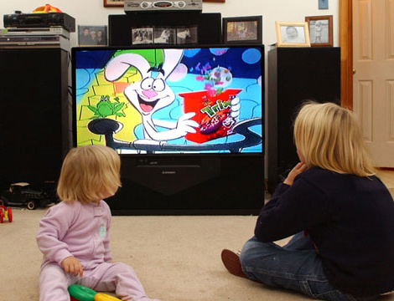
International laws & obesity
In 2022, British government limits marketing of unhealthy food and beverages
  High in fat, sugar, and/or salt
  Commercials only allowed to air 9 p.m. – 5:30 a.m.
  Zones in grocery stores
Kellogg’s response to British government laws
  Claim they are unfairly punished
  Laws do not consider the nutritional value of milk with their cereal
(Engine, L. L. C., 2022)
Notes:
New law in England as of fall of 2022
Only allow commericals of food and beverages that are high in fat, sugar, sodium to be aired between 9pm and 5:30 am
Only allow these items to be in certain parts of the grocery store

Slide 27
International laws & obesity
Article 11 of the United Nations International Covenant on Economic, Social, and Cultural Rights (1976)
  Everyone’s right to adequate food and free from hunger
  Entire diet has a mix of nutrients
  Diets should promote physical activity, development, mental growth, and maintenance
Before 2004, WHO focused on limiting hunger and malnutrition
In 2004, WHO’s Global Strategy
  Addressed chronic disease related to obesity
  Encouraged governments to educate consumers
In 2006, laws to combat obesity promoted as part of Global Strategy
  Norway
  Quebec’s Consumer Protection Act
  British Office of Communications
  Board of Health in New York
(Stettner, J., 2010)
Notes:
Prior to 2004, the motives of the World Health’s Organization response to food was to ensure hunger and malnutrition was limited.
In May 2004, the WHO’s Global Strategy addressed chronic disease related to obesity throughout the world.
Some countries took initiatives to set laws to reduce childhood obesity.
Examples include:
Norway prohibiting marketing strategies that are unfair to consumers
Quebec’s Consumer Protection Act prohibits commercial advertising to children under the age of 13
British Office of Communications setting time limits for advertising.
in 2008, the Board of Health in New York City requires that food items must contain less than 0.5 grams of trans fat per serving

Slide 28
religion

Slide 29
Religion & American obesity
Religious men vs. women
  Researched in 2006 by the Journal for the Scientific Study of Religon
  Key differences were found
    Religious men were less likely to become obese
    Religious women were more likely to turn to food for comfort
2017 study on Christans in Texas
  112 participants (90% female, 10% male; 88% Caucasian, 8% Black, 4% other)
  Survery on their beliefs on the body as a temple, what items they believe destroy their body, and their personal habits
  Results:
    Participants felt physical inactivity, poor diet, and being obese "somewhat" destroy the body
    Did not believe physical inactivity, poor diet, and obesity were sinful
    Aclohol and cigarette usage were scored higher that poor diet
    Premarital sex was scored lower than poor diet
(Cline & Ferraro, 2006)
(Faires et. Al., 2020)
Notes:
Study on the difference between religious men and religious women
women who participate in religious activities were more likely to become obese than women who did not participate in religious activities
men who were religious were less likely to become obese.
Authors state “This means that men may be turning to religion, instead of food, as a form of comfort and through this avoiding obesity”
Study on Christians that live in Texas
- presented a verse that described the body as a human temple
Asked to answer what factors they believe destroy the temple
Prayer habits, church attendance, physical activity, dietary intake, attitudes about certain lifestyles
Results:
Felt very strongly about smoking and drinking destroying the body, but less strongly with poor diet, physical activity and being overweight
49% thought poor diet and physical inactivity destroys the human body
79% report that alcohol destroys the human body
32% thought premarital sex destroys the human body

Slide 30
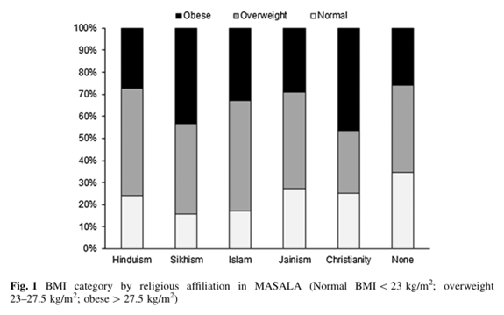
Religion & international obesity
(Bharma et. Al., 2018)
Notes:
A cross-sectional analysis study done in South Asia in 2018,
examined the relationship between religious affiliation and overweight/obesity.
After adjusting for age, sex, amount of time lived in the United States, marital status, education, insurance, and state of health, there was an obvious correlation between religions and weight.
LOOK AT THE OVER WEIGHT PORTION
Tells how people address bein over weight (lose, maintain, gain)

Slide 31
Culture

Slide 32
What is Culture? the customs of a social group or people
Industry
Culture is defined as the customs of a particular social group or people
  Purchasing
  Choices
  View
People’s food environment determines the options they have
Work culture (Nobrega et. Al., 2016)
  Poor working conditions, night shift, rotating shift, hold more than 1 job
  Uncertainty on when breaks will be
  On site access
Obesity
Before the 20th century, excess body weight was seen as a luxury (Suminska et. Al., 2022)
  Social status
  Not a part of the working class
Obesity now seen as an epidemic
  People have accepted it
  Both high and low income
The way people around you eat will influence how you eat
  What you order at a restaurant
  How big you make your plate
Notes:
INDUSTRY
- Culture is defined as the customs of a particular social group or people.
How people purchase food, eat, drink, and view food is a part of their culture.
Food environment (like what stores and restaruants are built in their area) influences what their options are
Where will they meet friends and family for dinner
What will they bring home to the kids
Is there a grocery store to stop buy on the way home for dinner ingredients
Could they place a mobile order on the way home so they don’t have to get three kids out of the car
WORK
many people spend most of their time at work.
Work culture is an important component of people's lives and influences their dietary intake.
Night shifts, rotating shifts, having multiple jobs, not knowing when their next break or meal time on site will be
All of those influence how much they eat in a sitting and what choices they make
Having access to food on site
OBESITY
Used to be seen as a luxury, social status, being able to have money to dine at fancy restaurants and not have to worry about food access
It is now an epidemic that impacts the high class, low class, and everywhere in between
People have begun to accept that it is an epidemic
Think negatively about obese and the ideal body is a skinny body
The choices we make in social situations can contribute
What we chose to order
How big we make our plate

Slide 33
Turning away from homecooked
Homecooked meals were the norm
When food industry picked up, women got a taste of what it is like to not cook everything from scratch
  Bakeries in America opened in 1880’s
  Incorporate prepackaged ingredients
19th century, more women joined the working class
Working class was accustomed to homecooked meals
  Street food, booths, vendors, pop up carts
  European immigrants and Americans
(Turner, 2015)
Notes:
Men would work and women would cook hot meals for the family.
During industrialization tasks like sewing, soap making, wood making, and other home jobs were sent outside of the home
Preparing hot meals stayed inside for the woman to prepare.
Then, restaurants and packaged foods were easy to access.
Women were able to incorporate some premade ingredients into their daily cooking
Pre made cakes and canned items
For the working class, the culture of buying these items was crucial
having the time to bake items purely from scratch was seen as a luxury because the woman did not need to be in the working class.
the working class was accustomed to home cooked meals but were not able to go home to a fresh meal for lunch.
- This is when street food, carts, vendors, and pop up booths began.

Slide 34
Family
Case Control Study over 150 obese children and 150 healthy children (BMI)
Methods: collected data on paternal and maternal characteristics, family environment, family’s eating behaviors, children’s lifestyle factors
Results:
  Increased risk if more than one child in the family, one or more parents were obese, viewed food as reward, fast-food consumption, supplement use, video games, sleeping more than 9 hours a night
  Decreased risk if eating breakfast, F/V consumption daily, sleeping 7-9 hours a night, moderate physical activity
Conclusion: preventing obesity is a family approach that can be passed down from generations
(Ghanaian et. Al., 2021)
Notes:
In Iran, children between the ages of 2-15. 150 obese children and 150 healthy weight
Studied on:
Paternal and maternal traits: BMI age
Family environment: number of children in the family
Family’s eating behaviors: fast food consumption, breakfast, supplements, fruit and vegetables
Lifestyle: video games, physical activity, sleeping habits, chewing habits, how they view food, do they eat at the dinner table, do they reward themselves with food
Results:
Risk for obesity increased: more children in the family, one or both of the parents are obese, fast food consumption, use supplements, video games, view food as a reward, sleep more than 9 hours a night
Preventative factors: eating breakfast, consuming fruits and vegetables daily

Slide 35
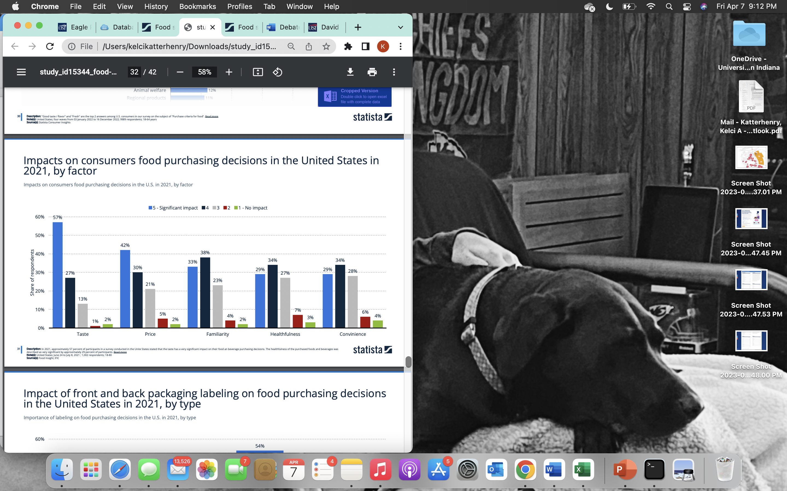
Consumers decisions
29% of Americans report eating at a sit-down restaurant > 1 a week
  33% White
  16% Black
  21% Hispanic
Grocery Shopping
  51% completely in store
  19% even between in store and online
  8% completely online
When consumers do look at the nutrition facts label, they look at
  Calories
  Total sugars
  Sodium
Only 12% of respondents report looking at serving size
Notes:
29% of Americans eat at a sit down restaurant more than once a week
33% of White Americans
16% of Black Americans
21% of Hispanic Americans
51% of Americans reported shopping in store only
19% using online and in store evenly
8% report doing most of their grocery shopping online
When researching the correlation between price of shopping trip and method of shopping, as the price spent increased, the tendency to shop online increased.
Two main reasons for impulse buying: “price was too good to pass up” and “treat myself”
The chart: Out of taste, price, familiarity, healthfulness, and convenience, healthfulness was reported as the least impactful on food purchasing decisions in the United States.
Respondents said that when they do read the nutrition label
12% say they look at serving size
The three most looked at facts on the label are calories, sugar, and sodium

Slide 36
Access and the results
BMI grocery stores
BMI full-service restaurants
BMI each fast-food restaurant in a 1 km commute (Dornelles, 2019)
F/V consumption distance from grocery store (Michimi & Wimberly, 2010)
Notes:
People’s food environment influences how easy they can or can not obtain food.
BMI increased when they were closer to the grocery store, but decreased when they were closer to full service restaurants
The more fast food restaurants people pass on their commute correlates to their BMI
Passing 5 restaraunts vs passing 100 restaraunts
Being able to look at the impact of how close people are too restaurants, fast food, and grocery stores shows that all three can impact the health of the public.
Shows there needs to be a balance between having access, but possibly too accessible is a thing

Slide 37
ethics

Slide 38
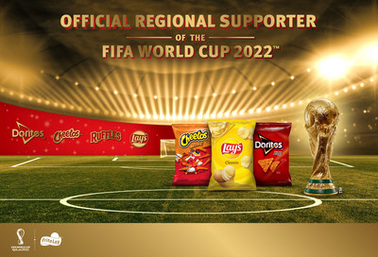
Food industry perspective
Goal of making profit
Hyperpalatable food drives sales up
  Consumers love the products
  Continue to introduce new items
Continuously purchasing unhealthy food is the consumers choice and responsibility
Invest in lobbyists to protect their business when public health policies threaten their sales
Promote public health in other ways
  Sponsoring sporting events
  Developing less unhealthy products
(Tempels et. Al., 2017)
Notes:
Just like any other business, the food industry is looking to make the biggest profits they can.
Hyperpalatable foods are present in processed foods on grocery store shelves and in fast food.
- Cover what exactly these foods are in the next slide, but just know that these are foods that taste good and people want to keep buying
- Companies such as Nestle and PepsiCo have recognized the sale increase and have continuously added new products
People will continuously enjoy these foods and purchase them again
The food industry argues that continuously purchasing and consuming food is an individual choice of the consumer
not the company's responsibility.
Lobbyists will go against public health policies for financial benefit of their business and against public health
- Example - Companies recognize that lowering sodium guidelines would affect their sales.

Slide 39
Public Health Perspective
Public health at expense of food industry’s profits
Hyperpalatable foods have similar, addictive effects as drugs
Marketing to children who are unable to differentiate true and false advertisement
  Characters
  Prizes
Unethical motives of sponsoring public health initiatives
  Drawling attention away from unhealthful products
  Combats government regulation
  Creates a healthy brand reputation, even with unhealthy products
  Shifts responsibility to the consumer
(Tempels et. Al., 2017)
Notes:
Yes the food industry is a business, but the food industry is not like any other furniture, bedding, or clothing company.
- Instead, the food industry holds public health in its hands.
Hyperpalatable foods have been engineered to have higher levels of sugar, salt, flavor, fat, and other chemicals.
- According to food science research, the effects of hyperpalatable foods is similar to the effects of drug addiction.
Practices used to target children include character-branded products, free gifts in boxes, and gamification of products.
Since children are unable to distinguish the truth and lies in advertisements, is this an ethical marketing approach?
Using advertisements to encourage kids to develop the previously mentioned “addiction” like effects on food, promotes the behavior of choosing high fat, sugar, and salty foods.
Perhaps companies do recognize their contribution to poor public health. This is demonstrated by a variety of food companies sponsoring sporting events, including healthy recipes on the back of their packaging, and developing less unhealthy products
Critics point out four unethical motives behind these actions:
drawling attention away from unhealthful products
2) a way to combat government regulation
3) have a healthy reputation even if the products are not healthy
4) shifts responsibility to the consumer
- For example, shifting responsibility to the consumer is seen in soda beverages. The majority of sodas are offered in “sugar-free” varieties; therefore, the consumer has the decision to choose sugar free, lower in calories or made with sugar and calories

Slide 40
Weight stigma
Qualitative study with 3 focus groups (Healthy Weight, Overweight, & Health Professionals)
All groups felt “overweight” and “obese” were subjective
  Based on appearance
  Identify by eye
All groups felt BMI is objective, but unreliable
  Height
  Muscle mass
All groups felt people have control on prevent excessive weight gain
Judgement lessens the closer one is to the person who is overweight
(Sikorski et. Al., 2012)
Notes:
The purpose of the study was to assess the stigma of overweight and obesity in the general population compared to health professionals
all participants felt that the terms overweight and obesity were subjective
They reported that those terms are mainly based on appearance
All recognized that BMI is an objective measurement but questioned its relevance
people who become closer to someone who is overweight have a milder perception of them
participants report judgement on an overweight or obese person they do not know
gradually reduce the judgement the closer they become to the individual.
When it comes to the controllability of gaining excessive weight and the emotional response, all three groups had negative thoughts and stigmas

Slide 41
Adjectives from healthcare professionals about overweight people
Hoggish
Unfriendly
Dumb
Cuddly
Lazy
Inappropriate
Round
Dull
Slothful
Happy
Funny
(Sikorski, 2012)
Notes:
“I would add ‘dishonest’ to the extent that they keep claiming to feel comfortable about themselves”
“Overweight patients smell.”
“they keep lying to themselves and making excuses”

Slide 42
Economics

Slide 43
Food industry
$14 billion spent on food and beverage advertisement in 2022
  80% was fast food, sugary beverages, and candy
Taxing sugar sweetened beverages
  Discourages consumption
  Increase revenue to reformulate products
  Raise health awareness
50 countries, 8 U.S. cities have taxes on sugar sweetened beverages
  Lowered BMI
  Lowered healthcare costs
(Statista)
Notes:
According to the 2022 Obesity Report in the United States
- global evidence suggests that taxing sugar sweetened beverages is the number one way to:
- discourage sugary beverage consumption
- increase revenue to reformulate products
- raise health awareness.
Estimates indicate that national taxing on sugary sweetened beverages would prevent over half a million cases of childhood obesity in 10 years
Also, food and beverage marketing is competitive because of all the companies and products on the market.
According to Statista, the food industry spent $14 billion dollars in 2022 on marketing to American consumers
Out of the $14 billion dollars, 80% was spent on fast food, sugary beverages, and candy

Slide 44
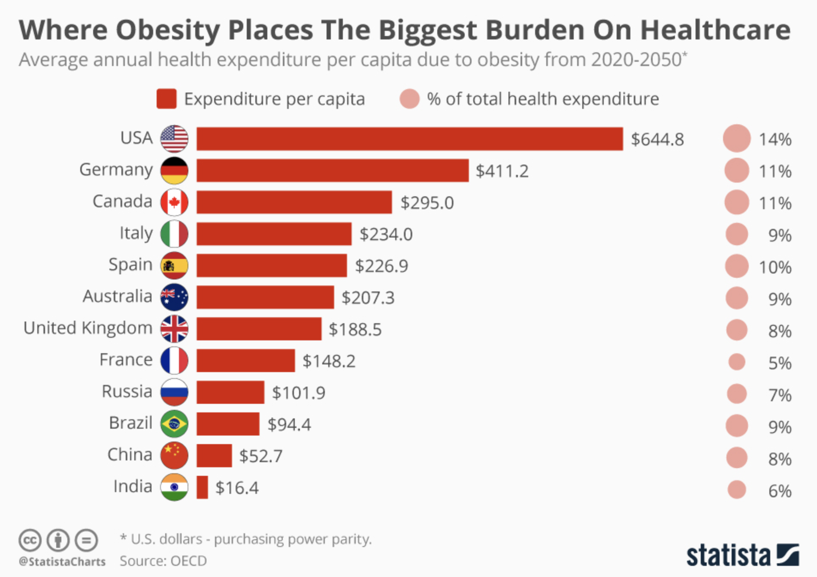
Healthcare
People who are obese are more likely to develop other diseases
8.4% of healthcare costs in OCED nations
Higher rate of specialty care visits, in patient stays, and surgery
2.4x more prescriptions than a healthy weight individual
Longer hospital stays
Obesity is responsible for the following treatment costs
  70% of all diabetes
  23% of CVD
  9% of cancers
(McCarthy, 2019)
Notes:
- healthcare services more frequently with a higher rate of specialty care visits, inpatient stays and surgery, all leading to higher healthcare spending.
The OECD states that obese people
have 2.4 times more prescriptions than healthy-weight individuals on average
hospital stays are longer and require more expensive and complex treatment.
Obesity is expected to cost the health system
- $644 per capita annually from 2020 to 2050 - 14 percent total American health expenditure.
- Canada will "only" have to spend $295 each year during the same period which equates to 11 percent of its total health spending.

Slide 45


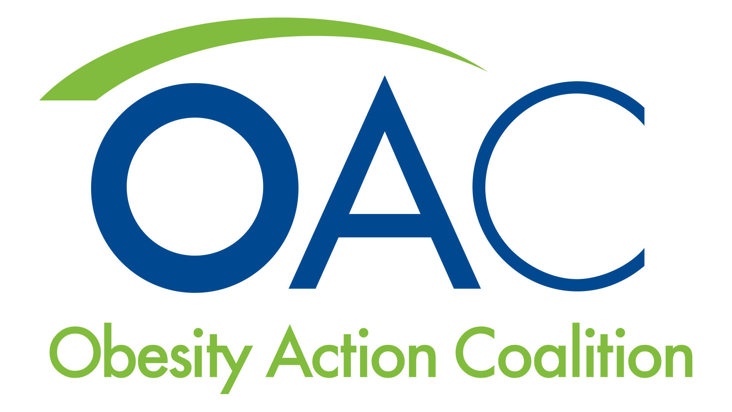
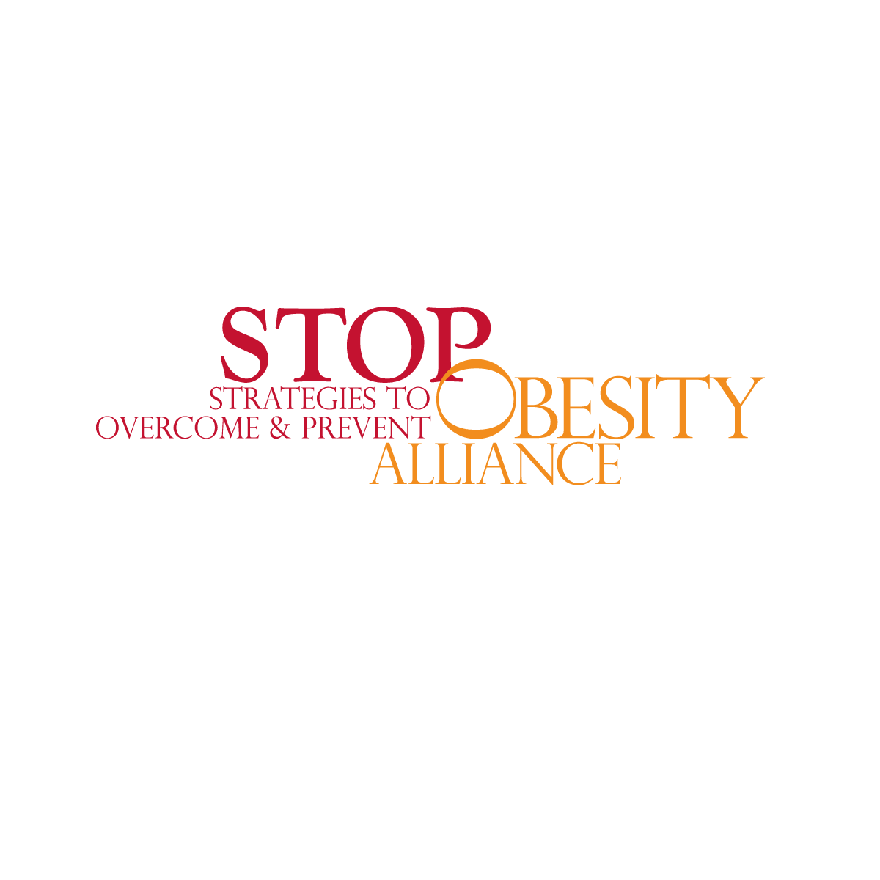
Government agencies, private organizations, and societal foundations
The American society for metabolic and bariatric surgery
Strategies to overcome and prevent obesity alliance
The academy of nutrition and dietetics
Obesity action coalition
eatright.org/
asmbs.org/about
obesityaction.org/
stop.publichealth.gwu.edu/
Notes:
AND
Principles include:
Amplify the contribution and value of diverse nutrition and dietetics practitioners to the public
Position registered dietitian nutritionists as the experts in food and nutrition
Expand workforce demand and capacity
Incorporate research, professional development, technology and practice to foster innovation and discovery
Collaborate with key stakeholders to solve the greatest food and nutrition challenges, now and in the future
Focus on making a system-wide impact across the food, well-being and health care sectors
Have a global impact in eliminating all forms of malnutrition.
Include evidenced based research and guidelines for:
Food and beverage consumption
How to talk to kids about weight and making healthy choices
How RD can help all forms of malnutrition
How to develop healthy body image and habits
AMERICAN SOCIETY FOR METABOLIC AND BARATRIC SURGERY
The vision
Is to improve public health and well-being by lessening the burden of the disease of obesity and related diseases throughout the world
Improve the lives of people with obesity and related diseases by advancing the art and science of metabolic interventions and bariatric surgery interventions by
Continuously improving the care and treatment of people suffering from obesity.
Advancing the science and understanding of metabolic and bariatric surgery.
Fostering communication between health professionals on obesity and related conditions.
Being the recognized authority and resource on metabolic and bariatric surgery.
Advocating for people with obesity to ensure access to high quality treatment.
Serving the educational and professional needs of our diverse membership.
OBESITY ACTION COALITION
Founded in 2005
70,000 members, national non-profit
Donations are tax-deductible
Dedicated to giving a voice to Americans with obesity and empowering them to better their health
Focuses on:
Raising awareness and improving access to prevention and treatment of the disease of obesity
Providing evidence-based education on obesity and its treatments.
Fighting to eliminate weight bias and discrimination.
Elevating the conversation of weight and its impact on health.
Offering a community of support for people affected.
A resource platform for Education, awareness, advocacy, and support
Education: providing reliable resources
Awareness: on the impact weight has on health, empowering individuals affected by excess weight to take the challenge and take the first step
Advocacy: preventing weight bias and increasing access to care
Support: provide science based, reliable resources to improve their health
STRATEGIES TO OVERCOME AND PREVENT OBESITY
George Washington University
What do they do?
Conduct research: coverage and costs of obesity from direct medical and employer costs; and research on weight stigma
Develop tools: develop tools for healthcare professionals to safely talk about weight
Drive Collaboration: for barriers that prevent reducing obesity such as environmental factors and treatment and coverage
Before this alliance was born, FDA was being difficult with approving anti-obesity medications
FDA thought of these drugs as cosmetic, rather than medical
This alliance message was that obesity is a disease and medications should be available for people who need them
FDA response
since then we have seen substantial progress, not only in the development of newer and safer anti-obesity medications, but also an increased recognition that obesity is a disease.
This organization encourages professionals to prescribe them only when neccessary
Recently
Drug shortages are life threatening for people on these anti-obesity medications
Ozempic being used by celebrities for cosmetic reasons
Now time for health care professionals to come together to ensure that people who medically need these medications have access to them

Slide 46
1. Develop a healthy meal from each of the restaurants
McDonalds
Applebee's
Burger king
Olive garden
Ihop breakfast
Pizza hut
Maggie
Dr. Theuri
Skyler
Kenecia
Justin
Sarah
2. Describe what nutrition professionals can do to promote these choices

