Slide 1
Measuring Impact
Strategies used to measure the impact of your AL$ program on students, faculty, staff

Slide 2
Examples Implemented
Cost savings for students:
  Southern University Shreveport – almost $10,000 per Criminal Justice student
  Central State University- $180,000
Learning benefits for students
  Central State University: increase in student performance and retention
  Central State University: Equity and Access priorities;
Faculty Adoption
  Bethune Cookman – all Gen Ed courses – over 200 sections
  Southern University – adding OER to their online courses

Slide 3
Measuring Impact
Faculty Engagement
  Tennessee State & Central State - # of faculty participating in workshops
  TSU, BCU, CSU, EWU, MC, SUS – # of contributions to the MERLOT collection, authoring OER, adding comments and learning exercises
  Cal State University – # of teaching ePortfolios about adopting OER
Faculty Awareness and Readiness
  Tennessee State University – communication strategies and organizational assessments
Capabilities of Staff
  # of MERLOT-campus members with contributions
  # of campus members with Creative Commons certificate

Slide 4
Supporting HBCU’s Aggregating and creating DERivative and Original OERs for your Communities
Overview of Collection Development
And
Partner services to support HBCU programs authoring OER by Reusing, Remixing, revising, redistributing, and Retaining educational resources

Slide 5
A HEWLETT GRANT Goal: create a collection of culturally contextualized OER for the African American community
Build/expand the MERLOT collection of OER that is culturally contextualized for the African American community by:
  Identifying existing OER and cataloging them in MERLOT for others to Reuse, Redistribute, and Retain
  Revising/Remixing existing OER materials and cataloging them in MERLOT for others to Reuse, Redistribute, and Retain
  Creating new OER with MERLOT Content Builder and/or other MERLOT Partner Tools and cataloging them in MERLOT for others to Reuse, Redistribute, and Retain
  Authoring teaching ePortfolios to capture Open Educational Practices of HBCU faculty

Slide 6
The Project needs Your Recommendations for Organization of Africana/African American/Black Studies Collection
MERLOT will create separate library shelves for different groups of materials that you would like in your collection. Current categories:
General Collection, Biographies, HBCU Histories
Explore free and open educational resources related to African topics across disciplines in the broader MERLOT collection
Academic Support Services, Arts, Business, Education, Humanities, Mathematics and Statistics, Science and Technology, Social Sciences, Workforce Development
Explore online resources across a wide range of other open online libraries using MERLOT's SmartSearch
Africana topics, African American topics, Black Studies topics

Slide 7
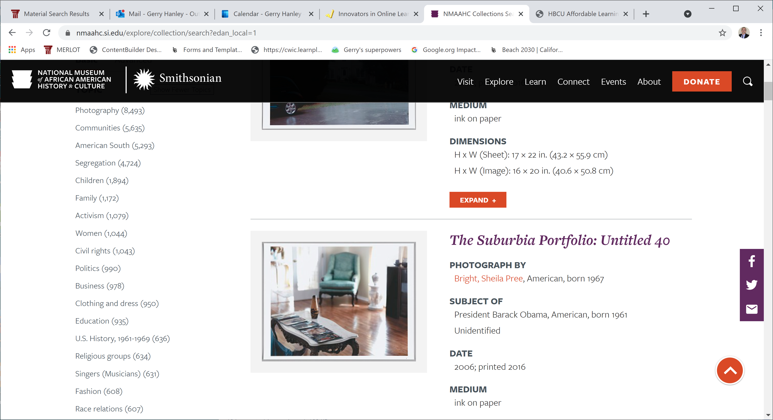
National Museum of African American History and Culture’s Taxonomy
https://nmaahc.si.edu/explore/collection/search?edan_local=1

Slide 8
Partners to support HBCUs creating original and derivative OERs
You can choose what might work for you or don’t use at all

Slide 9
Partners to support HBCUs creating original and derivative OERs
Faculty are at different levels of readiness and capabilities to create OER. They need a choice of technologies to select tools that will be “a gift and not a burden”.
  Instructional design coaching and resources to help them plan and develop their OER
    MERLOT partner: O’Donnell Learn, book by Kevin Kelly
  Easy to use authoring platform that enables them to revise and remix existing OER (e.g. open textbooks) as well as augment the available OER with some original content
    MERLOT partners: ecoText, SoftChalk, MERLOT Content Builder,
  Easy to use teaching platforms (some already in use by HBCUs) that use OERs
    MERLOT partner: Odigia, better use of campus LMS, Gooru’s Navigated Learning for College Success

Slide 10
O’Donnell Learn’s Free
Instructional design support
O’Donnell Learn has been a MERLOT partner for many years
Expertise in instructional design guided by inclusive principles and universal design for learning (UDL). Here is a short video introducing their Purposeful Learning Framework.
Webinars led by Carrie O’Donnell, the founder, and Brett Christie, UDL expert, will provide:
  A series of professional development webinars about designing quality OER
  Access to their OER self-assessment tool that helps faculty evaluate their courses and figure out what are the most impactful changes they can make to improve the experience for their students.
    With a CC BY license, your institution can customize it to align with your goals and culture.

Slide 11
Partners to support HBCUs creating original and derivative OERs
ecoText:
  Easy-to-use platform for uploading open textbooks and enabling faculty to add, edit, comment, contextualize the content to meet their instructional goals.
  Easy-to-use platform for students to highlight and add their comments and notes about understanding and analyses of the content, enabling Open Pedagogy and student engagement
  Derivative etextbooks containing the faculty edited content are published and are freely available to others to use. These derivative open textbooks will be cataloged in MERLOT
  The technology platform cost $2.99 per student to support the tools that enable open pedagogy and derivative works.

Slide 12
Partners to support HBCUs creating original and derivative OERs
SoftChalk:
  Easy-to-use platform for creating interactive learning assignments, turning OER content into effective learning resources
  Many institutions are already using SoftChalk – so no new costs for the institution
  Faculty can publish their lessons in the SoftChalk Cloud for others to reuse and have them cataloged in MERLOT for easy discovery
  Workshop series underway https://softchalk.com/learn-more/webinars/innovators

Slide 13
Partners to support HBCUs creating original and derivative OERs
MERLOT Content Builder:
  Easy-to-use platform for creating multimedia websites for remixing and contextualizing OER
  MERLOT Content Builder is FREE to use and hosts the OER for FREE
  Faculty supported by the grant will have to create teaching ePortfolios that capture how they are using OER in their courses. MERLOT will provide templates to easily create teaching ePortfolios of their open educational practices

Slide 14
Partners to support HBCUs creating original and derivative OERs
Odigia:
  Easy-to-use platform for designing interactive learning experiences with OER and non-OER, turning content into engaging curriculum.
  Easy-to-use platform for students to highlight and add their comments and notes about understanding and analyses of the content, enabling Open Pedagogy and student engagement
  Student-centered time-management tools to support learners staying on track and faculty-centered performance indicators of student learning and engagement
  Derivative courseware containing the faculty edited content is published and are available to others to use.
  The technology platform and curated content costs about $29 per student to support the tools that enable open pedagogy, social learning skills, and derivative works.

Slide 15
Navigated Learning: competency-based learning for college success skills
Gooru has been a partner with MERLOT and a non-profit organization that provides an open source platform for delivering OER within a competency based learning framework called Navigated Learning – “Google Maps approach to learning success”
MERLOT/SkillsCommons has created an online OER course on ‘college success skills’ to help students learn how to use campus resources, advisors, & services to succeed in college.
You can customize this free and open online course for your students

Slide 16
How to Choose a Partner?
We’ll Explore Together
We’ll be integrating webinars about these services throughout the year
If you want a special 1:1 session for your campus, we can make arrangements

Slide 17
Paying For Partner Services
Some partners are offering their initial services for FREE (e.g. O’Donnell Learn, MERLOT)
Some partners offer a low cost institutional license which your institution will have to pay
Some partners offer services that are paid by the students
You can decide if you want to use some of your grant funds to subsidize the cost of partner service
We will be exploring ways for “others” to pay for partner services

Slide 18
Questions?
We’re here to help you succeed.
Contact support @skillscommons.org or Gerry.Hanley@csulb.edu

Slide 19
  Identifying existing OER and cataloging them in MERLOT for others to Reuse, Redistribute, and Retain
We will provide webinars for HBCU hubs and affiliates to invite them to showcase their OER in the MERLOT collection.
  MERLOT will expand the taxonomy of the Africana or African American or Black Studies collection to include categories recommended by HBCUs, including history of HBCU institutions and within departmental disciplines of the HBCU hubs (e.g. biology, criminal justice, etc.)
  MERLOT team will provide professional development workshops showing HBCU faculty how to catalog their resources to enable easy discovery by others, including creating bookmark collections and course ePortfolios.
  MERLOT will expand the HBCU Affordable Learning Solutions Community Portal to showcase the resources cataloged by HBCUs

Slide 20
  Revising/Remixing existing OER materials and cataloging them in MERLOT for others to Reuse, Redistribute, and Retain
Some faculty will want to edit existing OER to contextualize the more generic content
  Augment the content with additional materials which faculty authored themselves or faculty provide alternative and/or complementary interpretations
  Publish the derivative OER so others can user the edited OER
Some faculty will want their students to comment and add their reflections and analyses of the existing OER
  Open Pedagogy enables students to co-construct the curriculum
Some faculty will want to remix/reorganize OER to create a new contextualization for the content

Slide 21
  Create New OER materials and cataloging them in MERLOT for others to Revise, Remix, Reuse, Redistribute, and Retain
Some faculty will want to author new learning assignments that use existing OER
Some faculty will want to author new OER curriculum
Some faculty will want to author their Open Educational Practices in a teaching ePortfolio so others can reuse the “know-how” of teaching and not just the content of the course

