Slide 1
Planning Your Campus’ Affordable Learning Solutions
Strategies for HBCUs and other MSIs
OLC Innovate 2024 Virtual Conference
Notes:
Robbie open at 9:00 MT
NOTE: All times listed in MT as listed on OLC Innovate 2024 program

Slide 2
The What
Welcome
Project Background
Re-Energizing with AI
Notes:
Robbie and Gerry 9:00 – 9:30

Slide 3
The Why
Data
Success Stories
Notes:
Quinetta introduce Jean Jaques after data discussion
Data: 9:30 – 9:50

Slide 5
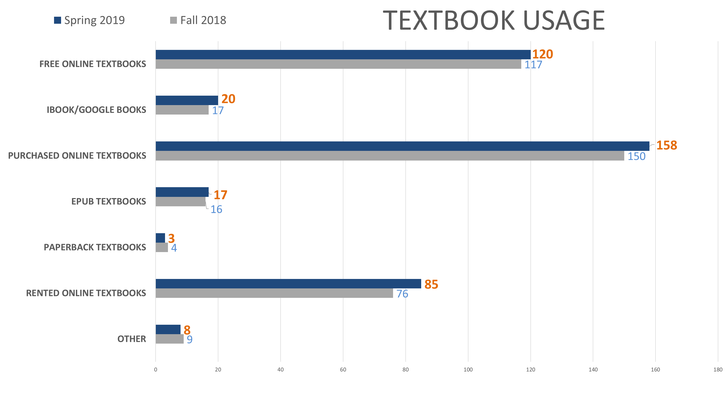

Slide 6

Dr. Jean-Jaques Medastin
Albany State University
Notes:
Jean-Jaques 9:50 – 10:02
Quinetta introduce Monique

Slide 7
Dr. Monique Earl-Lewis
Morehouse College
Notes:
Monique 10:02- 10:15

Slide 8
15 Minute Break
Notes:
Quinetta dismiss to break 10:15

Slide 9

The How
Stipends
Notes:
Robbie 10:30 – 10:45

Slide 10
Hub and Affiliate Support
Letters
Fall 2024 Workshops
Communication Protocols
1:1 PRN
Building the Culturally Responsive Collection in MERLOT
Portal Development Expectations
ePortfolio
Notes:
Maria, Qinetta, Gerry. 10:45- 11:45
Maria - this slide

Slide 11
Scope of Work for Hubs
  Attend HBCU AL$ OER AI Conference in June 2024, Nashville TN
  Convene Faculty Training on OER and the use of MERLOT
  Complete Baseline Faculty Survey
  Update Course Syllabi to reflect OER Materials
  Attend at least two (2) OER Professional Development Webinars a semester
  One (1) introductory OER workshop for your Institution or faculty department meeting a year
  Minimum of (1) faculty member complete an AL$ ePortfolio (template provided)
Notes:
Maria

Slide 12
Scope of Work for Affiliates
Scope of Work is similar for Affiliates as for Hubs but is scaled back.
Letters with specific details will be made available within the next three weeks – to be signed by the named Affiliate Lead.
An executive level project description letter will be provided to each institution's President or Chancellor.
Notes:
Maria

Slide 13
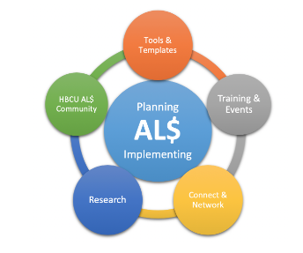
Resources
Planning Your Campus Affordable Learning Solution
https://www.merlot.org/merlot/viewSite.htm?id=9162632
Notes:
Maria

Slide 14
Expectations By Priority
Hub and Affiliate Letters
Fall 2024 Workshops Attendance, Convening, and Participation
Culturally Responsive Content Development and Collection
Portal Development
ePortfolios
Notes:
Maria
Dismiss for break

Slide 15
15 Minute Break
Notes:
Qinetta dismiss to break

Slide 16
Resources
Planning Your Campus Affordable Learning Solution
https://www.merlot.org/merlot/viewSite.htm?id=9162632
Notes:
Quinetta – Reminder of where to find resources

Slide 17
The When
Initial Due Dates:
Signed Letters – June 1
Portal Updates for Existing Hubs – July 1
https://info.merlot.org/merlothelp/topic.htm#t=Content_Builder_Welcome.htm
Portal Start-Up Details to MERLOT Team – New Hubs only – July 1
https://www.merlot.org/merlot/viewSite.htm?id=9162632&pageid=9185393
Adding Content to MERLOT Collection – First item due by October 1
1st ePortfolio – December 1
https://info.merlot.org/merlothelp/topic.htm#t=Create_Course_ePortfolios.htm
Ask for assistance on any component if/as needed after attending project workshops – Fall 2024
Notes:
Quinetta 12:00 – 12:20

Slide 18
Gates Foundation Project Invitation
As an AL$ HBCU, You will have the opportunity to participate in an innovative AL$ project.
Just launching this month…
Notes:
Gerry 12:20 – 12:40

Slide 19




Relevant, Equitable, Active Learning
Opportunities for HBCU’s to learn about and adopt innovative general chemistry courseware
Notes:
Gerry

Slide 20

REAL Chemistry Project:
Gates Foundation+Carneigie Mellon University+Arizona State University
Relevant –Equitable-Active Learning Intro Chemistry Courseware
April 22, 2024
Opportunities for HBCUs to learn about and adopt innovative courseware in Chemistry
Notes:
Gerry

Slide 21

Purpose
Looking for institutions with faculty teaching Chemistry who would like to be part of a innovative courseware development project for transforming a “bottleneck” class in Chemistry into an engaging and effective course for majors and non-majors in MSIs.
Notes:
Gerry
21

Slide 22

What Is Different about REAL Chem?
https://landing.inspark.education/real-chemistry
My 4 Cents:
Support Time management Skills and Practicing
Social Learning and Social Support for Learning
Explains RELEVANCE of chemistry to students’ lives
Delivers formative and summative feedback for learning concepts and improving metacognitive skills
Notes:
Gerry
22

Slide 23

What is the process?
Does your institution and faculty want to learn more? Provide me your contact info
Attend an webinar and demonstration of REAL Chem
01
04
02
Co-Develop MOU with CMU-ASU to become a VANGUARD CAMPUS
With Professional Development and Technical Assistance, Adopt REAL Chem in Fall 2024
03
Notes:
Gerry
23

Slide 24

What are your next steps?
Email me- gerry.hanley@csulb.edu
4
Provide name, email, & phone of coordinating contact person
3
2
How many chem faculty might attend?
1
How many sections of Intro Chem could use REAL Chem AND what is the total enrollment in these courses?
Notes:
Gerry
24

Slide 25
Closing
Notes:
Robbie 12:40 -1:00

Slide 26
Thank you!
Project Leads
Dr. Robbie Melton
Dr. Deborah Chisolm
Dr. Quinetta Crawford-Bartley
Dr. Audie Black
Tennessee State University
Support Team
Dr. Gerry Hanley
Maria Fieth, MA², RTC
MERLOT
California State University
Guest Senior Fellows
Dr. Jean Jaques Medastin
Albany State University
Dr. Monique Earl-Lewis
Morehouse College

