Slide 1


Integrating Open Culture. Practices into Existing Institutional Structures
An HBCU AL$ Summer Series Workshop

Slide 2
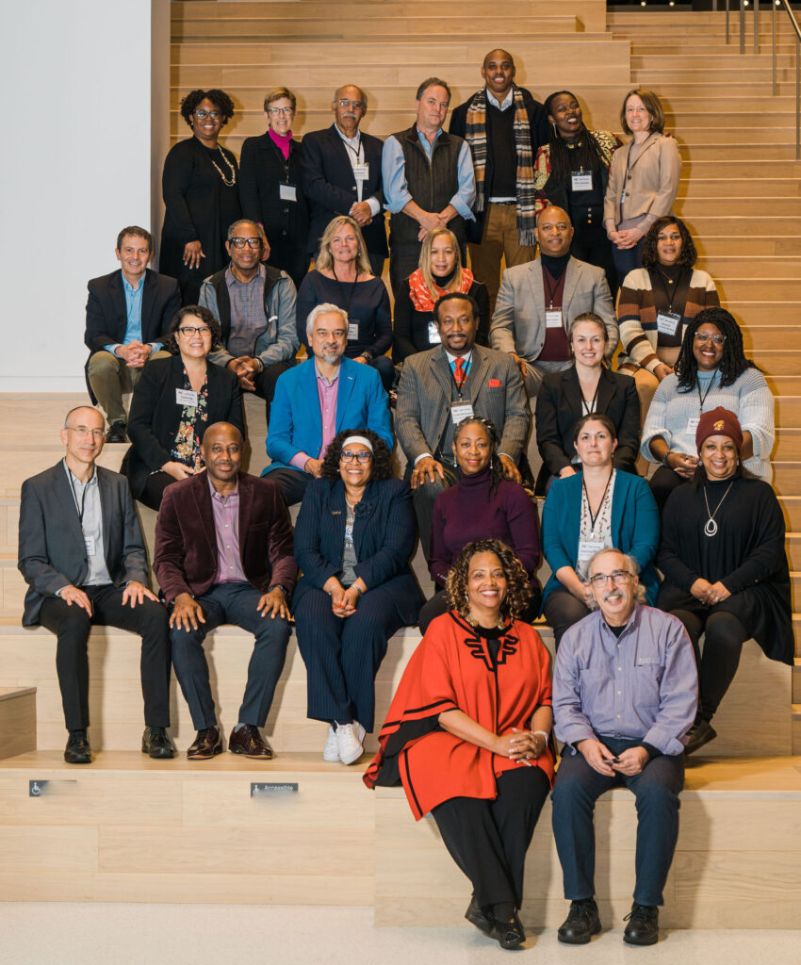






Sustaining Open Cultures in HBCUs
Led by Tennessee State University and supported by the California State University Long Beach MERLOT and SkillsCommons and MIT OpenCourseWare teams, the collaboration and community of Historically Black Colleges and Universities (HBCUs) are designing and deploying strategies making higher education more affordable by reducing the cost of course materials and increasing culturally responsive content.
The HBCU Affordable Learning Solutions (AL$) project provides any HBCU free access to the tools, technologies, and some services for them to initiate their own AL$ program and learn from their HBCU colleagues.
This project is made possible through the essential support from the William and Flora Hewlett Foundation.
Notes:
MERLOT https://MERLOT.org
SkillsCommons. https://SkillsCommons.org
HBCU Community Portal https://www.hbcuals.org/
HBCU Resource Center https://www.merlot.org/merlot/viewSite.htm?id=9162632

Slide 3
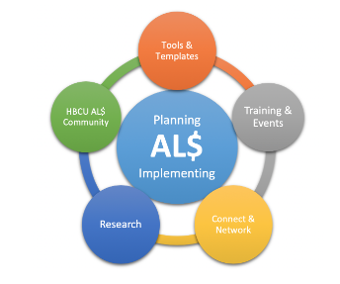
Planning is Critical for Creating
Campus-Wide Open Culture and
Sustaining Implementation
Notes:
Resource Center – Start Here https://www.merlot.org/merlot/viewSite.htm?id=9162632

Slide 4
Agenda
Portal Design and Upkeep
ePortfolios
Expanding the HBCU Cultural Collection
SkillsCommons - Workforce Development Tools

Slide 5
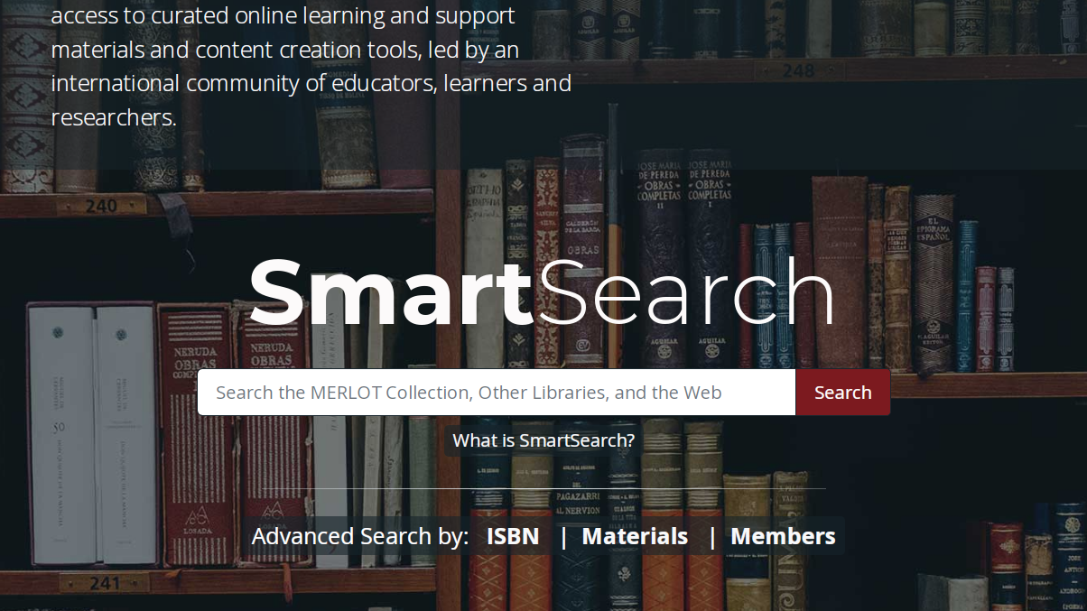
Have You Registered Yet? www.MERLOT.org

Slide 6
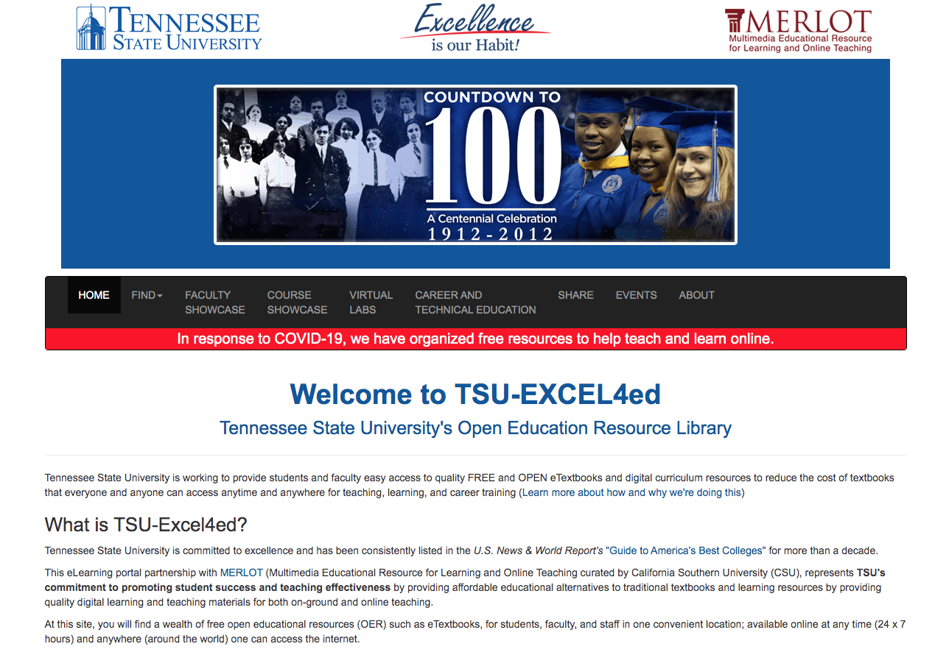
HBCU Portal Design
All Hubs are required to build and maintain a Hub Portal.
Affiliates may opt in to the Portal adoption process.
Notes:
MERLOT Community Portals https://www.merlot.org/merlot/communities.htm?page=2&fromAdvancedSearch=true&type=2&sort.property=title
TSU Hub https://tsu-excel4ed.merlot.org/

Slide 7
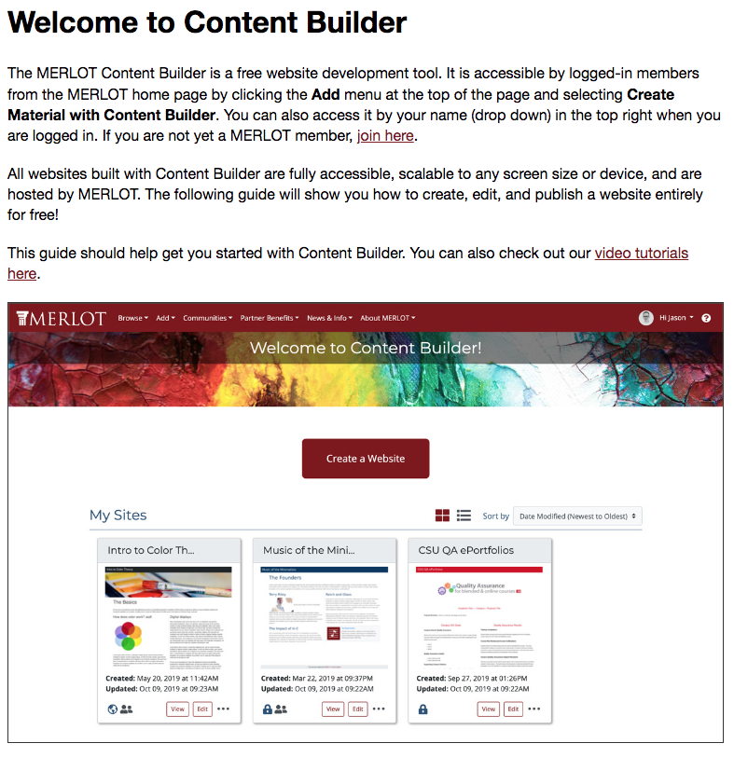
MERLOT Content Builder
Notes:
MERLOT Content Builder https://info.merlot.org/merlothelp/topic.htm#t=Content_Builder_Welcome.htm

Slide 8
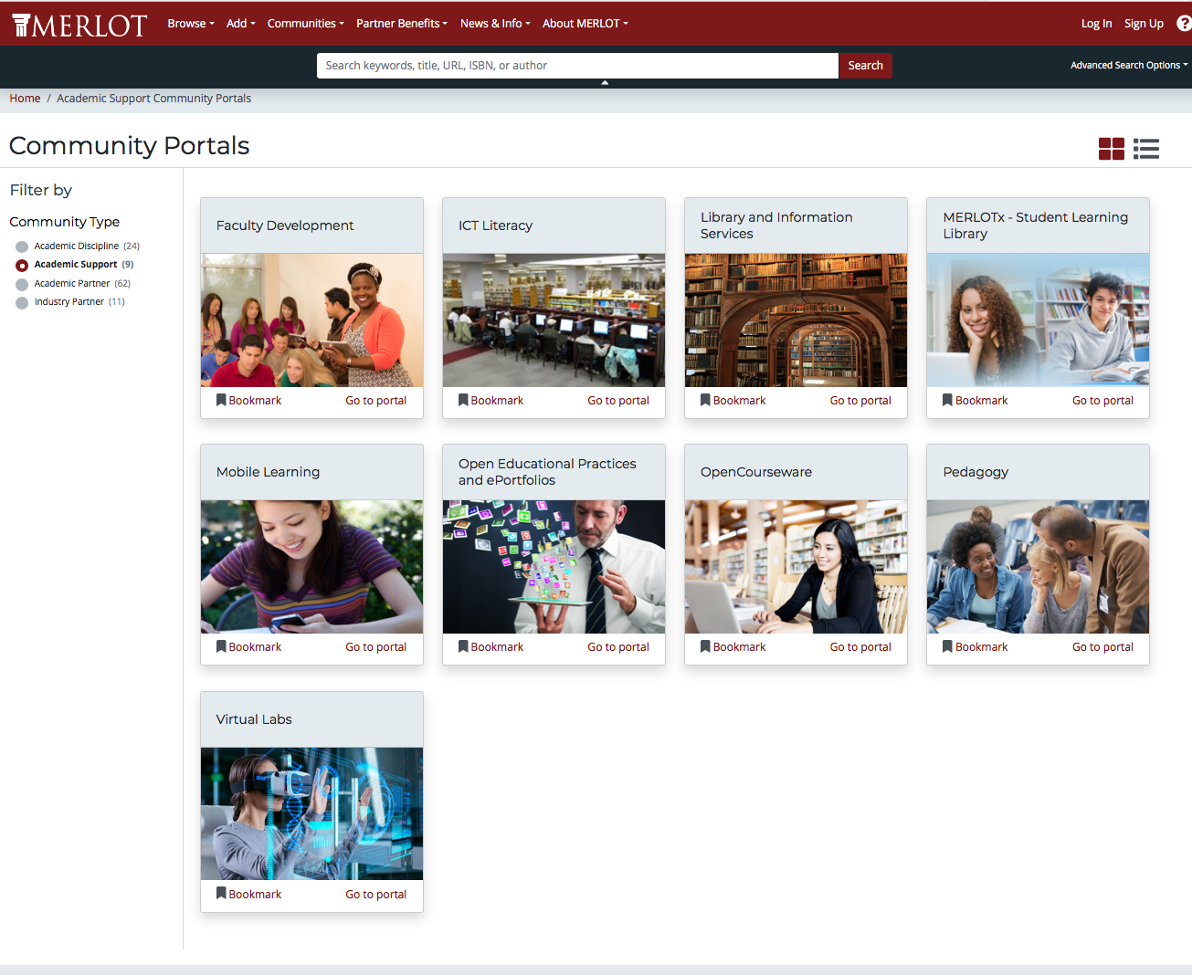
Portals allow universities to showcase their materials and successful outcomes.
Community Portals https://merlot.org/merlot/communities.htm?type=1&fromAdvancedSearch=true
HBCU Hubs https://merlot.org/merlot/communities.htm?type=2&fromAdvancedSearch=true
Better Support Features
Notes:
Community Portals: https://www.merlot.org/merlot/communities.htm?type=1&fromAdvancedSearch=true

Slide 9
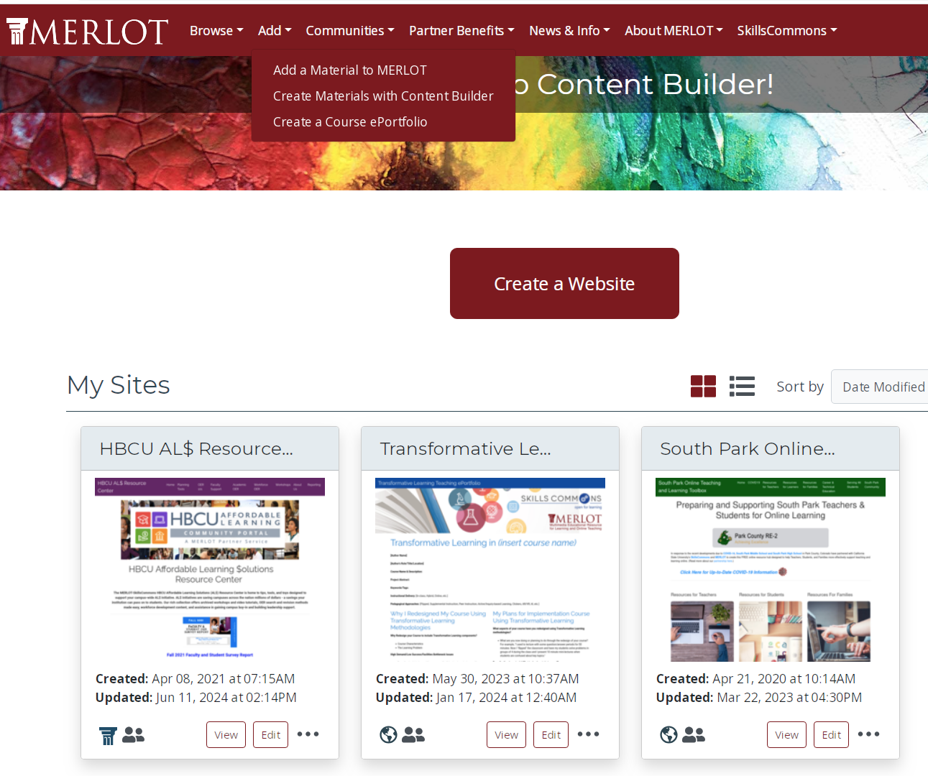
Log into MERLOT.
Go to “My Content Builder” in upper right corner.
Create a new site or edit an existing site.

Slide 10
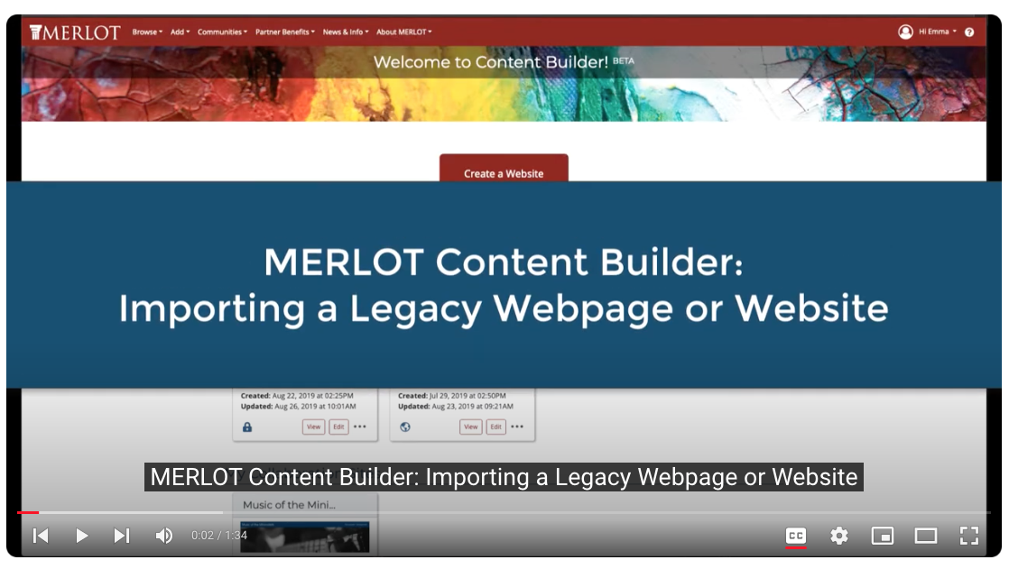
MERLOT Content Builder Tutorials
https://youtu.be/Tx2OimIFrNo?si=5abYd9F0Te0x
orUBORr_ZCXI0D1v_6
https://youtu.be/ZXoNG4EvA-o?si=8G4BBKh5cgASPQl1
Notes:
Content Builder Tutorials https://info.merlot.org/merlothelp/topic.htm#t=Content_Builder_Welcome.htm

Slide 11
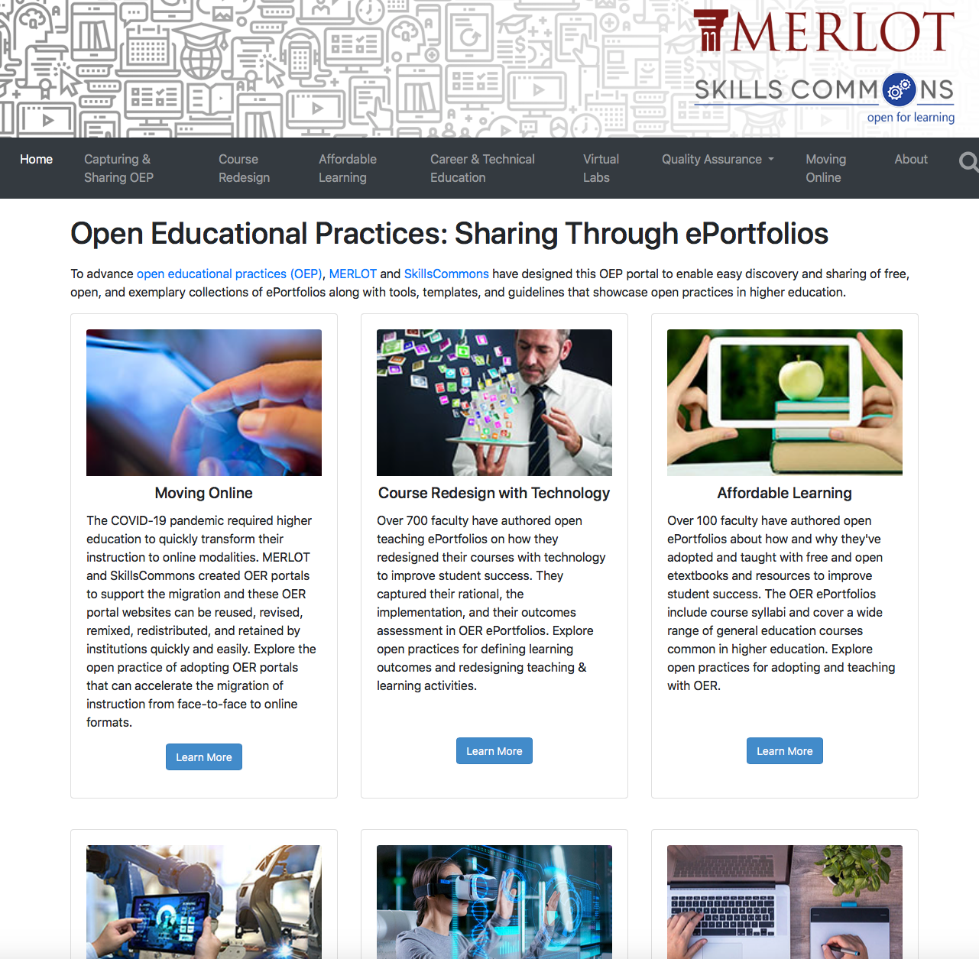
Open Educational Practices Portal:
Giving You the “Know-How” for Adopting OER
https://oep.merlot.org/
Notes:
OE Practices Portal: https://oep.merlot.org

Slide 12
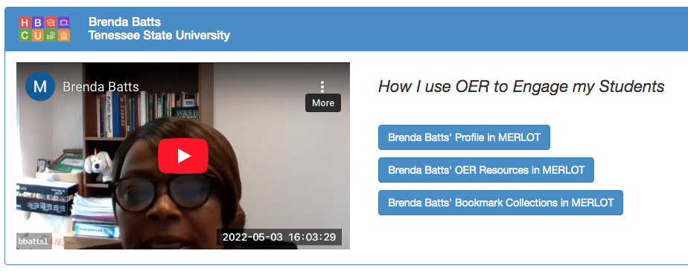
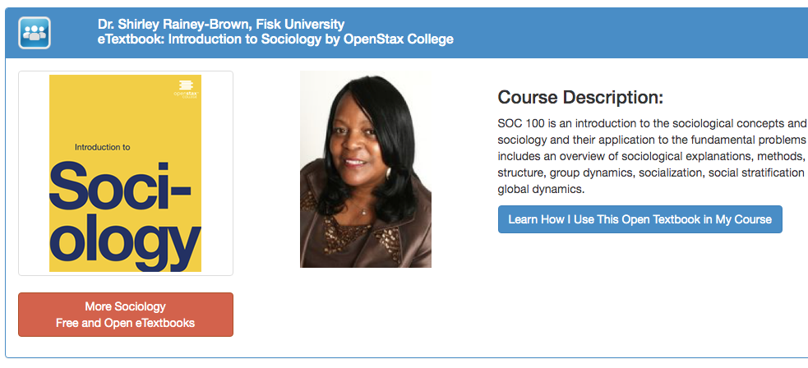
HBCU ePortfolio Examples
Notes:
Faculty Video Showcases https://www.hbcuals.org/facultyshowcase.html
ePortfolios https://www.hbcuals.org/facultyshowcase.html

Slide 13
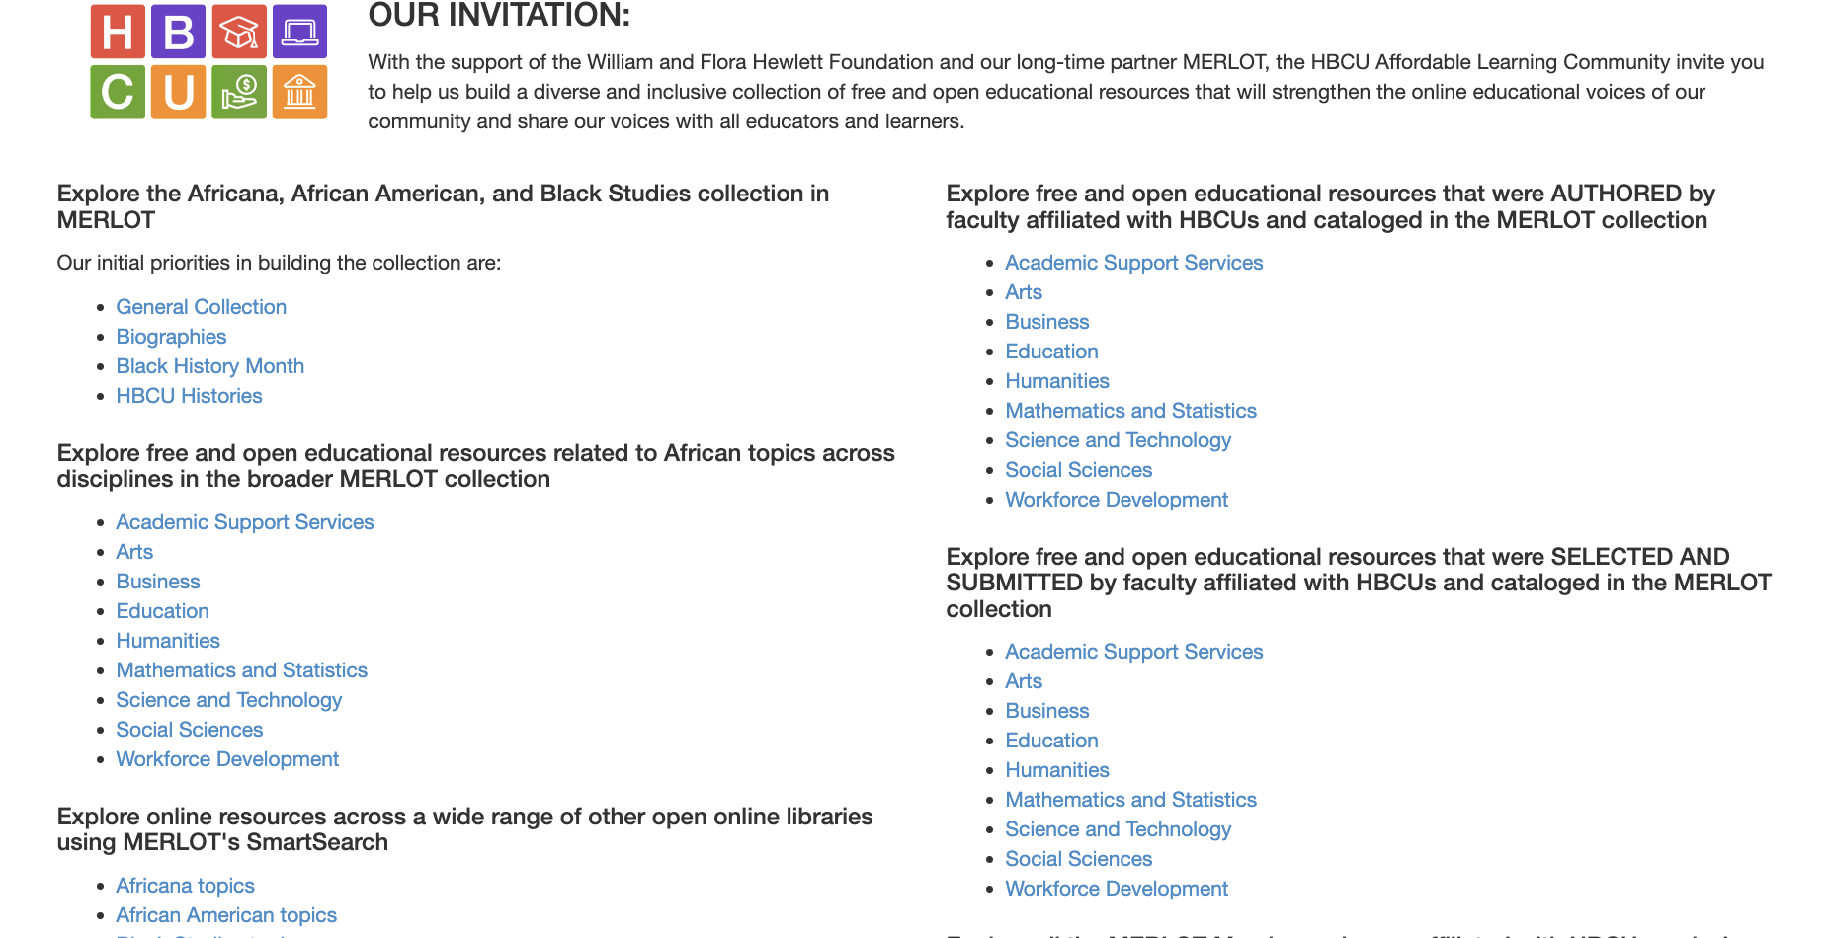
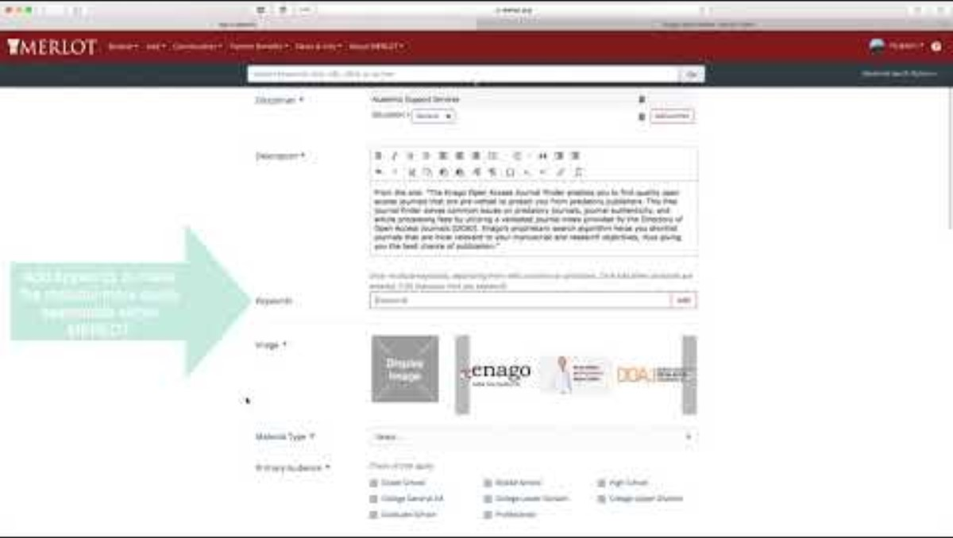
Adding to the HBCU Cultural Collection in MERLOT
Notes:
Adding to Collections in MERLOT https://www.youtube.com/watch?v=2LyHMPe-52I

Slide 14
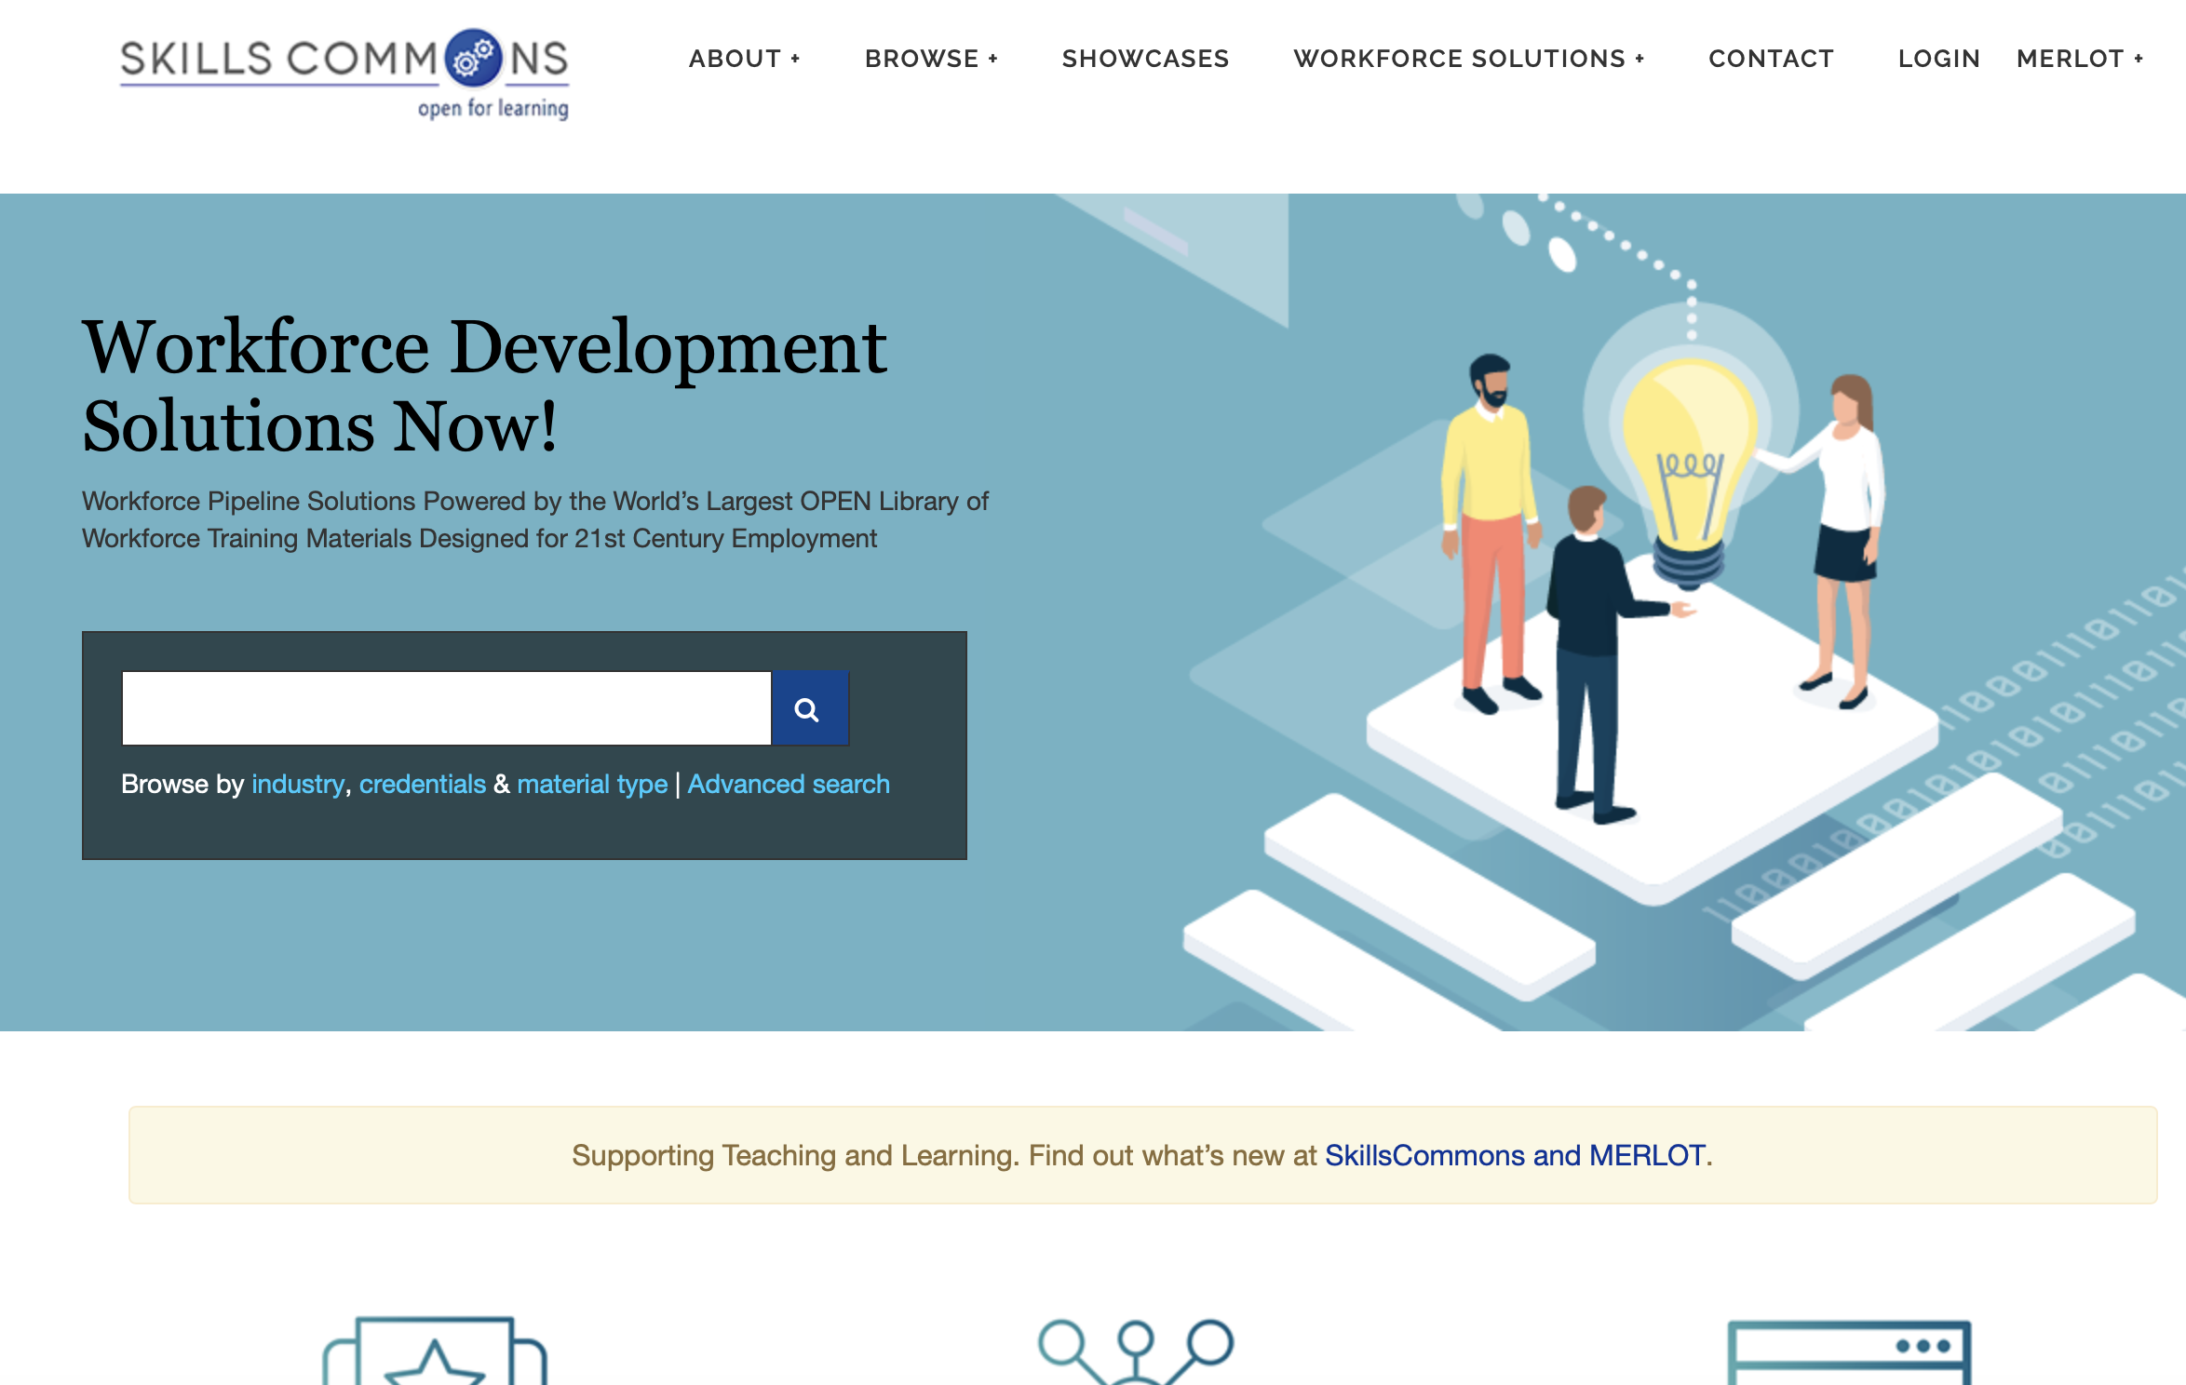
SkillsCommons: The World’s Largest Repository of Open Workforce Development Materials
Notes:
www.skillscommons.org

Slide 15
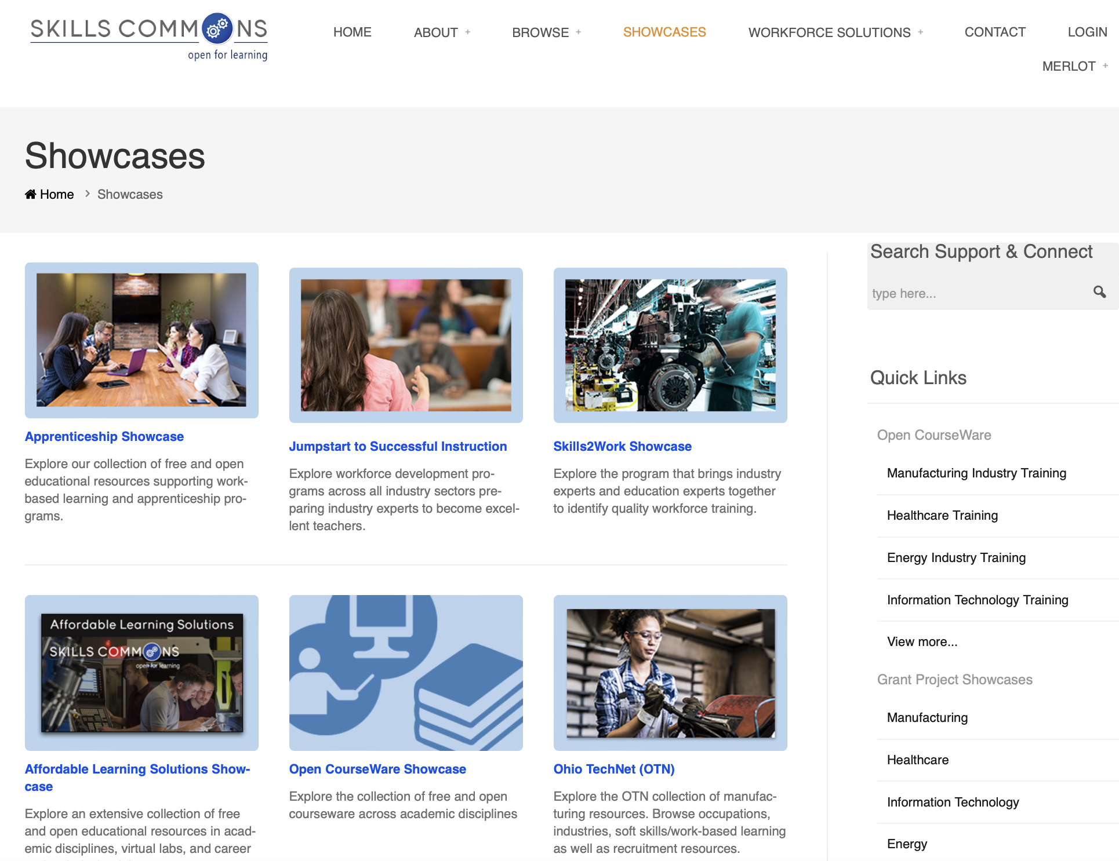
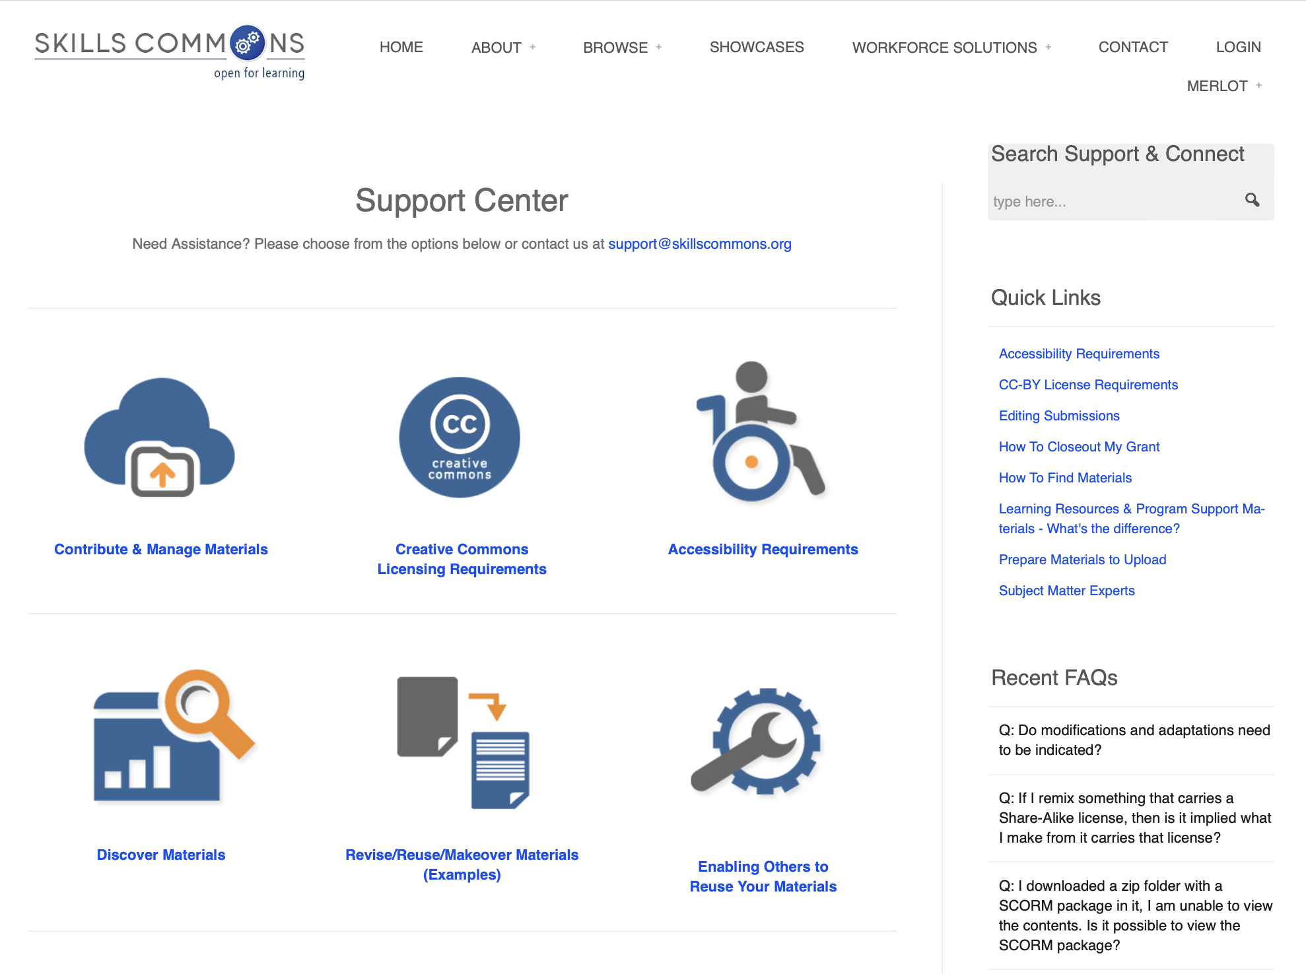
SkillsCommons: The World’s Largest Repository of Open Workforce Development Materials
Notes:
https://support.skillscommons.org/showcases/
https://support.skillscommons.org

Slide 16
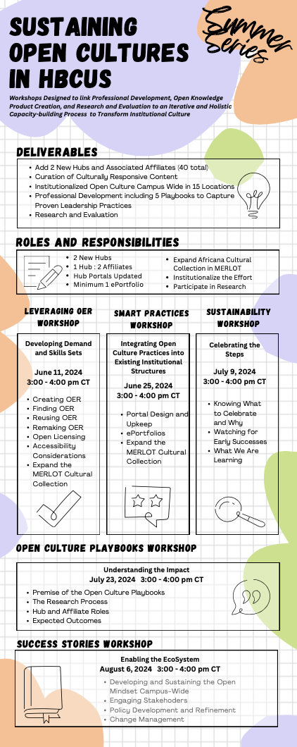
Next Workshop: July 6th, 2024
3:00 – 4:00 pm CT
Register Here! https://www.merlot.org/merlot/viewSite.htm?id=9162632&pageid=9185394
Notes:
Workshop 3 of 5

Slide 17

Questions

Slide 18
Questions?
WebMaster@MERLOT.org
Support@SkillsCommons.org
Rick Lumadue: Director, MERLOT - SkillsCommons
Maria Fieth: Director, MERLOT - SkillsCommons
This work is licensed under a Creative Commons Attribution 4.0 International License.
Notes:
Maria.fieth@csulb.edu

