Slide 1


Enabling the EcoSystem
An HBCU AL$ Summer Series Workshop

Slide 2
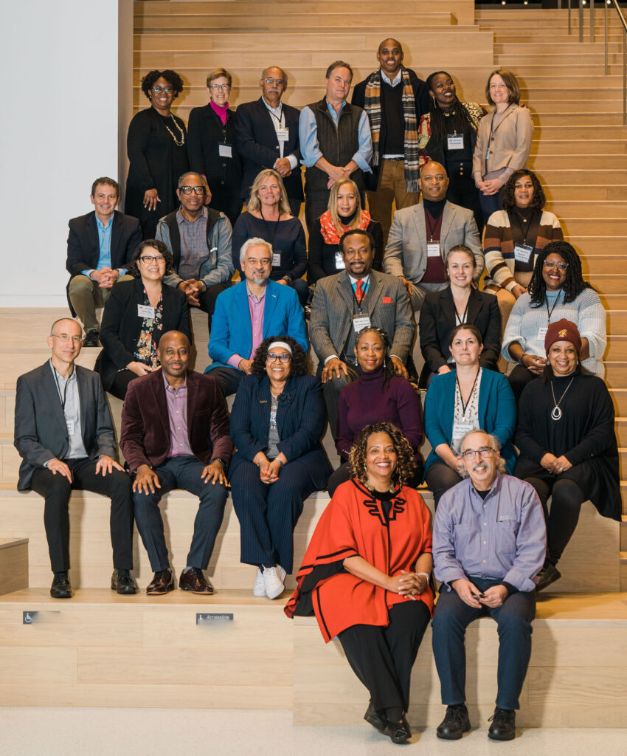





Sustaining Open Cultures in HBCUs
Led by Tennessee State University and supported by the California State University Long Beach MERLOT and SkillsCommons and MIT OpenCourseWare teams, the collaboration and community of Historically Black Colleges and Universities (HBCUs) are designing and deploying strategies making higher education more affordable by reducing the cost of course materials and increasing culturally responsive content.
The HBCU Affordable Learning Solutions (AL$) project provides any HBCU free access to the tools, technologies, and some services for them to initiate their own AL$ program and learn from their HBCU colleagues.
This project is made possible through the essential support from the William and Flora Hewlett Foundation.
Notes:
MERLOT https://MERLOT.org
SkillsCommons. https://SkillsCommons.org
HBCU Community Portal https://www.hbcuals.org/
HBCU Resource Center https://www.merlot.org/merlot/viewSite.htm?id=9162632

Slide 3
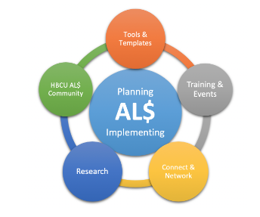
Planning is Critical for Creating an OER Mindset and
Sustaining Implementation
Notes:
Resource Center – Start Here https://www.merlot.org/merlot/viewSite.htm?id=9162632

Slide 4
Agenda
Benefits of Using the MERLOT HBCU AL$ TA Portal
HBCU Resource Center Planning Resources Overview
Developing HBCU Faculty Showcases/ePortfolios for OER Adoption
Open discussion of current needs and wishes

Slide 5

Benefits of Using the MERLOT TA Portal
HBCU AL$ Portal: https://www.hbcuals.org/
MERLOT TA Portal:
https://www.merlot.org/merlot/viewSite.htm?id=9166767

Slide 6

HBCU AL$ Resource Center
https://www.merlot.org/merlot/viewSite.htm?id=9162632
Notes:
HBCU AL$ Planning Resources website where users can customize (revise/remix/reuse) resources and brand for their own campus

Slide 7
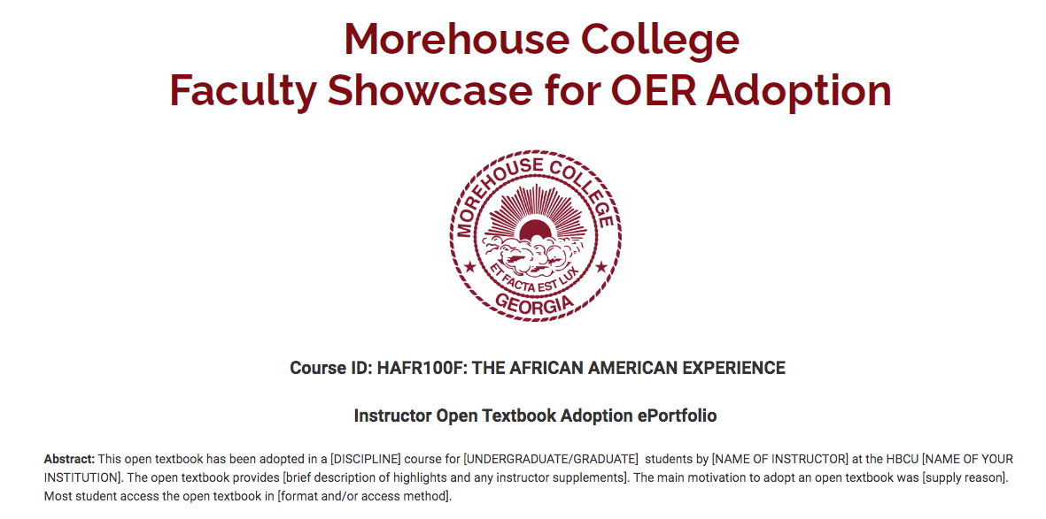
Developing Faculty Showcase/ePortfolios
Morehouse Faculty Showcase: https://www.merlot.org/merlot/viewSite.htm?id=9163173
Notes:
Having HBCU faculty creating OER and then cataloging it in MERLOT will help build the Cultural Collection.

Slide 8
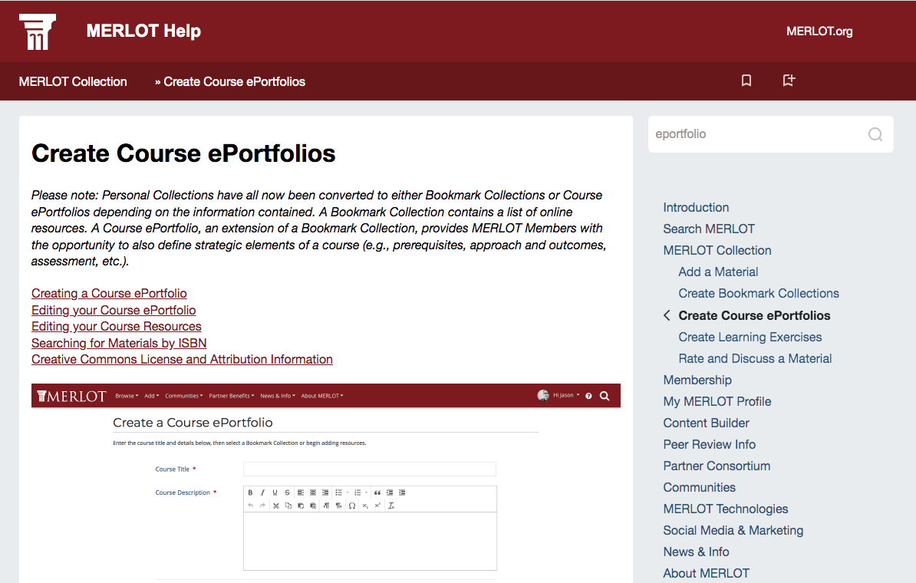
Faculty Showcase/ePortfolio How-To
https://info.merlot.org/merlothelp/topic.htm#t=Create_Course_ePortfolios.htm&rhsearch=eportfolio&rhhlterm=eportfolios%20eportfolio%20eportfolio%E2%80%9D
Notes:
Step by step instructions for building your own ePortfolio

Slide 9

Make your voice count! Contribute to the
HBCU AL$ Playbooks today!
https://bit.ly/oecplaybooks
Want to know more about Playbooks?
https://docs.google.com/presentation/d/11mo56QT4CWVABk50CjsfN-tx3NWcW9UEWO1yjppY6o0/edit#slide=id.p

Slide 10

Open Discussion: How can we better assist your HBCU AL$ efforts?

Slide 11
Questions?
webmaster@merlot.org
Maria Fieth: Director, MERLOT-SkillsCommons
Gerry Hanley: Executive Director, MERLOT-SkillsCommons
This work is licensed under a Creative Commons Attribution 4.0 International License.

