Slide 1
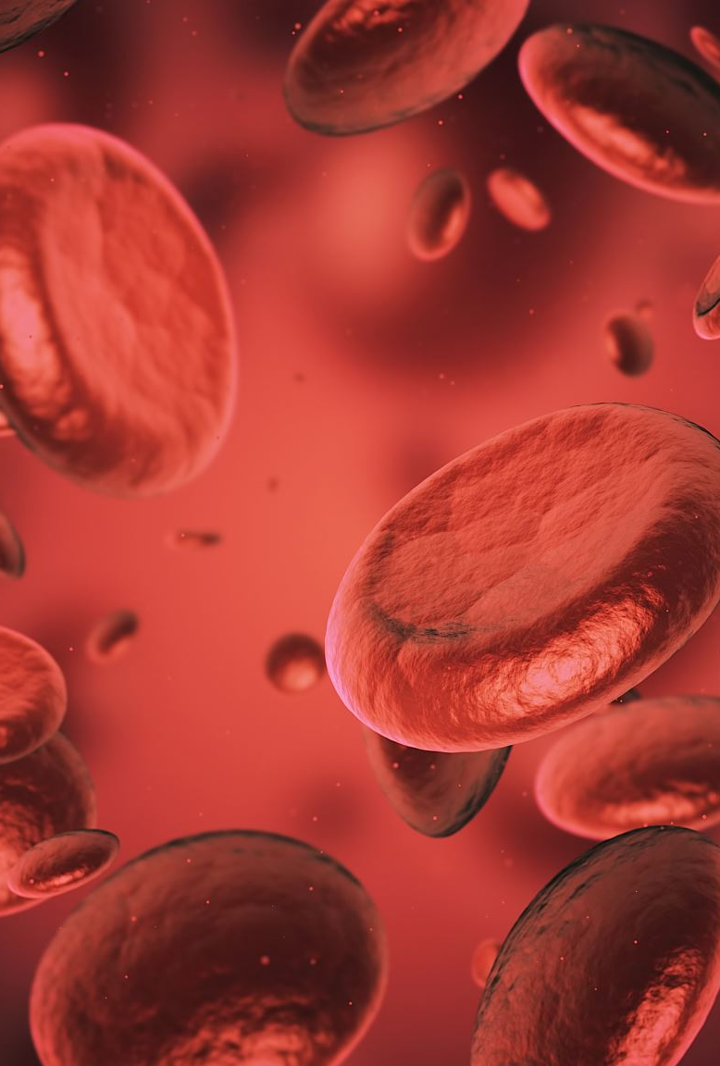
Hematological Disorders
Emily Schad

Slide 2
Types of Leukocytes (White Blood Cells)
Notes:
Insert pic of chart
Use your own drawing?

Slide 3
A word about suffixes
“-ia” means “not enough” like “pancytopenia”, “leukopenia”, ”anemia” “thrombocytopenia”
“-cytosis” – USUALLY means “too much” - “thrombocytosis”, “leukocytosis”
  - But not always – for example: phagocytosis - cell eating

Slide 4
Leukopenia
Low WBCs
Worry about neutrophil level
“ANC” = absolute neutrophil count = ___
Should be above 1000, worry if less than 500
“immunocompromised”
Notes:
Why worry about neutrophil level specifically?

Slide 5
Blood Cancer
Leukemia
  Cancer of blood or bone marrow
  Acute vs Chronic
  Lymphocytic vs Myelocytic
Lymphoma
  Cancer of lymph nodes
  Hodgkin's vs Non-hodgkins
Multiple Myeloma
  Cancer of plasma cells
Notes:
Lymphoma can have blasts, further along though.

Slide 6
Think about it
Is there a leukemia tumor?
How would you diagnose leukemia or lymphoma?
Notes:
diagnose= bone marrow biopsy vs lymph node biopsy

Slide 7
Blasts
Non-functional, immature WBCs called Blasts are overly produced
These blasts overwhelm bone marrow and other tissues, causing fewer RBCs, functional, mature WBCs, and platelets to be made
Notes:
Blasts are immature WBCs made in cancerous bone marrow. Nonfunctional as WBCs.

Slide 8
Think about it
What are some signs and symptoms of someone with a blood cancer diagnosis? Why?
Notes:
For answer see next slide

Slide 9
s/s of Leukemia (blood cancer)
Fatigue
Low-grade fever
Night sweats
Weight loss
Bleeding
infections
Bone pain
Lymphadenopathy (enlarged lymph nodes)
Splenomegaly (enlarged spleen)
Hepatomegaly (enlarged liver)
CNS involvement – esp. with ALL and in kids
Labs: Elevated blast count, Thrombocytopenia (low platelet count), anemia
Philadelphia chromosome
Notes:
Philadelphia chromosome – chromosome 9 and 22 are switched? -unknown
Bone pain – Sternum (breastbone), tibia (shin bone), femur (thigh bone)
Splenomegaly, hepatomegaly, and lymphadenopathy more common with ALL than AML (WHY?)
-from dr c. cancer can build up there. Can be generated there
Blast count - >100,000 indicates blast crisis?

Slide 10
Malignant Leukocytosis
What do you think could happen to a patient with an elevated “blast” count?
Notes:
WBC of > 120,000 suggests leukemia. Blasts >100,000
See next slide

Slide 11
Leukoblastic Emboli
Excess blasts can cause emboli in small blood vessels
Especially in lungs and cranial circulation
Blood vessels can burst and form infiltrates
In lungs – see SOB, dyspnea
Cranial – HA, lethargy, confusion, coma
Treatment: apheresis (mechanical filtering of blood, kind of like dialysis), then start chemo right away to stop bone marrow from producing more blasts

Slide 12
Leukemias
Can be caused by exposure to toxins including other chemotherapy or radiation
Lymphocytic (B and T cells) vs Myelocytic (all types of blood cells)
Acute – s/s develop suddenly. Usually more medically concerning
  Acute leukemia is most common cancer diagnosis in children, usually ALL
Chronic – s/s develop slowly if at all. Cells more differentiated
  Affects more older adults

Slide 13
ALL (Acute Lymphocytic Leukemia)
Risk factors: Philadelphia chromosome, pre-natal radiation exposure
s/s: anemia, infections, flu-like symptoms, fatigue, lymphadenopathy, splenomegaly, hepatomegaly, fever, weight loss
More likely to have CNS involvement (LP to diagnose this)
Prognosis worse for adults and T-cell ALL (Vs. B cell ALL)
Notes:
Do sites of bone pain change depend on CA dx? Yes they can, she’s sending video
Since Igs are released from Lymphoid B cells, is there low Ig release in ALL and CLL? – can still have with acute ones
Why is prognosis worse for t cell?-unknown!

Slide 14
AML (Acute myeloid [myelogenous] leukemia)
Apoptosis (normal cell death) of myeloid cells is disrupted
Risk factors: genetic mutations, history of Hodgkin's lymphoma, history of receiving other chemotherapy, age greater than 65
s/s: anemia, thrombocytopenia, infections
Will see myeloblasts present in bone marrow

Slide 15
Leukemia treatment
Treatment can vary based on age. Patient age can be a determining factor for mortality (wordy)
Different phases of chemotherapy administration
Bone marrow transplant

Slide 16
Hyperuricemia and Tumor Lysis Syndrome
Leukemic cancer cells die after chemo administration
Cell death causes a biproduct of uric acid to form
Filtered in kidneys, can crystallize and cause renal damage or failure
s/s: high uric acid level, hyperkalemia, hyperphosphatemia, hypomagnesemia, hypocalcemia, acidosis
Treat: frequent lab monitoring, IV fluids, allopurinol, rasburicase enzyme
Notes:
Allopurinol - lowers uric acid levels, used in gout

Slide 17
CLL (Chronic Lymphocytic Leukemia)
Usually affects older adults
B cells do not mature, stay “blasts”
Risk factors: herbicide, agent orange exposure, chromosomal abnormality (trisomy 12)
S/s: usually asymptomatic and this is found accidentally. High WBC count. Or see s/s of ALL when disease progresses.
Thankfully 90% can go into remission with treatment!
Notes:
Few or no Igs (antibodies) released, or they are mutated, so prone to infection

Slide 18
CML (Chronic myeloid leukemia)
Usually affects older adults
Risk factors: Affects more men than women, 95% have the Philadelphia chromosome
s/s: Infections, anemia, thrombocytopenia, fever, fatigue, bone pain
Too many myeloid cells produced
Can be treatable and curable
Bone marrow transplant can treat
See next slide for phases of this disease

Slide 19
Phases of CML
Chronic – neutrophils start to lose differentiation. May see weakness, weight loss, splenomegaly, anemia, high WBC count
Accelerated – neutrophils more undifferentiated. May see more splenomegaly, increased abdominal discomfort from that, fever, night sweats, bone pain, weight loss. Lasts 6-12 months
Blast crisis – myeloid blast cells don’t differentiate, start of acute leukemia. ore blasts present. See s/s of AML.

Slide 20
Think about it
Notes:
Review this CBC. What concerns you?

Slide 21

Think about it
What is the role of B cells vs T cells?
Notes:
What is the role of B cells vs T cells?

Slide 22
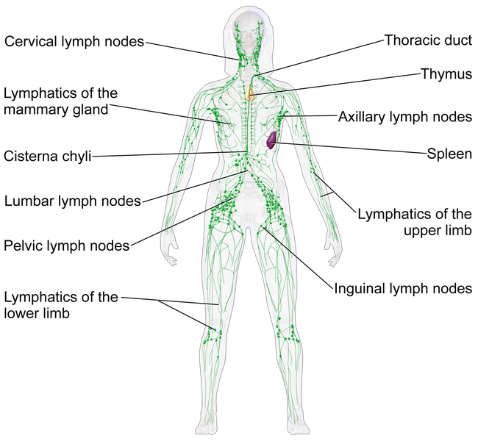
Lymphomas
Solid tumors
Enlarged, painless lymph node
Can be caused by viruses and carcinogens
Can see “B Symptoms” manifest
https://upload.wikimedia.org/wikipedia/commons/f/f4/Blausen_0623_LymphaticSystem_Female.png
Notes:
Painful or tender enlarged LN more indicative of infection
Image source: https://upload.wikimedia.org/wikipedia/commons/f/f4/Blausen_0623_LymphaticSystem_Female.png

Slide 23
Epstein Barr Virus
Usually get from mononucleosis infection
Stays in B lymphocytes for one’s whole life

Slide 24
B symptoms
Fever (often with no other s/s of infection)
Fatigue
Weight loss
Severe night sweats
Increased susceptibility for infections
Notes:
Signs of lymphoma. Can see with HL and NHL
Fevering more at night , so sweating and breaking at night (night sweats)

Slide 25
Hodgkin's Lymphoma (HL)
Usually affects males age 15-40, and 55 and older
usually affects a LN or LN group above the diaphragm
B-symptoms with pruritis (itching)
Hallmark sign – presence “Reed Sternberg” cells in the LN. Abnormal, large, cancerous B lymphocyte cells that have 2 nuclei that look like owl’s eyes
  Presence of these is diagnostic for HL
Very curable disease

Slide 26
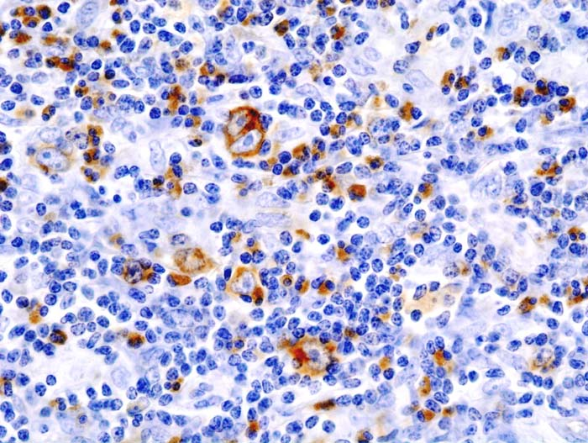
Notes:
https://commons.wikimedia.org/wiki/File:Hodgkin_lymphoma_%284%29_CD30_immunostain.jpg
Slide from a lymph node biopsy
“Reed Sternberg” cells in the LN. Abnormal, large, cancerous B lymphocyte cells that have 2 nuclei that look like owl’s eyes

Slide 27
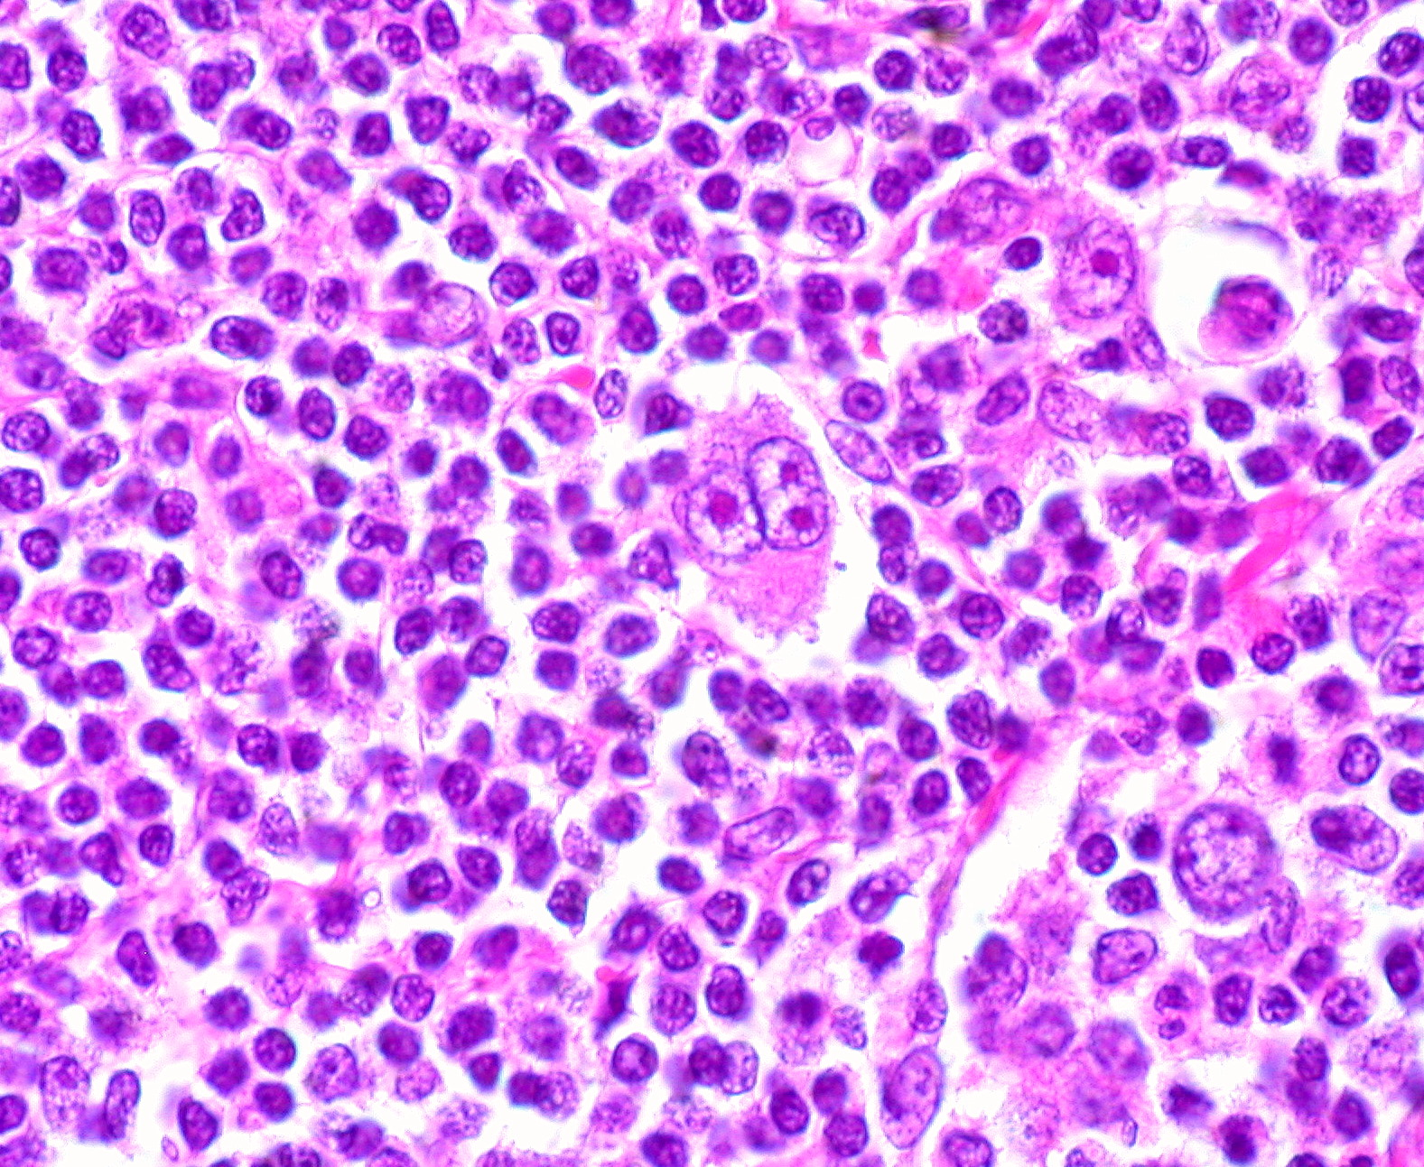
Notes:
https://commons.wikimedia.org/wiki/File:Hodgkin_Disease,_Reed-Sternberg_Cell.jpg
Another example

Slide 28
Non-Hodgkin’s Lymphoma (NHL)
Usually affects B-cell lymphocytes
Incidence has increased since 1970s
EBV, HIV, other chemicals/carcinogens can cause. As well as chromosomal translocations.
83% of all Lymphoma cases
Usually affects those in their 60s
Can be indolent (slow-growing) but this can progress to fast-growing
Affects one or many nodes (can be generalized)
Diagnose with LN biopsy
Quickly fatal if untreated. Survival rates aren’t as good as HL, but still survivable
Notes:
Why do you think incidence has increased since 1970s?

Slide 29
A word about pesticides
Round-Up (Glyphosate)
  Manufactured by Monsanto predominantly
  Evidence currently mixed about cancer association
  Some studies found increased risk of NHL and multiple myeloma occurred with exposure (Weisenburger, 2021; Zhang et al., 2019), some found no increased risk (Donato et al., 2020)
Diaznon
  Organophosphate pesticide
  Confirmed increased risk for NHL (Hu et al., 2017)
  Banned in US in 2004

Slide 30

What is the role of plasma cells?
They are B Lymphocytes that make immunoglobulins
Notes:
They are B Lymphocytes that make immunoglobulins

Slide 31
Multiple Myeloma (MM)
Malignancy of plasma cells in bone marrow
Risk factors: age greater than 60, chromosome 13 or 14 abnormality, autoimmune disorders, exposure to radiation, pesticides, herbicides, agent orange, or certain viruses
organ damage causes increased mortality
Plasma cells make dysfunctional antibodies (“Ig”s) and abnormal proteins (“M” & “Bence Jones” proteins)
  These proteins damage tubular tissue in kidneys
  Can see Bence Jones proteins secreted in urine
Plasma cells secrete a paraprotein that can cause body fluids to become viscous and can break down into amyloid deposits
  Causes heart failure and nephropathy
Plasma cells can also form tumors in bone and soft tissue

Slide 32
Myeloma and the bones
Bone pain is usually first symptom of MM. especially in the back
Osteolytic bone lesions – areas of bone damaged from abnormal, increased activation of osteoclasts
This can lead to hypercalcemia and increased pathologic fractures, including compression fractures which can lead to spinal cord compression
Notes:
Remember osteoclasts break down bone and cause bone to be reabsorbed

Slide 33

Other MM S/S
Weight loss, weakness, neutropenia, anemia (often requiring transfusions), thrombocytopenia, purpura
Bone and renal involvement are big issues

Slide 34

What kind of lab values and s/s might you see in a MM patient?
Notes:
Lab values – hypercalcemia, kidney damage so high BUN and creatinine, anemia, thrombocytopenia, neutropenia (because bone marrow is crowded by malignant plasma cells)
S/S- bone pain esp. back pain, pathologic fractures, compression fractures (worry about spinal cord compression) (s/s spinal cord compression= pain, numbness or weakness in extremities, loss of bowel/bladder control) , weight loss, weakness.

Slide 35
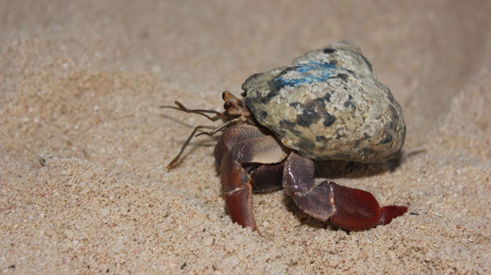
Calcium high
Renal impairment
Anemia
Bony lesions
Infections
Notes:
Just remember – CRAB-I!
Image source: https://www.publicdomainpictures.net/en/view-image.php?image=40480&picture=crab

Slide 36
MM diagnosis and treatment
Diagnosis: presence of 10% or more plasma cells in bone marrow, M-proteins in blood or urine, Bence-Jones proteins in urine, and organ or tissue damage from plasma cells (Ex: Lytic bone lesions)
Treatment: evolving. Often chemo, and can have autologous or allogeneic bone marrow transplant
Notes:
Can I use dr. c’s graphic here?
Explain auto vs allo bmt

Slide 37

What is “Agent Orange”?
A chemical used in the Vietnam War to destroy crops and forests (“defoliant”)
The soldiers who used it had an increased incidence of chronic lymphocytic leukemia, Hodgkin's lymphoma, and non-Hodgkin’s lymphoma
Notes:
(Frumkin, 2003)

Slide 38
References
Donato, F., Pira, E., Ciocan, C., & Boffetta, P. (2020). Exposure to glyphosate and risk of non-Hodgkin lymphoma and multiple myeloma: an updated meta-analysis. Med Lav, 111(1),63-73. DOI: 10.23749/mdl.v111i1.8967
Frumkin, H. (2003). Agent Orange and Cancer: An Overview for Clinicians. Environmental Carcinogens, 53(4).
Hu, L., Luo, D., Zhou, T., Tao, Y., Feng, J., & Mei, S. (2017). The association between non-Hodgkin lymphoma and organophosphate pesticides exposure: A meta-analysis. Environmental Pollution, 231, 319-328. http://dx.doi.org/10.1016/j.envpol.2017.08.028
Weisenburger, D. D.. (2021). A Review and Update with Perspective of Evidence that the Herbicide Glyphosate (Roundup) is a Cause of Non-Hodgkin Lymphoma. Clinical Lymphoma Myeloma and Leukemia, 21(9), 621–630. https://doi.org/10.1016/j.clml.2021.04.009
Zhang, L., Rana, I., Shaffer, R. M., Taioli, E., & Sheppard, L.. (2019). Exposure to glyphosate-based herbicides and risk for non-Hodgkin lymphoma: A meta-analysis and supporting evidence. Mutation Research/reviews in Mutation Research, 781, 186–206. https://doi.org/10.1016/j.mrrev.2019.02.001
Textbook

