Slide 1


Part 3 Acid- Base balance
Dr. Kristina Buszta CRNA
Part 1: Pathophysiology of Electrolytes
Part 2: Fluids
Part 3: Acid-Base balance
Notes:
Hi my name is Dr. Kristina Buszta CRNA, this is the third lecture in a three part series. Here I will review acid and base balance.

Slide 2
Overview
What is pH and why do we care?
Acid
Base
Acid-base balance
Buffer system
Respiratory acidosis
Metabolic acidosis
Respiratory alkalosis
Metabolic alkalosis
Testing acid-base balance
Notes:
This lecture will cover, what pH is and why do we care, what is an acid and base, that balancing system, the buffer system, and each type of acidosis and alkalosis and finally a quiz.

Slide 3
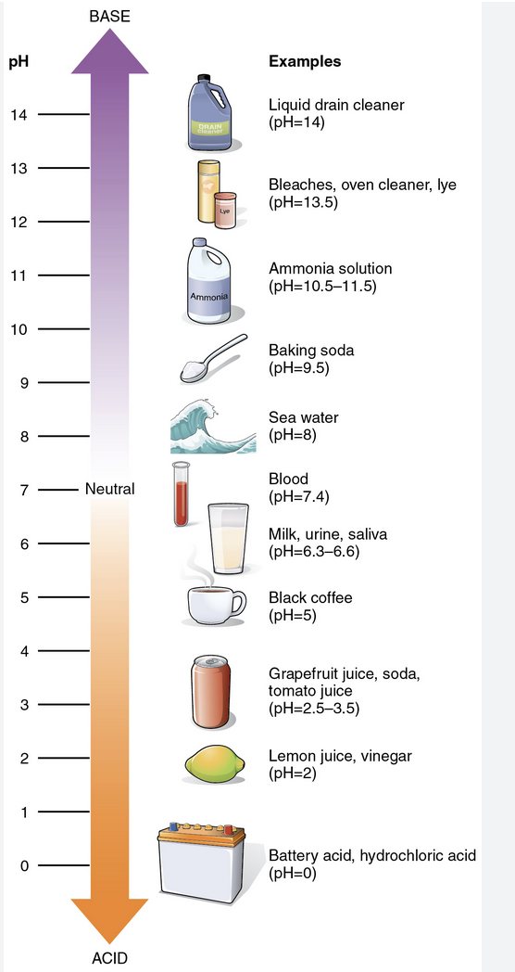
What is pH
pH stands for Power/Potential of hydrogen
216 pH Scale
OpenStax College
https://commons.wikimedia.org/wiki/File:216_pH_Scale-01.jpg
CC by
Notes:
pH stands for Potential Hydrogen, it uses a scale 0 – 14 to quantify how much hydrogen a solution has. Hydrogen is an acid so this scale shows how acidic or how alkalotic (another way to say Basic) a solution is.
This pH scale is helpful to reference since it uses everyday examples we are familiar with. Drain cleaner is highly toxic because it has a high pH and is alkalotic. Battery acid is toxic because it is extremely acidic. Black coffee, the kind that occasionally will burn a hole in your stomach is acidic and baking soda, why we use it in baking, is alkalotic. In this lecture we will focus on blood at a pH of 7.4. The body always strives to maintain this pH in order to function properly.
https://commons.wikimedia.org/wiki/File:216_pH_Scale-01.jpg

Slide 4
Why do we care about pH?
Body tries to always maintain homeostasis
The body must maintain a range of pH in order to function normally 7.35 – 7.45
  Normal clotting times
  Free radicals, cell death
Notes:
Why do we care about pH as nurses?
pH is vital for maintaining homeostasis. Normal pH around 7 is crucial for things like blood clothing, for drugs to work in the bod as well as preventing cell death and release of free radicals.
https://medschool.co/tests/arterial-blood-gas

Slide 5
Henderson – Hasselbach – what and why?
What is it? A way to calculate pH
Why?
Not used
Notes:
When hearing about pH you will often hear about Henderson-hasslebach equation. It is a way to calculate a substances pH, that is all we really need to know. In a clinical setting pH is calculated in the lab using a machine. Since we don’t ever use it I’m not even going to show you the complicated equation.

Slide 6
What is an acid?
An acid is something that donates a cation, in interpreting acid- base balance the CO2 is the acid
It causes the pH of solution to decrease, also known on the pH scale of less than 7.35
Carbon dioxide is an acid, in the form of carbonic acid (H₂CO₃ ) when it combines with a hydrogen ion
  Excreted through the lungs during exhalation
We use Carbon dioxide values in arterial blood gases to assess acid- base balance
Normal range for pCO₂ is 35 – 45 mmHg
Notes:
An acid is something that donates a cation, remember that is a positive ion, in the form of a hydrogen ion.
It causes the pH of a solution to decrease, that is go below 7.35 on the scale. In the body we refer to Carbon dioxide as an acid. It combines with hydrogen to become carbonic acid and is excreted in the lungs through exhalation. Other acids in the body are metabolic acids and are excreted through the kidneys.
Acidemia is the term used when blood pH is less than 7. 35
The normal range for this acid is 35 – 45mm Hg
https://med.libretexts.org/Bookshelves/Anatomy_and_Physiology/Book%3A_Acid-base_Physiology_(Brandis)

Slide 7
What is a base?
Something that accepts a cation also called alkaline
It causes the pH of a solution to increase, also known on the pH scale as above 7.45
Examples: bicarbonate (HCO₃) lactate, phosphate, or sulphate
We use bicarbonate values in arterial blood gases to assess acid-base balance
Normal range 22 -26 mEq/L
Notes:
A base is the opposite of an acid, is can accept a cation. It causes the pH of a solution to increase, go above 7.45 on the pH scale. In the body some of the basic components are lactate, phosphate or sulphate. You will often hear lactic acid. it is an addition of a hydrogen atom to lactacte to make it acidic. It is caused by a breakdown of glucose under anerobic conditions, meaning without oxygen. This can be seen in sepsis, from hypoperfusion or decreased oxygenation at the tissue level. We have experience with lactic acid build up after a tougher-than-normal workout when we have sore muscles.
Alkalemia is the term used when blood pH exceeds 7.45
Normal range for bicarbonate is 22 – 26 milliequivalents per liter
Lippincott CoursePoint Enhanced for Porth's Essentials of Pathophysiology
Tommie L. Norris

Slide 8
What is acid/base balance
  The body’s metabolism produces acids, to maintain pH balance, those acids must be eliminated or metabolized.
  Acids produced by the body are either respiratory acids or metabolic acids
  Respiratory acids (carbonic acid H₂CO₃) are eliminated by the lungs
  Metabolic acids are eliminated by the kidneys
  pH is maintained through eliminating acids and bases via buffering, using first respiratory and then metabolic methods using the kidneys
Notes:
The body has buffers to maintain that normal pH. The respiratory and renal systems are the main buffers. The respiratory system acts the quickest in acute changes and then the metabolic buffers is the kidneys.
https://med.libretexts.org/Bookshelves/Anatomy_and_Physiology/Book%3A_Acid-base_Physiology_(Brandis)
Lippincott CoursePoint Enhanced for Porth's Essentials of Pathophysiology
Tommie L. Norris

Slide 9
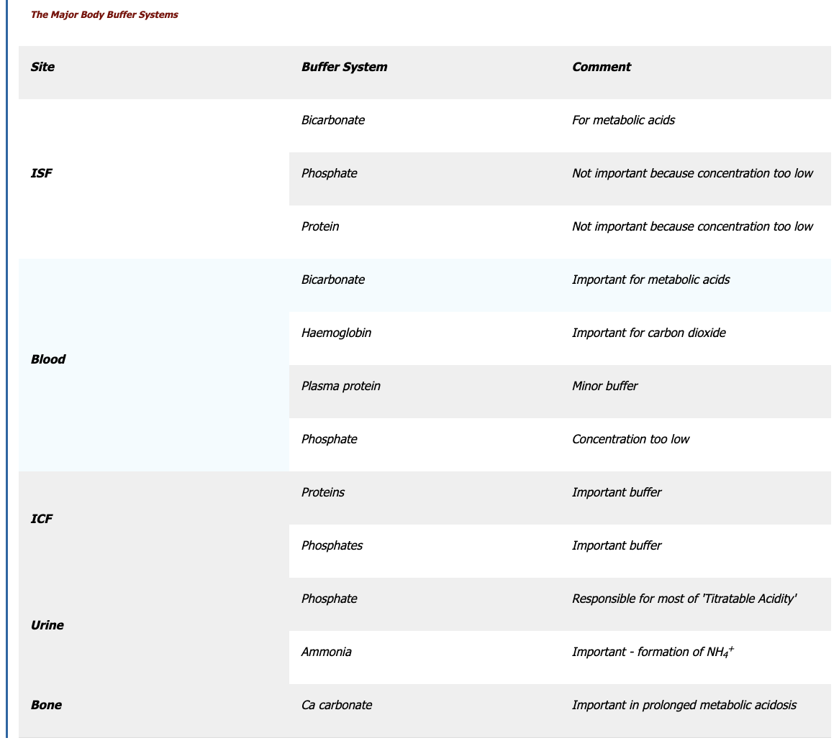
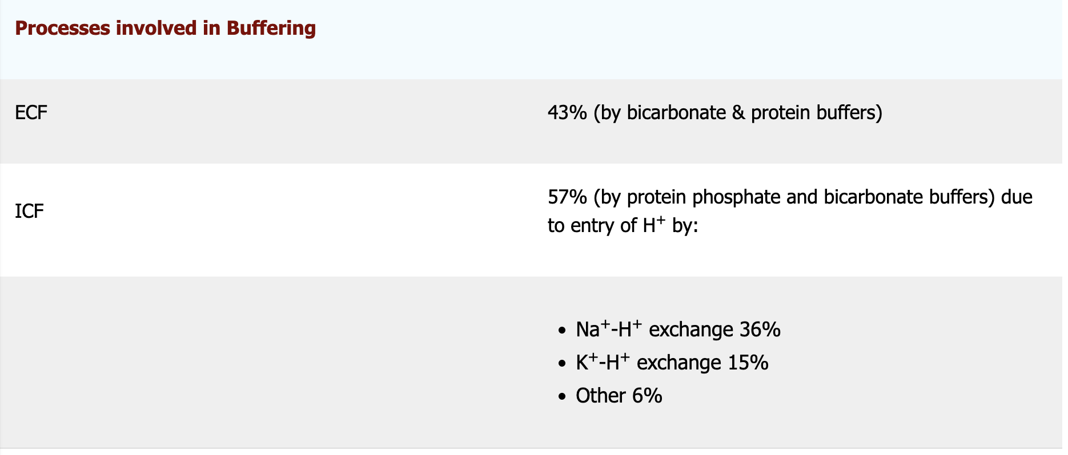
Buffers – First line of defense in balancing acid/base
Atrribution: Buffering
Kerry Brandis
https://med.libretexts.org/Bookshelves/Anatomy_and_Physiology/Book%3A_Acid-base_Physiology_
(Brandis)/02%3A_Control_of_Acid-Base_Balance/2.02%3A_Buffering
Notes:
The major buffer in the extracellular fluid is CO 2 and bicarbonate for metabolic acids. It is further enhanced by respiratory changes to control for carbon dioxide. Renal mechanisms also contribute to elimination of acids.
Other buffers in the blood are the proteins and phosphate buffer system and are responsible for respiratory acid- base imbalances. Phosphate buffer system is so low it does not provide a large amount of help towards buffering acid-base balance.
The chart on the left highlights the buffer system in each fluid space.
In the interstitial fluid, the extracellular fluid outside of the blood vessels, the components are bicarbonate, phosphate and proteins and you can see their use.
In the blood is bicarbonate, hemoglobin, plasma proteins and phosphate. In the intracellular fluid there is only proteins and phosphates.
The chart on the right highlights the major buffers in the extracellular fluid which is bicarbonate and protein and in the intracellular fluid compartment is protein phosphate and bicarbonate.
https://med.libretexts.org/Bookshelves/Anatomy_and_Physiology/Book%3A_Acid-base_Physiology_(Brandis)/02%3A_Control_of_Acid-Base_Balance/2.02%3A_Buffering

Slide 10

Buffer system explained
Dr. Frank O'Neill
Acid/Base Balance Buffers: Anatomy and Physiology
CC by
Notes:
Here is another person's explanation of the buffer system
https://www.youtube.com/watch?v=jmHpXh3ZeCw

Slide 11
How does the respiratory system function to buffer?
By altering ventilation- respiratory rate
in ventilation causes in carbon dioxide in the blood and an in acidosis in pH
The opposite is true…..
in ventilation causes a in carbon dioxide levels and a in acid levels, in pH
Notes:
Since we discussed that carbon dioxide acts as an acid, retaining more in the body by slowed respiratory rate seen as seen in head injuries, lung diseases, or narcotic use, will increase the amount of carbon dioxide and decrease the pH.
Carbon dioxide is lipid soluble so changing carbon dioxide concentrations affects the pH in all fluid compartments.
When ventilation decreases it causes an increase in carbon dioxide due to poor respiratory excretion of CO2, and a resulting increase in acidosis which is a decrease on the pH scale.
Therefore, the opposite is true, an increase in ventilation will decrease carbon dioxide levels and cause a decrease in acid, which is seen as an increase on the pH scale.

Slide 12
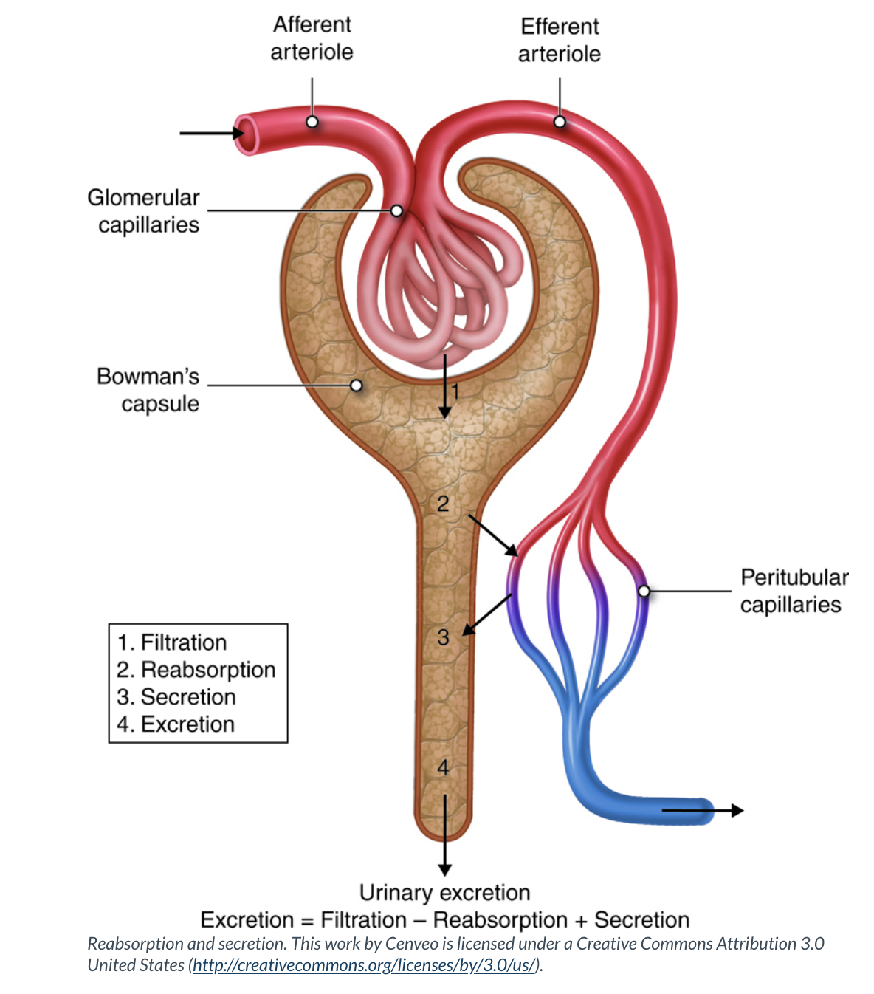
How the renal system regulates metabolic acids
Kidneys can eliminate acids and retain bicarbonate (base)
More information: https://med.libretexts.org/Bookshelves/Anatomy_and_Physiology/Book%3A_Acid-base_Physiology_(Brandis)/02%3A_Control_of_Acid-Base_Balance/2.04%3A_Renal_Regulation_of_Acid-Base_Balance
Notes:
Kidney's act as a buffer by eliminating acids or retain base in the form of bicarbonate. This is a very in-depth topic, more information can be found using the link provided.

Slide 13
Introduction to acid – base disorders
Respiratory acidosis
Metabolic acidosis
Respiratory alkalosis
Metabolic alkalosis
Notes:
There are 4 types of acid- bae disorders
Respiratory acidosis, metabolic acidosis, respiratory alkalosis and metabolic alkalosis

Slide 14
Respiratory acidosis
Most seen acid – base imbalance
Can be caused by hypoventilation from narcotics, obesity, head injury, congestive heart failure, lung disease or nerve/muscle disease (Guillen-Barre, Amyotrophic lateral sclerosis, C3,4,5 or higher spinal cord damage)
Characterized by
  pH below 7.35
  Partial pressure of carbon dioxide (PaCO₂) greater than 45
The body’s acid
Notes:
Respiratory acidosis is due to alterations in pCO2 levels, meaning the partial pressure of CO2 in the arterial blood. Partial pressure is referred to the pressure coefficient of CO2 in the arterial blood, partial pressure refers to the pressure exerts by the gas. This can be seen in hypoventilation from narcotics, obesity, head injuries, lung diseases or various nerve or muscle diseases.
You will see an acidotic pH, below 7.35
And because CO2 is the acid that is being built up due to poor respiratory excretion, the partial pressure of CO2 will climb above 45.
Initially a rise in CO2 is a respiratory stimulant however an extremely high rise in CO2 is a respiratory depressant.
To compensate the body retains bicarbonate, the base. This is buffered acutely by the respiratory system and over a longer period of time, because it is a slower process, the renal system.

Slide 15
Metabolic acidosis
Can be caused by: diarrhea, lactic acidosis, diabetic ketoacidosis
Characterized by:
  pH below 7.35
  HCO₃ below 22
Notes:
Metabolic acidosis is commonly seen in the intensive care unit.
It can be caused by diarrhea (think c. defficile), GI suctioning, lactic acidosis, or diabetic ketoacidosis.
I want to add a quick piece on lactic acidosis, it is a metabolic by product of cells with low oxygen perfusion, it can be seen in sepsis or even extreme exercise or weightlifting.
The pH will also be below 7.35 on the pH scale, the bicarbonate, the base that is a metabolic byproduct, is low, so too little base pushes the equation to the acidic state.
The body will try to eliminate this high level of acid by breathing off CO2.

Slide 16
Respiratory alkalosis
Can be caused by: hyperventilation (panic attacks, high respiratory rate on ventilator settings) or fever
Characterized by
  pH greater than 7.45
  CO₂ normal
  HCO₃ high, greater than 26 mEq/L
Notes:
Respiratory alkalosis can be caused by hyperventilating that can be seen in panic attacks or even high respiratory rate on a ventilator setting.
It is characterized by a pH greater than 7.45
CO2 is normal
And bicarbonate is high, signaling too much base, levels are above 26 mEq/L

Slide 17
Metabolic alkalosis
Caused by: vomiting (eliminating stomach acid)
Characterized by
  Higher than normal pH > 7.45
  CO₂ normal
  HCO₃ low
Notes:
Metabolic disorders are derangements in bicarbonate that alter pH. This can be seen in vomiting. Metabolic alkalosis is characterized by a pH higher than 7.45, a normal CO2, and a low bicarbonate level.

Slide 18
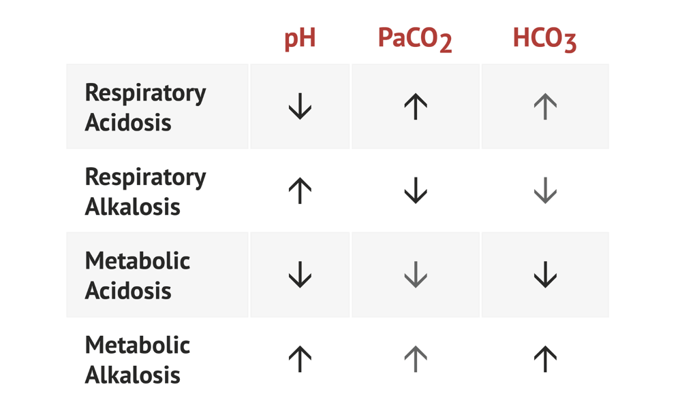
Analyzing acid-base balance
Arterial blood gas
  Why?
  Analyze 3 labs pH, CO₂, HCO₃
  Steps to interpreting arterial blood gas (ABG) results
  1. Decide if pH is acidotic, normal or alkalotic
  2. Asses respiratory component: Is the CO₂ low, normal or high
  3. Asses metabolic component: Is the HCO₃ low, normal or high
  https://www.acidbase.org/indextest.php
pH | 7.35 – 7.45
pCO₂ | 35 – 45 mmHG
HCO₃ | 22 – 26 meQ/L
Notes:
We test acid base status using an arterial sample, because an intracellular sample is impossible, therefore we are looking from the outside in!
First you look at the pH if it is below 7.35 it is acidotic, if it above 7.45 it is alkalotic, if it falls between those values, it is normal
Then look at the CO2 is it low or high it is remember this is respiratory in nature
If the HCO3 is low or normal it is remember this is metabolic in nature
An easy way to remember normal values of pH and CO2 is they both contain 35 - 45
Study and understand the chart to the right, this is crucial to understanding acid-base disorders and how to interpret arterial blood gas results.
Lets go through one of them, if the pH is low, the CO2 (remember this is the acid) is high then you have respiratory acidosis.
Often times you have a clinical picture to aid in your judgement as well as previous ABG tests.
https://medschool.co/tests/arterial-blood-gas

Slide 19

Acid-base disorders
Dr. Frank O'Neill
Acid – Base Anatomy: Anatomy and Physiology
CC by

Slide 20
What is compensation?
The body’s way to alter the pH
Can be uncompensated, partially or fully compensated
Three options
  Uncompensated: pH is out of normal range and either CO₂ or HCO₃ is out of range
  Partially compensated: All values will be out of normal range
  Fully compensated: when the pH is normal, but the other values are out of range
Notes:
Compensation is the body's way to alter the pH back to normal, it is going to adjust respiratory rate or kidney retention or excretion to get back to homeostasis.
It can be uncompensated, partially or fully compensated.
Uncompensated is when the pH is out of normal values and one of the other lab values (CO2 or bicarbonate) is out of range
Partially compensated is when you now have all three values out of normal range
To find who the problem child is CO₂ or HCO₃ you have to look at who is abnormal value falls in line with the pH
Lets look at an example

Slide 21
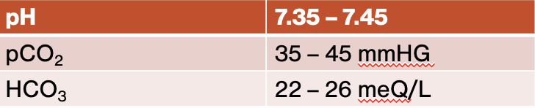
Uncompensated example
Definition: pH is out of normal range and either CO₂ or HCO₃ is out of range, not both!
pH | 7.31 | acidic
pCO₂ | 67 | Too much acid!
HCO₃ | 24 | normal
Reference values
pH | 7.49 | alkalotic
pCO₂ | 38 | normal
HCO₃ | 29 | alkolotic
Notes:
So in this uncompensated example if we approach it in the three steps, we look at pH of 7.31, which is outside of the normal 7.35 – 7.45 so it is acididc
Remember you can have acidemia from too little base, in the form of too little bicarbonate, or too much acid in the form of carbon dioxide.
Here the CO2 is outside of the normal range of 35 – 45 mmHg so it is also acidic
The bicarbonate is 24, within the normal range of 22 -26 meQ/L
So this is respiratory acidosis
Respiratory because it the CO2, remember the respiratory component, is too high
In the purple chart, pH is alkalotic, the CO2 is normal, and the bicarbonate is too high, meaning too much base causing a metabolic alkalosis.

Slide 22
Partially compensated example
All values will be out of normal range
What came first, chicken or egg? Who caused the problem?
pH | 7.31 | acidosis
pCO₂ | 31 | alkalotic
HCO₃ | 16 | Acidotic aka too little base
Notes:
When looking at an ABG result and all three values are off, how do you know if the CO2 (the lungs) or the bicarbonate (the kidneys) are the problem that is altering the pH.
Answer: look to see what the pH is doing!
In this example the pH is acidic
The co2 is lower than normal, so it is not causing the acidemia
The bicarbonate is lower than normal and since this is the base, and you are too low in base, it is acidic, so the culprit is the bicarbonate which is the metabolic component so this is partially compensated metabolic acidosis
The CO 2 is trying to get the pH back to normal by getting rid of the acid
This would be considered fully compensated if the pH was normal

Slide 23
Fully compensated example
when the pH is normal, but the other values are out of range
Reference values
pH | 7.41 | Normal
pCO₂ | 33 | alkalotic
HCO₃ | 17 | acidodic
Notes:
The pH is normal
CO2 is lower than normal which is alkalotic
Bicarbonate is acidotic
To determine if this respiratory or metabolic in nature we then go back and take a closer look at the pH, given the standard pH of blood is 7.4, where does this value fall?
On the alkalotic side, so the culprit is the CO2, and the bicarbonate is trying to help so this is a fully compensated respiratory alkalosis.

Slide 24
Clinical scenarios
Reference values
An 18 year old male with ulcerative colitis presents with profuse diarrhea for three days. In the Emergency department his HCO₃⁻ is 13 on his basic metabolic panel. An ABG is obtained, and it is:
pH 7.28, CO₂ 27, HCO₃13
Step 1: pH is acidotic
Step 2: CO₂ is alkalotic
Step 3: Bicarbonate is acidotic
Because of the diarrhea, you can guess this is metabolic in nature
This is Partially compensated metabolic acidosis
The ABC's of ABGs: Teaching Arterial Blood Gases to Adult Learners
Deborah DeWaay, MD
, Joel Gordon, MD
https://doi.org/10.15766/mep_2374-8265.9038
Open access

Slide 25
Clinical scenario
Reference values
A 35 year female physician with a history of asthma and severe allergies to pollen develops urticaria, hypotension and stridor when she puts on a pair of latex gloves. In the Emergency Department her ABG is pH 7.21, CO₂ 64, HCO₃⁻ 26
Step 1: pH is acidotic
Step 2: CO₂ is acidotic
Step 3: Bicarbonate is normal
Because of the stridor you can guess this will be respiratory in nature
This is uncompensated respiratory acidosis
The ABC's of ABGs: Teaching Arterial Blood Gases to Adult Learners
Deborah DeWaay, MD
, Joel Gordon, MD
https://doi.org/10.15766/mep_2374-8265.9038
Open access
Notes:
Because this is an acute onset of respiratory stridor which signals an obstruction, it would be hard to compensate so this is an uncompensated respiratory acidosis

Slide 26
Practice, practice, practice
http://www.m2hnursing.com/ABG/casestudy1.php
Notes:
https://tacomacc.libguides.com/oer/attribution#:~:text=To%20%22attribute%22%20something%2C%20you,%3A%20Title%2C%20Author%2C%20License.

