Slide 1
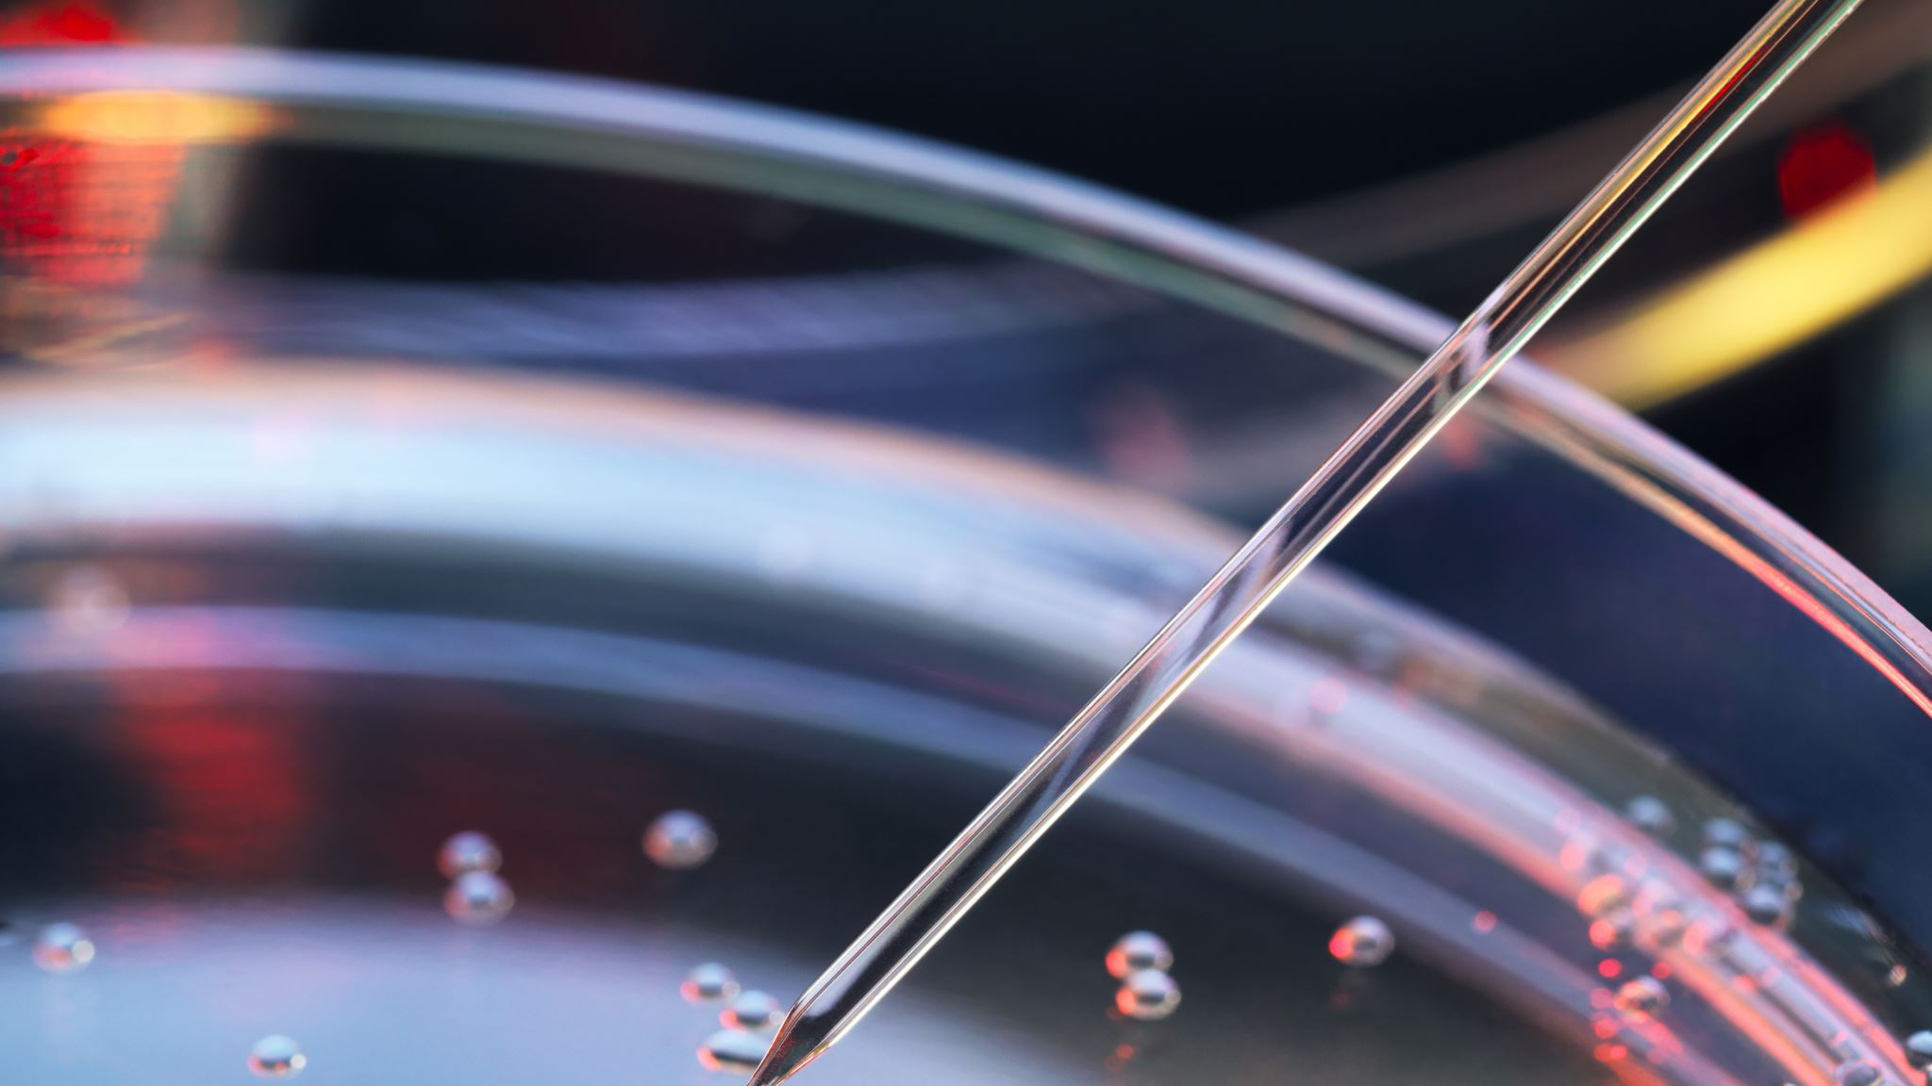


Coagulation
Emily Schad, RN, BSN
Notes:
Hi my name is Emily Schad. I have been an RN for 7 years and have predominantly worked in oncology and hematology. I’m currently obtaining my masters of science in nursing. I have an interest in pathophysiology and open education. Please enjoy this lecture about coagulation.
Delicate balance between inappropriate clotting (thrombosis) and bleeding
I have inserted slides throughout this presentation called “Think about it”. These are intended to challenge you to think about this content as it relates to what you may already know, or to think outside the box. I have enclosed the answers either at the bottom of the slide, in the recording, or in the subsequent slides. If you would like to get the full learning experience of this presentation, please consider hiding the notes section of these ppts and challenge yourself to answer these questions on your own first. Hopefully it will help you better learn the material. Cheers!

Slide 2
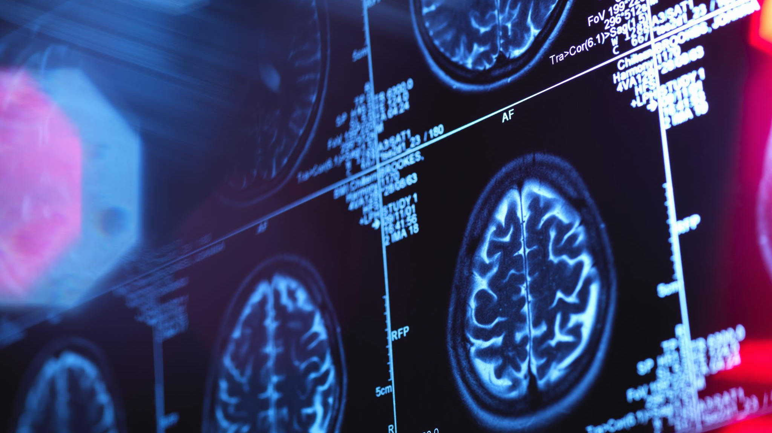

Think about it
What are some disorders caused by thrombosis or bleeding?
Notes:
Many deadly diseases are caused by an imbalance in the coagulation system, whether it’s inappropriate clotting forming a thrombus that leads to stroke, PE, or MI or hemorrhage after a trauma.
-stroke, heart attack, hemophilia, hemorrhage, DVT, the list goes on

Slide 3
Helpful open education (OE) video about blood clotting
https://www.youtube.com/watch?v=gExUCrpAKyQ
Notes:
The technical term for blood clotting is hemostasis

Slide 4

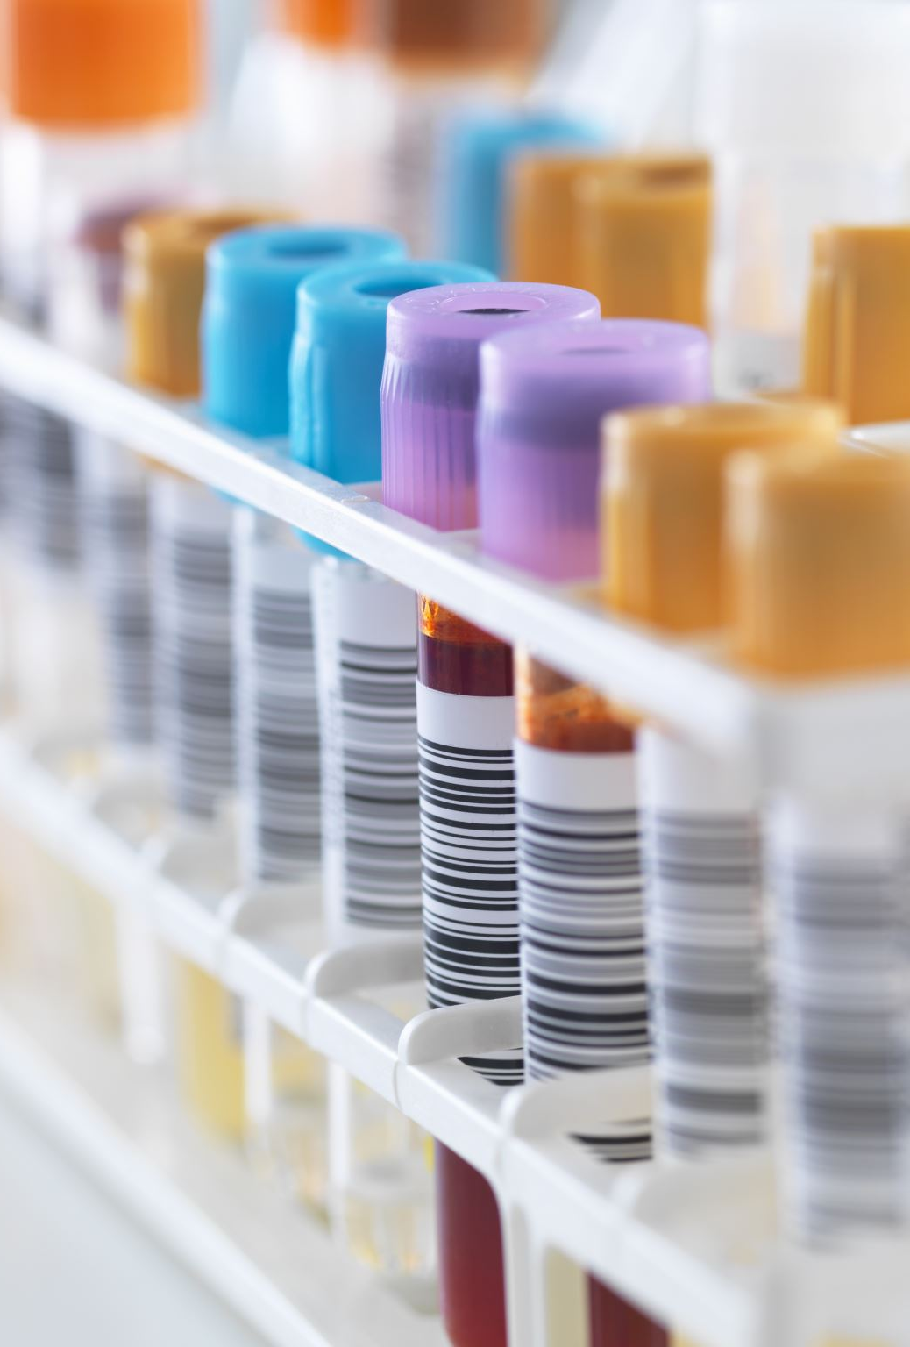
The Players
Platelets
Von Willenbrand factor
  Made in the endothelium
  Released from endothelium and circulate in blood plasma
Clotting factors
  Made in the liver, Vitamin K needed to synthesize
  Procoagulants
  Anticoagulants
Notes:
These are the different cells and compounds needed for proper clotting

Slide 5
Platelets
Made in the bone marrow
Form from a larger cell called a megakaryocyte
Normal platelet count is 150,000 to 400,000 per microliter of blood
Notes:
Platelet count less than 20,000 can cause spontaneous bleeding

Slide 6
Steps of clotting
1) Vasoconstriction
2) Platelet plug formation
3) Fibrin clot formation
4) Clot is broken down

Slide 7
Vasoconstriction
smooth muscle vascular spasm occurs, which constricts blood vessel
Caused by prostaglandins
Reduces blood flow to injured area
Notes:
First thing that happens when a blood vessel is injured

Slide 8
Platelet plug Forms
Platelets adhere to collagen exposed in damaged blood vessel
Platelets release chemicals that make adjacent platelets stick to the injured area and form a platelet plug
Procoagulant chemicals are secreted
Then platelets become activated and their shape changes from smooth disc to a round spikey sphere
Platelet plug is weak on its own, needs something else to give structure – fibrin!
Notes:
Platelets and other clotting chemicals often need to become activated to work, otherwise blood would be clotting in our blood vessels for no reason.

Slide 9
Coagulation
Fibrinogen is a plasma protein that converts to fibrin, which forms a mesh that traps intravascular components like RBCs and leukocytes (to help heal the injury) which forms a clot
Plasma becomes like a gel
Notes:
A platelet plug alone isn’t enough to form a clot, fibrin is needed to give the clot structure

Slide 10
Cascade
The body has many different coagulation factors normally circulate in the blood in an inactive state
When clotting is needed, these factors activate each other one by one in a “cascade”
Inactivation is a similar cascade process when clot dissolves
Notes:
Clotting occurs through a complex cascade process where each factor activates the next and so on
Even if some components of this complex cascade are missing, blood can still clot. It is redundant because clotting is so important for survival.

Slide 11
Intrinsic Clotting Pathway
Takes about 1-6 minutes
Caused by activation of factor XII
Activated when blood leaves a vessel and touches injured vessel wall

Slide 12
Extrinsic Clotting pathway
Caused by trauma to tissue or blood vessels which causes release of a chemical called tissue factor which causes this pathway to activate
Can clot in 15 seconds
Activated when blood leaves a vessel and touches tissue

Slide 13
Similarities
Both pathways are activated when blood leaves a vessel
Both pathways have the same eventual clotting outcome
Both lead to activation of factor X, which causes prothrombin to convert to thrombin, then thrombin converts fibrinogen to fibrin
Notes:
Please see image of these pathways on the next slide

Slide 14
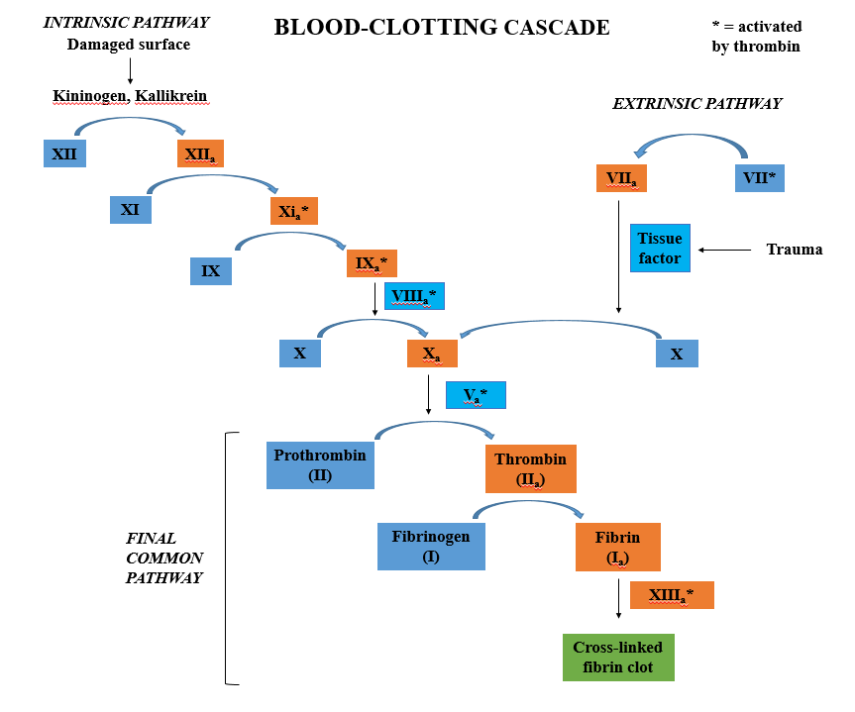
Notes:
Even if some components of this complex cascade are missing, blood can still clot. It is redundant because clotting is so important for survival.
https://commons.wikimedia.org/wiki/File:Blood_Clotting_Cascade.png
Jcchem183, CC BY-SA 4.0 <https://creativecommons.org/licenses/by-sa/4.0>, via Wikimedia Commons

Slide 15
Clot Retraction
The first step of dissolving the clot
This process helps bring broken blood vessel edges together
Clot begins to shrink

Slide 16
Clot lysis/dissolution
Final stage of clot breakdown
Sequence of steps
injured tissues slowly release a chemical called t-PA which helps the body digest fibrin and the clot starts to dissolve
Plasmin is activated to help dissolve clot

Slide 17
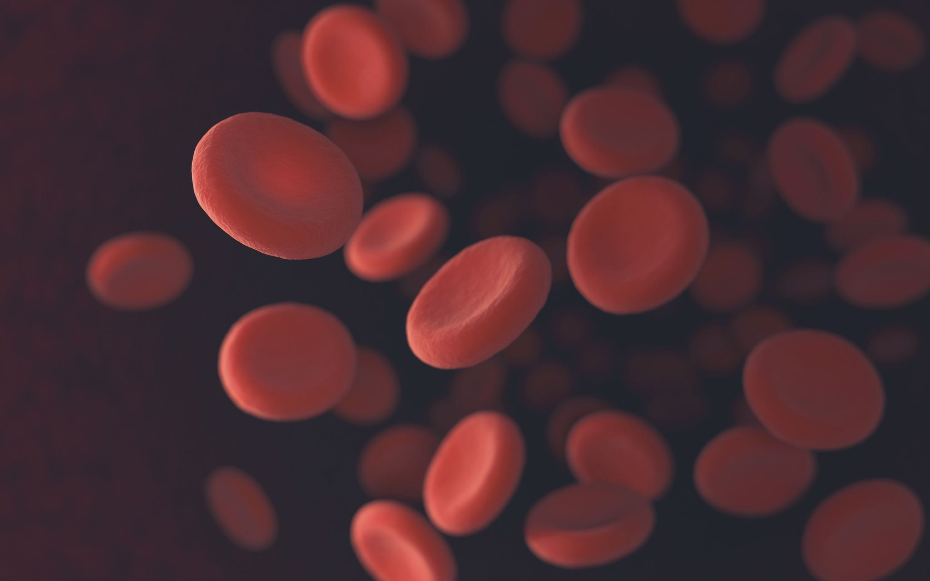
Think about it…
How does blood move in an artery vs. in a vein?
Notes:
Artery walls are lined with smooth muscle that helps push blood out to the body, they are thicker than vein walls
Vein walls have almost no muscle, but skeletal muscle of surrounding tissues (like calves) and valves help blood move back to the heart

Slide 18
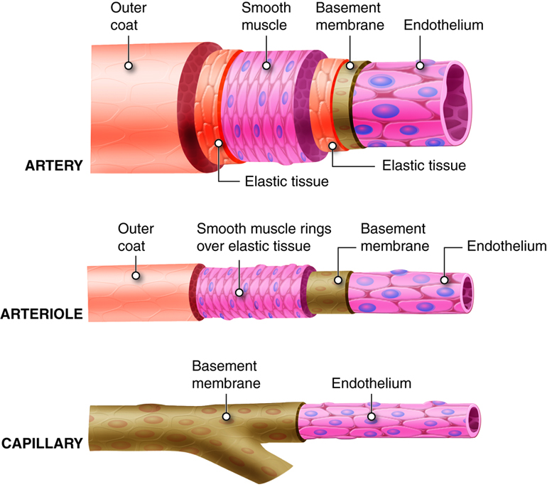
Notes:
Artery structure
https://pressbooks.ccconline.org/bio106/chapter/cardiovascular-structures-and-functions/

Slide 19
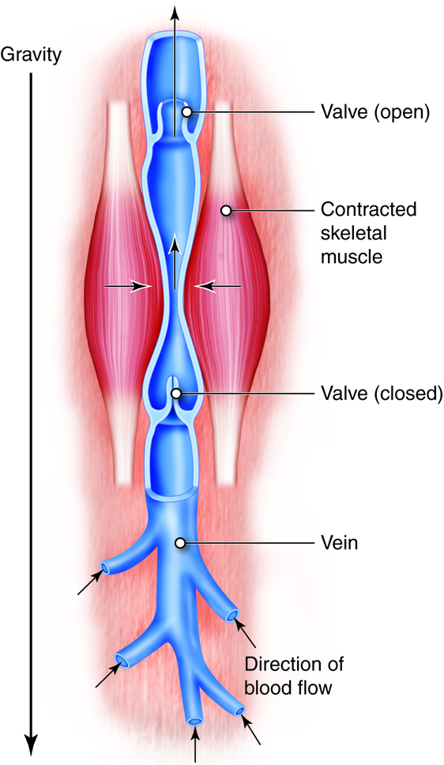
Notes:
Vein structure. Note the valves and skeletal muscle contracting. Valves stop blood from flowing backward
https://pressbooks.ccconline.org/bio106/chapter/cardiovascular-structures-and-functions/

Slide 20
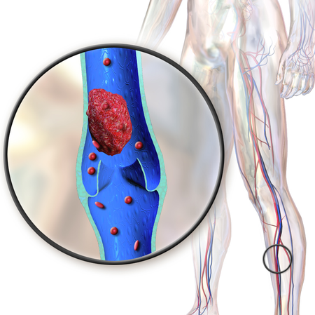
Venous Thromboembolism (VTE)
Notes:
Major concern in nursing, especially for inpatient populations
https://commons.wikimedia.org/wiki/File:Blausen_0290_DeepVeinThrombosis.png

Slide 21
VTE
Risk factors: immobility, bedrest, cancer, myocardial infarction (MI), excess of estrogen (i.e. birth control pills), smoking, obesity, surgery, heart failure, sepsis, pregnancy and post-partum.
Occurs when blood flow slows or stops and blood accumulates
Platelets and clotting factors aren’t as mobile so they stick together and the body’s clot inhibitors can’t bind to that clot as easily
Puts patient at high risk for stroke & thromboemboli (lung clot)
Treatment: heparin, lovenox or other drugs. Compression stockings, sequential compression devices, and best of all… ambulation

Slide 22
Who is at risk for bleeding?
Deficient in platelets or von willenbrand factor
Liver failure - means enough clotting factors are not made in the liver
Low platelets from low production in bone marrow from leukemia, aplastic anemia, radiation, chemo, other blood cancers, or another condition like DIC, TTP

Slide 23
S/S of thrombocytopenia or a bleeding disorder
Nosebleed (epistaxis)
Petechiae/purpura (cluster of petechiae)
Bleeding gums
Excessive vaginal bleeding
Bloody stools (melena) or vomiting blood (hematemesis)
Enlarged spleen
Biggest concern – intracranial hemorrhage (brain bleed)
Notes:
Petechieae tiny purple spots under the skin
Large spleen d/t it having to break down extra blood components if platelets are being destroyed in excess
Intracranial hemorrhage can occur spontaneously if platelets are very low
I work on a blood cancer/bone marrow transplant unit and many of our patients have very low platelet counts, and so a huge concern we have is about patients falling. patients whose platelets are below 10,000 we automatically consider them a fall risk until we can get their platelet count to at least above 10,000

Slide 24
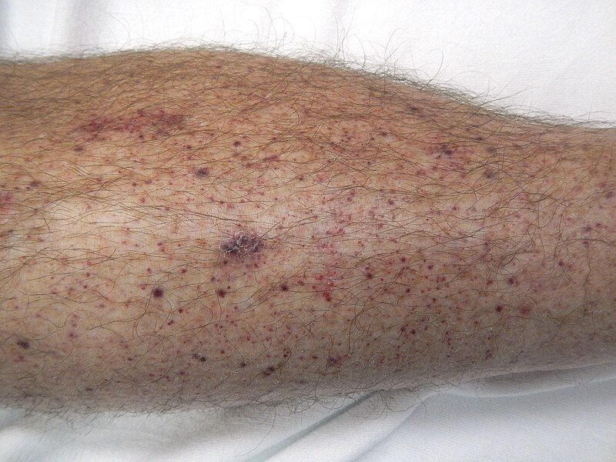
petechiae
Notes:
An example of petechiae
https://commons.wikimedia.org/wiki/File:Petechia_lower_leg.jpg

Slide 25
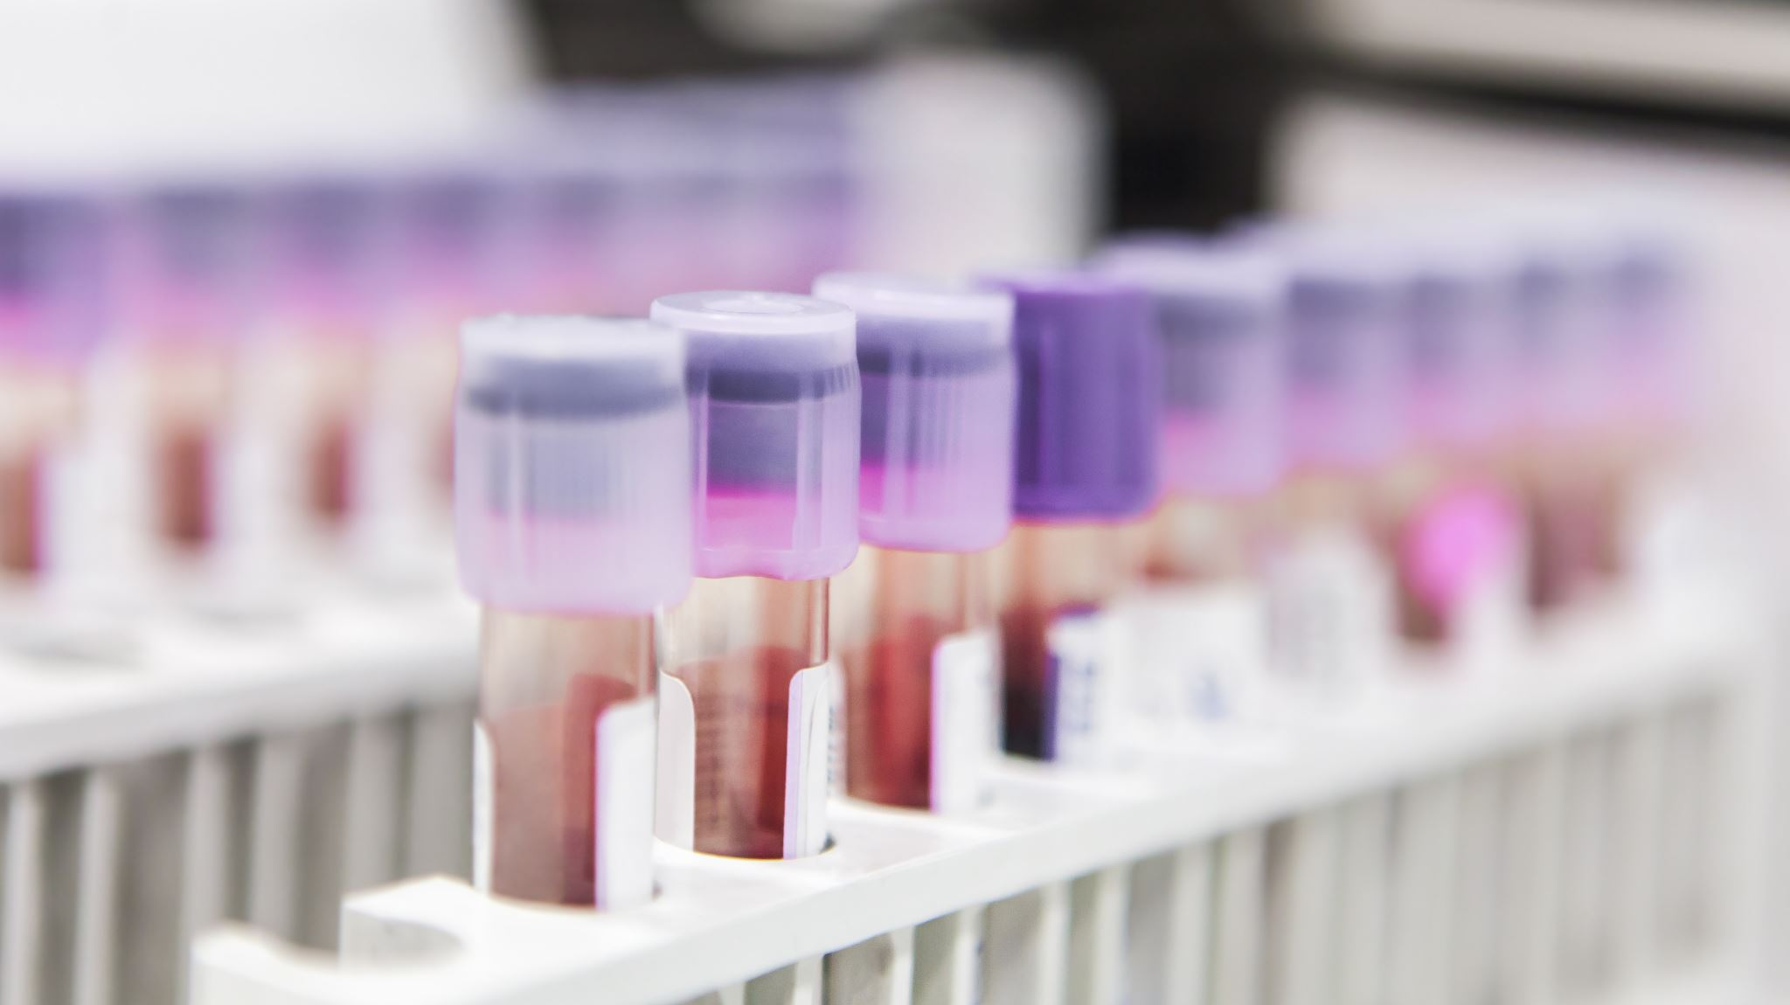
Lab values of someone with a bleeding disorder
Low platelet count
low pTT/INR
Notes:
Other more specific values depending on what’s going on such as measuring specific clotting factor levels, fibrinogen, d-dimer, etc.

Slide 26
Immune thrombocytopenic purpura (ITP)
Autoimmune disorder or acquired after an infection (ex: hep c, HIV, H. pylori)
Body forms antibodies against platelets
Plt formation can be inhibited, and platelets destroyed
Occurs mostly in children, sometimes they can outgrow this disorder
s/s – bruising, gums bleeding, splenomegaly, epistaxis, platelet counts less than 30,000
Some cases are mild and some are more severe, requiring splenectomy, immunosuppressant drugs
Some cases can resolve w/o treatment

Slide 27
Thrombotic thrombocytopenia purpura (TTP)
Combo of Thrombocytopenia, hemolytic anemia
Rare
Sometimes genetic but more often acquired from an infection
Caused by a deficiency in ADAMTS 13 enzyme that prevents clotting
People get clots in their vascular system because of overactive clotting, but will have bleeding elsewhere because their platelets are used up
These small clots can lead to organ damage
Will see s/s of anemia
Treatment: plasmapheresis
Notes:
Plasmapheresis is kind of like dialysis, their plasma is taken into a machine that gets rid of it and replaced with plasma that has the ADAMTS 13 enzyme that the patient needs

Slide 28
Heparin Induced thrombocytopenia (HIT)
About 10% of those who receive Heparin have mild HIT, about 1-5% can have life threatening response
Immune response to the drug Heparin and body’s own platelet factor 4 leads to increased platelet activation
leads to excessive coagulation and subsequent bleeding risk (when all other clotting factors used up)
Positive feedback loop
Treatment: stop Heparin! And use a different anticoagulant if appropriate.

Slide 29
Hemophilia
X linked recessive disease
Affects mostly males
Caused by a deficient clotting factor
  Factor VIII in hemophilia A (more common)
  Factor IX in hemophilia B
Causes bleeding in joints or elsewhere in body. Bleed very easily
Women who carry this trait are not affected
Important to prevent trauma in these pts. Avoid aspirin or NSAIDS
Can replace factor VIII
Currently no cure

Slide 30
Disseminated Intravascular Coagulation (DIC)
A serious complication- overreaction of the inflammatory response from a prior tissue or endothelial injury
Begins when the intrinsic and/or extrinsic pathway is activated, but response is abnormal
Can arise from these conditions: obstetric complications (50% of cases) infection, burns, shock, trauma, surgery, malignant tumors, snake bite, and more
Notes:
Remember how complicated the clotting cascade was? DIC is basically what would happen if that all went wrong

Slide 31
DIC continued
Excessive thrombi are formed and use up all the clotting factors available resulting in microthrombi which block small blood vessels including those of organs resulting in ischemia and organ failure. Then hemorrhagic bleeding occurs because there are no available plts/ clotting factors any longer.
See s/s of bleeding or clotting such as blood oozing from puncture sites
Treatment- treat underlying cause!! protect airway, IV fluids and blood products, heparin gtt

Slide 32

Video explaining DIC
https://www.youtube.com/watch?v=QEkVv1lrDyo
Notes:
(about 11 mins long)

Slide 33
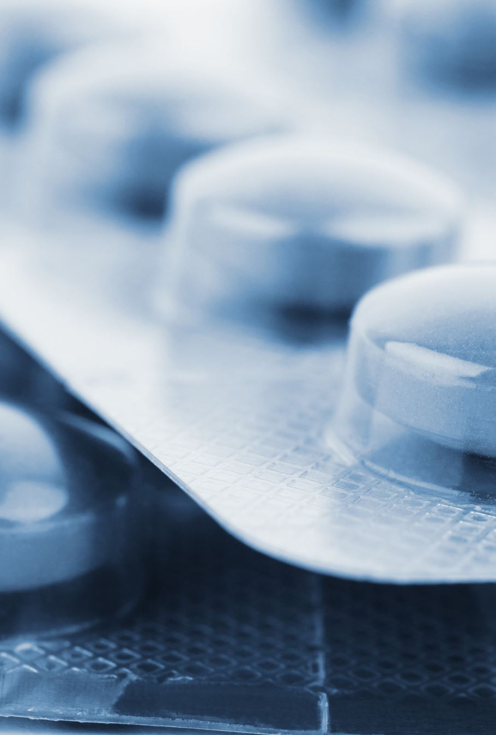
Drugs
Aspirin, copidogrel (Plavix) – platelet inhibitors
Warfarin – decreases coagulation factors and makes vitamin K less usable
Heparin – body makes some of this naturally. Suppresses fibrin formation and decreases availability of clotting factors
Notes:
Lovenox is a derivative of heparin but is not associated with HIT as much.

Slide 34
nutrition corner
https://www.youtube.com/watch?v=pQ88YcR6ASI
https://www.youtube.com/watch?v=hBbQ7kNdND0
https://www.youtube.com/watch?v=Og5umU7VWXY
https://www.youtube.com/watch?v=rRmwSjWq7qY
Strawberries, kiwis, berries, onions, garlic, tomatoes, and more have anti-clotting properties with less risk of bleeding than with medications. These foods can result in reduced mortality from thrombotic events!

Slide 35
References
Norris, T. L. & Tuan, R. L. (2020). Porth’s Essentials of Pathophysiology (5th edition). Wolters Kluwer.

