Slide 1
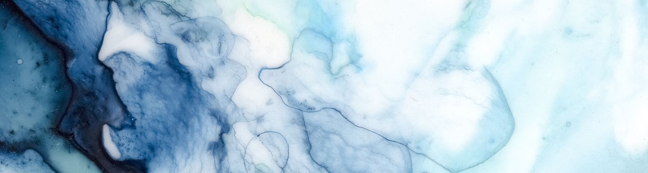
Part 2: Fluids
Dr. Kristina Buszta CRNA
Part 1: Pathophysiology of Electrolytes
Part 2: Fluids
Part 3: Acid-Base balance
Notes:
Hi everyone my name is Dr. Kristina Buszta Nurse Anesthetist, this lecture will review fluids, it is part 2 of a 3 part series.

Slide 2
Overview
Definitions
Fluid compartments
Intracellular vs extracellular concentrations of electrolytes
Hydrostatic pressure
Osmosis
Osmotic pressure
Tonicity
Composition of body fluid
Fluid shifts
Edema & third spacing
Fluid loss
Notes:
I will review definitions used through the lecture, fluid compartments, electrolyte concentrations, hydrostatic and osmotic pressure, osmosis, tonicity, composition of body fluids, fluid shifts, edema and third spacing and fluid losses

Slide 3
Definitions
Hydro – presence of excessive fluid (hydrothorax)
Ascites – accumulation of fluid in peritoneal cavity
Effusion – accumulation of fluid (blood, plasma, pus, or ECF) in serous cavities
Colloid – large molecular weight particle, in blood the colloid is plasma proteins
Notes:
You will see prefix hydro meaning the presence of excessive fluid such as HYDROTHORAX
Ascites is fluid accumulation specific to the peritoneal cavity
Effusion is an accumulation of any fluid in a serous cavity such as pleural effusion or pericardial effusion

Slide 4
Fluid compartments
Stored Intracellularly or extracellularly
  2/3 body fluid is contained intracellularly (ICF)
    High amounts of K⁺ and Phosphate HPO²⁻₄
  1/3 is contained extracellularly (ECF) – within blood vessels as plasma and interstitial space
    High amounts of Na⁺ , Cl⁻, Proteins
    Moderate amounts of HCO₃⁻
    Small amounts of K⁺ , MG⁺ , Po₄⁻³ , Ca⁺
Notes:
You do need to know basics of electrolytes, which is part 1 of this lecture series.
There are two fluids compartments, intracellular and extracellular. 2/3 of body fluid is intracellular which contains high amounts of potassium and phosphate.
The other 1/3 of body fluids are contained extracellularly, within blood vessels as plasma and interstitial space. The composition of extracellular fluid is mostly sodium, chloride and proteins.
Why is it relevant that there is a high amount of potassium intracellularly? Because of fluids shifts through cellular membranes via sodium/potassium pump.
Also real world example: Occasionally see abnormally high potassium lab values on tough lab draws where cells are broken up and potassium is released into extracellular space.
Note interstitial space – when this compartment is fluid overloaded is is often called ‘third spacing’
Adapted from
Lippincott CoursePoint Enhanced for Porth's Essentials of Pathophysiology
Tommie L. Norris chapter 8 disorders of fluid and electrolyte balance

Slide 5
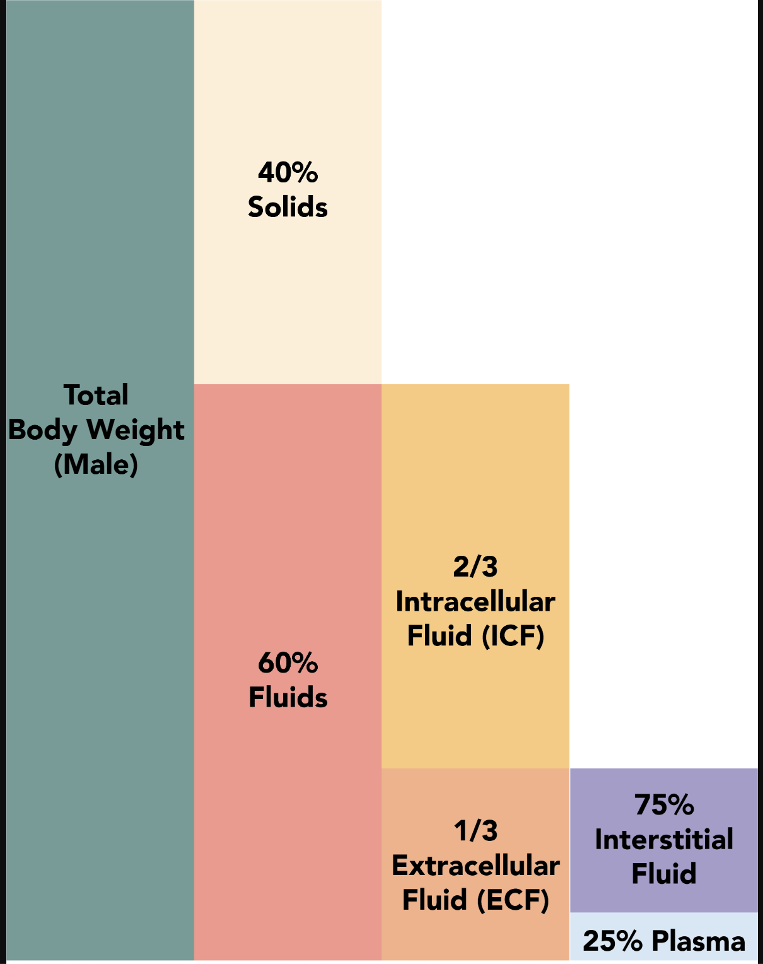
Body components
Fluid compartments are intracellular or extracellular
Extracellular is composed of interstitial fluid and plasma
Fluid composition of the body
Alan Sved and David Walsh
https://commons.wikimedia.org/wiki/File:Fluid_composition_of_the_body_1.3.png
CC By SA

Slide 6
Extracellular vs intracellular concentrations of electrolytes
Electrolyte | Intracellular Concentration | Extracellular Concentration (mmol/L)
Sodium | 10 – 14 mEq/L | 135- 145 mEq/L
Potassium | 140 – 150 mEq/L | 3.5 – 5.5 mEq/L
Chloride | 3 – 4 mEq/L | 98– 106 mEq/L
Bicarbonate | 7 – 10 mEq/L | 24 – 31 mEq/L
Phosphorus | varies | 2.5 – 4.5 mg/ dL
Calcium | < 0. 25 mmol/L | 8.5 – 10.5 mg/dL
Magnesium | 40 mEq/kg | 1.8 – 3.0 mg/L
Notes:
Here is a review of the concentration of electrolytes in intracellular vs extracellular compartments
Many intracellular proteins are negatively charged and attract positively charged Potassium ions, which is why potassium is so high intracellularly.

Slide 7
Hydrostatic pressure: what is it and why do we care
Pressure of a fluid against the walls
Hydrostatic pressure causes fluid shifts between compartments
Hydrostatic pressure is exerted by pumping of the heart – this is what composes blood pressure
At the capillary level hydrostatic pressure is greatest at the arterial bed, forcing filtration out of the blood vessel
At the venous end of the capillary bed, the hydrostatic pressure is less than surrounding tissue, allowing reabsorption back into the blood vessel
Notes:
The simplest definition of hydrostatic pressure is the pressure of fluid against vessel walls. It causes fluid shifts between the intracellular and extracellular compartments. The pressure originates by the pumping heart, which composes blood pressure. At the capillary level hydrostatic pressure is greatest at the arterial bed, forcing filtration out of the blood vessel.
At the venous end of the capillary bed, the hydrostatic pressure is less than the surrounding tissue, allowing reabsorption back into the blood vessel.
Hydrostatic pressure is especially important in governing the movement of water in the nephrons of the kidneys to ensure proper filtering of the blood to form urine. As hydrostatic pressure in the kidneys increases, the amount of water leaving the capillaries also increases, and more urine filtrate is formed. If hydrostatic pressure in the kidneys drops too low, as can happen in dehydration, the functions of the kidneys will be impaired, and less nitrogenous wastes will be removed from the bloodstream. Extreme dehydration can result in kidney failure.

Slide 8
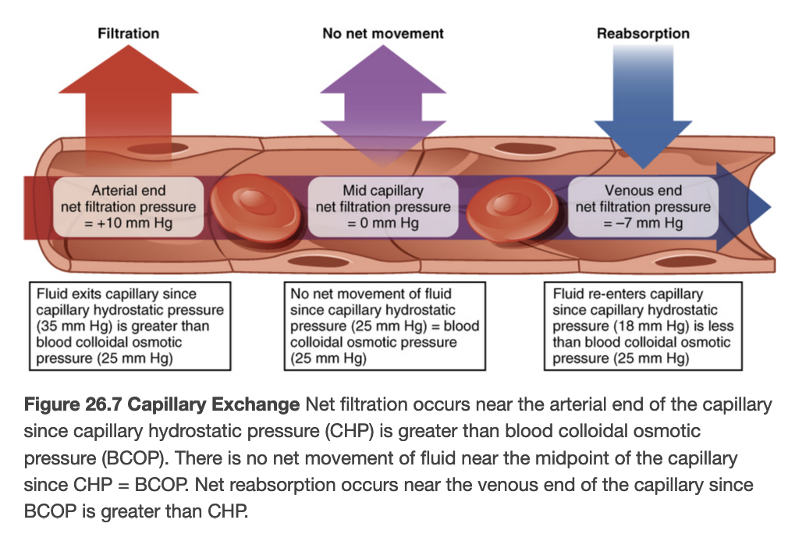
View of hydrostatic pressure at capillary bed
Anatomy and physiology
Openstax
https://openstax.org/books/anatomy-and-physiology/pages/26-introductionCreative commons Attribution
Notes:
Here is a view of hydrostatic pressure at work, you can see at the arterial bed, far left, hydrostatic pressure is greatest, causing filtration.
because hydrostatic pressure is even at the mid capillary area there is no movement.
at the venous end there is less hydrostatic pressure inside the blood vessel that the surround tissues which allows for reabsorption back into the blood vessel.
This image discusses osmotic pressure which is a pressure caused by proteins also known as colloids within the blood that causes a pull inward. When Hydrostatic pressure is greater than osmotic pressure, filtration occurs.
When osmotic pressure at the venous end is greater than hydrostatic pressure, reabsorption occurs.
This is how disease states like low albumin, or low proteins can cause edema. The blood vessel is lacking the osmotic pull inwards.
Anatomy and physiology chapter 26

Slide 9
Osmosis of fluids
Osmotic gradient is caused by difference in solute concentration on either side of semi-permeable membrane
Example: water will move from where concentration of solutes is high to lower concentration of solutes.
As water moves across membrane it generates OSMOTIC PRESSURE
Water moves by osmosis from plasma to the interstitial fluid and vice versa
Notes:
An osmotic gradient is produced when there is a difference of concentration of solutes on either side of a membrane

Slide 10
Osmotic pressure
The degree of osmotic pressure is the hydrostatic pressure needed to move water across the membrane
OSMOLE: The pull caused by non-diffusible particles on one side of the semi-permeable membrane
Expressed as 1 thousandths of an osmole (millisomoles) per liter (refers to fluids outside the body)
OsmolaRITY: osmolar concentration in 1 liter of solution
OsmoLALITY is osmolar concentration in 1kg of water (used when referencing fluids inside the body)
Notes:
The number of non-diffusible particle determines the osmotic activity of a solution
Serum osmolality is 275 – 295 Mosm/kg

Slide 11
Tonicity
Tension that the osmotic pressure of a solution with non diffusible solutes exerts on cell size because of water movement across the cell membrane.
Example Glucose
  Can’t penetrate cell membrane but pulls water out of cell, causing an osmotic force.
Notes:
Tonicity refers to the osmotic pressure of a solution with non-diffusible solutes, these solutes exert pressure on a cell to influence the size of the cell due to water movement across the cell membrane.

Slide 12
Tonicity of fluids
Does solution cause cells to shrink? Swell? Or not change cells water content?
Hypertonic – has high than normal tonicity, pulling water from the cell, causing cell to shrink
Hypotonic- has lower osmolality than Intercellular fluid, causes cells to swell because water is pulled into cell
Isotonic – has same tonicity as the solution, does not cause change in water content of cells
How does this impact cells in the body?
Notes:
Different fluids have different tonicity- causing cells to shrink, swell or cause no change in cell size.
A hypertonic solution is one that has higher than normal tonicity that causes water to be pulled from the cell and results in cell shrinking.
A hypotonic solution has a lower osmolality than intracellular fluid and causes cells to swell because water is forced into the cell.
An isotonic solution is one with the same tonicity as intercellular fluid, causing no change in cell size.
Example of isotonic solution, one that has the same osmolality as the intracellular fluid is 0.9% sodium chloride

Slide 13
Replacement solutions
Intravenous fluids
  all isotonic
  To replace fluids in the extracellular space
  Example:
    Plasmalyte (compatible with blood)
    0.9% normal saline (compatible with blood)
    Lactated ringers/ Ringers lactacte (not compatible with blood)
Other intravenous solutions used
  Albumin (Colloid)
  Hypertonic saline
  Half normal saline
  Dextrose containing solutions
  Dextran and hetastarch (colloid)
Notes:
To briefly touch on IV fluids, they are all to replace fluids in the extracellular compartment and are isotonic such as plasmalyte, normal saline, lactated ringers. Any iv fluids that contain dextrose or calcium are contraindicated with blood product because the mixing with citrate in the blood transfusion with calcium causes clotting. Dextrose will cause cell breakage also known as hemolysis.
For the other iv solutions you can see used, a few of them are listed here.
The colloids, remember are the higher molecular weight substances such as albumin, hetastarch and dextran. They will stay intravascularly which is helpful when replacing fluid losses, not blood loss since there is not hemoglobin or cells in these fluids and treating hypotension.
Other solutions are hypertonic saline, half normal saline and dextrose containing solutions.
More info: https://med.libretexts.org/Bookshelves/Anatomy_and_Physiology/Fluid_Physiology_(Brandis)/08%3A_Applied_Physiology_of_Transfused_Fluids/8.01%3A_Infusion_of_Isomolar_Fluids

Slide 14
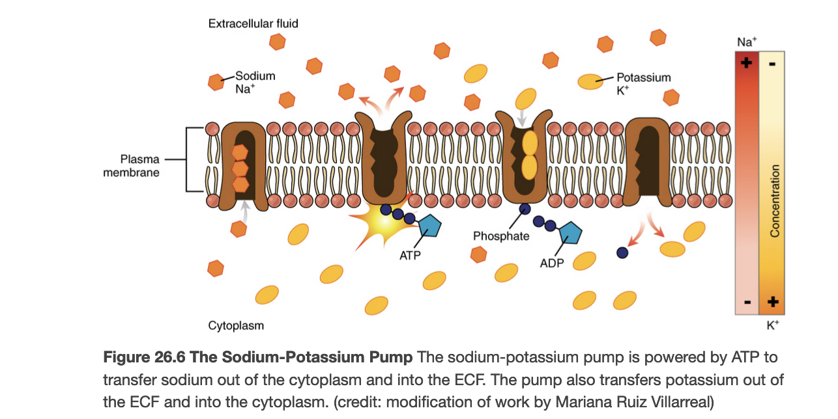
Fluid Shifts
Fluid shifts
  Cell membrane not permeable to + and – ions – use pump to change gradients ( aka diffusion)
  Na/K pump located in cell membrane to exchange sodium and potassium
    Requires energy in form of atp
  Aquaporins transport water by osmosis through cell membrane
Anatomy and physiology
Openstax
https://openstax.org/books/anatomy-and-physiology/pages/26-introductionCreative commons Attribution
Notes:
Third spacing photo - https://nurseyourownway.com/2020/05/10/intracellular-versus-extracellular-space-theres-a-third-space/
Cell membrane is the barrier between ions as well as lipid soluble substances like oxygen and carbon dioxide which dissolve and pass through the lipid bilayer of a cell membrane.
Ions move from areas of higher concentration to lower concentrations.
High levels of sodium is required in the extracellular space and high levels of potassium are maintained in the intracellular space by the sodium potassium channels AKA sodium/potassium pump.

Slide 15
Edema
Edema is caused by increased capillary pressure, decreased colloidal osmotic pressure, increased capillary permeability or obstruction of lymphatic flow
Can be in brain, larynx, lungs – life-threatening
Can also be in peripheral tissues (pitting edema) causing decrease movement, oxygen transport, nutrient and waste exchange
Notes:
Pitting edema occurs when there is fluid overload in the interstitial space.
Edema can be Seen in heart failure, kidney disease, sodium retention, pregnancy, environmental heat stress; by venous obstruction like in pulmonary edema or liver disease with portal vein obstruction or decreased arteriolar resistance seen with calcium channel blocking drugs. Decreased colloidal osmotic pressure will cause an increased loss of plasma proteins or decreased production of plasma proteins (seen in burns or protein wasting kidney disease, liver disease or malnutrition).
Increased capillary permeability will cause edema due to inflammation, allergic reactions, ascites, tissue injury or burns. Lastly obstruction of lymphatic flow can cause pitting edema when there has been surgical removal of lymph nodes on cancer related obstruction of lymphatic structures.
https://commons.wikimedia.org/wiki/File:Fluid_composition_of_the_body_1.3.png

Slide 16
Third spacing
Impaired fluid transport out of the Extracellular fluid and into the transcellular fluid space
Caused by overactivated inflammatory response (SIRS), pancreatitis, hypoalbuminemia which is part of severe liver failure, and third-degree burns.
Notes:
Third spacing is caused by increased extracellular fluid in the transcellular space.
It can be seen in Systemic inflammatory response syndrome, pancreatitis, hypoalbuminemia which is part of severe liver failure, and third-degree burns.

Slide 17
Fluid loss
Kidneys and GI tract
Sweat
Dehydration/vomiting/diarrhea/fever
Insensible loss
  From lungs (breathing)
  Evaporation from skin
Notes:
Most sodium loss occurs through kidneys, which function to release to retain sodium. Other sodium losses occur with vomiting, diarrhea, gastrointestinal suction and sweating. Sodium functions to regulate the extracellular volume since it is the major cation in that compartment. Chloride and bicarbonate also add to the osmotic activity in the Extracellular fluid.
100 milliliters of water is required for each 100 calories to metabolize and eliminate metabolic wastes, this increased 12% for every 1-degree Celsius increase in body temperature. This is seen in fever which also increases respiratory rate which results in increase in insensible water loss through breathing and through the skin as in evaporation. Insensible is the term we use to mean we are unaware of it. Insensible loss is only water, not solutes, loss.

Slide 18
Fluid gains
Oral intake
Metabolic processes that generate small amount of water
Renin angiotensiongen system
Notes:
Cellular dehydration caused by an increase in Extracellular osmolality and a decrease in blood volume trigger a thirst center in the hypothalamus. Another stimulus for thirst is circulating angiotensin II from the kidneys. This is released in response to low blood volume and blood pressure. Thirst sensation decreases with age, head trauma, cranial tumors, hydrocephalus and subarachnoid hemorrhage.
Polydipsia is excessive thirst are due to water losses associated with diarrhea, vomiting, diabetes mellitus and insipidus. May also persist despite adequate hydration in people with congestive heart failure, diabetes mellitus and chronic kidney disease.
Cells of brain and nervous systems are most affected by increases in intracellular water, symptoms include apathy, lethargy, headache progressing to disorientation, confusion, gross motor weakness and depression of deep tendon reflexes and eventually seizures and coma this is known as water intoxication.

Slide 19
Quiz
1. In the capillary bed, where is hydrostatic force out of the blood vessel highest?
2. Will a hypotonic solution cause cells to shrink or swell?
3. What are the three compartments of the extracellular fluids?
4. Fluid accumulation in the transcellular space is also know as?
5. Where is most sodium/water loss from?
Notes:
At the arterial bed
Swell
Interstitial, plasma and transcellular
Third spacing
kidneys

Slide 20
References
Norris, T. L. (2019). Disorders of fluid and electrolyte balance. Wolters Kluwer Health https://thepoint.lww.com/Book/Show/897101

