Slide 1
Part1: Pathophysiology of electrolytes
Dr. Kristina Buszta CRNA
Part 1: Pathophysiology of Electrolytes
Part 2: Fluids
Part 3: Acid-Base Balance
Notes:
I’d like to share the basics of electrolytes and some of the pathophysiology associated with electrolyte disturbances. This is part of a three part series and each compliment one another. I recommend listening in numerical order.

Slide 2
overview
Terms/definitions
Review of basic fluids and electrolytes
  Cations - Sodium, potassium, calcium, magnesium, hydrogen
  Anions – chloride, bicarbonate
  Normal values of each
Abnormalities of electrolytes
  Causes of Hyper/hypo electrolyte imbalances
  Signs and symptoms
D. Case scenarios
Quiz
Notes:
This lecture will go over terms used with electrolytes, a breakdown of what electrolytes, electrolyte disturbances sign/symptoms, case scenarios and lastly a quiz.

Slide 3
Definition of electrolytes
Substances that separate in solution to form charged particles
Cations- positively charged ions noted with X⁺
Anions – negatively charged ions noted with X⁻
Measurement of electrolytes is noted as the concentration or amount in each volume of fluid
  Milligrams per deciliter weight of the solute in one tenth of liter mg/dL
  Milliequivalents per liter shows the charge equivalency for given weight of electrolyte mEq/L
  Millimoles per liter, is one thousandth of a mole (the molecular weight of a substance expressed in milligrams) mmol/L
Notes:
The simplest definition of an electrolyte is a substance that separates to form a negative or positively charged particle. Cations are positively charge ions with a superscript plus sign. And Anions are the opposite, negatively charged particles with a superscript minus sign.
When you see values of electrolytes the are written as the concentration in a volume of fluid. This can be written as milligrams per deciliter, milliequivalents per liter or millimoles per liter. You can see how those are abbreviated here in bold.

Slide 4

Review of cations
Na⁺ Sodium purpose is to maintain blood pressure, blood volume and pH values
  Normal values 135 – 145 mEq/L
K⁺ Potassium Purpose to maintain heart and muscle contraction
  Normal values 3.5 – 5.5 mEq/L measured in extracellular fluid
Notes:
Starting with cations, sodium and potassium. You will note in bold how each electrolyte is abbreviated.
Sodium's purpose is to maintain blood pressure, blood volume and pH values. Normal values are 135 – 145 milliequivalents per liter.
Potassium is for heart and muscle contractions, normal values are 3. 5 – 5.5 milliequivalents per liter. Both of these correspond to electrolyte values in the extra cellular fluid which is covered in lecture 2 Fluids.
Here is an app with a free feature for lab values

Slide 5
Cations continued
Mg⁺ Magnesium purpose to maintain contraction and relaxation of muscles (deep tendon reflexes, heart and uterus)
  Normal values 1.3 – 2.1 mEq/L
  Required for vitamin D and calcium absorption
  Best friends with calcium
Ca⁺ Calcium purpose is to strengthen bones, clotting factor and cardiac muscle strength
  Normal values 9 - 10.5 mEq/L
Notes:
Magnesium also maintains contraction and relaxation of muscles, both smooth and skeletal like the heart and uterus. Normal extracellular values are 1. 3 – 2.1 mEq/L. it is necessary for vitamin D and Calcium absorption and works closely with calcium at the cellular level.
Calcium works in the heart on muscle strength, while the other electrolytes work in the heart on electric conduction (potassium, sodium). It also maintains bone strength and contributes to clotting factors. Normal extracellular values are 9 – 10.5 milliequivalents per liter.

Slide 6
Review of anions
Ch⁻ Chloride – follows sodium, main function same as sodium maintain pH, blood volume and blood pressure
  normal value 97 – 107
HCO₃⁻ Bicarbonate – aka carbonic acid – maintains body pH system by acting as a buffer
  Normal value 22-29 mMol
Po₄⁻³ Phosphate purpose is to regulate calcium bone and teeth formation
  Normal value 3 – 4mg/dl
Notes:
The negatively charged electrolytes, or anions are chloride, bicarbonate and phosphate.
Chloride follows sodium with the same functions, blood pressure, blood volume and pH.
Bicarbonate is also known as carbonic acid and plays a big role in balancing the acid base system to maintain homeostasis in the pH system. Normal values are 22 – 29 millimoles per liter.
Phosphate helps regulate calcium and normal values are 3 – 4 milligrams per deciliter.
https://youtu.be/N1Db7re91GM
https://openstax.org/books/anatomy-and-physiology/pages/26-3-electrolyte-balance?query=bicarbonate&target=%7B%22index%22%3A0%2C%22type%22%3A%22search%22%7D#fs-id1386356

Slide 7
Electrolyte abnormalities
NA⁺ Sodium
  Hypernatremia > 145 mEq/L
    Signs/symptoms include swollen dry tongue, nausea/vomiting and increase muscle tone
    Seen in dehydration , Cushings syndrome, increased dietary intake, diabetes, excessive diaphoresis, vomiting or hypertonic saline administrations
  Hyponatremia < 135 mEq/L
    s/s neuro: lethargy, seizures and coma
    Seen in AIDS, adrenal insufficiency, congestive heart failure
Notes:
Because sodium is part of the sodium bicarbonate molecule, it is important in regulating acid–base balance. As a current-carrying ion, Na+ contributes to the function of the nervous system and other excitable tissue.
Hyper natremia is when the sodium exceed 145 milliequivilants per liter. The signs and symptoms are dry tongue, nausea and vomiting and increase muscle tone. Disease states that cause hypernatremia are dehydration, Cushings syndrome, an increase in dietary sodium intake, diabetes, excessive diaphoresis (or sweating) and hypertonic saline solutions.
Hyponatremia is when values are less than 135 milliequvilents per liter. The signs and symptoms are primarily neurological: lethargy, seizures and coma. This is seen in AIDS, adrenal insufficiency, and congestive heart failure.
Lippincott CoursePoint Enhanced for Porth's Essentials of Pathophysiology
Tommie L. Norris
Lab Values Reference Lite App for iOS
From merlot

Slide 8
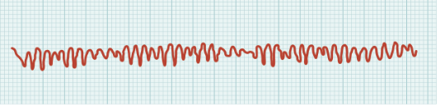
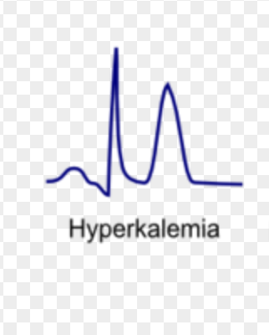
Electrolyte abnormalities
K⁺ Potassium
  Hyperkalemia > 5.5mEq/L
  signs/symptoms:
    heart: ST elevation, peaked T waves, Ventricular fibrillation, hypotension and bradycardia
    GI: diarrhea and hyperactive bowel sounds
    Muscles: paresthesia or numbness, increased deep tendon reflexes
  Seen in acidosis, Addison’s disease, dehydration, infection, renal failure, tissue damage, hemolysis, transfusion of older blood products, Ace inhibitors and angiotensin receptor blocking drugs, NSAIDS, spironolactone
Cardiac arrythmias
https://commons.wikimedia.org/wiki/File:2024_Cardiac_Arrhythmias.jpg
CC by SA
De-T wave morphology
CardioNetworks
https://commons.wikimedia.org/wiki/File:De-T_wave_morphology_%28CardioNetworks_ECGpedia%29.png
CC By SA
Notes:
Potassium derangements are when values fall outside the normal range of 3.5 – 5.5
When you have levels above 5.5 you can see ST elevation and peaked T waves This can progress to ventricular fibrillation like in the figure to the right. This will be accompanied by hypotension and bradycardia.
In the gastrointestinal system you will see diarrhea and hyperactive bowel sounds. And in the muscled you will see parathesis or numbness, increased deep tendon reflexes.
Hyperkalemia is seen in acidosis, Addisons disease, dehydration, infection, renal failure, tissue damage, hemolysis which is seen with difficult blood draws, transfusion of older blood products, ACE inhibitors, and angiotensin receptor blocking drugs. Drugs such as non steroidal anti-inflammatory drugs and spironolactone can also lead to hyperkalemia.

Slide 9

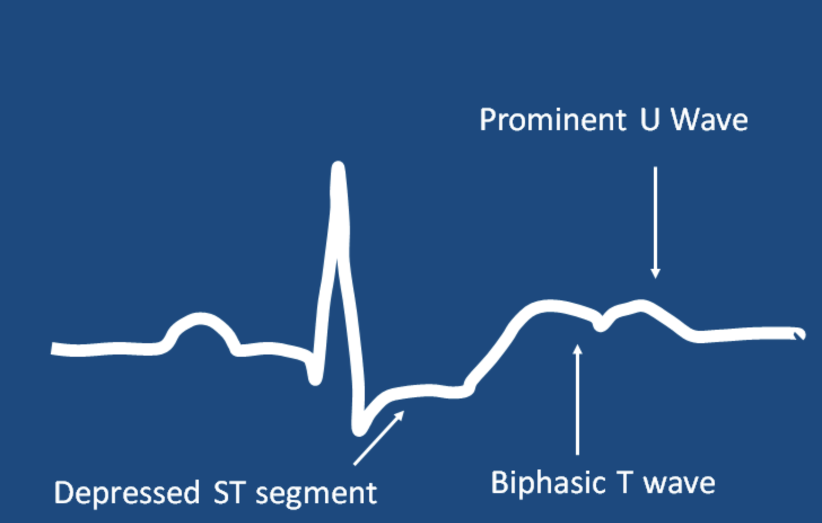
Electrolyte abnormalities
Hypokalemia <3.0 signs/symptoms:
  heart: ‘low and slow’, prominent U-waves, flat T-waves, ST-depression
  GI: decreased motility, constipation, abdominal distention, paralytic ileus
  Muscles: decreased deep tendon reflexes, flaccid paralysis
  Seen in alkalosis, ascites, burns, chronic pyelonephritis, Cushing syndrome, diarrhea, vomiting, diuretics, salicylates, and insulin use
Ecg pattern of Hypokalemia
Open courses tei athinas
https://commons.wikimedia.org/wiki/File:ECG_Pattern_Of_Hypokalemia.png
Notes:
Hypokalemia is when values fall below 3.0 and include low and slow heart function with prominent U waves, flat T waves and ST depression and show in the figure to the right.
In the gastrointintestinal system there will be decreased motility, constipation, abdominal distention and paralytic ileus which means the absent bowel sounds. Iin the muscles you will see decreased deep tendon reflexes and flaccid paralysis. Hypokalemia can be found in alkalosis, acites, burns, chronic pyelnophritis, Cushing Syndrome, diarrhea, vomiting, diuretics, salicylates and insulin use.
Goldberger's Clinical Electrocardiography (Ninth Edition)
A Simplified Approach
2018, Pages 104-113
Chapter 11 - Drug Effects, Electrolyte Abnormalities, and Metabolic Disturbances
https://doi.org/10.1016/B978-0-323-40169-2.00011-1

Slide 10
Electrolyte abnormalities
MG⁺ Magnesium
  Hypermagnessium >2.1meq/L “calm and quiet’
    s/s: heart block, prolonged PR intervals, bradycardia, hypotension
    Hyporeflexia, decreased deep tendon reflexes, slow GI, shallow respirations, confusion
  Hypomagnessium <1.3 meq/L
    s/s torsades de pointes, Ventricular fibrillation, tachycardia, ST depression, T wave inversion
    Hypereflexia, increased deep tendon reflexes, nystagmus, diarrhea, confusion
Notes:
Hypermagnesium is levels greater than 2.1 mEq per liter and can be thought of as everything is calm and quiet. In the heart there will be heart block, prolonged PR intervals, bradycardia and hypotension. You will also see hyporeflexia, decreased deep tendon reflexes, slow GI symptoms, shallow respirations and confusion.
Hypomagnesisum, when levels are less than 1.3 millequivilents per liter will cause torsades de pointes, ventricular fibrillation, tachycardia, ST depression and T wave inversion. You will also see hyperreflexia, increased deep tendon reflexes, nystagmus, diarrhea and confusion

Slide 11


Electrolyte abnormalities
Ca+ Calcium
  Hypercalcemia >10. 5
    s/s: constipation, bone pain, renal calculi, slow deep tendon reflexes, muscle weakness
  Hypocalcemia <9
    s/s: Trousseaus’ sign and Chvosteks signs , circumoral tingling and diarrhea
    Risk for fractures, bleeding and cardiac dysrhythmias
Notes:
Calcium levels above 10.5 will show symptoms of constipation, bone pain, renal stones, slow deep tendon reflexes and muscle weakness
Hypocalcemia, levels below 9, will have trousseaus signs and chvosteks signs, scan the QR code to watch an example of these
You will also see circumoral tingling and diarrhea. Hypocalcemia increases risks of fractures, bleeding and cardiac dysrhythmias.
Scan the QR code

Slide 12
Electrolyte abnormalities
HCO₃⁻ Bicarbonate – one of the body’s pH buffers – related to arterial bicarb level - see acid/base for further details
  Results from carbon dioxide (CO₂) and water (H₂O)
  Low levels of Bicarbonate caused by severe vomiting or diarrhea (metabolic acidosis) or certain diuretics, Addison's disease or chronic nephritis, renal system will adjust to excrete hydrogen ions to conserve Bicarbonate ions
  High levels of Bicarbonate (metabolic alkalosis) due to ingestion of bicarbonate ions, like antacids for acid reflux, or Cushing's disease
Notes:
Bicarbonate is one of the body’s pH buffers, check out the acid base lecture for further details.
Bicarbonate is formed from carbon dioxide and water
Low levels of bicarbonate, less than 22 millimols per liter is caused by severe vomiting or diarrhea, or certain diuretics, Addisons disease, or chronic nephritis. The renal system will adjust to excrete hydrogen ions to conserve bicarbonate ions.
High levels of bicarbonate, greater than 29 millimols per liter can be due to ingestion of bicarbonate ions, like antacids for acid reflux or Cushings disease.
https://openstax.org/books/anatomy-and-physiology/pages/26-3-electrolyte-balance?query=bicarbonate&target=%7B%22index%22%3A0%2C%22type%22%3A%22search%22%7D#fs-id1386356
For more information on how and why the body buffers see lecture 2 on abg
Move bicarbonate to acid base lecture

Slide 13
Electrolyte abnormalities
Po₄⁻³ Phosphate – goes opposite of calcium, if calcium high, phosphate low
  Hyperphosphatemia (aka low calcium) > 4.5 mg/dl
    s/s: Trousseau’s and Chvostek's signs, diarrhea, weak bones, bleeding risk and cardiac dysrhythmias
  Hypophosphatemia (aka high calcium) < 2.8 mg/dL
    S/s: constipation, slow deep tendon reflexes, severe muscle weakness, renal calculi, decrease heart and respiratory rate
Notes:
Phosphate is the opposite of calcium, when one is high the other is low
Hyperphosphatemia is with levels above 4.5 milligram per deciliter you will see Trousseaus and Chvosteks signs, diarrhea, weak bones, increased bleeding risk and cardiac dysrhythmias.
Hypophastemia is levels less than 2. 8 milligrams per deciliter. The signs and symptoms include constipation, slow deep tendon reflexes, sever muscle weakness, renal calculi, and a decreased heart and respiratory rate.

Slide 14
QUiz
1. a patient with kidney failure presents after missing dialysis, He has elevated T waves on EKG, what electrolyte is most likely responsible?
2. Which electrolyte is highest inside the cell?
3. you attempt to draw blood on a patient and it comes out slowly, it is sent to the lab and the potassium comes back >7, why?
4. Most common cause of hypokalemia?
Notes:
hyperkalemia
Potassium
hemolysis of cells, releasing intracellular potassium
diuretics

Slide 15
quiz
5. Chvostek and Trousseau signs are tests for what electrolyte abnormality?
6. what electrolyte is responsible for clotting?
7. water follows which electrolyte?
8. What electrolyte functions to buffer the acid/base system in the body?
Notes:
5. Hypocalcemia
6. Calcium
7. Sodium
8. bicarbonate

Slide 16
References
Anatomy and Physiology, OpenStax, Creative Commons Attribution, https://openstax.org/details/books/anatomy-and-physiology?Book%20details
Norris, T. L. (2019). Disorders of fluid and electrolyte balance. Wolters Kluwer Health https://thepoint.lww.com/Book/Show/897101

