Slide 1
Introduction to Hematology and Anemia
Emily Schad, RN, BSN
Notes:
Hi my name is Emily Schad. I have been an RN for 7 years and have predominantly worked in oncology, hematology, and bone marrow transplant. I’m currently obtaining my masters of science in nursing. I have an interest in pathophysiology and open education. Please enjoy this lecture about introduction to hematology and anemia
I have inserted slides throughout this presentation called “Think about it”. These are intended to challenge you to think about this content as it relates to what you may already know, or to think outside the box. I have enclosed the answers either at the bottom of the slide, in the recording, or in the subsequent slides. If you would like to get the full learning experience of this presentation, please consider hiding the notes section of these ppts and challenge yourself to answer these questions on your own first. Hopefully it will help you better learn the material. Cheers!

Slide 2

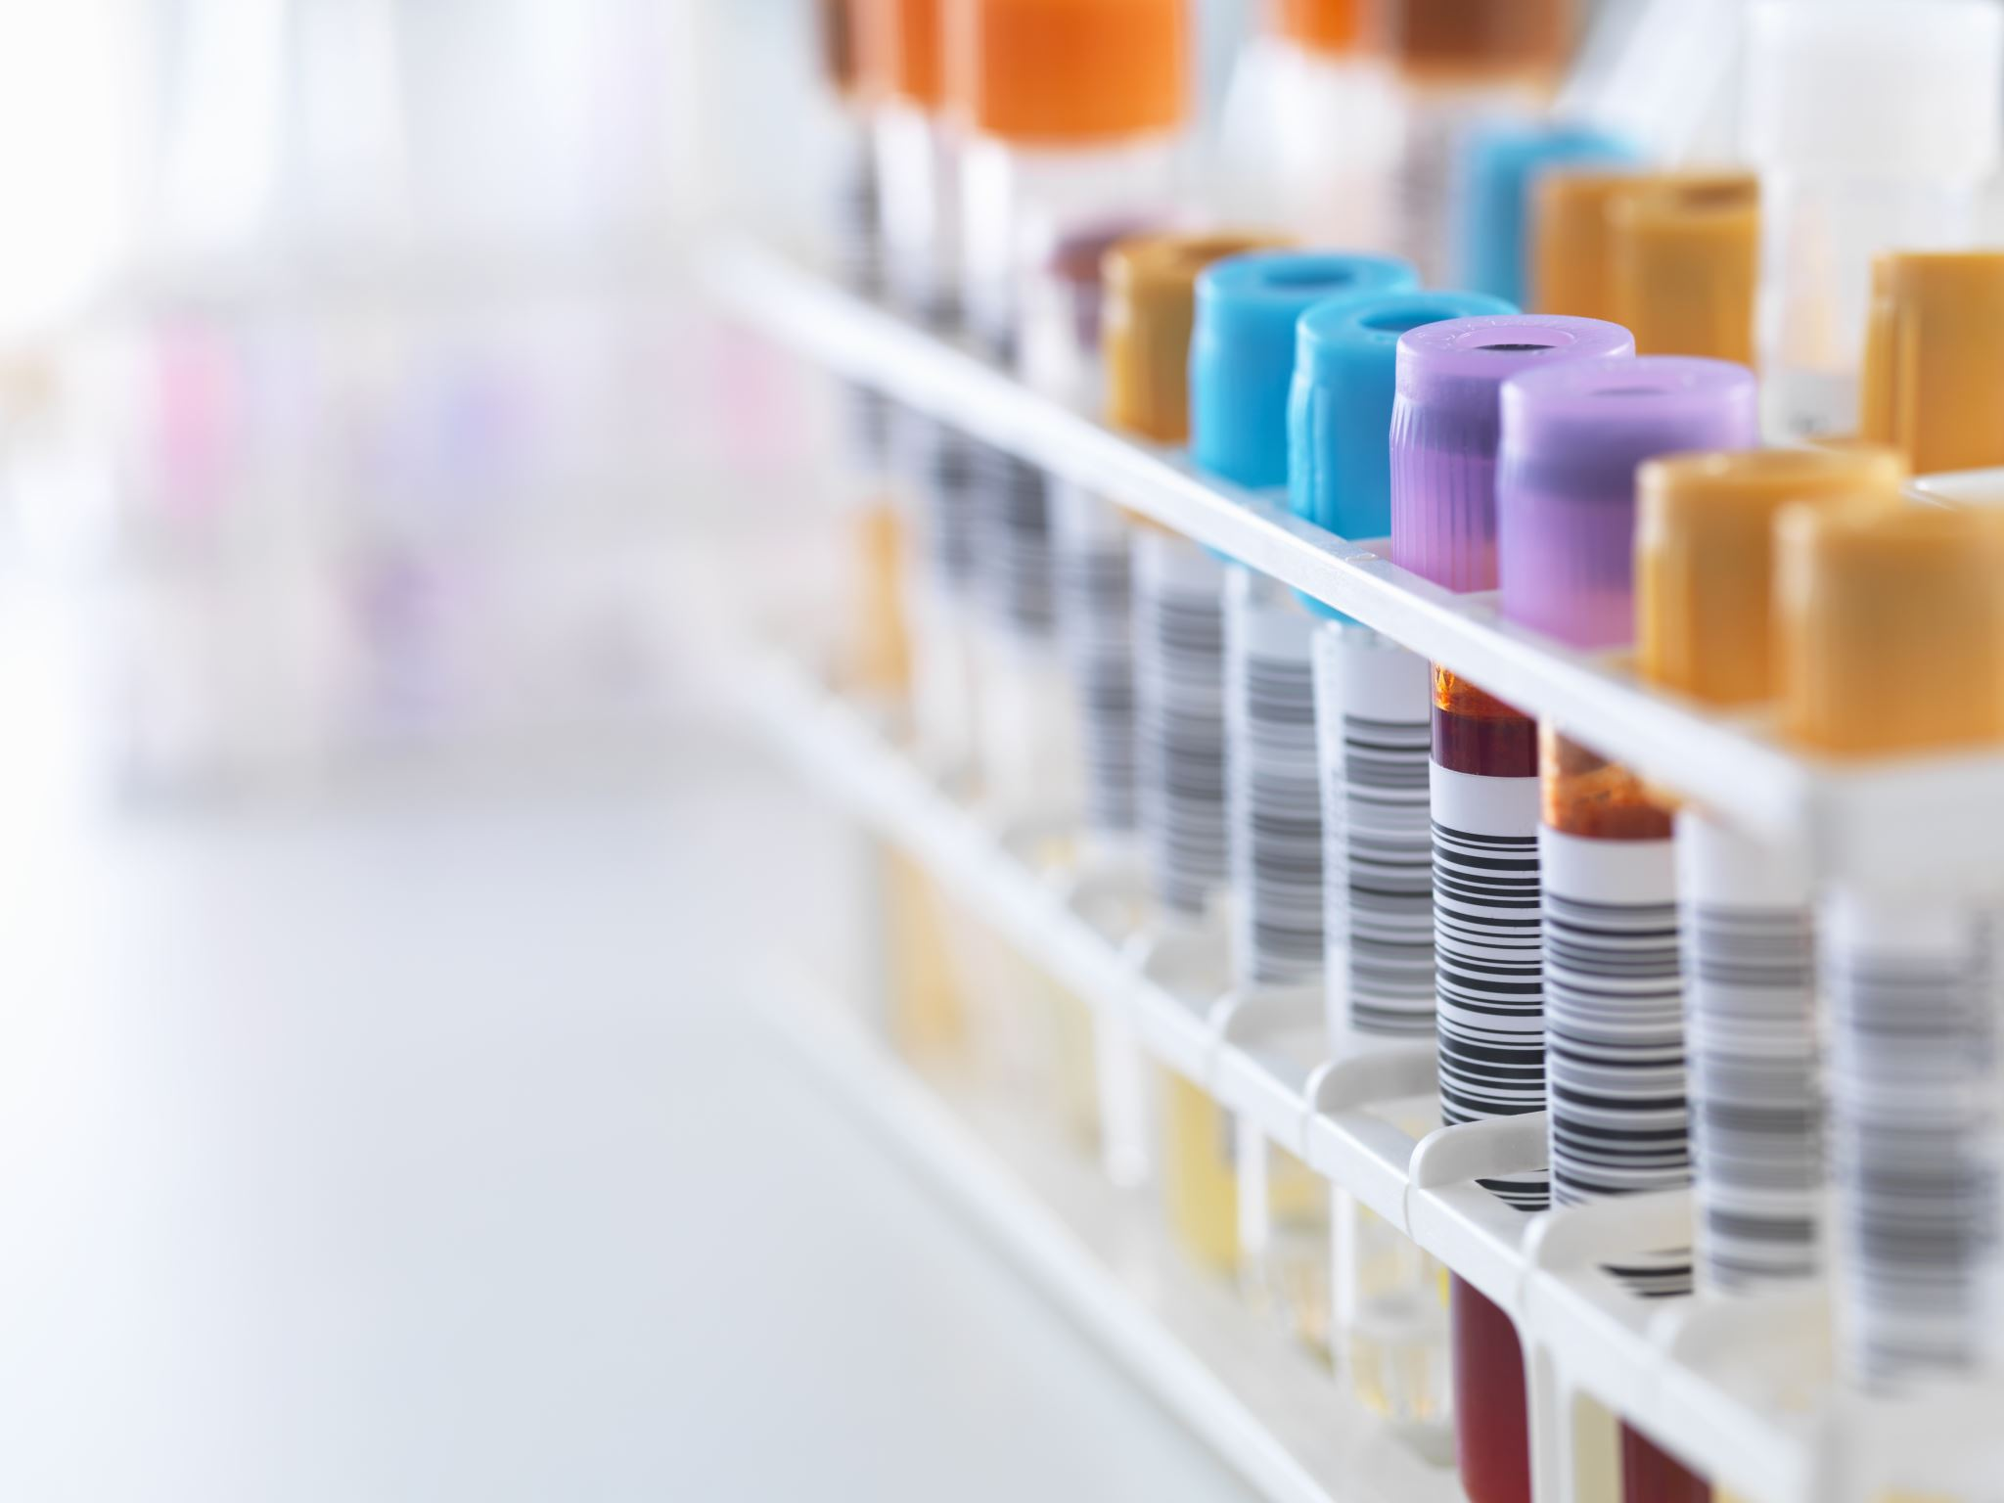
Blood Composition
Plasma – liquid component of blood
Red blood cells (RBCs) – Erythrocytes
White blood cells (WBCs) – Leukocytes
Platelets – Thrombocytes
Fun fact – the human body contains 5 – 6 liters of blood (about 1.5 gallons)
Notes:
Human blood has 4 components:
Plasma contains nutrients and liquid to help blood flow
Erythrocytes carry oxygen and hemoglobin
Leukocytes or wbcs control immune function
Platelets help blood clot

Slide 3
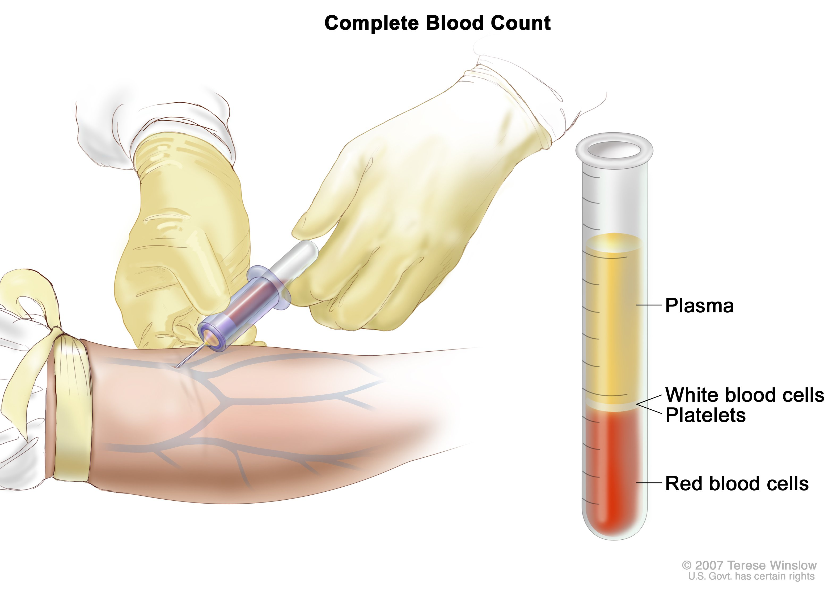
https://www.flickr.com/photos/nihgov/29466760926
Notes:
https://www.flickr.com/photos/nihgov/29466760926
Mostly composed of plasma

Slide 4
Plasma
Contains water, proteins (albumin, globulins, and fibrinogen), and a small amount of other molecules
Albumin – most abundant. Forms plasma osmotic (also called colloid oncotic) pressure. Too large to pass through capillary wall
Globulins – lots of different types including hormones and immunoglobulins
Fibrinogen – protein that is broken down to form fibrin, which helps with blood clotting

Slide 5
Think about it
You are caring for a patient that was recently stabilized in the ICU for septic shock. His blood pressure has been stable, but is now 89/55, and you suspect he is volume depleted. He has significant pitting edema (swelling) in his extremities. He is ordered to have nothing by mouth. What order might you suggest to the provider?
a.) Start IV hydration - Normal saline infusion at 125 mL/hr
b.) IV human albumin
Notes:
Answer – B. Albumin. Albumin can be used to treat edema because the protein particles attract fluid and water to the intravascular system, pulling the fluid from the swelling and into the veins. Albumin cannot be lost through the capillaries because the particles are too large, so it cannot contribute to edema like normal saline would.

Slide 6
Where in the body do RBCs, WBCs, and platelets come from?
Notes:
Answer – all formed in bone marrow, but some WBCs differentiate further in other areas like the thymus.

Slide 7
Erythrocytes (red blood cells [RBCs])
Flexible, disc shaped cells that contain no nucleus
Travel from the heart and lungs through arteries/arterioles/capillaries to carry oxygen (O2) to the body’s tissues.
They carry carbon dioxide (CO2) away from the tissues via capillaries/venules/veins and back to the heart and lungs
Contain protein Hemoglobin, which binds to oxygen and gives red color
Live around 120 days

Slide 8
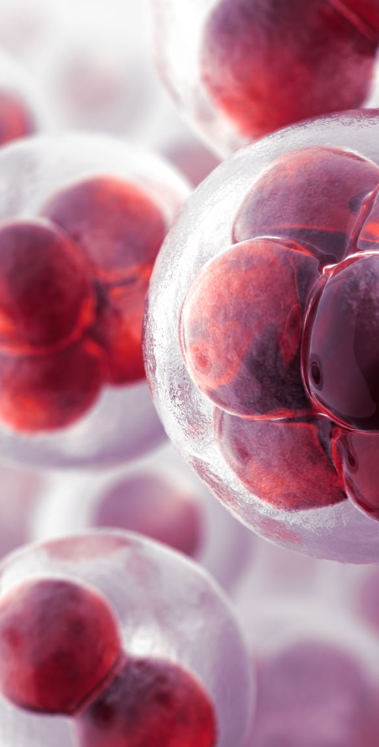
Thrombocytes (platelets)
Cell fragments from megakaryocyte cells
Form platelet plug
Contribute to blood clotting

Slide 9
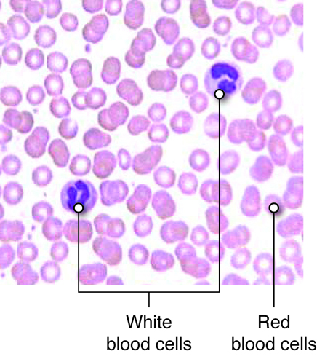
https://pressbooks.ccconline.org/bio106/chapter/cardiovascular-levels-of-organization/
Notes:
https://pressbooks.ccconline.org/bio106/chapter/cardiovascular-levels-of-organization/

Slide 10
Formation of RBCs
Synthesis of RBCs requires folic acid, B12, and iron
If the kidneys sense a need for more RBC production, for example in the setting of low O2, a hormone called erythropoietin is released
Patients with kidney disease often become anemic because their kidneys can’t make endogenous (their own) erythropoietin, so this is sometimes medically replaced

Slide 11

Think about it
Any idea why your pee is yellow?
Notes:
Answered on next slide

Slide 12
Death of RBCs
When the RBC life cycle ends, they are phagocytosed or broken down in the spleen, liver, bone marrow, and lymph Nodes
Heme is broken down into iron and bilirubin. The iron is sent from the spleen into the bone marrow to be recycled
The bilirubin is sent to the liver for filtration and removal
Bilirubin is present in bile. It’s also responsible for the yellow coloring in urine, and excessive amounts of bilirubin cause yellow skin and eyes seen in jaundiced patients (sometimes seen with liver disease)

Slide 13
Diagnostic tests
CBC – “complete blood count” – commonly performed blood test that describes the number and description of RBCs, plts, and WBCs
ESR – “erythrocyte sedimentation rate” – blood test that measures inflammation
BM Bx – Bone marrow biopsy – a large needle aspirates soft bone marrow, usually from posterior iliac crest. Can be used for specific diagnostics, such as diagnosing leukemia

Slide 14
Some parts of a CBC
Hgb – Hemoglobin content in the blood
Hct – Hematocrit - percentage of RBCs within the plasma. Can be affected by fluid volume (ex: Hct can increase with dehydration)
MCV – Mean Corpuscular Volume – measures the size of RBCs (“mean cell volume”)
MCHC – Mean Corpuscular Hemoglobin Concentration – How much hemoglobin is in the cell

Slide 15
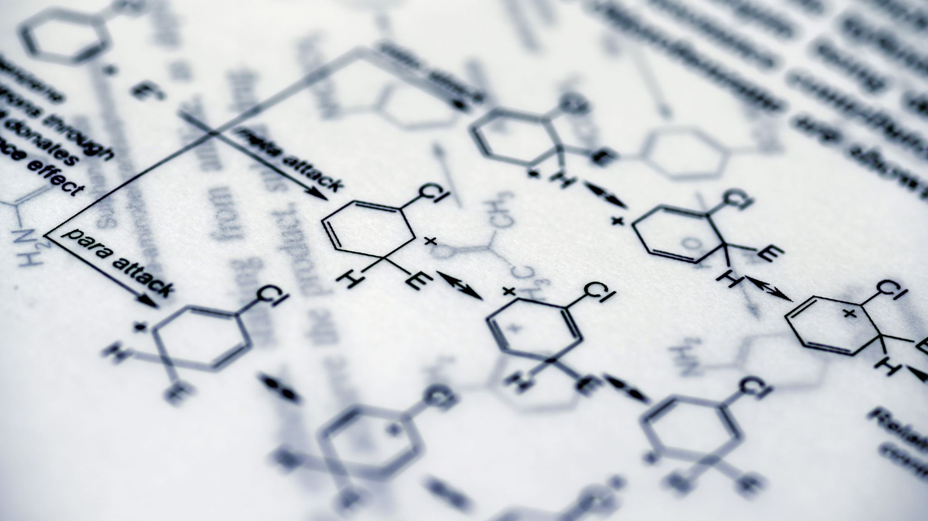
A word about suffixes
“-ia” means “not enough” like “pancytopenia”, “leukopenia”, ”anemia” “thrombocytopenia”
“-cytosis” – USUALLY means “too much” - “thrombocytosis”, “leukocytosis”
  - But not always – for example: phagocytosis - cell eating

Slide 16
Think about it
What types of scenarios could cause anemia?
Notes:
Bleeding, RBC destruction due to blood transfusion reaction, menstruation, low iron or B12 levels, sickle cell anemia, etc.

Slide 17
Anemia causes
Loss of RBCs
Hemolysis or destruction of RBCs
Problem with RBC production – vitamin deficiency or disease (bone marrow failure)

Slide 18
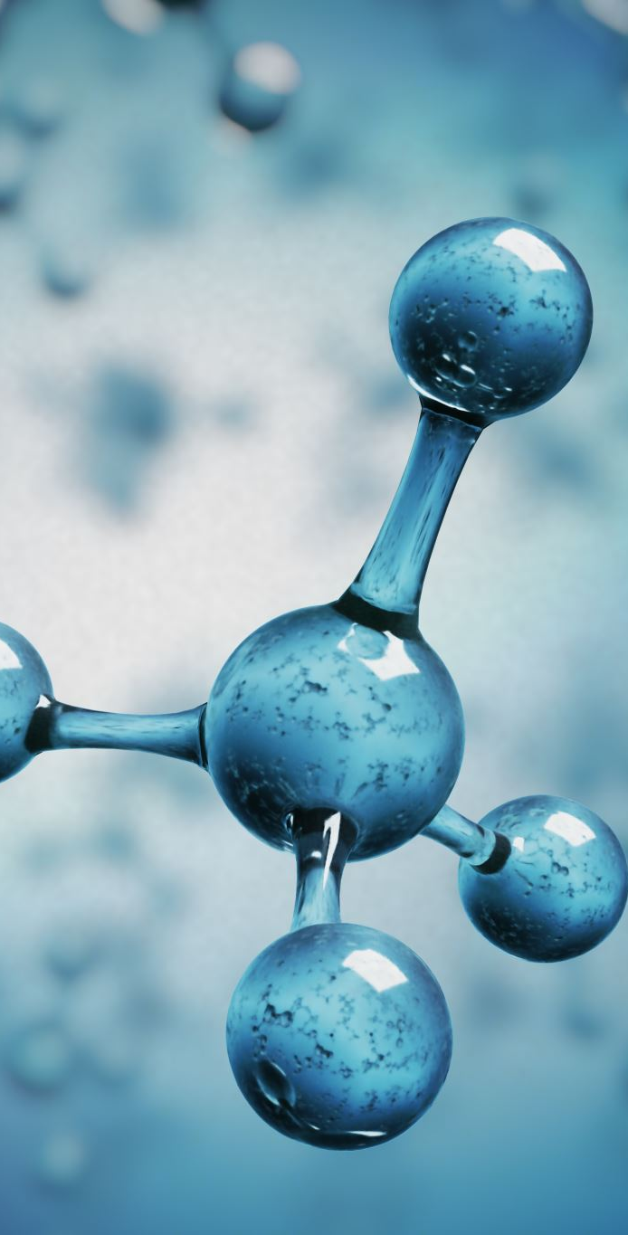
Nutrients needed for RBC growth and maintenance
Vitamin B12 – RBC DNA synthesis
Folic Acid (Vitamin B9) – DNA/RNA synthesis within RBCs
Iron – needed to make hemoglobin (Hgb)

Slide 19
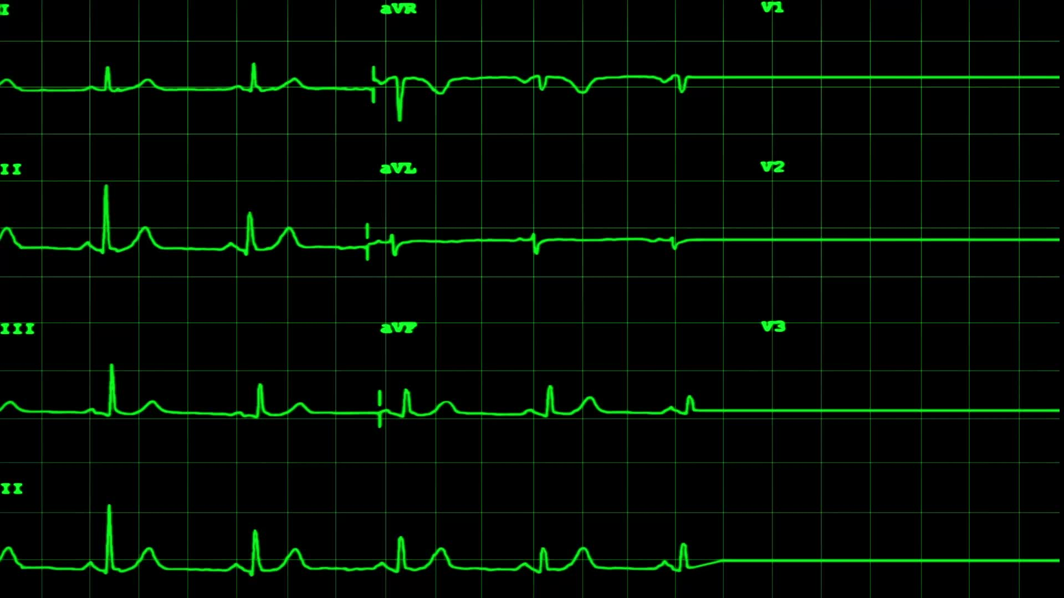
Think about it
How are anemia and oxygen level related?
What are some signs and symptoms (S/S) of low oxygen?
What are some signs and symptoms of bleeding?
Notes:
Answered in next slides

Slide 20
S/S of low oxygen (O2) levels (due to anemia)
Chest pain, tachycardia (increased heart rate [HR]), dizziness, faintness or fainting (syncope), shortness of breath (SOB), dyspnea (trouble breathing) on exertion (DOE), increased respiration rate, fatigue, headache (HA), weakness, pallor (paleness)
Notes:
Anemia means there are fewer RBCs present to carry oxygen throughout the body, which can leave someone starved for oxygen.

Slide 21
S/S of bleeding
See previous slide: s/s of low o2
Additionally: cool, clammy skin, loss of consciousness, tachycardia, hypotension
Some important terms to know:
Hematemesis – vomiting blood of any color
Coffee ground emesis – a type of hematemesis. vomit that looks like coffee grounds, blood is dark red, brown or black
Hematochezia – passage of fresh blood from the anus. This blood usually comes from the colon
Melena – passage of black, tarry stools. This blood usually comes from higher in the GI tract than hematochezia

Slide 22
Anemia terminology/classification
“Chromic” – color – Hgb content
  hypochromic – low hgb content – example: Iron deficiency anemia
  Normochromic – normal hgb content – example: hemorrhagic anemia
  hyperchromic – high hgb content
“Cytic” – size
  Microcytic – small RBCs – example: Iron deficiency anemia
  Normocytic – normal sized RBCs – example: hemorrhagic anemia
  Macrocytic/Megaloblastic – large RBCs – example: Vitamin B 12 and folate deficiency anemias
Notes:
Hemorrhagic anemia is caused from blood loss (hemorrhage). Cells are normal size and color, they are just being lost quicker than they can be replaced.

Slide 23
Iron Deficiency Anemia
Most common type of anemia worldwide
Cause – poor oral intake of iron or chronic blood loss
  Examples: from gastrointestinal (GI) bleeding, menstruation (a woman’s period), peptic ulcer disease, hemorrhoids, pregnancy, excessive aspirin intake, not eating enough iron
Etiology: Less iron available leads to less Hgb produced to transport oxygen
S/S – see s/s of low o2 and bleeding slides. Can have jaundice or pallor. Also – pica – which is unusual food cravings like for clay, etc.
  On a CBC: Small sized cells – Low MCV,
  Pale cells with low Hgb – Low MCHC
Notes:
Pregnancy – fetus uses more iron than normal.

Slide 24
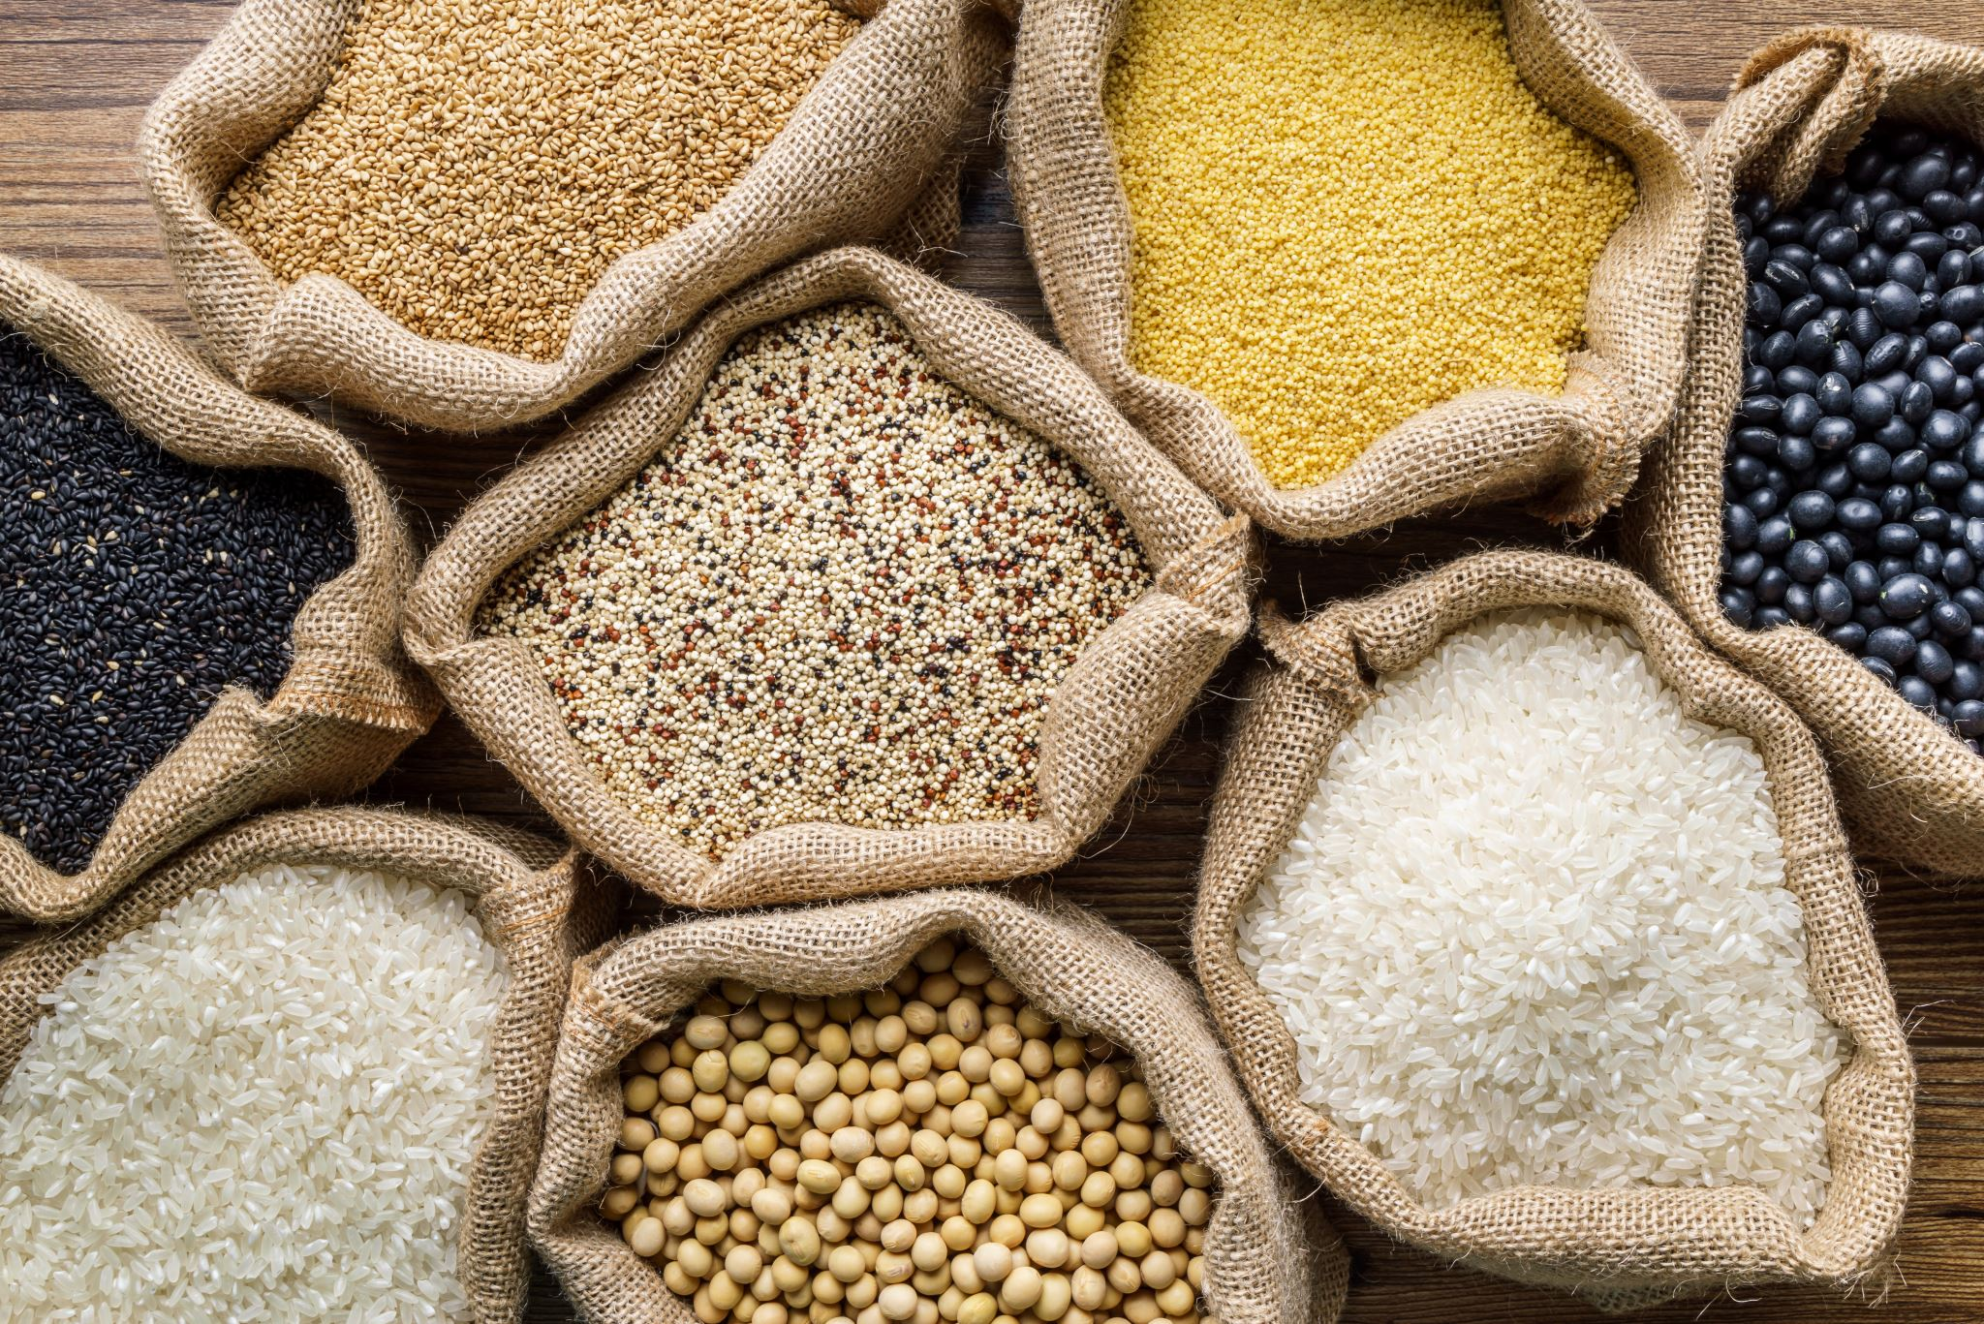
Foods high in iron
Meat, especially beef, eggs, broccoli, lentils, beans, hummus, nuts, soy tofu
Notes:
(Bohrer, 2017)

Slide 25
Megaloblastic anemias
B12 and Folic acid deficient anemias
Lack of these nutrients affects RBC formation; they are overly large
Develop slowly, so usually asymptomatic until condition is advanced

Slide 26
Vitamin B12 deficiency anemia
B12 also called cobalamin or cyanocobalamin – synthesizes DNA in RBCs, helps form myelin on neurons, and activates folic acid
Long absorption process which involves intrinsic factor protein which gastric parietal cells secrete
Populations at risk for B12 deficiency – vegetarians/vegans who don’t get enough in diet, older adults, and those with malabsorption disorders like those with celiac disease, long term proton pump inhibitor medication (PPI) use, gastric bypass, parasites, etc.
Notes:
PPI example: pantoprazole, omeprazole. Block parietal cell secretions.

Slide 27
S/S of B12 Deficiency Anemia
Slow developing disease
Normal s/s of anemia, jaundice, neurologic changes like foot and hand paresthesias (numbness and tingling), balance and gait issues, changes in mentation (thinking)
Labs: low B12 serum level, low hemoglobin, high MCV (this is a macrocytic anemia), normal MCHC
RBCs are not developed properly. They are large and flimsy and have a short lifespan of weeks instead of months
Notes:
RBCs need folic acid and b12 to fully develop and slim down to appropriate shape

Slide 28

Foods high in B12
Meat and dairy products (Rizzo et al., 2016)

Slide 29
B12 Supplementation
Recommended for older adults, those with IBS or with a history of bowel surgery (i.e. bariatric surg), those taking metformin, PPIs, H2blockers, and strict vegetarians/vegans (Langan & Goodbred, 2017)
B12 is made by microbes (bacteria) in the dirt (Greger & Stone, 2015)

Slide 30
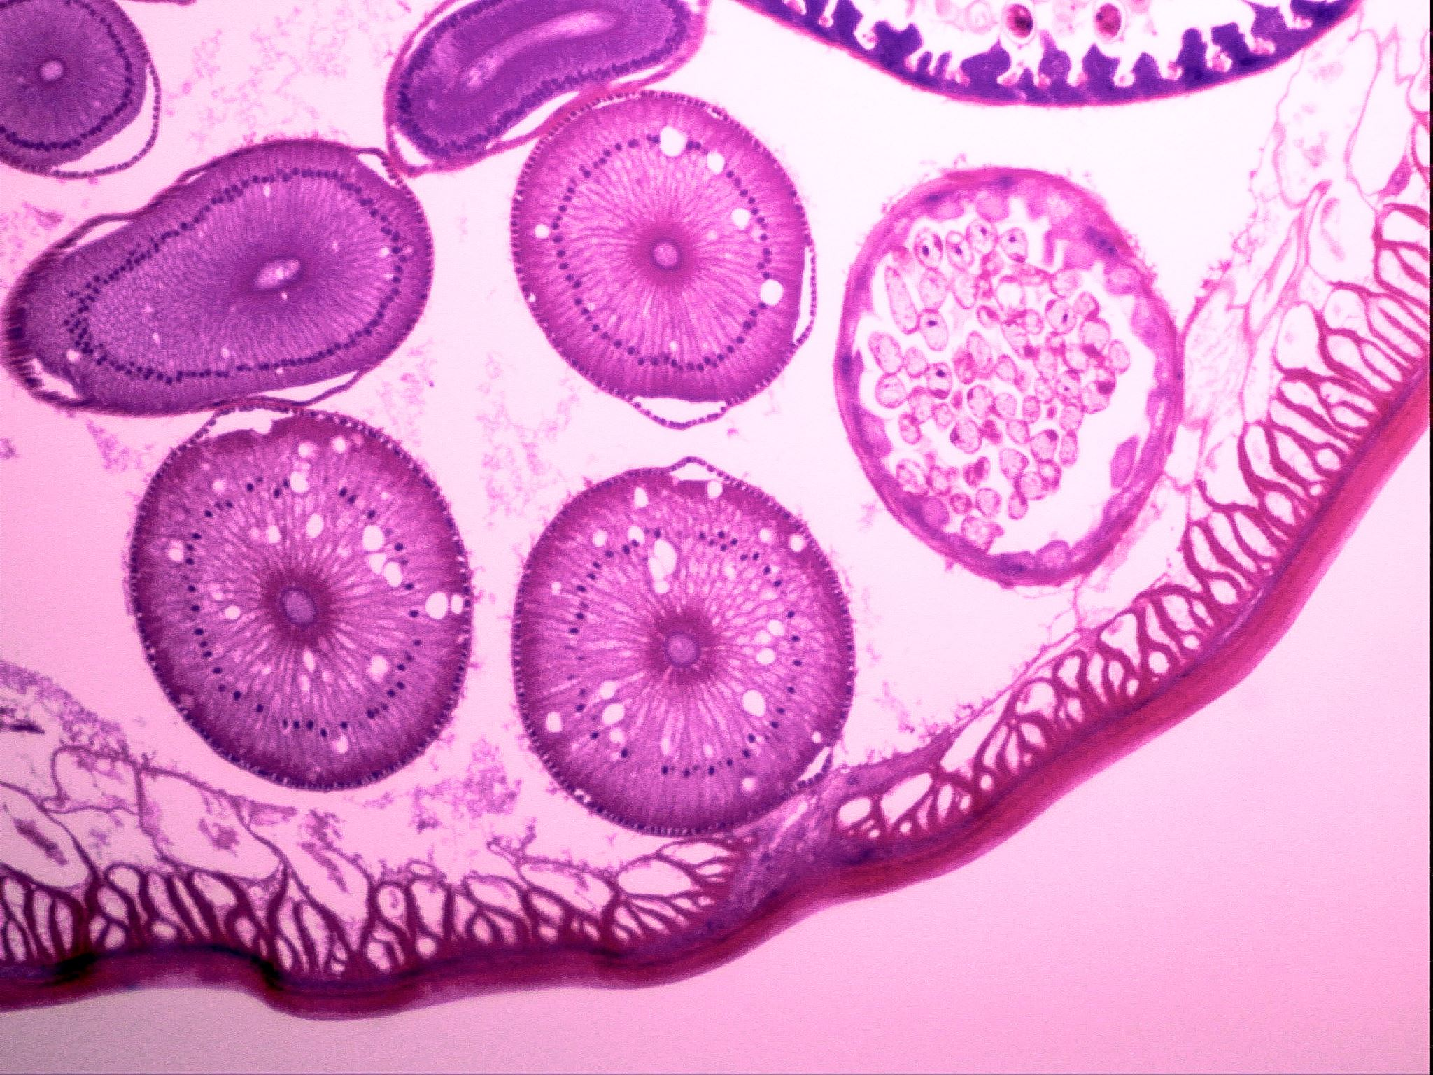
Pernicious Anemia
Caused by stomach failing to produce intrinsic factor which is necessary to absorb B12, so little or none is absorbed
Possibly caused by autoimmune damage to stomach mucosa
Labs helpful in diagnosis (Dx): see B12 deficiency anemia slide, and will see serum parietal cell and/or intrinsic factor antibodies

Slide 31
Think about it
What does folic acid/ folate do? Why do pregnant women need folic acid?
The difference between folate and folic acid:
Notes:
Folic acid is involved in dna synthesis and regulation, produces RBCs, breaks down a harmful amino acid called homocysteine (found in meat and dairy foods), and new evidence suggests it protects endothelium and has a role in cardio protection (Jones, 2019). Folic acid is necessary in pregnancy to form the neural tube early in pregnancy which will become the baby’s brain and spinal cord, and it is important for the increased dna synthesis needed to form a child.
Folate is found naturally in foods. Folic acid is the synthetic, supplement form. Our body actually absorbs the supplement better, which is unusual. Usually whole food sources of vitamins are superior to supplements.
https://www.hsph.harvard.edu/nutritionsource/folic-acid/

Slide 32
Those at risk for folic Acid/folate deficiency anemia
Pregnant and lactating women
Alcohol (ETOH) abusers
Malnourished
Celiac, inflammatory bowel disease (IBS)
Those with inflammatory diseases like rheumatoid arthritis (RA), tuberculosis (TB), psoriasis, systemic infections
Some medications can interfere, antibiotics, anticonvulsants, methotrexate
Notes:
Any disease where nutrition isn’t absorbed properly – etoh use, celiac, etc.
(Jones et al., 2019)

Slide 33
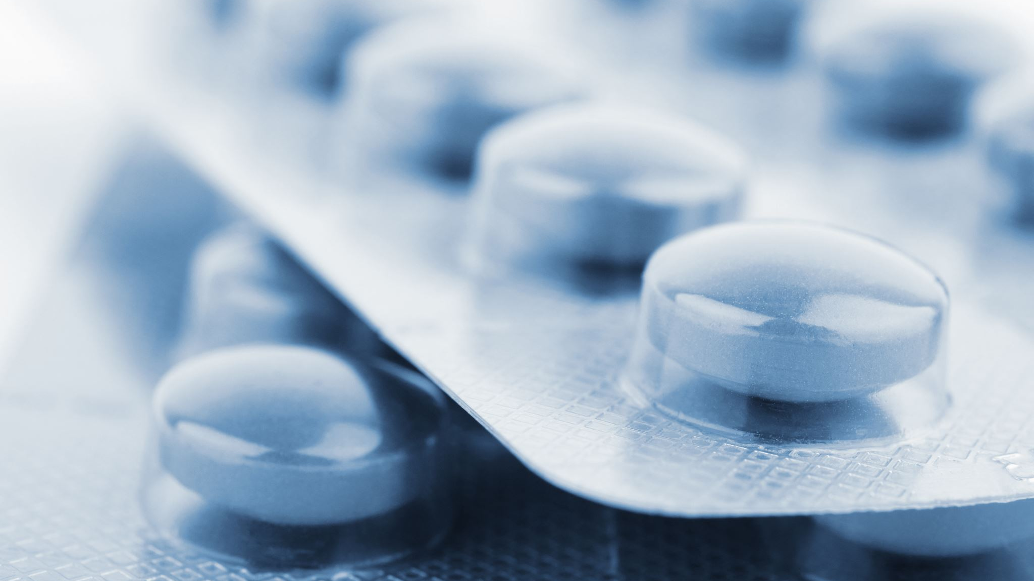
B12 and folic acid
B12 helps activate folic acid, so must be supplemented together

Slide 34
Foods high in folate
Leafy green vegetables, fruits, meats
Much is lost in cooking green vegetables
In US – flour and grains are fortified with folic acid
Notes:
(Jones, 2019)

Slide 35
Aplastic anemia
Bone marrow failure from toxic substances like chemo, radiation, or from infection (viral hepatitis and mononucleosis can cause)
Rarely can be idiopathic
Affects stem cells – so all types of blood cells are low, WBCs, thrombocytes, and RBCs
Can be called “pancytopenia” “pan”- “all” “penia” – not enough
s/s- fatigue, dizziness, dyspnea, pallor, bruising, bleeding (easily, like if flossing - bleeding is excessive and normal activities like this could be dangerous), petechiae, frequent infections
Notes:
Petechiae – small hemorrhages under skin

Slide 36
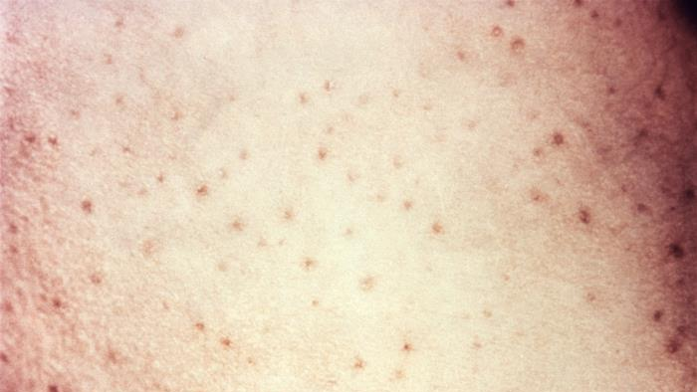
Notes:
petechiae
https://phil.cdc.gov/Details.aspx?pid=6238

Slide 37
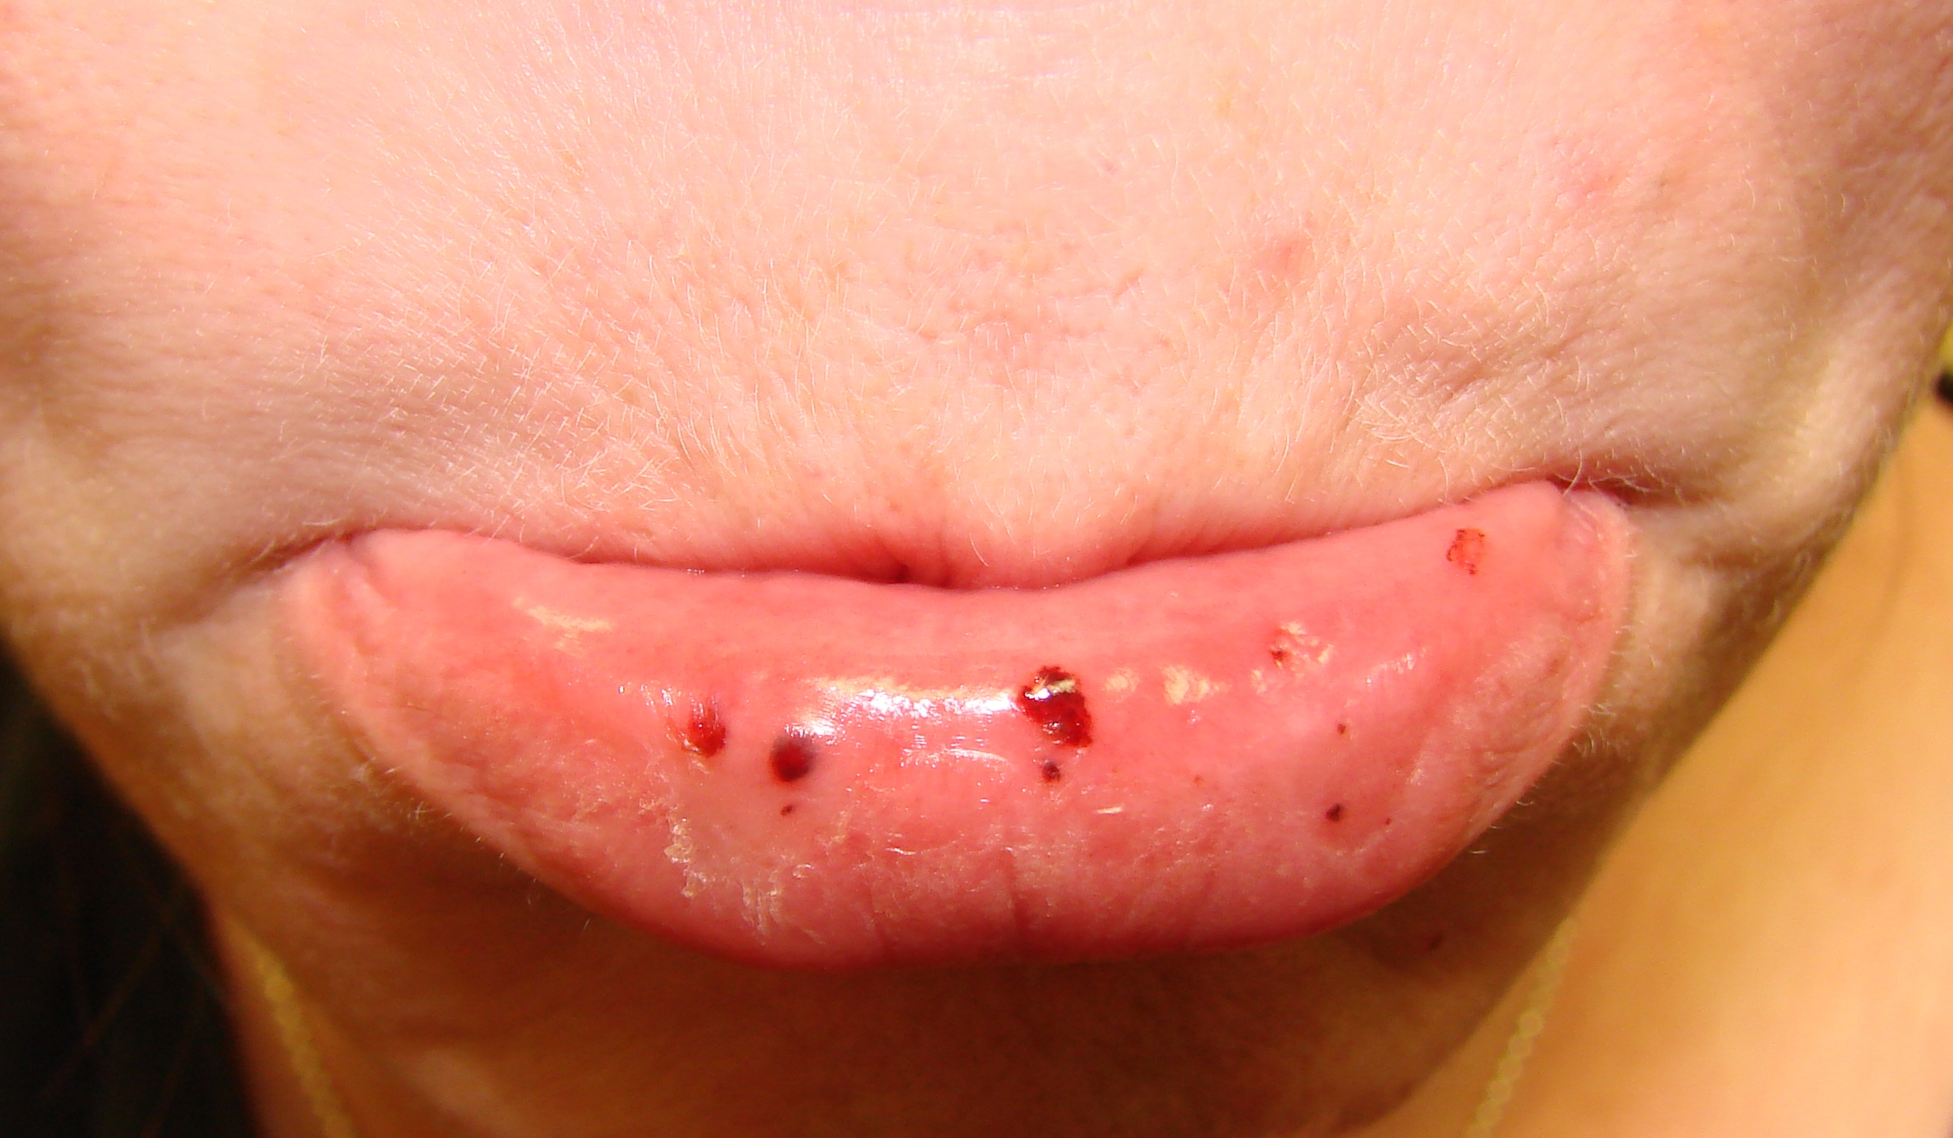
Notes:
Petechiae
https://commons.wikimedia.org/wiki/File:Oral_petechiae.JPG

Slide 38
Think about it
Is aplastic anemia the same as leukemia? Do leukemic patients have aplastic anemia?
Why are stem cells given as a rescue therapy to many cancer patients? (also called a bone marrow transplant)
Notes:
No! When acute leukemia patients are first diagnosed they will often have anemia and thrombocytopenia, but Their bone marrow is making too many immature WBCs called “blasts”, so it is not a deficiency of all types of blood cells.
However, when chemotherapy and/or radiation is given as a treatment to cancer it also affects the bone marrow, which does cause pancytopenia, though this is called “myeloablation” and is not aplastic anemia. When the bone marrow is depleted enough and the cancer is in a certain degree of remission, a stem cell infusion from the patient or a donor will be given to go into the bone marrow and help make new blood cells to rescue the body from deadly pancytopenia (from the chemo).

Slide 39

Think about it
Why do some anemias cause jaundice and some cause pallor?
Notes:
Jaundice – too many rbcs broken down – B12,
Pallor – not enough rbcs in total – aplastic, hemorrhagic
Iron deficiency can cause either

Slide 40
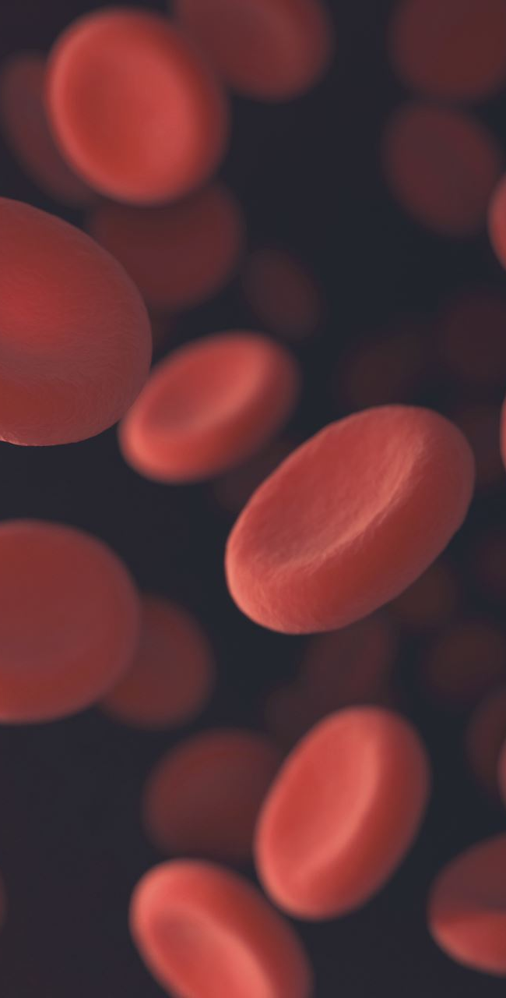
Hemolytic anemia
Too many RBCs broken down. Various causes
Acquired
  One type of blood transfusion reaction
  Rh factor incompatibility of mother to fetus
  Drugs, poisons
Inherited
  Sickle cell disease
  Thalassemia

Slide 41
Acquired Hemolytic anemia
Different types
Antibody mediated – like with transfusion reactions, Rh factor incompatibilities of infants
Membrane destruction – Certain drugs, poisons, diseases can cause
  Malaria
  A vascular obstruction can mechanically cause membrane rupture – example: disseminated intravascular coagulation (DIC)

Slide 42
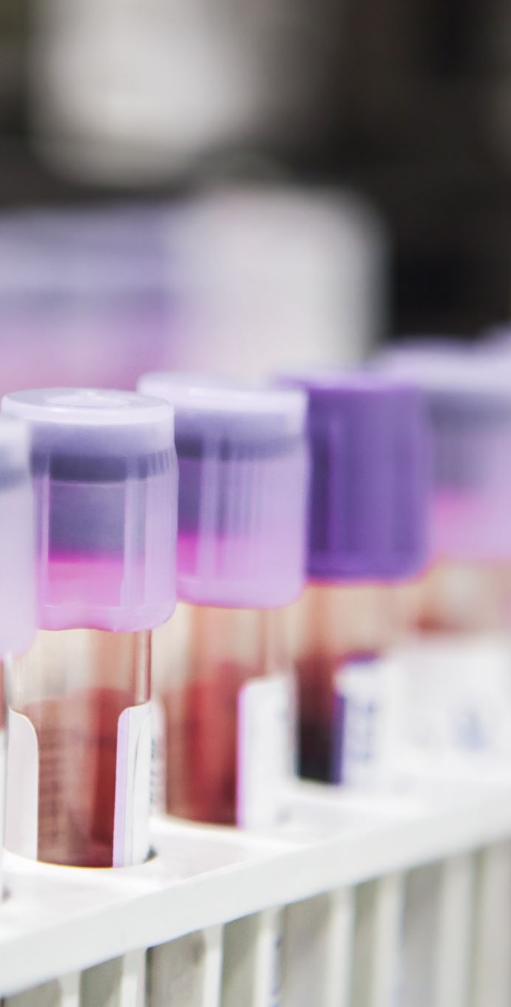
Blood types
Blood types: A, B, AB, and O
O – universal donor -has no antigens, but has antibodies for A and B
AB is the universal recipient because they have no antibodies for A or B
Notes:
For example, someone with blood type A has antibodies for B innately (when they are born)

Slide 43
Rh Factor
The positive or negative given after blood type
Another name for the D antigen
Unlike A, B, or O types, humans have no innate Rh antibodies until they are exposed to Rh antigen through mother or fetus’s blood or a transfusion
Once exposed, Rh antibody is produced though, and a reaction occurs
Notes:
if mom is rh- and baby is rh+ mom’s antibodies can attack baby. only happens during a second pregnancy with Rh+ child

Slide 44
Lab tests and hemolytic anemia
High reticulocyte count - reticulocytes are immature RBCs. This number will be high with hemolytic anemias because the bone marrow is working overtime to make enough RBCs because they are being destroyed prematurely.
Direct COOMBS test or Direct antiglobulin test (DAT) – looks for an antibody or complement on RBC’s surface. A positive test could indicate Rh incompatibility, history of blood transfusion reactions, etc.

Slide 45
Blood transfusions
Blood, platelets, plasma, and more can be given via intravenous transfusion if a patient’s levels are low
Some religions prohibit blood transfusions, for example Jehovah’s witnesses
Informed Consent must be obtained from the patient to receive blood unless in an emergent situation
Notes:
Jehovah’s witnesses believe it is against god’s will to receive blood and they will lose eternal salvation

Slide 46
Blood transfusion reactions
Types of reactions
  Febrile
  Hypotensive
  Allergic
  Hemolytic
  Transfusion-associated circulatory overload (TACO)
  Transfusion-related acute lung injury (TRALI)
  Other more specific types
Notes:
Reactions are rare but they can happen

Slide 47
Allergic
Most common transfusion reaction
Ranges from a mild rash to life threatening anaphylaxis, so treat like a medical emergency
Not from a blood type incompatibility
Host mounts immune response to a donor protein like immunoglobulin A or haptoglobin, not an A or B antigen
s/s – hives (urticaria), rash, itching (pruritis), flushing, hypotension (low BP), facial or eye edema, angioedema (throat swelling)
Treat symptoms and if need treat anaphylaxis
Notes:
More common with platelets than rbcs

Slide 48
Hemolytic
Medical emergency
Almost always from A/B/O/Rh incompatibility
Host fights the donor blood transfused
Acute or delayed – within 24 hours or within 28 days
Distinct s/s – back/flank pain, nosebleed (epistaxis), DIC, blood in urine (hematuria), oliguria/anuria, acute kidney injury (AKI)/failure, pain at IV site
can see chills, fever, hypotension with this type and other types of transfusion reactions
Delayed = will see fall in hgb, jaundice
Renal damage is caused because kidneys are filtering donor hemolyzed cells
Notes:
These are very rare today with increased patient identification present through barcode scanning, wrist bands, positive patient identification.

Slide 49
Febrile
febrile - fever chills malaise
Can be from cytokines and antibodies present against blood due to history of previous transfusions
Leukocyte reduced products can be given
Notes:
Happens more often with platelets. Patients may need HLA (specially) matched blood products where more antigens than just A or D are matched

Slide 50
For all types of reactions
First, stabilize the patient
Lab testing can confirm which type of reaction occurred and why
Keep the bag of blood to send for testing

Slide 51
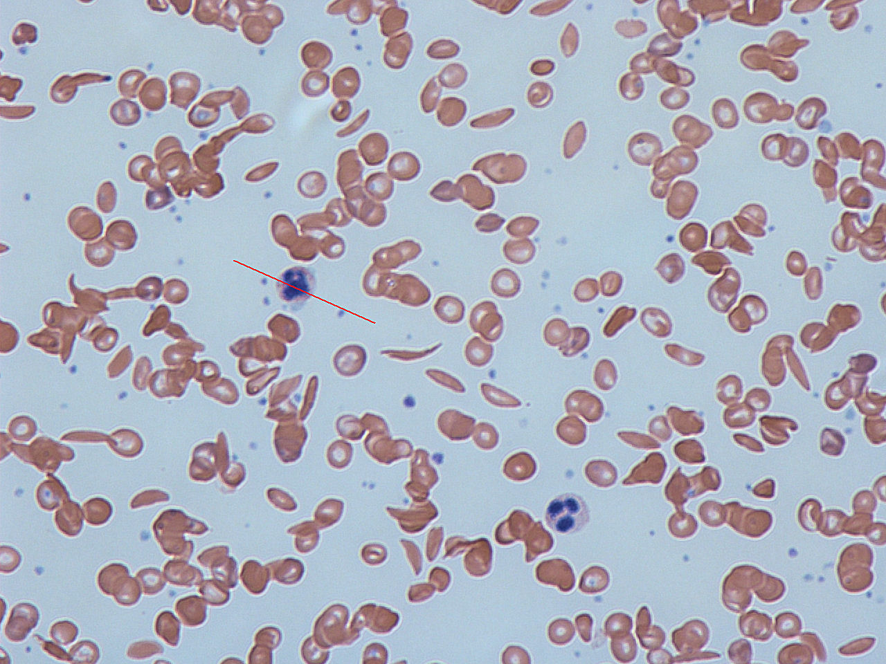
Sickle Cell Anemia
Notes:
https://commons.wikimedia.org/wiki/File:Sickle_cells.jpg
Inherited hemolytic anemia
See the sickled erythrocytes present along with regular round cells.

Slide 52
Sickle Cell Anemia
Inherited recessive disorder
Can have the just the trait or disease
US – all newborns screened
Have abnormal HgbS instead of normal HgbA
HgbS at risk for sickling when triggered
Sickled cells more “gel” like at risk for adherence to other cells and cell wall
Triggers: cold, stress, physical exertion, infection, dehydration, hypoxia (high elevations), acidosis
Notes:
Patient should avoid triggers to prevent episodes and organ damage

Slide 53
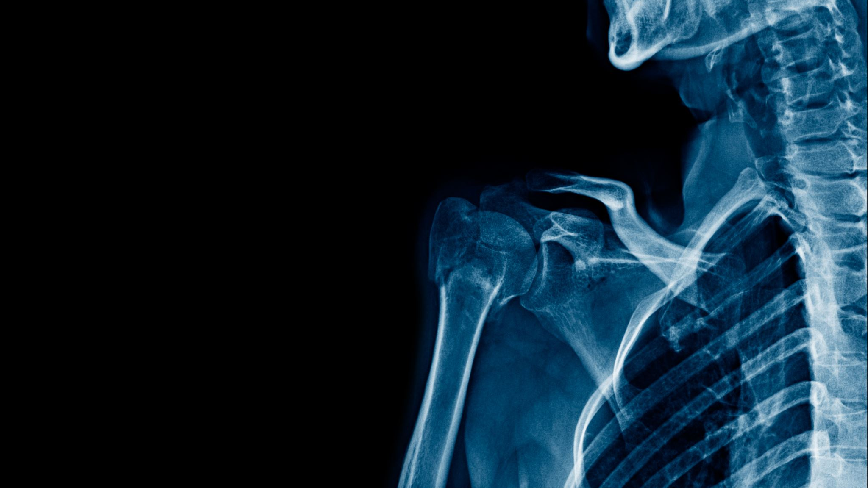
Sickle Cell crisis Physiology (1/2)
Increased cell adherence leads to vessel occlusion, tissue damage (ischemia) and death (infarction)
  painful
Called vaso occlusive crisis – can happen anywhere, esp. abdomen, chest, bones, joints, small strokes (transient ischemic attacks [TIAs])
Acute chest syndrome – vaso occlusive crisis in lungs
  Leading cause of death in sickle cell patients
  Dyspnea, cough, sudden chest pain
Notes:
When triggered Sticky sickled cells stick together in a blood vessel and can block it

Slide 54
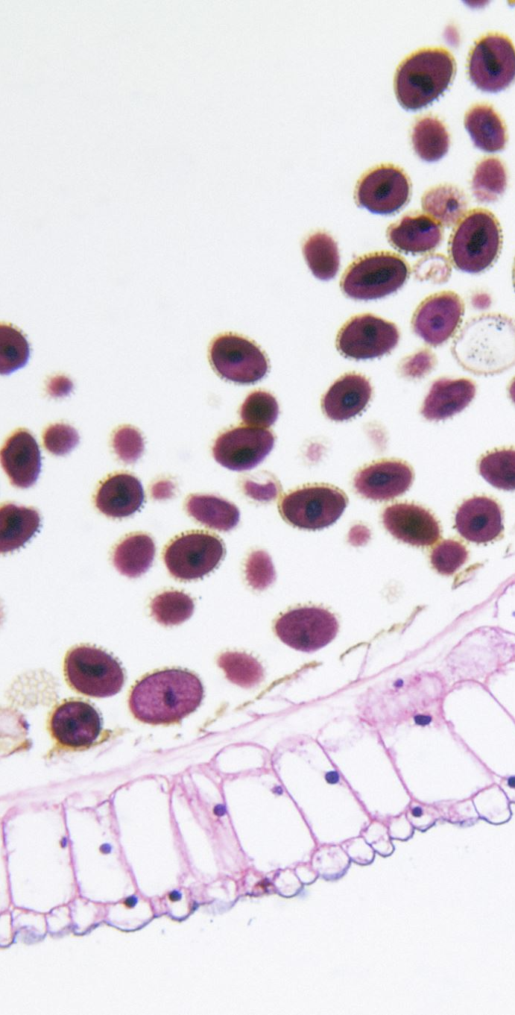
Sickle Cell Physiology (2/2) – The Spleen
Spleen destroys sickled cells, so working extra hard
Spleen also faces organ damage from vaso occlusion leading to ischemia
Can see splenomegaly
Most have hyperbilirubinemia from the increased RBC destruction
  jaundice, gallstones
At increased risk of infection because the spleen removes encapsulated pathogens i.e. streptococcus pneumoniae, some flu types

Slide 55
Sickle cell anemia treatment
Adequate hydration to keep blood flowing and prevent cells from clotting
Pain management is huge -especially in a crisis
Oxygen as needed
Blood transfusions
Avoiding triggers
Notes:
Sometimes patients receive stem cell transplant for this

Slide 56
Thalassemia
Inherited hemolytic anemia
Abnormal hemoglobin synthesis leads to increased hemolysis
Bone marrow activity increased resulting in osteopenia and increased risk of fractures
Jaundice, splenomegaly, hepatomegaly can occur
Keep hemoglobin above 8-9 to reduce risk of complications
s/s – see anemia s/s (slides 19-20)

Slide 57
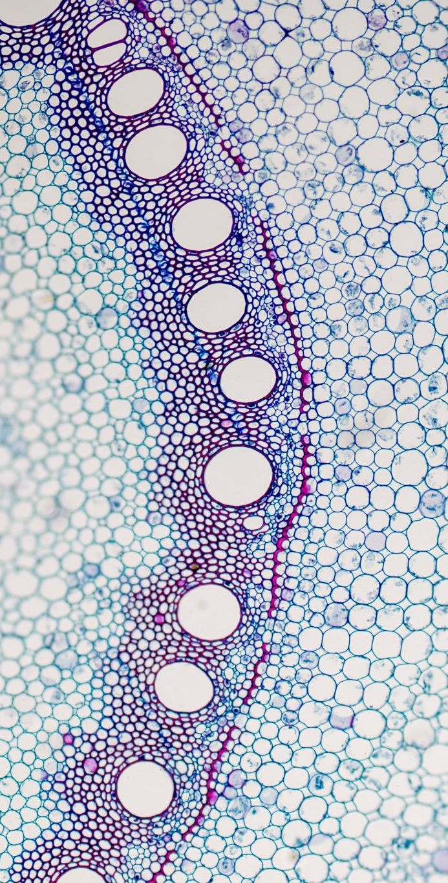
Polycythemia
Too many RBCs
Hematocrit (HCT)
  >54% men
  >47% women
Primary (Polycythemia vera) – in bone marrow. too much of all blood cell types.
  Treat with therapeutic phlebotomy
Secondary – more common. Body makes too many RBCs to try to compensate for chronic blood hypoxia (ex: COPD, smoking)
s/s – hypertension (HTN), dusky skin, mucus membranes
Increased blood viscosity can lead to cardiac dysfunction, vascular obstruction
Notes:
Taking Testosterone can cause
Treated by blood letting where a clinician removes around 500 mLs to 1L of blood from the patient
Ohlander, S. J., Varghese, B., & Pastuszak, A. W. (2018). Erythrocytosis Following Testosterone Therapy. Sexual Medicine Reviews, 6(1), 77–85. https://doi.org/10.1016/j.sxmr.2017.04.001

Slide 58
References
Bohrer, B. (2017). Review: Nutrient density and nutritional value of meat products and non-meat foods high in protein. Trends in Food Science & Technology, 65, 103-112. https://doi.org/10.1016/j.tifs.2017.04.016
Greger, M., & Stone, G. (2015). How Not To Die: Discover the foods scientifically proven to prevent and reverse disease. Flatiron Books. (p. 407)
Jones, P., Lucock, M., Scarlett, C. J., Veysey, M. & Beckett, E. L. (2019). Folate and Inflammation - Links between folate and features of inflammatory conditions. Journal of Nutrition and Intermediary Metabolism, 18(2019), 100104, 1-6. https://doi.org/10.1016/j.jnim.2019.100104
Langan, R. C., & Goodbred, A. J. (2017). Vitamin B12 Deficiency: Recognition and Management. American Family Physician, 96(6), 384-389.
Norris, T. L. & Tuan, R. L. (2020). Porth’s Essentials of Pathophysiology (5th edition). Wolters Kluwer.
Ohlander, S. J., Varghese, B., & Pastuszak, A. W.. (2018). Erythrocytosis Following Testosterone Therapy. Sexual Medicine Reviews, 6(1), 77–85. https://doi.org/10.1016/j.sxmr.2017.04.001
Rizzo, G., Laganà, A., Rapisarda, A., La Ferrera, G., Buscema, M., Rossetti, P., Nigro, A., Muscia, V., Valenti, G., Sapia, F., Sarpietro, G., Zigarelli, M., & Vitale, S. (2016). Vitamin B12 among Vegetarians: Status, Assessment and Supplementation. Nutrients, 8(12), 767. https://doi.org/10.3390/nu8120767

