Slide 1
Nursing care for pediatric neurology~ Part 1
Dr. Kimberly Ndahayo, DNP, FNP-C, RN, CNRN
Notes:
Hello, my name is Dr. Kimberly Ndahayo, I am a Family practitioner with 15 years experience in adult and pediatric neurology. Today we begin our discussion on common conditions of pediatric neurology. Part one will focus on differences in pediatric neurologic assessments, neural tube defects, including spina bifida and anencephaly, hydrocephalus and infectious causes oof brain injury including encephalitis and meningitis. This overview of Pediatric neurologic conditions will focus on pathophysiology of the disease, diagnosis, treatment, and nursing considerations when caring for a child with complex neurologic condition.

Slide 2
Learning Objectives
Identify differences in pediatric neurologic assessment, pathophysiology and neurologic assessment of the pediatric patient.
Identify underlying pathophysiology of neural tube defects in addition to common pediatric conditions resulting from neural tube defects.
Discuss underlying causes of hydrocephalus as well as exam and diagnosis of this condition and nursing role in quick identification and intervention to reduce comorbidities.
Identify common underlying causes of infectious injury to the brain including encephalitis and meningitis as well as workup, treatment and nursing considerations.
Notes:
The learning objectives for todays presentation are to identify differences in pediatric neurologic assessment, pathophysiology and neurologic assessment of the pediatric patient.
Identify underlying pathophysiology of neural tube defects in addition to common pediatric conditions resulting from neural tube defects.
We will discuss hydrocephalus as well as the underlying causes of this condition, the nursing exam and anticipated diagnostic workup of this condition and nursing role in quick identification and intervention to reduce comorbidities.
And lastly, We will discuss meningitis and encephalitis, looking at the common underlying causes of infectious injury to the brain as well as workup, treatment and nursing considerations.

Slide 3
Pediatric Differences of the Central Nervous System
In infancy the brain constitutes approximately 10-12% of the newborn’s body weight, as compared to 2% in the adult body.
In the first year of life the brain doubles in size and continues to grow to approximately 80% of the adult brain by 3 years of age.
By 5 years of age the brain will have grown to nearly 90% of the final adult size.
In infancy the brain is highly vascular to support this rapid growth.
Fontanelles are open and will not fully fuse until 18 months.
Infants have around 50ml of cerebrospinal fluid compared to adults who have around 150ml.
Notes:
Looking at differences in the pediatric brain and central nervous system helps to guide our understanding of how the conditions we will discuss present in pediatrics. In infancy the brain constitutes approximately 10-12% of the newborn’s body weight, as compared to 2% in the adult body.
In the first year of life the brain actually doubles in size and continues to grow rapidly to approximately 80% of the adult brain by 3 years of age. By 5 years of age the brain will have grown to nearly 90% of the final adult size.
Another thing to note is that in infancy the brain is highly vascular to support this rapid growth.
In infancy the fontanels are open and will not fully fuse until age around age 18 months. The posterior fontanelle is typically the first to close around age 2 months, and the anterior fontanelle closes between 7-18 months.
And lastly, infants have around 50ml of cerebrospinal fluid compared to adults who have around 150ml.

Slide 4
Pearls in pediatric neurology assessment
Red flags:
  Falling off or failing to progress in developmental milestones
  Persistence of, or reoccurrence of newborn reflexes that typically disappear (example: Babinski reflex)
  Rapid increase in head circumference or bulging fontanelles
  Sudden fussiness
Assessing mental status by developmental age:
  Ask about family, pets, favorite toy or stuffed animal, school, movies, etc.
Using hand sized toys to assess extraocular movements, motor coordination, cognitive skills and speech, finger to nose.
Making the assessment a game: silly games such as Simon says, playing the copy game can allow for easy assessment of cranial nerves, checking tongue protrusion, facial nerves, transfer items from hand to hand.
Observe coordination in gait while patient is walking to get a sticker, have them jump from tile to tile on the floor.
Notes:
There are many red flags you will need to be aware of in the infant and pediatric population, many of which will be discussed as we navigate our way through the different conditions. However lets talk about a few key red flags to watch for in this population. When a pediatric patient starts falling off or failing to progress in their developmental milestones this is cause for concern and closer monitoring. When pediatric reflexes, such as the Babinski reflex which should disappear by age 2, suddenly re-emerge or fail to go away this can indicate a disorder of the central nerves system. Head circumference is something that will be monitored frequently in pediatrics due to the expected rapid grown in brain during the first five years of life. However, when there is a sudden unexpected or significant change in head circumference or bulging fontanelles this can indicant increased intracranial pressure.
Obtaining a good neuro exam in the pediatric patient can be difficult and findings can often appear abnormal if the child is non compliant, fussy or shy. Making the exam into an interactive game can go a long ways to not only obtaining a proper exam, but also building rapport with the patient and decreasing fears. Examples of this include asking more age relevant questions to assess mental status, for example asking about a favorite stuffed animal, pets, favorite toys. Using a light up ball in your hand can make the patient more interested in following it with their eyes to assess for extraocular eye movements. Using that same ball you can play a game where the child touches the ball with their finger and then touches their nose to assess for coordination. Playing simon says can be a great game to elicit just about any cranial nerve test, for example raising your eyebrows, smiling, frowning, puffing up your cheeks and so on.
And lastly, try to assess gait while they are doing a task such as following you to get a sticker, play “walk the line” or jumping from tile to tile. All of these simple things allow for you to get a great assessment while engaging the child.

Slide 5
Neural Tube defects
Neural tube defects occur when there’s an improper closing or no closure of the neural tube developing the brain and spine.
Occurs in the first trimester.
Causes include genetics, nutrition (such as folic acid deficiency) and environmental factors play roles in these defects.
The most common conditions resulting from a neural tube defect are spina bifida and anencephaly.
Notes:
Neural tube defects occur when there’s an improper closing or no closure of the neural tube developing the brain and spine. Neural tubes develop very early in pregnancy, in the first trimester, and more specifically in the first 6-8 weeks. While the exact causes of neural tube defects is not fully understood, we do know that factors including genetic causes, nutrition (such as folic acid deficiency) and environmental factors play roles in these defects. The most common conditions resulting from a neural tube defect are spina bifida and anencephaly.

Slide 6
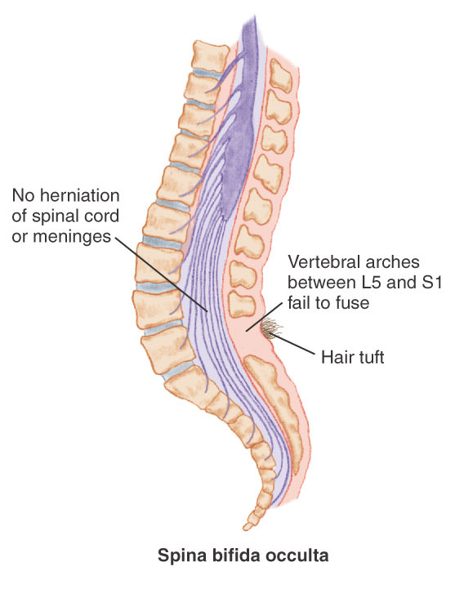
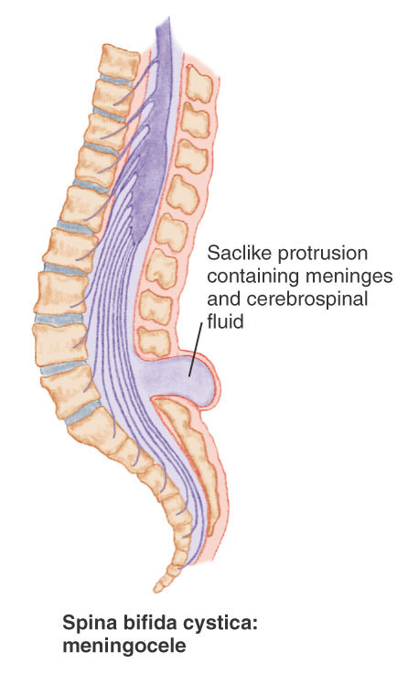
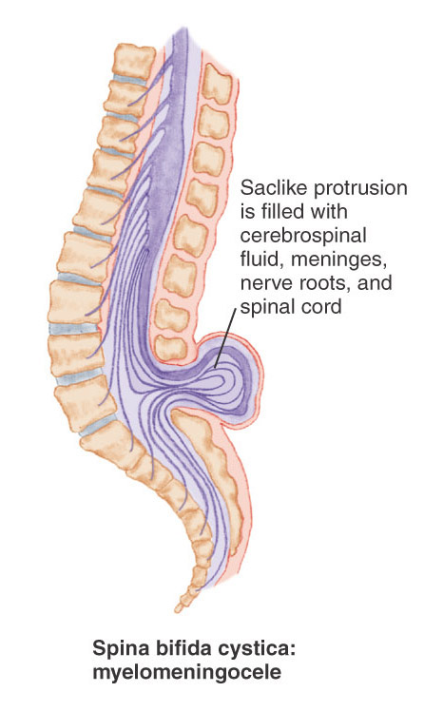
Neural tube defects: spina bifida
Occulta
- No herniation of the spinal cord or meninges.
Due to incomplete formation of the dorsal midline structures.
There is no visible exposure of the neural tissue and may appear as a dimple, hairy patch (hypertrichosis), limpoma (lipomyelomeningocele), or hemangioma around level L5-S1 of the spine.
Can have a “tethered cord” which occurs where there is traction on the cord.
Symptoms may include bowel or bladder issues.
Can have a delayed diagnosis.
Copyright © 2013, 2007, 2002 by Saunders, an imprint of Elsevier Inc.
Notes:
There are three main categories of spina bifida which range in terms of severity of the condition. The first is spina bifida occulta, which is the most mild form of spina bifida. As you can see on the image on the right each category is diagnose based off protrusion of the spinal cord. In Spina bifida occulta there is a small space or gap in the spine however, with no herniation of the spinal cord or meninges. This condition occurs to do an incomplete formation of the dorsal midline structures. Because there is no protrusion there’s also no visible exposure of the neural tissue and therefore I may be an appearance as minimal as a dimple. Several different characteristics can exist ranging from a dimple, a hairy patch which is known as hypertrichosis (hyper-tri-co-sis), lympoma also know as lipomyelomeningocele (lipo-myelo-menin-go-cele), or hemangioma, all of which occur around level L5 S1 of the spine. Depending on severity there can also be a condition referred to as tethered cord which occurs when there is traction on the spinal cord. Symptoms of this condition typically include bowel and bladder issues. Because the visible defect is less severe, diagnosis can be delayed particularly if symptoms are also mild, sometimes going undiagnosed into childhood and even adulthood.

Slide 7
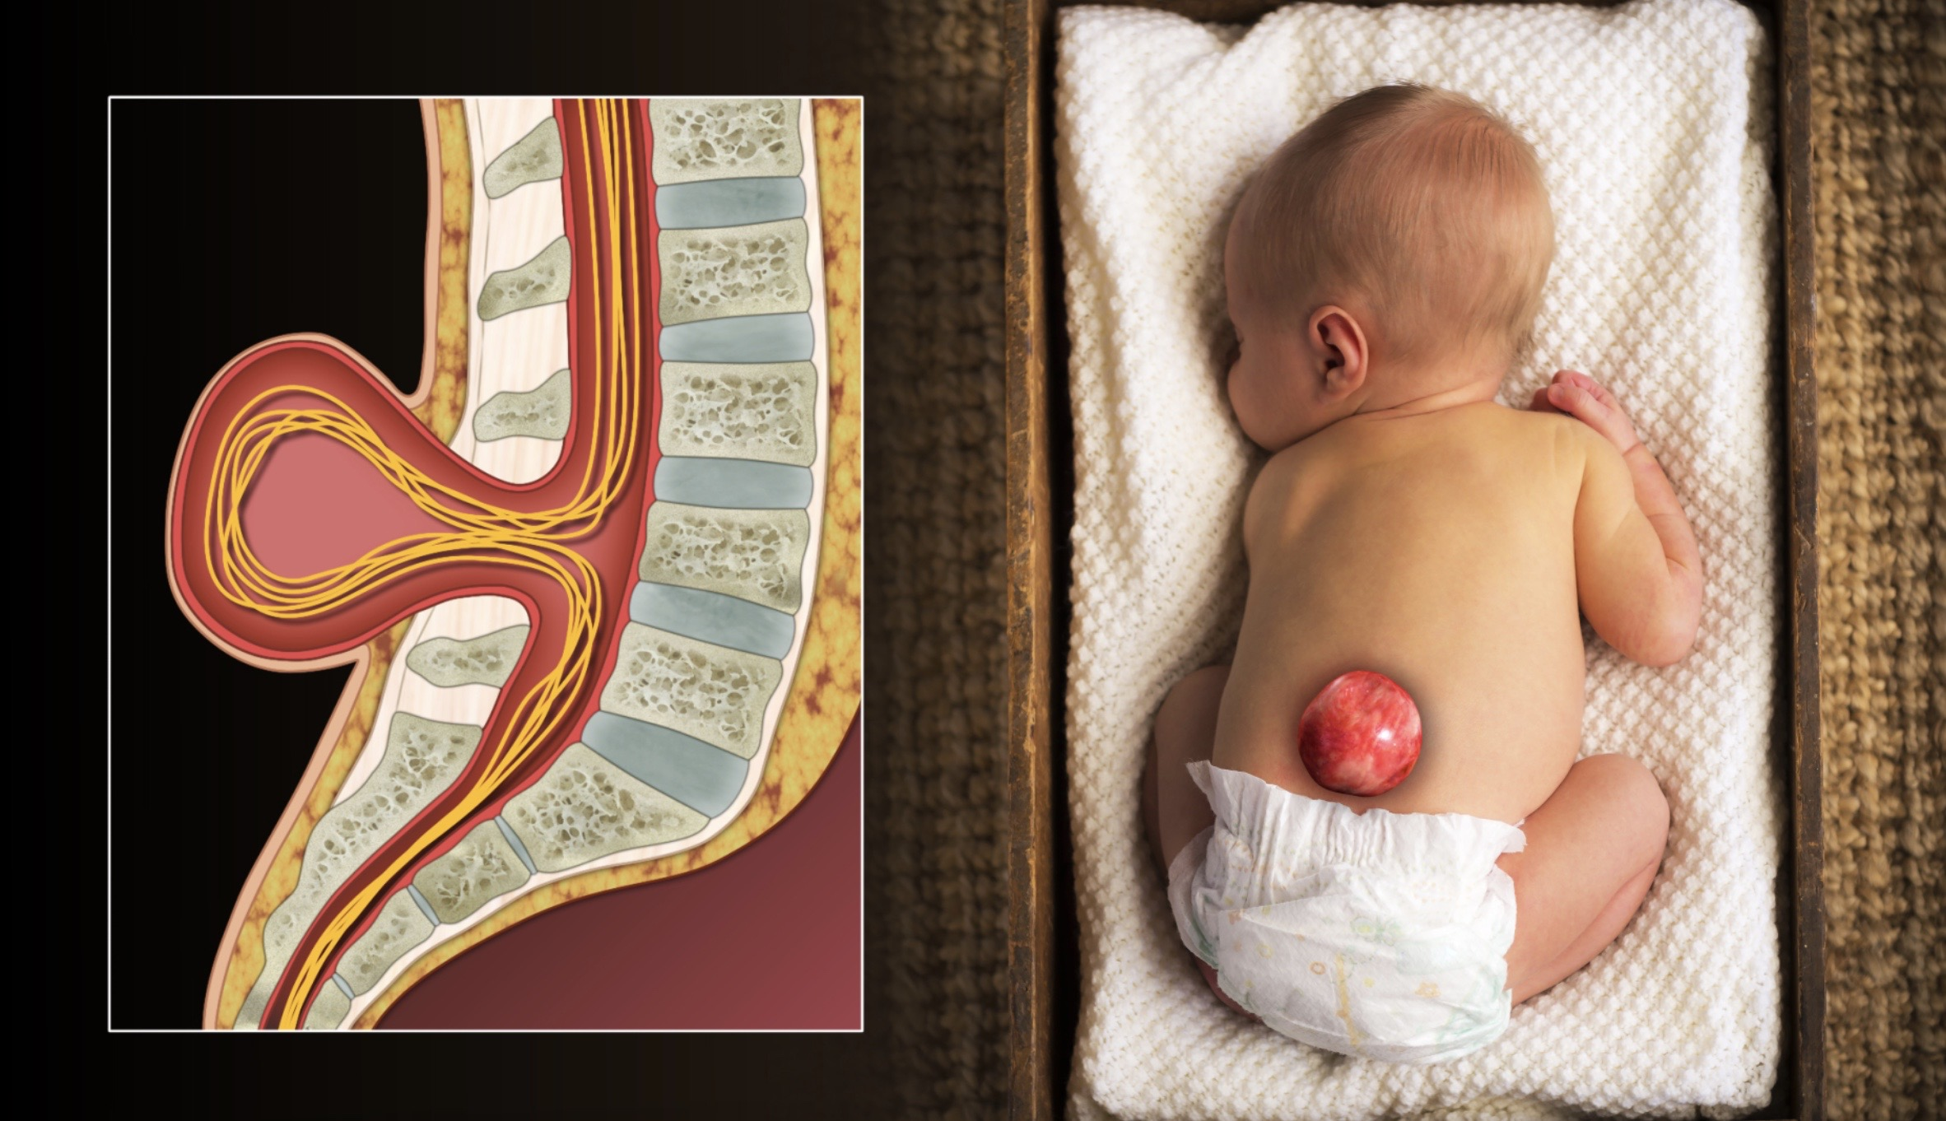

Neural tube defects: spina bifida
Meningocele
Posterior vertebral arches fail to fuse; saclike protrusion containing meninges and cerebrospinal fluid at some point along the posterior vertebrae.
Lesion can be at the cervical, thoracic, lumbar or sacral.
Typically, infant will develop hydrocephalus.
https://commons.wikimedia.org/wiki/File:3D_Medical_Animation_Spina_Bifida.jpg
Myelomeningocele
- Most severe form of spina bifida.
The posterior vertebral arches fail to fuse.
A saclike herniation contains meninges, cerebrospinal fluid, and a portion of the spinal cord or nerve roots
Notes:
The second form of spina bifida is called a meningocele. Meningocele occurs when there is a sack of fluid that protrudes through the spine. However, the spinal cord is not in the sack. Because of this, there’s typically little to no nerve damage and impact of disability is less significant then with a Myelomeningocele.
The third form of spina bifida is Myelomeningocele, this is the most severe form of spina bifida, and occurs when a sack of fluid protrudes through an opening in the spine. In this fluid filled sack is the spinal cord and nerves which then protrude from the spine, often causing damage to the nerves. Because of this, the impact to the infant is much more significant, and can cause severe urinary bladder issues as well as loss of sensation or paralysis in the lower extremities.
https://commons.wikimedia.org/wiki/File:3D_Medical_Animation_Spina_Bifida.jpg

Slide 8
Neural tube defects: spina bifida
Comorbidities/ Complications
  Bladder/ bowel issues
  Hydrocephalus
  Epilepsy
  Motor impairment including paralysis
  Skin issues related to decreased sensation (pressure sores, burns…)
  Latex allergy
Notes:
There are many comorbidities that accompany spina bifia and very significantly based on the severity of their condition. Common comorbidities include bowel or bladder dysfunction such as neurogenic bladder sometimes requiring catheterization. Hydrocephalus is a common finding that accompanies spina bifida and often requires intervention including shunts as well as long term management. We will discuss this more on its own in a few minutes.
Many patients with spina bifida can go one to develop seizures or epilepsy.
Depending on the severity of of spina bifida and impact to the spinal cord, motor impairments are common and can range from decreased motility and sensation to paralysis.
Also, because of nerve damage and decreased sensations, complications such as burns and pressures sores can occur.
One key feature in this patient population is that they very frequently develop a true latex allergy which will be important to be aware of in their medical care.

Slide 9
Neural tube defects: spina bifida
Treatments
Treatment requires complex management from neurology, neurosurgery, urology, orthopedics, rehabilitation medicine as well as services such as physical and occupational therapy.
Treatment for hydrocephalus typically requires a shunt
Surgical treatment of protrusion is typically done in the first 24 hours of life. If detected during pregnancy, intrauterine surgery can be done.
Treat comorbidities:
  Learning disorders
  Vision concerns
  Weight management
  Mobility needs
  Depression/mental health.
Check for Latex Allergies!!!
Notes:
Because of the wide range of severity of spina bifida, treatment can range profoundly. It is important to note that the treatment team for these patients is often complex and can include neurology, neurosurgery, urology, orthopedics, rehabilitation medicine as well as services such as physical and occupational therapy, social work and case management. Treatment for hydrocephalis typically requires shunt which will be managed by neurosurgery. Other surgical treatments will be needed for any level of protrusion and will typically be done in the first 24 hours of life. A key nursing intervention is the care of the meningocele including keeping this moist and sterile with sterile gauze and sterile normal saline. This will improve outcomes. Many times, if this mylomeningocele is detected during pregnancy, intrauterine surgery can be done.
Treatment for each comorbidity is needed and can range from catheter care for neurogenic bladder to orthopedics treating contractures or paralysis. Other concerns needing interventions can include learning disorders, vision concerns, weight management, depression/mental health.
And lastly, check for Latex Allergies! Individuals with spina bifida have a significant incident of natural latex allergies which is critical to identify and take precautions from time of birth to insure complications are reduced. This will include education to families about bottle fed/nipple use.

Slide 10
Neural tube defects: spina bifida
Nursing Considerations/ Patient Education
Prior to surgery: maintain skin integrity, keep sac moist with sterile, saline soaked, dressings, avoid contamination from bladder/bowels, expect antibiotics.
Post operatively: monitor for leakage of spinal fluid, maintain skin integrity, continue antibiotics, frequent neuro assessments, provide family support and teaching.
Common long term considerations: frequently can have neurogentic bladder, neurogenic bowl, require PT/OT, families require long term support and education, latex allergies are very common.
Other education: caution with hot surfaces/water, sunscreen, reposition frequently.
Notes:
Nursing Considerations/ Patient Education for this population are vast and very critical. Care prior to surgery includes maintaining skin integrity, keep sac moist with sterile, saline soaked, dressings, avoid contamination from bladder/bowels, expect antibiotics. Post operatively monitor for leakage of spinal fluid, maintain skin integrity, continue antibiotics, frequent neuro assessments, provide family support and teaching.
Common longterm considerations that will require management include neurogenetic bladder, neurogenic bowl, require PT/OT, families require long term support and education, latex allergies are very common.
Nursing education for these families is critical. Education may range from skin care post surgery, how to catheterize their child, feeding issues, understanding their possible latex allergy. One part of education that often gets missed can be long term skin care if or when impaired sensation is concern. In these patients with impaired skin sensation caution with hot surfaces or water is so important as they can easily be injured and not feel it. This ranges from a hot metal seat belt in a car, hot mug in the kitchen or hot water when showering. Also, sunscreen is really important as well as reposition frequently if immobile, or teaching the child to frequently reposition to minimize pressure sores.

Slide 11
Neural tube defects: Anencephaly
Anencephaly is a rare neural tube defect that results in defects in the skull and brain. Anencephaly occurs when the upper part of the neural tube fails to close and therefore the infant is born without the frontal lobes as well as the cerebrum of the brain.
CDC estimates that approximately 1 in 4,600 babies in the United States are born with anencephaly.
Cause is not fully understood but ranges genetic changes and environmental factures including maternal diet and medications used during pregnancy.
Notes:
Now we will look at the second most common neural tube defect, Anencephaly.
Anencephaly is a rare neural tube defect that results in defects in the skull and brain. Anencephaly occurs when the upper part of the neural tube fails to close and therefore the infant is born without the frontal lobes as well as the cerebrum of the brain.
The Center for Disease Control estimates that approximately 1 in 4,600 babies in the United States are born with anencephaly.
The cause of anencephaly is not fully understood and includes genetic causes such as genetic and/or chromosomal changes as well as environmental factures including maternal diet (again folic acid deficiencies) and medications taken by the mother during pregnancy.
https://www.cdc.gov/ncbddd/birthdefects/anencephaly.html

Slide 12
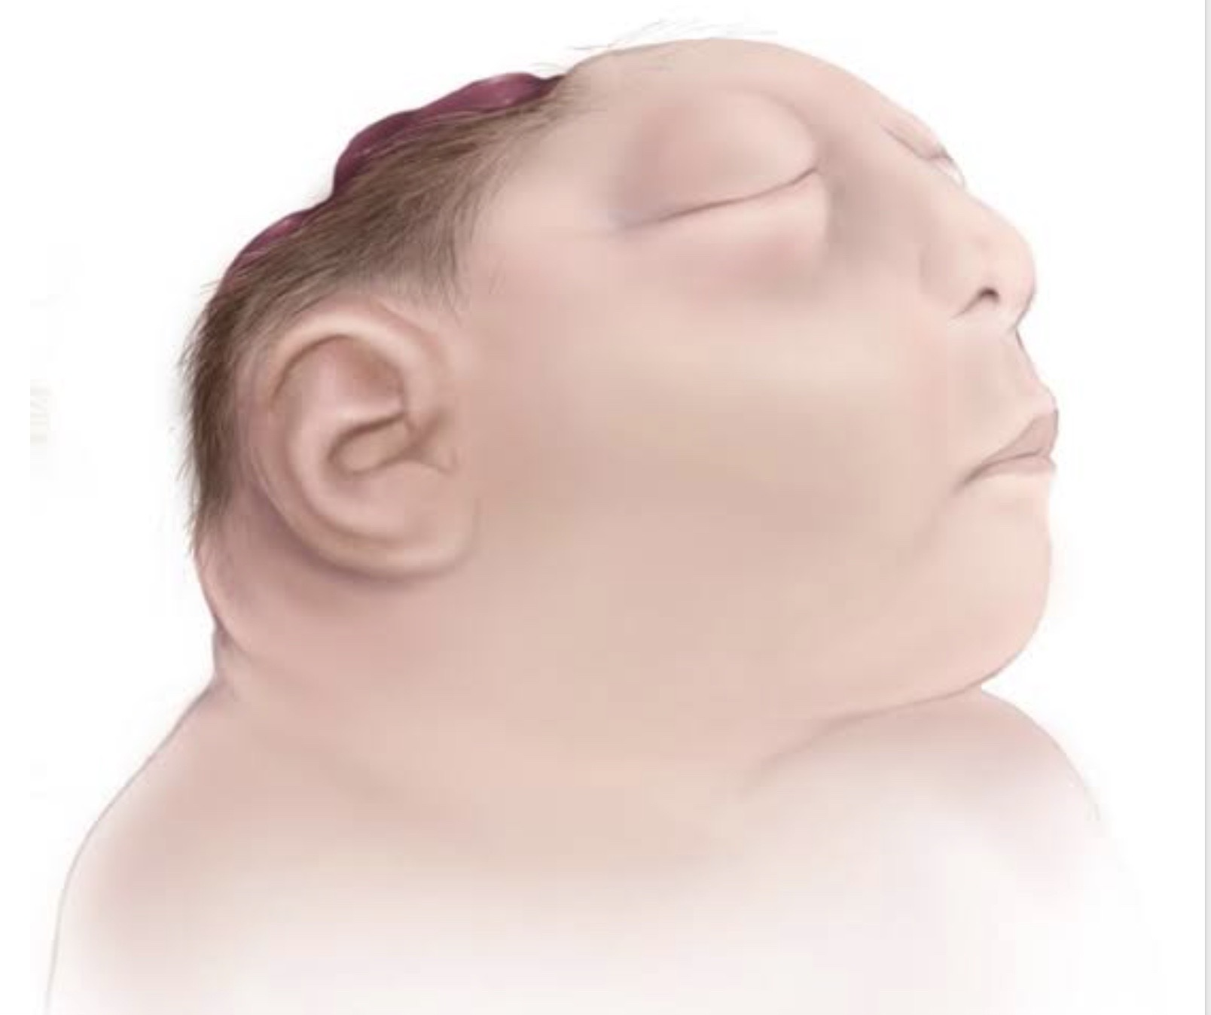
Neural tube defects: Anencephaly
Diagnosis
Anencephaly is often diagnosed on ultrasound while in utero but can also be diagnosed after birth.
Treatments
There is no cure or treatment for anencephaly and is almost always fatal shortly after birth.
Notes:
The diagnosis of anencephaly is often diagnosed on first on ultrasound where these malformations can be seen while in utero. Certain serum studies and amniocentisis can also reveal changes indicative of anencephaly. If missed during pregnancy, anencephaly will be quickly diagnosed after birth based on visual malformations.
There is sadly no cure or treatment for anencephaly and is almost always fatal shortly after birth.
https://garystockbridge617.getarchive.net/amp/media/anencephalic-baby-a6a02d

Slide 13
Neural tube defects: Anencephaly
Nursing Considerations/ Patient Education
Because there is no treatment, care should focus on parent and maternal support and palliative care.
It is estimated by the CDC that about 75% of babies with anencephaly are stillborn.
Notes:
Nursing Considerations and Patient Education for anencephaly are quite different than for most of the conditions we will discuss due to the fact that this is a fatal condition. Because there is no treatment, nursing care should focus on parent and maternal support and palliative care for the infant. It is estimated by the CDC that about 75% of babies with anencephaly are stillborn.

Slide 14
Hydrocephalus
Hydrocephalus occurs when there is a build up of cerebrospinal fluid in the ventricles of the brain. This build up of fluid increases pressure on the brain leading to numerous neurological complications.
Notes:
Hydrocephalus is a condition in which there is a buildup of cerebral spinal fluid in the ventricles of the brain. In a normal body, cerebrospinal fluid flows normally through the ventricles to the brain and spinal column. For a variety of reasons when hydrocephalus occurs, there’s either an obstruction of flow of cerebrospinal fluid, or excess amount of spinal fluid. Regardless of the cause this increase in cerebrospinal fluid places, additional pressure on the brain, causing damage to the tissue of the brain and can leads to numerous neurologic complications.
Hydrocephalus is typically not a condition but rather a side effect or symptom of that can accompany a variety of conditions, although congenital hydrocephalus can occur. Other causes include chiari malformation, neural tube defects such as spina bifida which was have already discussed, congenital brain malformations, tumors or cysts such as arachoid cysts, infections including meningitis which we will discuss more in a few minutes, traumatic brain injuries

Slide 15

Hydrocephalus
Symptoms:
Infants:
  Increase head circumference
  Bulging fontanels
  Vomiting or poor feeding
  Lethargy
  Irritability
  Seizures
Children & Adults:
  Headache
  Blurred vision
  Delayed pupil response
  Lethargy
  Nausea/ Vomiting
  Irritability or change in mood
  Decreased coordination or balance
Pexels.com
Notes:
Symptoms commonly seen in infants include Increase head circumference, bulging fontanels, vomiting or poor feeding, lethargy, irritability, and seizures. In children and adults these symptoms are very similar but just are expressed by the individual differently. These symptoms include headache, blurred vision which the older child can now report themselves, delayed pupil response on exam, lethargy or extreme fatigue, reported nausea/ Vomiting, irritability or change in mood and personality, decreased coordination or balance issues
https://www.pexels.com/photo/crying-newborn-baby-15128069/

Slide 16
Hydrocephalus
Comorbidities/ Complications:
Seizures or Epilepsy
Bladder or bowel issues
Developmental and/or cognitive disabilities
Vision changes or loss
If left untreated, death
Diagnosis:
CT or MRI with enlarged ventricles
Ultrasound in infants
Physical exam
Lumbar puncture
Notes:
Hydrocephalus can be diagnosed several ways. Imaging such as CT or MRI will help to determine if there are enlarged ventricles. In infants, ultrasound of the head is often used since it is cheaper, quicker and more tolerable to the infant. Never underestimate the importance of physical exam. While a physical exam cannot definitively diagnose hydrocephalus, it can be very instrumental in leading to the ordering of proper tests and lead to the right diagnosis. And lastly, lumbar puncture can be done and will often demonstrate increased opening pressures.
Patients with hydrocephalus can really range in terms of comorbidities or complications. Some infants and children tolerate treatment well and go one to live a relatively normal life with minimal impact. However other patients can have significant comorbidities including seizures or Epilepsy, long term bladder or bowel issues, developmental and/or cognitive disabilities, vision changes or loss, and if left untreated, death. While some of these outcomes are inevitable, it is critical to identify symptoms of hydrocephalus quickly to expedite interventions and improve outcomes.

Slide 17
Hydrocephalus
Treatments
  Shunt
    Most common treatment is shunt that allows the excess CSF to drain typically to the abdomen.
    Risks include surgical complications, risk of infection and may need to be replaced as the infant/child grown in length or if a block occurs.
  Endoscopic third ventriculostomy
    A surgical intervention in which a small hole is made either at the bottom of the ventricles or in between the ventricles to allow CSF to drain that way. This is less common and can be considered more invasive.
Notes:
The most common treatment for hydrocephalus is the surgical insertion of a drainage system, called a shunt. It consists of a long, flexible tube with a valve that keeps fluid from the brain flowing in the right direction and at the proper rate.
One end of the tubing is usually placed in one of the brain's ventricles. The tubing is then tunneled under the skin to another part of the body — such as the abdomen or a heart chamber — where the excess fluid can be more easily absorbed.
People who have hydrocephalus usually need a shunt system for the rest of their lives. They require regular monitoring.

Slide 18
Hydrocephalus
Nursing Considerations/ Patient Education:
Families need to be educated on signs and symptoms to watch for increased intracranial pressure throughout the lifespan as blockage, infection or growth can impair the shunt at any time
Some children will go on to have long term complications such as developmental delays, mobility impairments and seizures.
Care team may involve neurosurgery, neurology, OT, PT, social work and developmental providers.
Notes:
Nursing interventions for these patients includes early recognition of symptoms of increased intracranial pressure which includes knowing which symptoms to watch for as well as being well versed in neurologic exams. For patients diagnosed with hydrocephalus, these families need to be educated on signs and symptoms to watch for increased intracranial pressure throughout the lifespan as blockage, infection or growth can impair the shunt at any time
Some children will go on to have long term complications such as developmental delays, mobility impairments and seizures.
Care team may involve neurosurgery, neurology, OT, PT, social work and developmental providers.

Slide 19

Infectious causes
Notes:
Next, we shift our focus to infectious causes of neurologic conditions in the pediatric patient. You will not that some of these overlap closely with some of the conditions we have already talked about such as hydrocephalus

Slide 20
Infectious causes: encephalitis
Encephalitis occurs when there is inflammation to the brain tissue.
Common causes include viral or bacterial infection such as West Nile Virus, herpes simplex virus, enteroviruses, measles, mumps, rubella
Other causes can include autoimmune disease
Notes:
Encephalitis is a condition that occurs when there is inflammation to the brain tissue. This can happen for a variety of reasons, but common causes include viral or bacterial infection such as West Nile Virus, herpes simplex virus, enteroviruses, measles, mumps, rubella. Other causes can include autoimmune disease and injury to the brain.

Slide 21
Infectious causes: encephalitis
Symptoms
Diagnosis
Fever
Headache
Neck stiffness
Photophobia
Lethargy
Gait instability
Seizures
Confusion or change in behavior
Thorough history is key!!
  Ask about travel, vaccination history, tick bites,
Lumbar puncture to check CSF
CT scan
EEG if there is concern for seizures or altered mental status
Infection work up- CBC, CMP, UA, blood cultures
Notes:
Symptoms can vary greatly based on the severity as well as the areas of the brain that are affected. Common symptoms include
Fever
Headache
Neck stiffness
Photophobia
Lethargy
Gait instability
Seizures
Confusion or change in behavior.
When diagnosing encephalitis, a thorough history is key! Ask the patient/family about travel, vaccination history, tick bites, and other red flags for encephalitis. Lumbar punctures can be done to check CSF, and can reveal infections, increased protein or low glucose and increased opening pressures which will be helpful in treating the underlying cause. A CT scan or MRI may be obtained and would likely reveal the inflammation of the brain. An EEG may be done to rule out seizures (or understand burden of seizures) if there is concern for clinical seizure activity or altered mental status. And lastly a full infection work up should be done, working to find that underlying cause. this includes CBC, CMP, UA, blood cultures

Slide 22
Infectious causes: encephalitis
Comorbidities/ Complications
Seizures or epilepsy
Learning or cognitive delay
Hearing loss
Hydrocephalus
Notes:
As with hydrocephalus, long term comorbidities for encephalitis can vary greatly by child. Some children do quite well with quick intervention and can have minimal long term impacts. However, many children can go one to develop epilepsy (sometimes even years later) as well as learning and cognitive disabilities.

Slide 23
Infectious causes: encephalitis
Treatments:
Key to treatment is identifying the cause and treating early
IV antibiotics, steroids, IVIG,
For autoimmune cause, immunosuppressants are sometimes used
Notes:
Treatment for encephalitis will depend on the underlying cause. The key here, as with many of the conditions we are discussing today, is to identify the cause and treating early. Many patients will require close monitoring in the hospital and some even in the PICU. IV antibiotics, steroids, IVIG, are all potential options to treat depending on severity and cause
For autoimmune cause, immunosuppressants are sometimes used

Slide 24
Infectious causes: encephalitis
Nursing Considerations/ Patient Education
Patient typical requires acute care and hospitalization, sometimes PICU care
Patient team will typically include nursing, neuro-immunology, infectious disease, neurology and PT, OT and rehab post inflammation.
Nursing role should focus on great intake and detailed history.
During the acute phase diagnosis, critical care management and skills such as IV antibiotics administration.
Parent and caregiver support are important.
Notes:
These patients will very often require hospitalization and even PICU admission depending on level of severity. Patient team will typically include nursing, neuro-immunology, infectious disease, neurology and PT, OT and rehab post inflammation. Again, Nursing role should focus on great intake and detailed history.
During the acute phase diagnosis, critical care management and skills such as IV antibiotics administration.
Parent and caregiver support are important

Slide 25
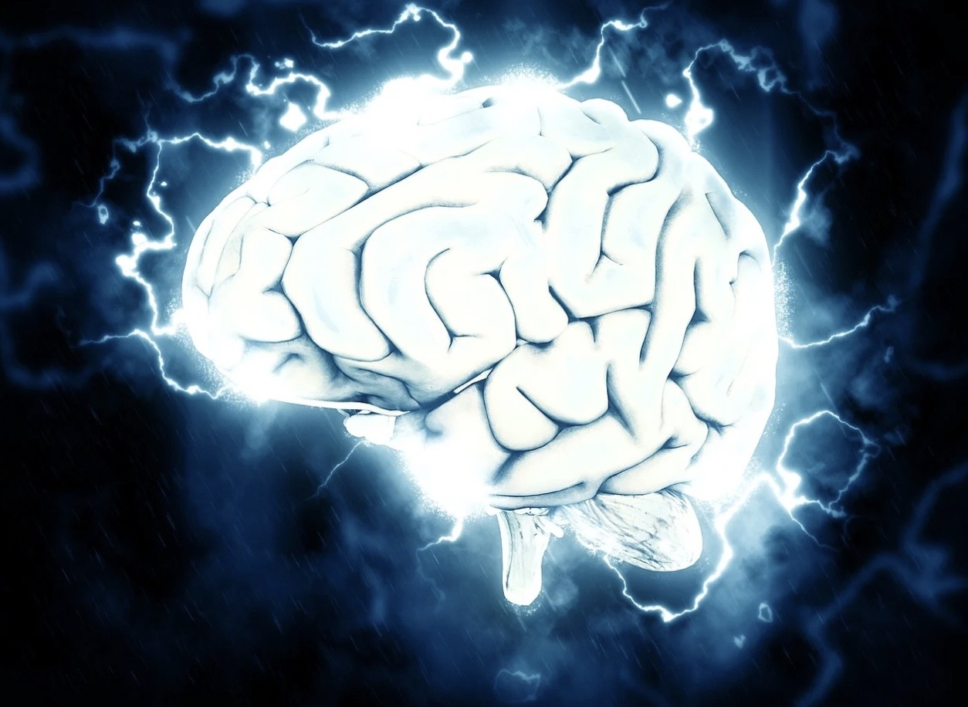
Infectious causes: meningitis
Meningitis occurs when there is an infection in the cerebrospinal fluid (CSF) leading to inflammation of the brain and spinal cord.
Typical causes include bacterial, viral or fungal infections as well as more rarely parasites.
Meningitis can cause encephalitis when it leads to inflammation of the brain, so the two diagnosis can go hand in hand.
Notes:
Meningitis occurs when there is an infection in the cerebrospinal fluid (CSF) leading to inflammation of the brain and spinal cord. Not all cases of encephalitis will have meningitis, but
Typical causes include bacterial, viral or fungal infections as well as more rarely parasites.
Menengitis can cause encephalitis when it leads to inflammation of the brain, so the two diagnosis can go hand in hand.

Slide 26

Infectious causes: meningitis
Symptoms:
Stiff neck is a classic symptom!
Confusion, agitation or altered mental status.
Headache
High fever
Nausea or Vomiting
Gait instability
Diagnosis
- Lumbar puncture is key to help find underlying cause and target treatment.
Wikimedia Commons
Notes:
Inflammation of the brain and spinal cord membraines cause pain due to inflamed meninges cuause pain.
mintchipdesigns, CC0, via Wikimedia Commons
https://commons.wikimedia.org/wiki/File:ChildwithHeadAche_2010.jpg

Slide 27
Infectious causes: meningitis
Comorbidities/ Complications
There is an estimated fatality rate of 30% and as high as a 50% incidence of developing long term neurological complications
Long term complications include
  Hearing loss
  Cognitive and learning impairments
  Epilepsy
  Hydrocephalus
Notes:
https://www.ncbi.nlm.nih.gov/pmc/articles/PMC8001510/

Slide 28
Infectious causes: meningitis
Treatments
Treatment will be based on underlying cause.
  Bacterial~ IV antibiotics (typically broad spectrum)
  Viral~ other than Herpes simplex virus, there are not great direct treatment options.
Corticosteroids
Hospitalization for treatment and monitoring

Slide 29
Infectious causes: meningitis
Nursing Considerations/ Patient Education
Acute phase: close monitoring, hospitalization, administration of IV antibiotics and IV fluids.
Education related to hospitalization, treatments being used including IV medications should take place to help the caregiver understand the treatment plan.
Vaccinations (specifically haemophilus influenzae b (Hib) S pneumoniae, Neisseria meningitidis as well as some of the newer developed meningococcal vaccines. Education parents about importance of vaccinations is a critical step for nurses to help reduce incidence of meningitis.
Notes:
Nursing considerations for the patient with meningitis are quite similar to those we have discussed for encephalitis. Close monitoring and hospitalization will likely be required, as well as administration of treatments including antibiotics, fluids and/or steroids.
Parent education about the disease and treatment will help alleviate fears and foster collaboration between the parents and treatment team.
However a real key nursing role is to help prevent meningitis when possible. Vaccinations are a hot topic today, however they remain the number one way to reduce incidence and comorbidities of meningitis. Vaccinations can include H InfluenzAe or Hib, S new-mon-yay, Nee-seria meningi-das, as well as the Meningicoccal vaccine.
Education during travel can help prevent other causes of meningites for example caution with water sources when traveling internationally to avoid malaria.

Slide 30
References: https://www.ncbi.nlm.nih.gov/pmc/articles/PMC8001510/ https://www.cdc.gov/ncbddd/birthdefects/anencephaly.html
Douglas Swanson; Meningitis. Pediatr Rev December 2015; 36 (12): 514–526. https://doi.org/10.1542/pir.36-12-514
Kahle, K. T., Kulkarni, A. V., Limbrick, D. D., & Warf, B. C. (2016). Hydrocephalus in children. The Lancet, 387(10020), 788–799. https://doi.org/10.1016/s0140-6736(15)60694-8

