Slide 1
Nursing care for pediatric neurology~ Part 2
Dr. Kimberly Ndahayo, DNP, FNP-C, RN, CNRN
Notes:
Hello, my name is Dr. Kimberly Ndahayo, I am a Family practitioner with 15 years experience in adult and pediatric neurology. Today we continue our discussion on common conditions of pediatric neurology. Part two will focus on autoimmune mediated neurologic conditions, tumors in childhood, genetic neurologic diseases and neuromuscular conditions in childhood.

Slide 2
Learning Objectives
Identify common autoimmune disorders that can affect pediatrics, including Multiple Sclerosis and Myasthenia Gravis, and how to care for the pediatric patient with these conditions.
Understand tumor based neurologic conditions in pediatric conditions such as Neurofibromatosis and Tuberous Sclerosis.
Identify underlying pathophysiology of some common genetic neurologic conditions as well as nursing care for this complex patient population.
Identify diagnosis, treatment and nursing considerations of neuromuscular conditions including Cerebral Palsy and Duchenne Muscular Dystrophy.
Notes:
The learning objectives for todays presentation are to
identify common autoimmune disorders that can affect pediatrics, while there are several, we will look specifically at Multiple Sclerosis with pediatric onset and Myasthenia Gravis, as well as how to care for the pediatric patient with these conditions.
Understand tumor based neurologic conditions in pediatric conditions such as neurofibromatosis and Tuberous Sclerosis.
Identify underlying pathophysiology of some common genetic neurologic conditions as well as nursing care for this complex patient population. While there are numerous genetic conditions resulting in neurologic conditions in pediatrics, we will focus on Angelmans syndrome and Glut 1 deficiency as there are two diagnosis you will likely come across in your nursing career.
Lastly, we will two common neuromuscular conditions, Cerebral Palsy and Duchenne Muscular Dystrophy, and the diagnosis, treatment and nursing implications when caring for this patient population.

Slide 3
Autoimmune
Autoimmune mediated neurological conditions in pediatrics means that the underlying cause of they neurological symptoms are based in an autoimmune disorder, or an over-active immune system attacking healthy cells of the body tissues and/organ
Common examples of pediatric autoimmune diseases include:
Guillain-Barré syndrome
Chronic inflammatory demyelinating polyradiculoneuropathy (CIDP)
Juvenile myasthenia gravis (JMG)
Juvenile dermatomyositis (JDM)
Multiple Sclerosis
Notes:
Autoimmune mediated neurological conditions in pediatrics means that the underlying cause of they neurological symptoms are based in an autoimmune disorder, or an over-active immune system attacking healthy cells of the body tissues and/organ
Common examples of pediatric autoimmune diseases include:
Guillain-Barré syndrome
Chronic inflammatory demyelinating polyradiculoneuropathy (CIDP)
Juvenile myasthenia gravis (JMG)
Juvenile dermatomyositis (JDM)
Multiple Sclerosis

Slide 4
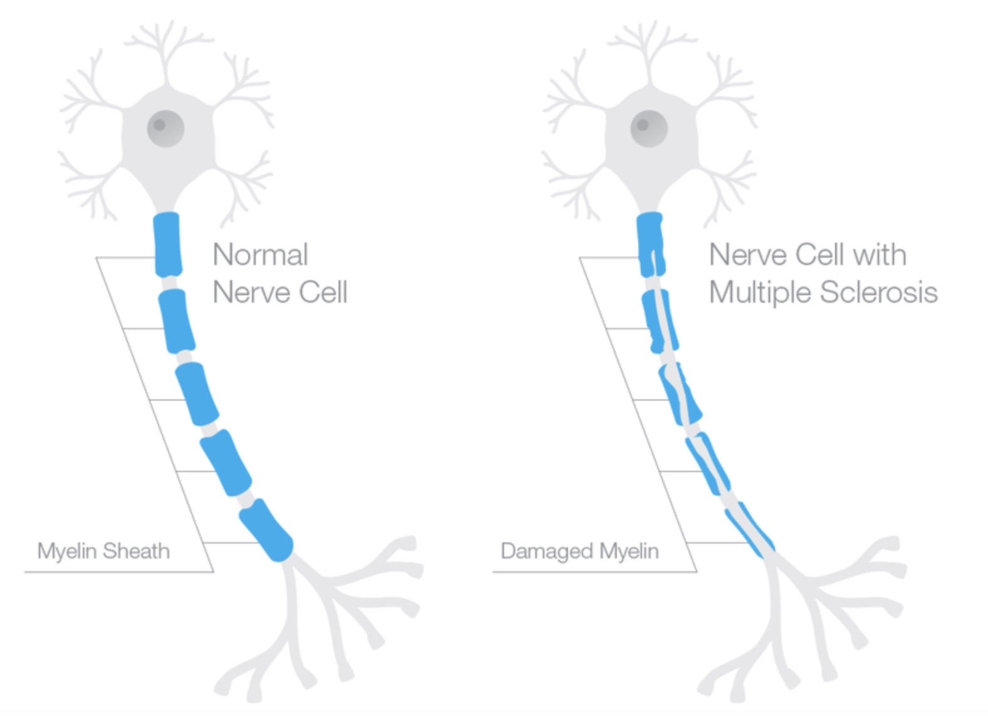
Autoimmune : Multiple Sclerosis
Multiple Sclerosis is an autoimmune disease affecting the central nervous system, both brain and spinal cord. MS attacks the myelin (which is the coating around nerve cells) and can leave plaque or lesions that then interfere with the nerve conduction resulting in the neurologic symptoms seen in patients with MS.
-Typically diagnosed in adulthood, about 5% of MS cases are diagnosed before the age of 16.
-Cause is unknown, but there is suspected genetic predispositions as well as environmental factors that can play a role in this.
Image: Wikimedia Commons
Notes:
First we will begin by looking at multiple sclerosis. This is a condition you may well be aware of as it affects nearly 1 million Americans according to the National MS Society. However less that 5% of cases of MS begin in childhood, therefore this is a diagnosis often overlooked in the pediatric population.
Multiple Sclerosis is an autoimmune disease affecting the central nervous system, both brain and spinal cord. MS attacks the myelin (which is the coating around nerve cells) and can leave plaque or lesions that then interfere with the nerve conduction resulting in the neurologic symptoms seen in patients with MS.
The underlying cause is not fully understood however, there is suspected genetic predispositions as well as environmental factors that can play a role in this.
https://www.nationalmssociety.org/About-the-Society/MS-Prevalence#:~:text=A%20study%20funded%20by%20the,than%20twice%20the%20original%20estimate.
https://upload.wikimedia.org/wikipedia/commons/a/a0/Adskcxvbklawe%3Blas.png

Slide 5
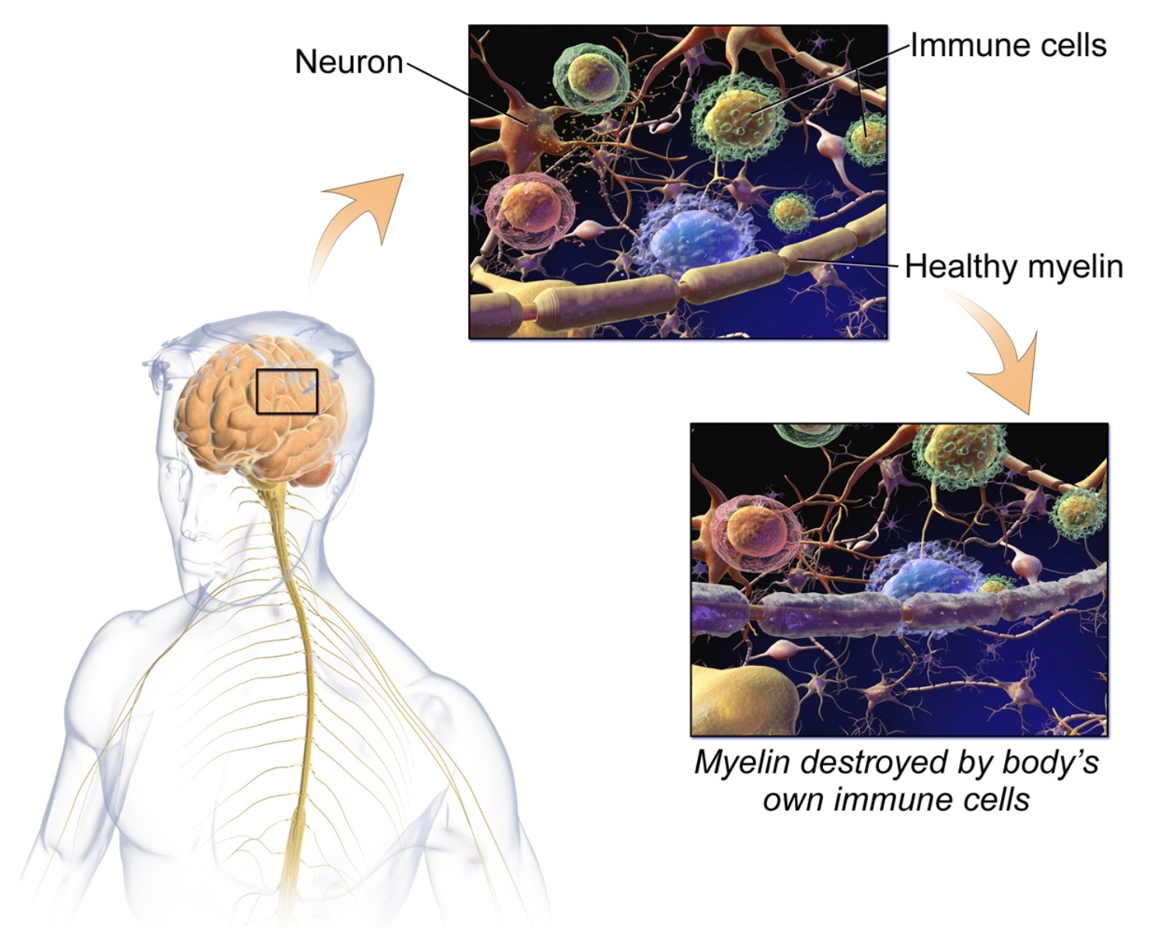
Autoimmune : Multiple Sclerosis
Symptoms
Vision changes
Weakness
Altered sensation/ numbness
Fatigue
Pain
Muscular changes such as weakness, imbalance
Bowel/bladder changes
Emotional irregularities
Speech changes
Cognitive changes/ memory problems
In pediatric onset cases of MS, episodes tend to be intermittent with periods of remission. Because of this it can take time to receive the correct diagnosis.
Image: Wikimedia Commons
Notes:
Symptoms of MS can vary greatly depending on the location of impact throughout the brain and spinal cord, as well as length of disease and frequency of exacerbations. Common symptoms reported include:
Vision changes
Weakness
Altered sensation/ numbness
Fatigue
Pain
Muscular changes such as weakness, imbalance
Bowel/bladder changes
Emotional irregularities
Speech changes
Cognitive changes/ memory problems
It is important to note that often when MS begins in childhood symptoms can present quite quickly and severly but then quickly go away (which we refer to as remission). Time between relapses may also be longer in some pediatrics. This presentation of quick return to baseline and prolonged remissions can often make diagnosis of MS in pediatrics quite challenging.
https://upload.wikimedia.org/wikipedia/commons/2/2e/Multiple_Sclerosis.jpg

Slide 6
Autoimmune : Multiple Sclerosis
Diagnosis
Diagnosis is based on variety of tests including:
Neurologic exam
History
MRI (looking for lesions on brain, spinal cord or optic nerves)
Lumbar puncture (looking for antibodies or proteins in the CSF)
Comorbidities/ Complications:
  Vision changes or loss
  Mobility difficulties
  Depression/anxiety
  Hypertension
  Chronic lung disease
  Comorbid autoimmune diseases
Notes:
Diagnosis is based on variety of tests including:
Neurologic exam
History
MRI (looking for lesions on brain, spinal cord or optic nerves)
Lumbar puncture (looking for antibodies or proteins in the CSF)
Common comorbidities seen with MS are:
Vision changes or loss
Mobility difficulties
Depression/anxiety
Hypertension
Chronic lung disease]
Comorbid autoimmune diseases
Again, many of these comorbidities may not be present yet in the pediatric patient, but because their MS will affect them throughout their lifespan, education and close monitoring is important to minimize these comorbidities.

Slide 7
Autoimmune : Multiple Sclerosis
Treatments
No cure
Treatment focus is managing symptoms and slowing progression
Because lesions lead to long term complications, goal is to decrease relapses and minimize plaque and lesions
Acute Phase:
Steroids, IVIG
Long term/Prevention:
Goal is to reduce episodes
Treatments include:
  Interferons: Avonex, Rebif, Betaseron and Plegridy
  Copaxone (acts similarly to the proteins that make up myelin in the brain and spinal cord)
  Oral medications: Fingolimod (Gilenya) is one of the few oral treatments frequently used in children.
  IV treatment: Rituxumab, Tysabri, Ocrevus are IV infusions
  Other:
    Vitamin D can help decrease MS activity
    Lifestyle: avoid smoking and secondhand smoke, healthy diet, exercise and sleep significantly help
Notes:
There is currently no cure for MS and treatment is focused on reducing frequency and severity of relapses and prolong remission periods.
During the acute phase of relapse steroids used short term, typically IV. IVIG is a medication made up of antibodies from healthy blood donors and these antibodies can help to decrease autoimmune response. Plasma exchange or plasmapheresis is done for more difficult cases, during this . It is a process where the blood is removed from the body and washed to remove disease-causing substances, such as antibodies from the plasma (the liquid component of blood). The blood cells are then returned to the body. Multiple treatments are required, given over a couple of weeks. Plasma exchange requires the surgical placement of a special line for IV access. Risks include changes in blood pressure and fluid balance as well as infection of the access site.
Different medications you may see used include
Interferons, which include Avonex®, Rebif®, Betaseron®, Plegridy®, These medications can mimic the effects of some proteins that your body and alter how the immune system responds and decrease the number of relapses.
Another medication used is Glatiramer acetate (Copaxone®), which is a SQ medication similar to the proteins that makes up myelin in the brain and spinal cord.
There are several oral medications available for MS, however Fingolimod (Gilenya) is one of the few oral treatments frequently used in children.
IV treatment: Rituxumab, Tysabri, Ocrevus are IV infusions you may see given
Other things that can help reduce morbidity include Vitamin D can help decrease MS activity, and lifestyle changes including avoiding smoking and secondhand smoke, eating a healthy diet, exercise and sleep.

Slide 8
Autoimmune : Multiple Sclerosis
Nursing Considerations/ Patient Education
MS is a chronic lifelong condition. As such education and patient support is very important.
Education regarding healthy lifestyle, smoking cessation, proper sleep and exercise and mental health screenings and support are important aspects of nursing care
Education regarding action plan for relapses as well as symptoms to watch for.
Notes:
MS is a chronic lifelong condition. Because of this this nursing role should focus on education and patient support.
Education regarding healthy lifestyle, smoking cessation, proper sleep and exercise, mental health screenings and support are important aspects of nursing care.
Helping to create a treatment action plan for relapses as well as symptoms to watch for is important.
Nursing will also need to education about medications used as many will be done at home by the patient.

Slide 9
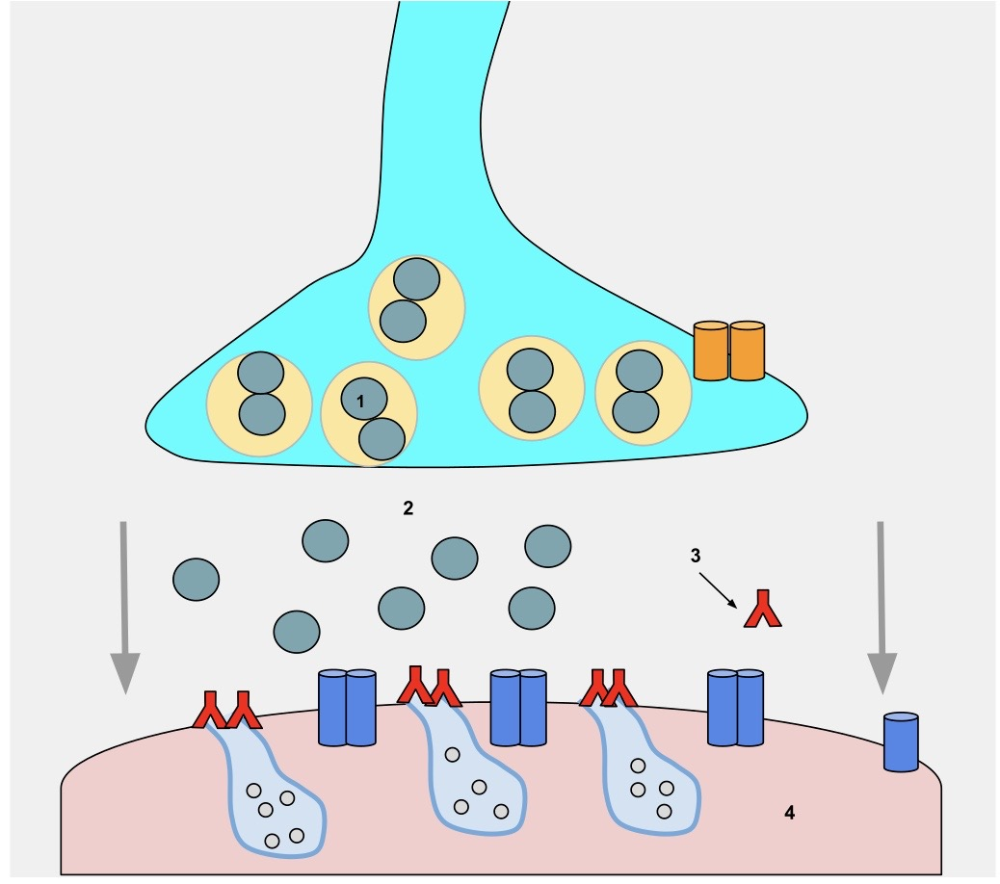
Autoimmune: myasthenia gravis
Myasthenia gravis is an autoimmune disease which causes decrease muscle tone and fatigue of muscles.
There is no cure but treatment aims to relieve symptoms.
Most common muscles effected are eye muscles, muscles of the face and mouth, neck and limb muscles.
When it occurs in childhood it is called Juvenile Myasthenia Gravid (JMG).
Cause: blocked acetylcholine release at the neuromuscular junction which prevents transmission of signals to muscles.
Image: Wikimedia Commons
Notes:
Myasthenia gravis is a chronic autoimmune and neuromuscular disease which causes decrease skeletal muscle tone and fatigue of muscles. The skeletal muscle is responsible for all movement in the body as well as facilitates breathing.
There is no cure but treatment aims to relieve symptoms
Most common muscles effected are eye muscles, muscles of the face and mouth, neck and limb muscles
When it occurs in childhood it is called Juvenile Myasthenia Gravid (JMG)
Lets take a step back into basic neuro-pathophysiology for one moment.
What are neuro-transmitters? Neurotransmitters are the chemicals that neurons (or brain cells) need to communicate information.
So when a signal or impulse travels down a motor nerve the body releases a neurotransmitter called ACETYLCHOLINE to bind to the electrical impulses at the neuromuscular junction which is where the motor nerve meets up with the muscle itself.
Because MG is an autoimmune disorder, antibodies created block this release of acetylcholine at the motor junction, thereby interrupting the the signal and preventing the muscle from contracting.
Because the Thymus glad regulated the formation of immune function, this gland can play a role in the underlying causes behind MG.
https://upload.wikimedia.org/wikipedia/commons/8/8f/Wikipedia_Project_Myasthenia_gravis_%285%29.svg

Slide 10
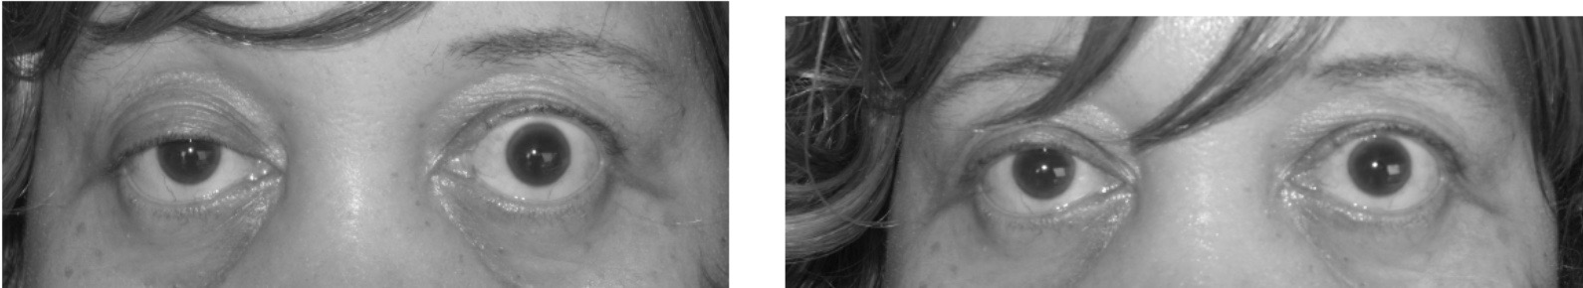
Autoimmune: myasthenia gravis
Symptoms
Myasthenic crisis
Symptoms vary based on muscle group affected but commonly include:
  Eyelid drooping (ptosis)
  Double vision (diplopia)
  Speech difficulty
  Difficulty swallowing, choking,
  Difficulty walking
  Difficulty with trunk support and neck stability
  In severe episodes breathing can be affected
A myasthenic crisis is considered a medical emergency
Occurs when skeletal muscles responsible for respiration are affected causing respiratory distress and even failure.
Causes can vary but often can be triggered by infection or stress.
Approximately15-20% of patients with MG will experience at least one myasthenic crisis in their lifetime.
Image: Wikimedia Commons
Notes:
Symptoms of MG can vary based on muscle group affected but commonly include:
Eyelid drooping (ptosis)
Double vision (diplopia)
Speech difficulty (dysarthria)
Difficulty swallowing and chewing
Difficulty walking
Difficulty with trunk support and neck stability
In severe episodes breathing can be affected
A myasthenic crisis is considered a medical emergency
Occurs when skeletal muscles responsible for respiration are affected causing respiratory distress and even failure.
Causes can vary but often can be triggered by infection or stress.
Approcimately15-20% of patients with MG will experience at least one myasthenic crisis in their lifetime.
https://upload.wikimedia.org/wikipedia/commons/5/57/Myasthenia_gravis_ptosis_reversal.jpg

Slide 11
Autoimmune: myasthenia gravis
Comorbidities/ Complications
Symptoms worsen with alcohol, fatigue or sleep deprivation, some medications (some antibiotics such as penicillin's and some cardiovascular medications)
Thyroid disease
Systemic lupus erythematosus, rheumatoid arthritis
Cardio myositis and subclinical cardiac dysfunction has also been reported
Diagnosis
Antibody titer tests
Repetitive nerve stimulation
Tensilon tests
Stimulated single fiber EMG (SSFEMG)
Notes:
Symptoms of MG can worsen or be triggered by alcohol, fatigue or sleep deprivation, infection, stress and even some medications (some antibiotics such as penicillin's and some cardiovascular medications)
Comorbidities such as Thyroid disease, Systemic lupus erythematosus and rheumatoid arthritis are also common in individuals with MG.
Cardio myositisn (MY-O-Ci-Tyson) and subclinical cardiac dysfunction has also been reported]
Diagnosis for MG includings:
Antibody titer tests: to see if antibodies are attacking your child’s neuromuscular system. If these tests are positive then the patient most likely has myasthenia gravis.
Repetitive nerve stimulation is a test done during an EMG (or elcro0my-ography) test and involves stimulating specific nerves and examining abnormal muscle movements.
Tensilon (Ten-Silon) tests involve injection of a small amount of a medicine called Tensilon. If the patient has myasthenia gravis you will see an immediate, brief increase in muscle tone.
Stimulated single fiber EMG (SSFEMG) is another test done during EMG, which is typically not one of the primary tests done but can be used when other tests are negative or inconclusive.

Slide 12
Autoimmune: myasthenia gravis
Treatments
No cure, focus on symptom management
Thymectomy- removal of they thymus gland
Monoclonal antibody
Anti-cholinesterase agents (pyrostigmine)
Immunosuppressive medications
Plasmapheresis and/or IVIG
Notes:
There is currently no cure of MG and treatment focuses on increasing remission as well as symptom management.
- Sometimes a Thymectomy may be done. This is a surgical removal of the thymus gland which can help to reduce symptoms.
Monoclonal antibody treatment is something more widely heard of now post covid, but for MG this is a treatment that targets the process by which acetylcholine antibodies injure the neuromuscular junction. The U.S. Food and Drug Administration (FDA) has approved the use of the medication e-cul-i-zu-mab for the treatment of generalized myasthenia gravis in adults who test positive for the antiacetylcholine receptor (AchR) antibody.
Anticholinesterase medications—Most common medication class used for MG, you will typically hear of mestinon or pyridostigmine, which works to slow the breakdown of acetylcholine at the neuromuscular junction and thereby improve neuromuscular transmission and increase muscle strength.
Immunosuppressive drugs—We talked about these related to MS, but these medications can help to improve muscle strength by suppressing the production of abnormal antibodies.
We also discussed plasmapheresis and intravenous immunoglobulin already for MS, but these can also be used for MG to target reduction of the antibodies effecting the cells

Slide 13
Autoimmune: myasthenia gravis
Nursing Considerations/ Patient Education
Complex care team includes nursing, neuromuscular specialists, neurology, orthopedics, genetic specialists, ophthalmology
Myasthenic crisis awareness
Medication use and administration
Notes:
Nursing Considerations and Patient Education for MG has several aspects.
The first is that patients with MG require a complex care team includes nursing, neuromuscular specialists, neurology, orthopedics, genetic specialists, ophthalmology.
Education regarding potential triggers is key to reduce exacerbations.
Patients should be aware of what a Myasthenic crisis is and symptoms to watch for to seek help right away.
Medication education and administration will also be needed for these patients.

Slide 14
Genetic conditions resulting in Tumors
Neurofibromatosis and Tuberous Sclerosis are both genetic conditions that result in benign tumor formation.

Slide 15
Genetics/Tumors: Tuberous Sclerosis
Tuberous Sclerosis is a rare genetic condition (TSC1 or TSC2 gene) in which non- cancerous tumors can form throughout the body.
These tumors can affect many different body regions, but most commonly affect the:
  Heart
  Brain
  Kidneys
  Eyes
  Lungs
  Skin
Notes:
Tuberous sclerosis results from a genetic mutation in the TSC1 or TSC2 genes, which are responsible for regulating cellular growth and function. Therefore, mutations in either of these genes results in uncontrollable grown of cells and tumors throughout the body. While this is a genetic condition, in nearly 75% of cases there is not a familial component. In the remaining 25% of affected patients, the mutated gene is passed on from one parent and there is a 50% chance of an affected parent passing TS on to their child.
While these tumors can grow throughout the body, the most common areas that are affected include the heart, brain, kidneys, eyes, lings and skin.

Slide 16
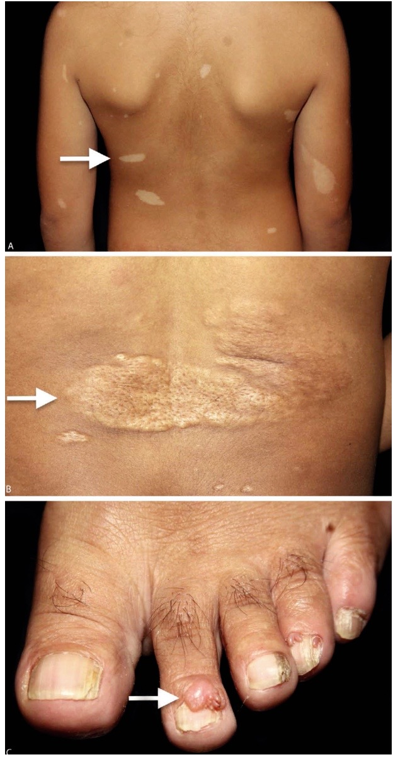
Tumors: Tuberous Sclerosis
Symptoms
Skin: white or red spots, raised areas, facial rash, thick skins on back
Growths around nail beds
Pitted teeth
Developmental concerns
Kidney problems
Heart tumors/ Rhabdomyomas
Brain Tumor
Diagnosis
Genetic testing
MRI
Echocardiogram
Ultrasound
Image: Wikimedia Commons
Notes:
Symptoms can vary depending on severity or progression of TS. One of the first signs are white skin patches on a baby's body, called hypomelanotic (HYPO-MEL-A-NOTIC) macules. As the child gets older, he or she may develop other lesions such as a rash across the cheeks and nose, areas of thickened skin, and small bumps under the fingernails or toenails. Heart tumors are common in as many as 50% of patients with TS and therefore frequent echocardiograms will be done throughout the lifespan. Brain tumors can also occur, the most common being cortical tubers, subependymal (SUBBA-PEN-Dee-Mal) giant cell astrocytomas (SEGAs), and subependymal (SUBBA-PEN-Die-Mal) nodules. While not everyone with TS develops a brain tumor, typically pediatric patients with TS will present with at least one type of these tumors.
Patients with TS have a high chance of developing epilepsy, often secondary to the tumors in the brain. There is also a higher chance of infantile spasms in infants with TS which are brief, repetitive muscle contractions and movements in the head, trunk, arms, and legs. Infantile spasms often go missed initially and are thought to be colic or reflux, however delayed diagnosis and treatment of infantile spasms have have significant impacts down the road on developmental concerns and ongoing epilepsy.
Over 80% of patients with TS will develop renal tumors, the three most common are renal cysts, renal angiomyolipomas (Angio-myo-lip-oma), and renal carcinomas. Renal angiomyolipomas (Angio-myo-lip-oma) are the most common, occurring in more than 80 percent of TSC patients. The majority of renal tumors are generally benign, however renal carcinoma, a cancerous growth on the kidney, can occur while more rarely. Because of the impact on the renal system, hypertension can occur.
Lesions of they retina or optic nerve called hamartomas (hammer-toe-ma) can occur and typically lay dormant, typically not causing vision loss. White patches, or retinal pigmentary disturbances, sometimes appear on the retina, iris, or eyelashes. These white patches aren't harmful and don't require treatment.
True diagnosis will be based on genetic testing looking for mutations in those TSC1 and 2 genes. However, typically testing is done for seemingly independent concerns prior to a final diagnosis and these can include things such as MRI, echo, ultrasound which will be looking at areas of concerns. If/when a tumor is seen on any of these tests that will prompt follow up workup and most likely genetic testing.
https://upload.wikimedia.org/wikipedia/commons/f/ff/Hypopigmented_macules%2C_Shagreen_patch_and_periungual_fibroma_of_tuberous_sclerosis.png

Slide 17

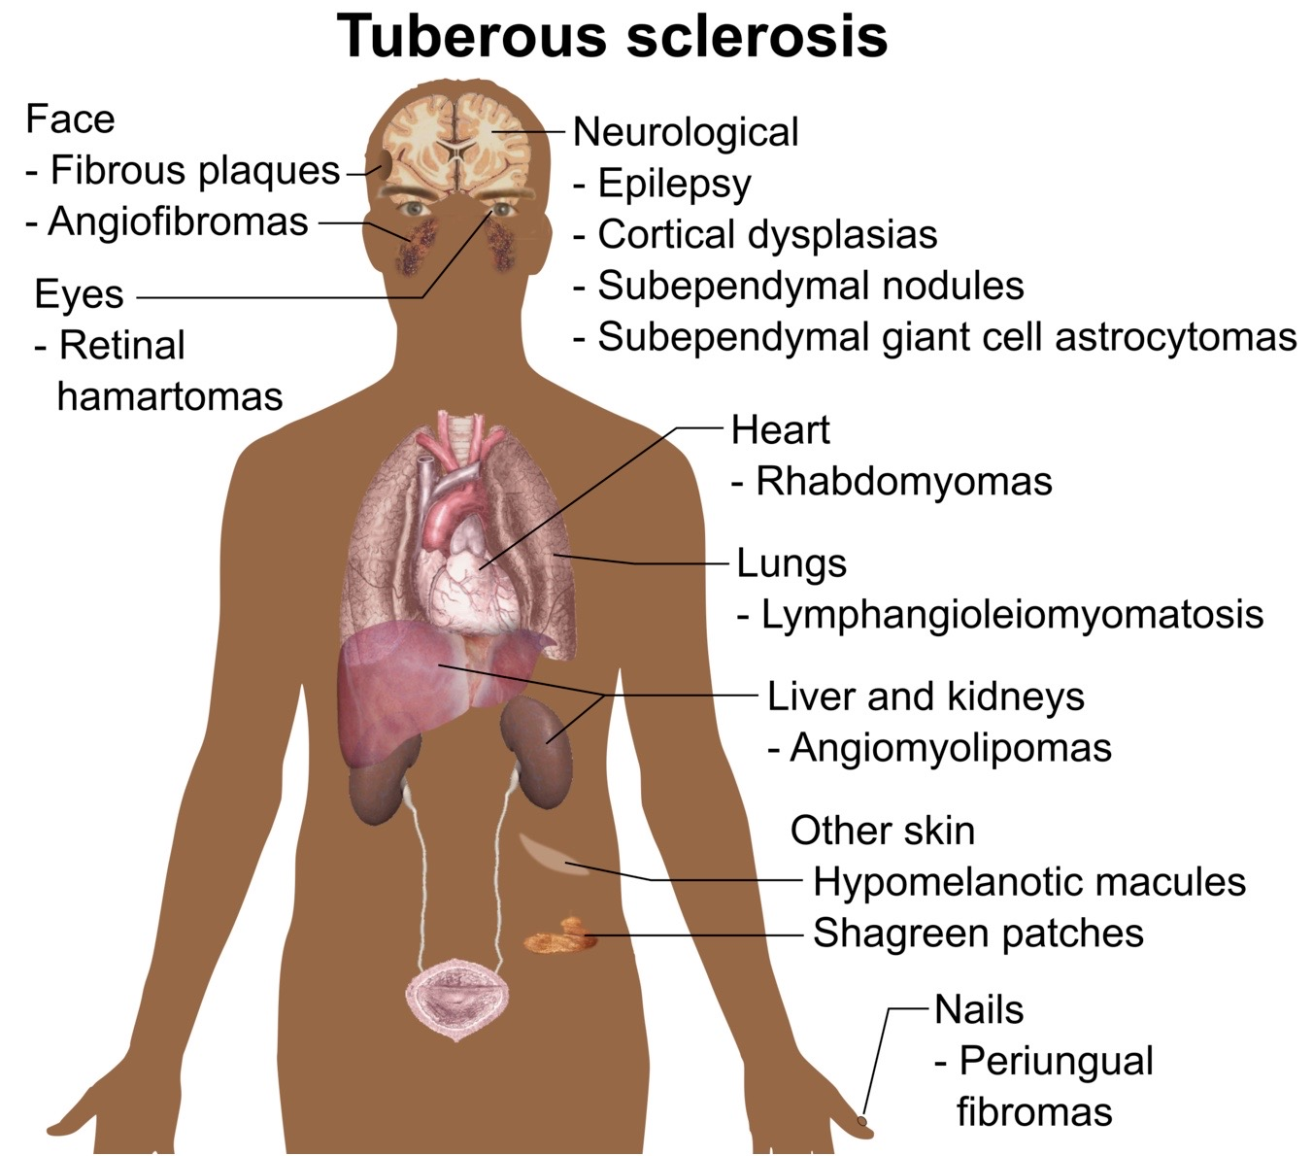
Tumors: Tuberous Sclerosis
Comorbidities/ Complications
Epilepsy
Cognitive/learning disabilities
Autism Spectrum
ADHD
Kidney problems
Respiratory issues
Skin abnormalities
Hydrocephalus
Image: Wikimedia Commons
Notes:
Comorbidities/ Complications can be vast because tumors can affect most any area of the body. Common comorbidities include Epilepsy, Cognitive/learning disabilities, Autism Spectrum, ADHD, Kidney problems, Respiratory issues, Skin abnormalities and Hydrocephalus
https://commons.m.wikimedia.org/wiki/File:Symptoms_and_signs_of_tuberous_sclerosis.png

Slide 18
Tumors: Tuberous Sclerosis
Treatments:
No cure
Focus is on treating symptoms/complications
  Epilepsy may be controlled through medication/ surgical intervention
  ASD/ADHD may be managed with medications, therapies and school interventions
  Skin abnormalities may require ablation or medication
  Brain tumors can be treated with surgery or medications
  Pulmonary issues may require medications such as inhalers
mTor inhibitor
Notes:
There is currently no cure for TS and treatment is focused on treating the variety of areas affected by this disease. This means that if the patient develops epilepsy they will require a neurologist to manage using medications or surgical interventions if refractory. If the has developmental concerns, autism or ADHD treatments may range from medication management, to therapy such as ABA and the patient may require IEP or 504 plans at school. Skin abnormalities are common and if they are bothersome may require topical medication or even ablation. Tumors affecting the brain will be monitored closely by neurosurgery and if they grow rapidly or cause issues, they may require surgical removal. If tumors affect the lungs a pulmonologist may recommend treatment including inhalers.
In addition to these, there are some tumor modifying medications that can be uses such as an mTor inhibitor which helps to interrupt the chemical reactions needed for tumor grown and therefore prevent or slow tumor formation.

Slide 19
Tumors: Tuberous Sclerosis
Nursing Considerations/ Patient Education:
Patients with TS require frequent monitoring for tumor growth including:
  MRI scans
  Ultrasound (heart, kidneys)
  Serum testing (evaluate kidneys)
  ECG (heart monitoring)
  CT scans (monitor for pulmonary functioning)
  Skin and eye exams
  Developmental tracking
Notes:
Patients with TS require frequent monitoring for tumor growth and complications therefore regularly scheduled testing will be done both at onset of diagnosis as well as regularly throughout the lifespan. These tests include: MRI scans to monitor the brain for tumor growth as well as other areas of concern; ultrasound to evaluate renal and cardiac concerns, routine Serum testing (evaluate kidneys), routine ECG (looking for any cardiac abnormalities), CT scans (which can help visualize a wide variety of areas of concern, as well as pulmonary functioning), routine Skin and eye exams, and Developmental tracking
https://www.childrenshospital.org/conditions/tuberous-sclerosis-complex-tsc#:~:text=One%20of%20the%20earliest%20signs,under%20the%20fingernails%20or%20toenails.

Slide 20
Tumors: neurofibromatosis1
Rare genetic disorder with neurological and cutaneous manifestations
Caused by mutations of the NF1
NF1 is the most common form of NF
Also known as Recklinghausen disease
Characterized by changes in pigmentation and growth of tumors along the nerves, skin and brain.
Symptoms
Often shorter stature
Cardiovascular (hypertension)
Behavior challenges, cognitive delays, executive functioning disability
Migraines/ headaches
Scoliosis

Slide 21
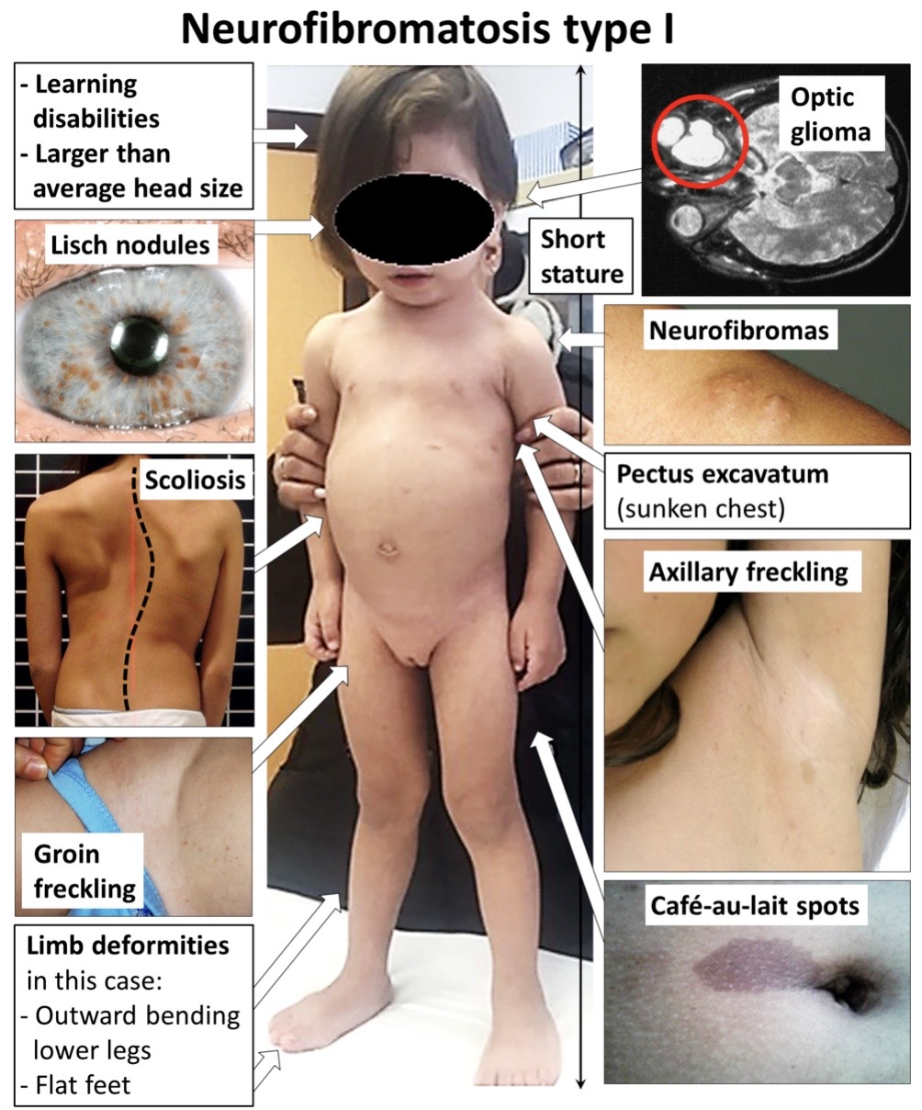
Tumors: neurofibromatosis 1
Diagnosis:
NF1 Clinical diagnosis= 2 or more of the following:
  6 or more “café au lait” spots
  2 or more cutaneous neurofibromas/ or 1 plexiform neurofibroma
  Freckling in armpits or groin
  2 or more Lisch nodules/ iris hamartomas
  Optic pathway glioma
  Deformities of bone (typically tibia)
  Family history of NF
Image: Wikimedia Commons
Notes:
Six or more flat, light brown spots on the skin (“café au lait” spots), which are the most common feature of NF1. These multiple birthmarks measure more than five millimeters in diameter in children or more than 15 millimeters across in adolescents and adults. They are seen at birth or develop during the first few years of life. Café-au-lait spots are not dangerous but indicate the possible presence of an NF1 gene change in the person. These skin marks also occur in other conditions, such as Legius syndrome, a genetic condition that affects how cells in the body communicate.Two or more soft, pea-sized bumps involving the skin (cutaneous neurofibromas), or one larger neurofibroma that involves multiple nerves (plexiform neurofibroma). Neurofibromas are tumors that originate from nerve cells. Plexiform neurofibromas are nerve-associated tumors involving nerves outside of the brain and spinal cord. They can be present at birth or may not become noticeable for many years. Although some cutaneous neurofibromas arise in childhood, most start appearing during or after the teenage years.Freckling in the armpits or the groin. This usually appears by 3 to 5 years of age. Freckles are similar in appearance to café-au-lait spots but are smaller in size. Freckling can occur in other conditions, but not with the other symptoms and concerns of NF1.Two or more growths on the iris of the eye (known as Lisch nodules or iris hamartomas). These nodules are harmless, not typically present until adolescence, do not affect vision, and do not require monitoring or treatment.A tumor of the optic pathway (optic pathway glioma). These tumors typically first appear by age 6, rarely in late childhood and adolescence, and almost never in adults. Although they can affect vision, most do not become symptomatic. Bone deformities. Abnormal development of the eye socket (sphenoid) or the tibia (one of the long bones of the shin).A parent, sibling, or child with NF1.
https://upload.wikimedia.org/wikipedia/commons/f/f2/Symptoms_of_neurofibromatosis_type_1.png

Slide 22
Tumors: neurofibromatosis 2
NF 2
Slow growing tumors affecting cranial, spinal and peripheral nerves
Schwannomas (tumors made up of Schwann cells which produce the myelin covering nerves
Most common on the 8th cranial nerve, therefore affect hearing
Notes:
NF 2 is less common than NF 1. Around 50% of individuals with NF 2 inherited this from their family, however the remainder of the cases are related to spontaneous mutation of the NF2 gene.
In NF2, slow growing tumors affect the cranial, spinal and peripheral nerves affecting the meninges.
Schwannomas are tumors that develop from the Schwann cells. The Schwann cells are the cells that produce myelin which covers and protects the peripheral nerves throughout the body. They most commonly affect the 8th cranial nerve and therefore can affect hearing. These are referred to as acoustic neuromas.
Schwannomas can also occur on the skin in which case they appear as bumps under the skin.
Meningiomas are the second most common tumor seen with NF2, with these tumors form in the tissue covering the brain and spinal cord.
Vision changes

Slide 23
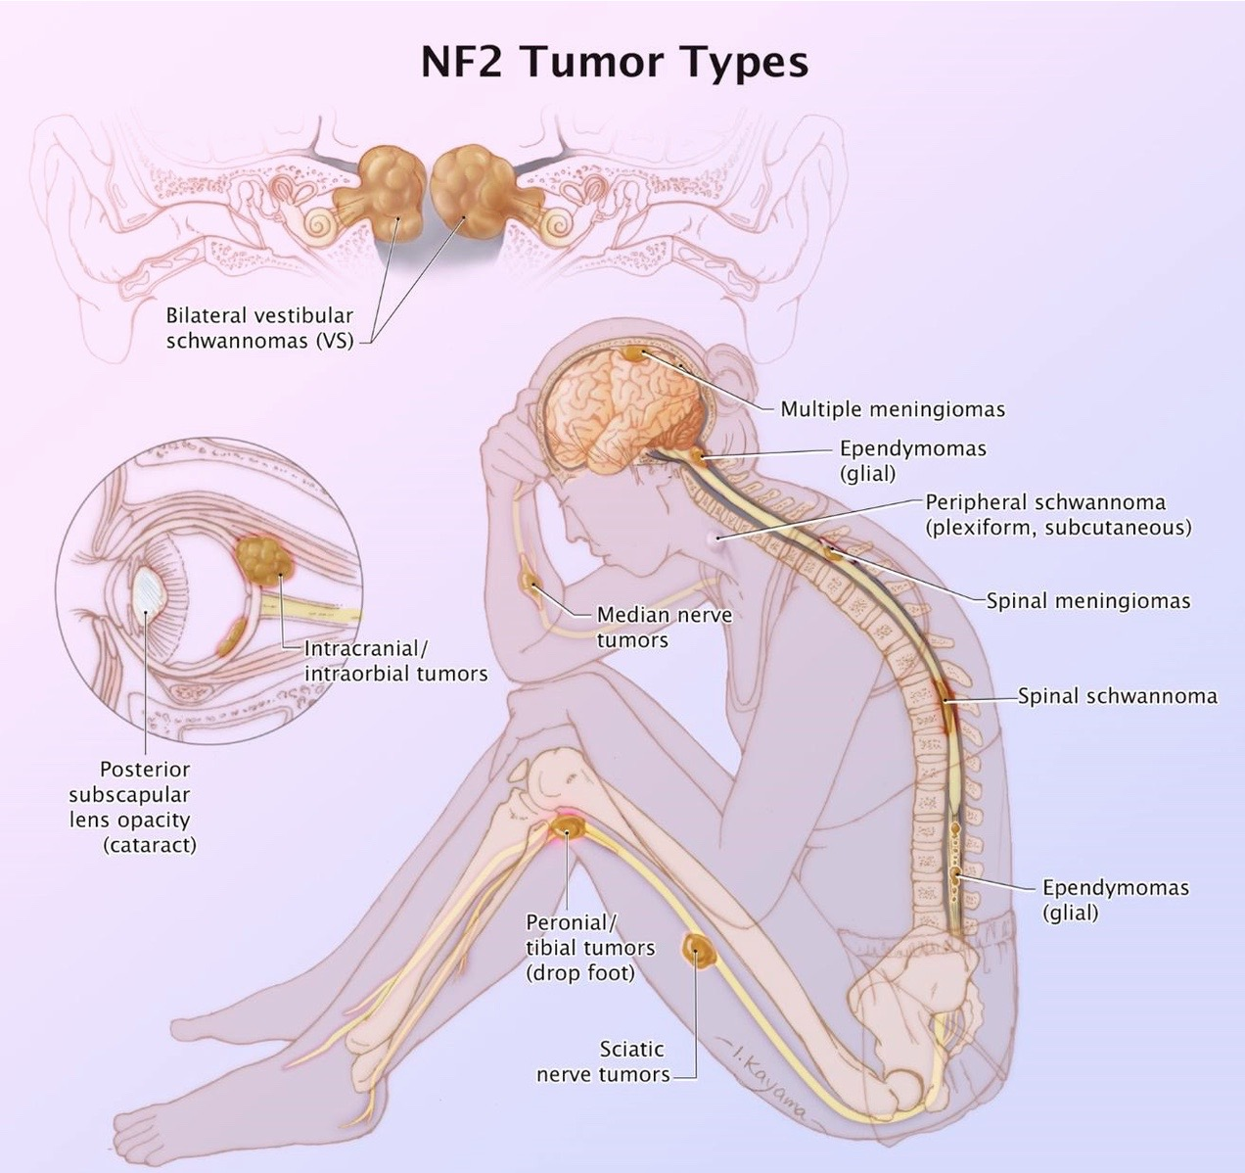
Tumors: neurofibromatosis 2
NF 2: Symptoms/ Diagnosis
Vision changes
Peripheral neuropathy
Tinnitus, hearing loss
Balance issues
Often have a first degree relative with NF
In pediatric onset, vision changes and meningiomas are the primary issue.
In adult onset first symptom is tinnitus/hearing loss
Clinical Diagnosis:
Vestibular schwannoma on MRI in BOTH ears
Or, vestibular schwannoma in one ear with a first degree relative with NF2 diagnosis
Notes:
You will see a lot of overlap between the symptoms of NF 1, Nf 2 and Schwannomatosis, however NF 2 and Schwannomatosis do not typically demonstrate the external characteristics we discussed with NF 1. Vision changes, peripheral neuropathy, tinnitus, hearing loss and balance issues are the most common presenting symptoms of NF 2. In pediatric onset, those vision changes and meningiomas are typically the first symptoms to present, while in the adult population hearing changes and loss are commonly the first symptoms. Diagosis is typically clinical initially but can be confirmed through genetic testing or biopsy. Clinical Diagnosis is based on either a Vestibular schwannoma on MRI in BOTH ears or vestubular schwannoma in one ear with a first degree relative with NF2 diagnosis
https://upload.wikimedia.org/wikipedia/commons/8/82/Neurofibromatosis_type_II_tumor_types.png

Slide 24
Tumors: Schwannomatosis
Etiology:
Mutation of SMARCB or LZTR1 gene
Typically occurs in adults
SWN Symptoms/ Diagnosis:
Pain
Weakness
Tingling
Decreased sensation
Headaches
Vision changes
Clinical Diagnosis:
Deep tissue schwannomas
Confirmation by tissue biopsy
Vestibular schwannoma on MRI in ONE ear
Notes:
Schwanomatosis is very different grom NF 1 and 2 in the genes it affects. Schwanomatosis affects the SMARCB or LZTR1 gene, although there are cases where the gene mutation is unknown. The onset and diagnosis of Schwanomatosis typically presents in adults over the age of 30, but I include it here in the pediatric presentation only because it is in the family of NF, and it is important to be able to differentiate the 3 different forms.
Schwannomatosis s/sx are quite similar to NF2 in that it involves tumor formation on the cranial, spinal and peripheral nerves. Impact can range, some people with Schwannomatosis can have just a few tumors while others have many throughout the body. Other common symptoms include chronic pain related to the tumors, decreased sensation such as numbness, tingling or weakness in the area affected by the tumors. Clinical diagnosis can be based on presence of deep tissue schwannomas which can then be confirmed by tissue biopsy, also imaging on MRI can reveal a vestibular schwannoma.

Slide 25
Tumors: neurofibromatosis
Nursing Considerations/ Patient Education
No current cure
Treatment focused on
  Slowing tumor grown- medications or surgery
  Symptoms/complications management
Routine screenings:
  Screen for new tumor growths
  Skin changes
  Growth: height, weight and head circumference
  Learning and developmental delays or concerns
  Scoliosis
  Blood pressure
  Vision
  Hearing
Notes:
There is currently no cure of any of the forms of NF. Treatment is guided by trying to prevent formation of new tumors which can be done with several tumor modulating medications. In. addition, treatment focuses on the complications and comorbidities from NF. The care team may be quite complex involving Neurosurgery, neuroopthalmology, neuro-oncology, rehabilitation medicine, urology, neurology, developmental specialists and orthopedics.
Nursing considerations include ongoing close monitoring of these patients which should include screening for new tumor growths, skin changes, height, weight and head circumference, learning and developmental delays or concerns, scoliosis, blood pressure, vision and hearing just to name a few.
https://www.aans.org/en/Patients/Neurosurgical-Conditions-and-Treatments/Neurofibromatosis#:~:text=There%20is%20no%20known%20treatment,or%20reduced%20with%20radiation%20therapy.

Slide 26
Pediatric neuromuscular/ movement disorders
Duchenne Muscular Dystrophy and Cerebral Palsy

Slide 27
Neuromuscular: Duchenne Muscular Dystrophy
Rare, 1/3,500
Affects mostly males
Caused by dysfunction in dystrophin production
Progressive damage to muscles leads to progression of muscle weakness
Notes:
Duchenne Muscular Dystrophy or DMD is a very rare genetic condition that affects around 1 out of 3,500 children in the US and is characterized by progressive damage to the muscles causing weakness. DMD almost always affects males but in some very rare cases can affect female children as well.
DMD is caused by genetic mutations that prevent the body from producing dystrophin, a protein needed to allow muscles to contract without damage. Without this, damage to the muscles occur, progressively weakening the muscles and leading to global weakness, and over time inability to walk and even breath or regulate cardiac function.

Slide 28
Neuromuscular: Duchenne Muscular Dystrophy
Symptoms
Diagnosis
Delayed onset of walking
Toe walking
Frequent falling
Difficulty standing from a sitting position (Gower’s Maneuver)
Fatigue
Cognitive and emotion stuggles
Speech delay
Most often diagnosed between 3-6 years of age
Genetic testing- looks for absence of the dystrophin gene
Muscle biopsy
Notes:
Symptoms may begin as young as 3-6 months, but most commonly the child develops seemingly normally until age 2-3 years when they begin showing sights such as difficulty walking, standing up straight, standing from a sitting position, running and jumping.
Onset can be gradual or sudden, but very characteristically around age 7 or 8 most children find that the disease process starts to excel, often outpacing any natural growth and gains and this is the age where most children begin with the most significant challenges including needing to utilize a wheelchair to walk. Between this age and the teenage years muscle loss will progress and start to impact ability to regulate heart and lungs, often meaning that the child now requires a trach or vent for breathing. Depending on severity of the disease, life expectancy can range, but this is a life limiting progressive disease and most patients will not live out of their 20s.

Slide 29
Neuromuscular: Duchenne Muscular Dystrophy
Comorbidities/ Complications
Short stature
Adrenal insufficiency
Hyperglycemia
GERD
Hypertension
Delayed puberty

Slide 30
Neuromuscular: Duchenne Muscular Dystrophy
Treatments:
Exercise: low impact (swimming)
Assistive devices: wheelchair, leg braces, crutches
Steroids: can improve muscle function
Ataluren: newer medication,
Creatine supplementation: can improve muscle strength
Treat complications: glucose, hypertension, cardiac, respiratory
Notes:
Because this disease has no cure and is considered terminal treatment is focused on delaying the progression of symptoms. Lifestyle modifications, including low impact exercises such a swimming can help to improve flexibility and movement. The patient will likely require assistive devices at some point, including a wheelchair, like braces or crutches to assist with mobility. In terms of medication steroids can be used as these can help improve muscle function at the very least in the short term. There’s a newer medication called add to Lauren, which can be used to slow progression, but has to be started while the patient still has some mobility. Creatinine supplementation has also shown to improve muscle strength and is frequently used in this population. In addition to these, treatment will focus on management of the comorbidities, such as managing glucose, irregularities, hypertension, managing any cardiac problems, as well as managing respiratory issues as the disease progresses, which may eventually involve things such as managing, trach and ventilation.

Slide 31
Neuromuscular: Duchenne Muscular Dystrophy
Nursing Considerations/ Patient Education:
Recognize concerns early= quick diagnosis
Emotional support, caregiver support
Helping with medication management
Assisting with increased needs and comorbidities are disease progresses
Notes:
As you can imagine, nursing considerations and patient education is vast for this patient population. The nursing role will flex significantly throughout this disease process. Initially, the nursing role should focus on recognizing potential concerns as the patient starts to lose milestones or parents bring up concerns, such as new toe, walking, or in ability to stand up unassisted. These are hallmark signs that the nurse will want to recognize to help provide quick diagnosis. Treatment and slowing of the disease truly hinges on the ability to start treatment based off of the diagnosis as young as possible. Once the patient has been diagnosed with this disease, the nursing Robo, focus significantly on patient education, as well as emotional and social support as this can be a very overwhelming disease from any parents to taken. Over the course of the child’s life span the nursing rall will encompass many aspects. This will include routine assessments as well as clothes, tracking and documentation of progression of the disease. This will also include assisting with any patient needs as the disease progresses so for example, at some point the nurse will need to help educate the family under respiratory support, working a ventilato and so on.

Slide 32
Neuromuscular: Cerebral palsy
Cerebral= brain, Palsy= movement
Occurs more in males, apx. 2-3/1000 births
30-50% will have cognitive impairments
Caused by damage to the brain, including
  Fetal or perinatal brain damage
  Higher risk in premature and multiple births
  Hypoxia
  Maternal infection
  Kernicterus
  Teratogenic factors
Notes:
Cerebral palsy refers to a disorders that can affect the ability to move, as well as maintain proper balance and posture. The term broken down means cerebral, brain, palsy, weakness, or muscular difficulty there for the diagnosis literally means weakness or muscle difficulty related to a neurologic cause. As we will discuss, the symptoms can vary quite significantly from mild to quite severe and there are several different types of cerebral palsy, including spasticity, ataxia, dyskinesia.
The cause for cerebral palsy is not fully understood, but can be caused by abnormal development in the brain or damage of the developing brain. This can occur in utero, and the child may be born with this which is referred to as congenital cerebral palsy, but can also occur secondary to injury to the brain around 80 to 85% of cases of cerebral palsy are congenital CP meaning occurring while in utero.
Common causes include fetal or perinatal brain damage, premature birth, as there’s a much higher incidence of CP in babies, born prematurely, as well as babies born as a twin or multiple. Hypoxia was originally believed to be the primary cause of CP however, is now understood to be only one of the many causes. Hypoxia can occur due to separation from the placenta, cord compression, or bleeding during birth. Kernicterus is when damage is the cost of the brain by jaundice.

Slide 33
Neuromuscular: Cerebral palsy
Symptoms & Diagnosis
Spastic CP
Most common, apx. 80% of cases of CP
Spasticity
Hemiparesis
Spastic quadriplegia
Dyskinetic CP
Difficulty controlling muscles (hands, arms, legs, feet)
Difficulty speaking, swallowing
Muscle tone can change from weakness to dystonia
Ataxic CP
Difficulty with balance and coordination
Ataxic gait (legs wider apart)
Difficulty with fine motor tasks (handwriting)
Comorbidities:
  Epilepsy Developmental delay Paralysis
  Visual Impairment Hearing difficulty
Microcephaly Dyspraxia Respiratory
Notes:
Signs of cerebral palsy can present quite differently and vary by ages. Because CP has such a wide spectrum of impact, symptoms can greatly vary as well. Some signs of CP can be noticed quite young as the child fails to meet motor and movement milestones. In more severe cases of CP signs can be seen in infants, quite young and will be noticed as floppiness or stiffness, head lag, when lifting the infant, as well as dystonic movements, particularly of the arms or legs.
Spastic cerebral palsy is the most common affecting around 80% of patients with CP and this involves spasticity or stiffness of the muscles and can often encompass spastic Hema paresis what affects only one side of the body or spastic Quadra plegia quadriplegic in which the spasticity affects all four limbs typically impacting the ability of the individual to walk or ambulate independently.
Comorbidities with spastic, cerebral palsy typically include developmental disabilities, such as an intellectual delay, epilepsy, as well as issues with vision hearing and speech
The second form of cerebral palsy is known as Dyskinetic CP, an individuals with this form of CP typically have difficulty controlling their movements, most notably with their extremities. This can make it very difficult for them to sit and walk, and you may notice that movements are slow or overly quick and jerky. These movements can also create issues with the face mouth and throat, creating problems with sucking, swallowing and talking, you will notice in this population that they can go back-and-forth from being hemiplegic to the stomach quite quickly
And then the third form of CP is ataxic, which means that the individual has difficulty with balance and coordination. This can sometimes be less noticeable than the other two forms of CP however, will present itself in difficulty with coordination, such as writing, and slower movements, as well as just generalized weakness.
Diagnosis is clinical, and based off of symptoms and progression of those symptoms. Early diagnosis of CP is quite important to allow for quick intervention and improved outcomes. This is one of the many reasons we do such frequent, developmental monitoring, and check ups from infancy through the early years of childhood development.

Slide 34
Neuromuscular: Cerebral palsy
Treatments:
Medications:
  Baclofen, diazepam, Dantrolene (spasticity)
Therapies
  ABA, OT, PT, Speech
Surgery
  Gastrostomy (GT), spastic release
Psychosocial
  School plan, home nursing care, emotional support
Adaptive
  Wheelchair, braces, communication device
Notes:
There is no specific treatment for CP in focus of treatment is on improving symptoms. To that, and you will see treatment such as medication’s, which may be used to help reduce spasticity, or improve muscle tone, and to help with other side effects, including medication’s that may help with drooling, or comorbidities such as medication’s treating epilepsy. These patients very frequently require surgery or braces and many cases wheelchairs if mobility is significantly affected. Therapy is incredibly helpful for this patient population including physical therapy, occupational therapy and speech therapy depending on the child’s needs.

Slide 35
Neuromuscular: Cerebral palsy
Nursing Considerations/ Patient Education
Patient/ caregiver support
Ensure therapeutic communication
Prevent injuries
Encourage ROM and mobility
Reposition frequently

Slide 36
References https://www.nationalmssociety.org/About-the-Society/MS-Prevalence#:~:text=A%20study%20funded%20by%20the,than%20twice%20the%20original%20estimate. https://www.ninds.nih.gov/health-information/disorders/myasthenia-gravis#:~:text=Myasthenia%20gravis%20is%20a%20chronic,%2C%20and%20allow%20for%20breathing). https://www.aans.org/en/Patients/Neurosurgical-Conditions-and-Treatments/Neurofibromatosis#:~:text=There%20is%20no%20known%20treatment,or%20reduced%20with%20radiation%20therapy. https://www.aans.org/en/Patients/Neurosurgical-Conditions-and-Treatments/Neurofibromatosis#:~:text=There%20is%20no%20known%20treatment,or%20reduced%20with%20radiation%20therapy. https://medlineplus.gov/genetics/condition/neurofibromatosis-type-1/ https://www.ninds.nih.gov/health-information/disorders/neurofibromatosis#:~:text=Neurofibromatosis%202%20(NF2)%20is%20less,inheriting%20the%20abnormal%20NF2%20gene. https://www.nhs.uk/conditions/muscular-dystrophy/#:~:text=Duchenne%20MD%20%E2%80%93%20one%20of%20the,into%20their%2020s%20or%2030s https://rarediseases.info.nih.gov/diseases/6291/duchenne-muscular-dystrophy
Notes:
https://upload.wikimedia.org/wikipedia/commons/a/a0/Adskcxvbklawe%3Blas.png

