Slide 1

Heroes in Literature
Claudette Colvin
The Power of One, Two, and Three
Rose Zimbardo, “Heroic Imagination Stories Series”
Philip Hoose, “Claudette Colvin: Twice Toward Justice”
HIP Lesson, “The Power of a Situation”
Claudette Colvin: Heroic Imagination Stories Series by Philip Zimbardo is licensed under Attribution-NonCommercial-ShareAlike 4.0 International

Slide 2
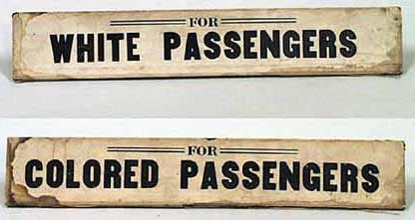
The System
Jim Crow Laws
Systems create Situations…

Slide 3
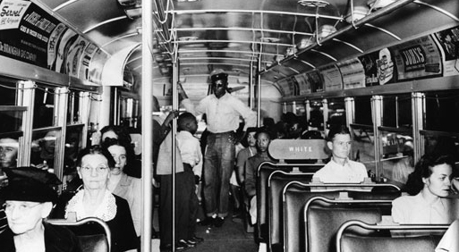
The Situation: Segregation on Montgomery Buses

Slide 4
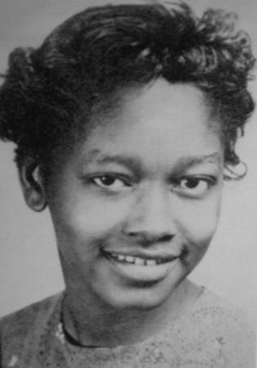
The Individual
Claudette Colvin, a 15-year-old student at Booker T. Washington High School in Montgomery.

Slide 5
After looking at the Situation and the System, we need to return to and consider the Individuals within it and the unique psychology they bring with them into that Situation.
What are some of Claudette’s beliefs, culture, expectations, and past experiences?
(Text from The Power of a Situation Lesson)

Slide 6
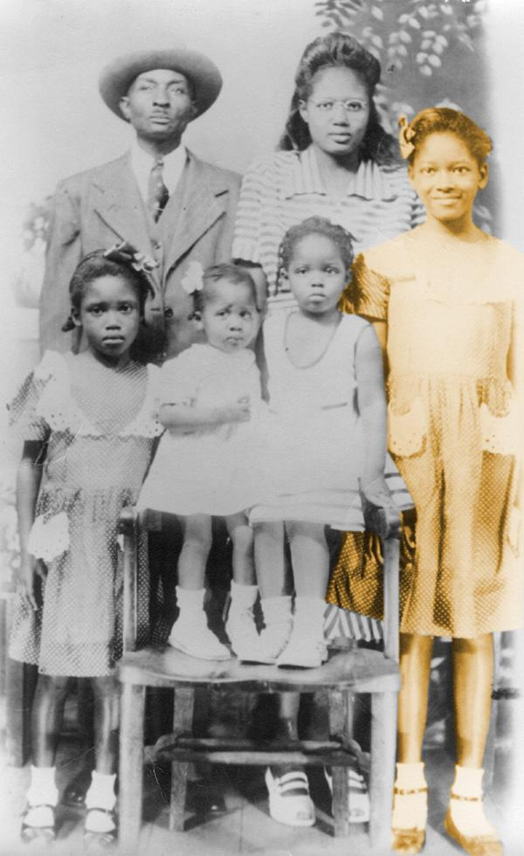
Childhood experiences
“I was about 4 years old the first time I ever saw what happened when you acted up to whites…”
Claudette’s mom slapped her because she had touched a white kids’ hand.
“Don’t you know you’re not supposed to touch them?”
“I Learned I should never touch another white person again.”
In-group vs. Out-group, Us vs. Them

Slide 7
Prevailing Environment
Segregation, Racism, and Social Injustice in Montgomery, Alabama in 1950’s.
Jeremiah Reeves case: July 1951, this 16-year-old student was discovered having sex with a white woman, Mabel Ann Crowder, in her home. Although they had an ongoing, consensual affair,
Police tortured him into confessing her rape, along with and many others, for which he was convicted, imprisoned and executed March 28, 1958, at age 22.
.

Slide 8
Psychological Effects:
Stereotype threat and Fixed mindset
  “We Black students constantly put ourselves down. If you were dark-complexioned, they’d call you “nappy-headed”. Not “nappy-haired”… And the “N” word- we were saying it to each other, to ourselves… For some reason we seemed to hate ourselves. We students put down our hair texture and skin color all the time. Can you imagine getting up in the morning everyday and looking into the mirror and saying to yourself, “I have bad hair”? Or “I’m Black and nobody likes me”?

Slide 9
Turning Point:
Stand up!
  “I was going to do something different…I was done talking about “good hair” and “good skin” but not addressing our grievances… I was tired of adults complaining about how badly they were treated and not doing anything about it. I’d had enough of just feeling angry about Jeremiah Reeves. I was tired of hoping for justice.”
  Claudette was tired of inaction, of being a bystander to the injustices around her. She developed a Growth mind-set and realized she can change, she can make a difference. She was ready to STAND UP!

Slide 10
Education
A sophomore year teacher, Miss Geraldine Nesbitt gave Claudette confidence. She made her students see that “they had a history, too. That their story didn’t begin by being captured and chained…” She dedicated a whole month to Black history, which had a strong influence on Claudette’s decision to act when the moment came.

Slide 11
The Power of One:
Speak Out, Be the First
Back to THE SITUATION…
  “When my moment came, I was ready.”
    PAUSE BUTTON:
    “I was thinking, “Why should I have to get up just because I’m Black?”
    Right then, I decided I wasn’t going to take it anymore. I hadn’t planned it out, but my decision was built on a lifetime of experiences.”

Slide 12
Resisting the barriers:
Peer Pressure and Conformity:
Bus driver: “I need those seats.”
Claudette stayed put in her seat.
Claudette’s three classmates sitting with her instantly got up and moved to the back of the bus, instead of supporting Claudette and becoming her allies.
The Power of Authority:
Bus driver: “Why are you still sittin’ there?... Gimme that seat!... Get up, gal.”

Slide 13
ACTION:
Claudette stood her ground, stood up for what she believed in, and responded by yelling,
“It’s my Constitutional right!”

Slide 14
Results
Reverend Johnson: “Claudette I am so proud of you. Everyone prays for freedom. We’ve all been praying and praying. But you’re different- you want your answers the next morning. And I think you just brought the Revolution to Montgomery.”
This is an example of the phenomena of the Diffusion of Responsibility and Group Ignorance.
Everybody else sat around and waited for change. They waited for someone else to do it. They looked around and no one else was acting so they went along too and became just another Passive Bystander.
Until Claudette Colvin showed them a better path.

Slide 15
The power of Two:
An Ally, Rosa Parks
“Another negro woman has been arrested and thrown in jail because she refused to get up out of her seat on a bus for a white person to sit down. It is the second time since the Claudette Colvin case that a negro woman has been arrested for the same thing.
This has to be stopped.”

Slide 16
The power of Three:
A Network forms
“We are therefore asking every Negro to stay off the buses Monday in protest…”
The Montgomery Bus Boycott Begins.

Slide 17
Browder V. Gayle
“The testimony of… Miss Colvin and the others reinforced the Constitution’s position that you can’t abridge the freedoms of the individual. The boycott was a simple case of legal and human rights being denied.”
-June 19, 1956
-> “The “separate but equal” doctrine set by the Supreme Court in 1896 in the case of Plessy v. Ferguson can no longer be applied.”

Slide 18
The Power of One, Two, and Three
Just as Systems create Situations, Individuals have the power to change the outcome of a Situation and thus change the System.
One of the great human right victories in U.S. history was started by this young lady, Claudette Colvin, standing up and tall for her constitutional rights.

