Slide 1

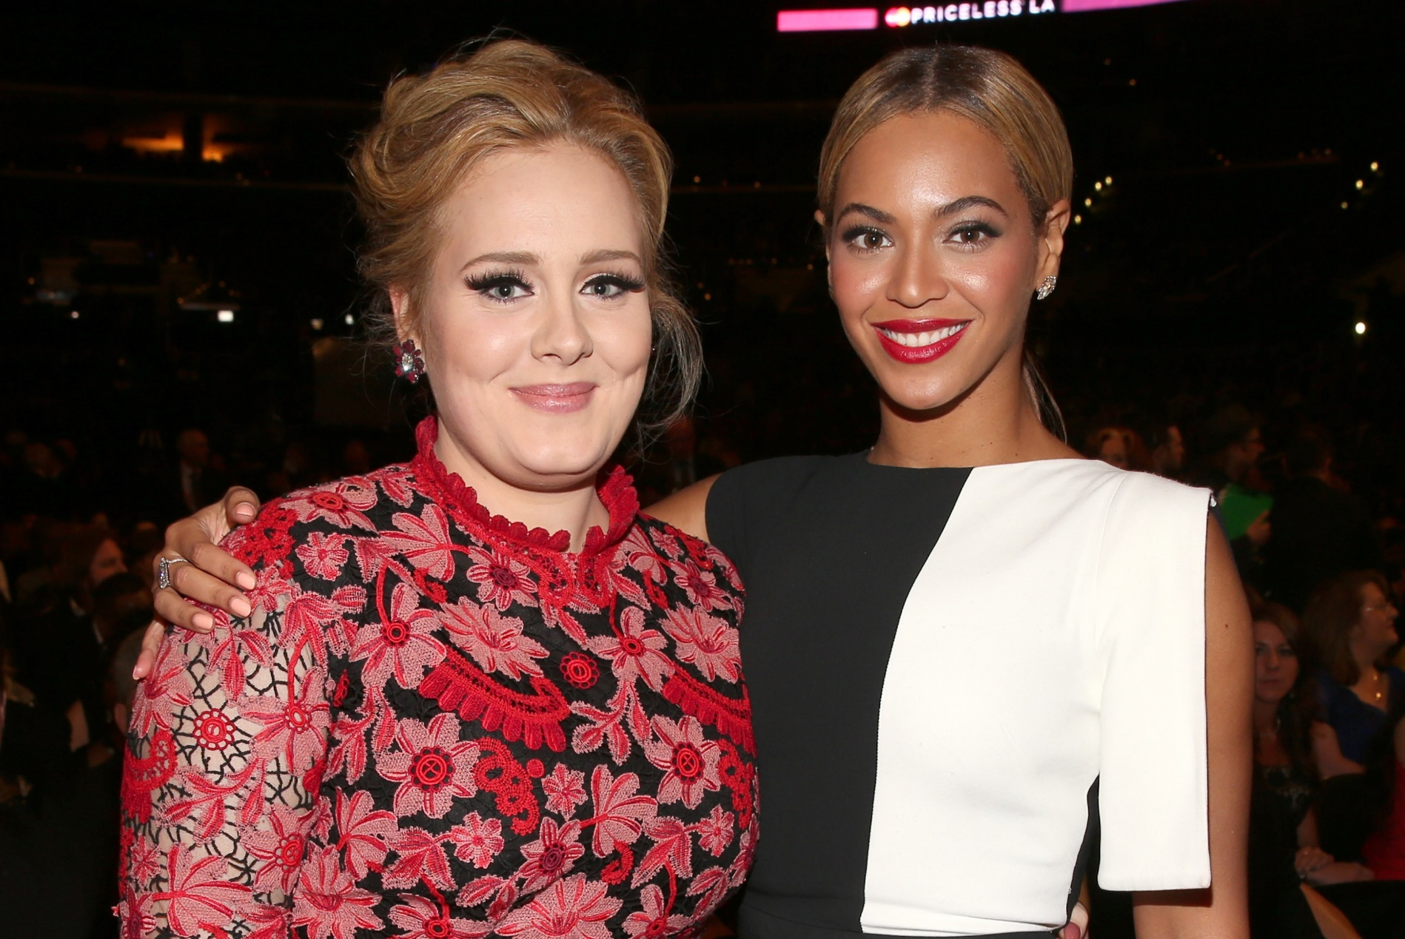
Personalities
By
Heidi de Carlo

Slide 2
When we talk about personality, we talk about personality adjectives
Personality adjectives
Qualities
Good aspect of a person
Flaws
Bad aspects of a person

Slide 3
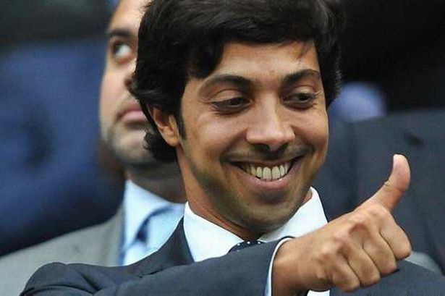
Personality
Personality includes the person’s thought pattern, express feelings, emotions and perform.

Slide 4
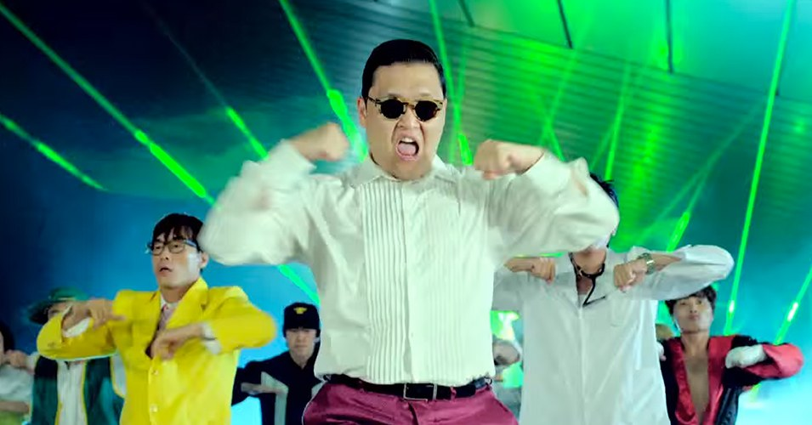
Personalities
A communicative act with a neighbour depicts values, views and moods.

Slide 5
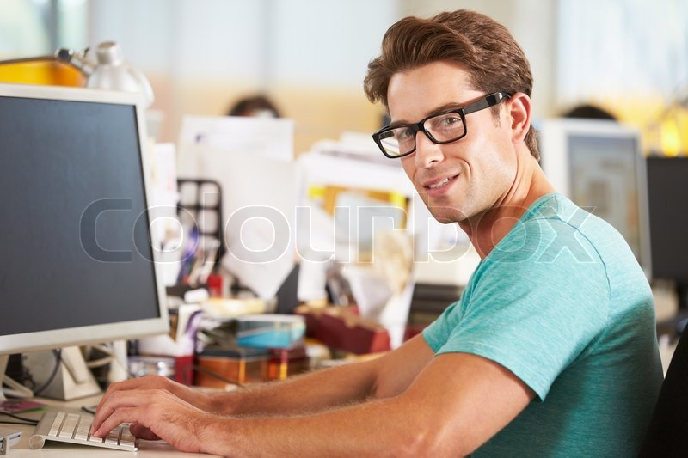
When we want to ask about someone’s personality
The question is: What is (the person) like?
What is David like?
He is creative.
He has innovative ideas.

Slide 6
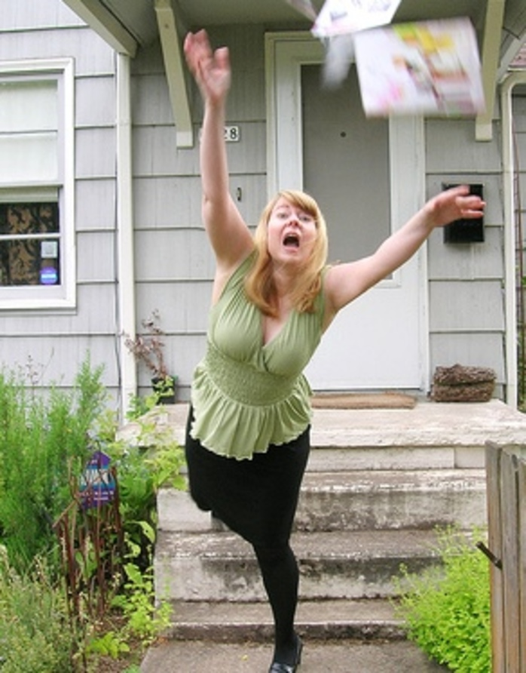
What is Sophia like?
She is a disaster. She accidently drops things and breaks them all the time.
She is clumsy.

Slide 7
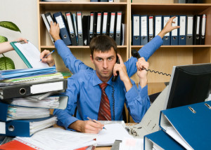
What is Peter like?
Peter works very hard.
He is hard-working.

Slide 8
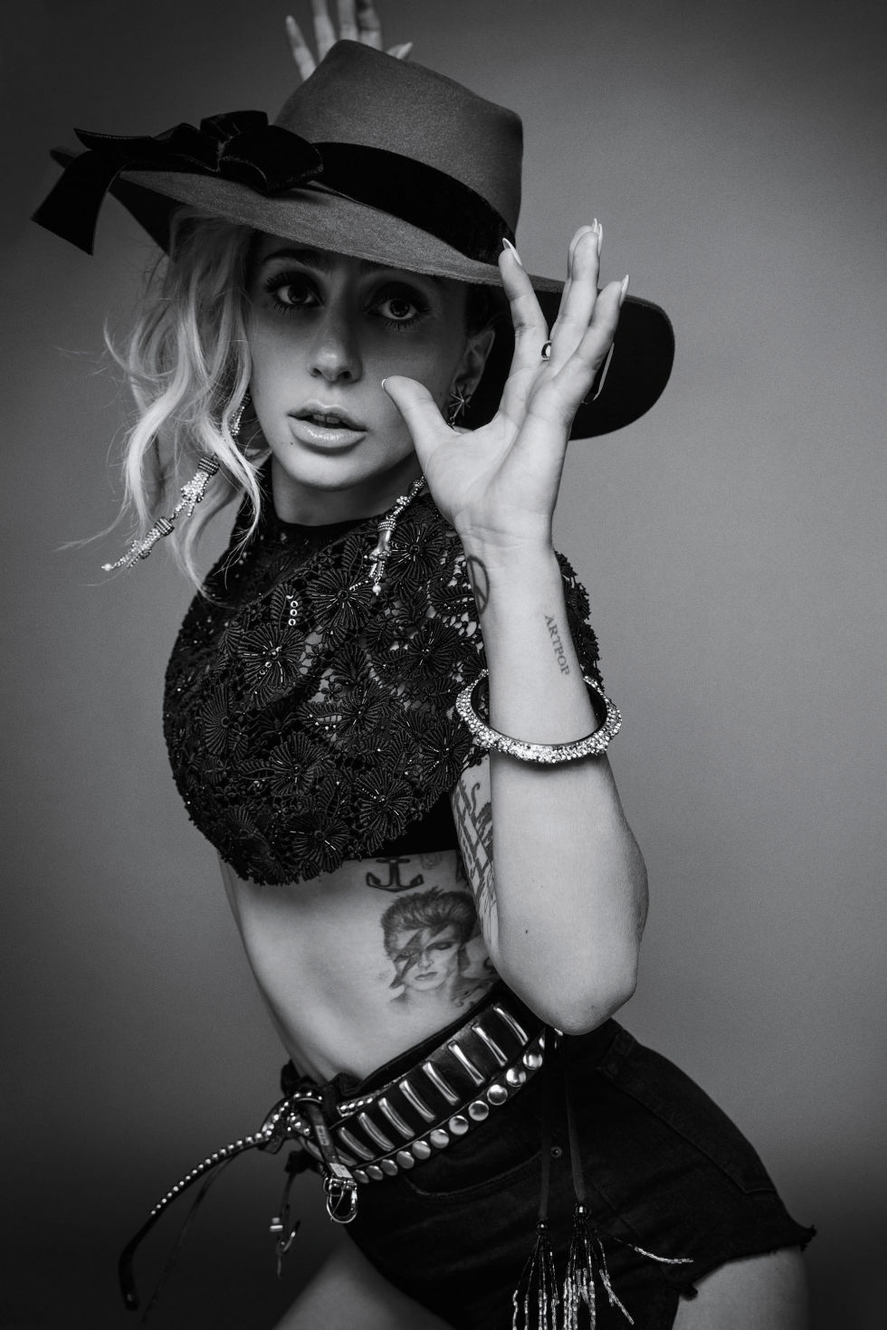
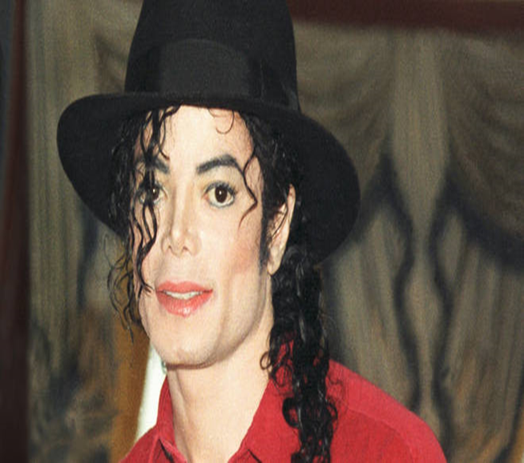
personality
The end

