Slide 1
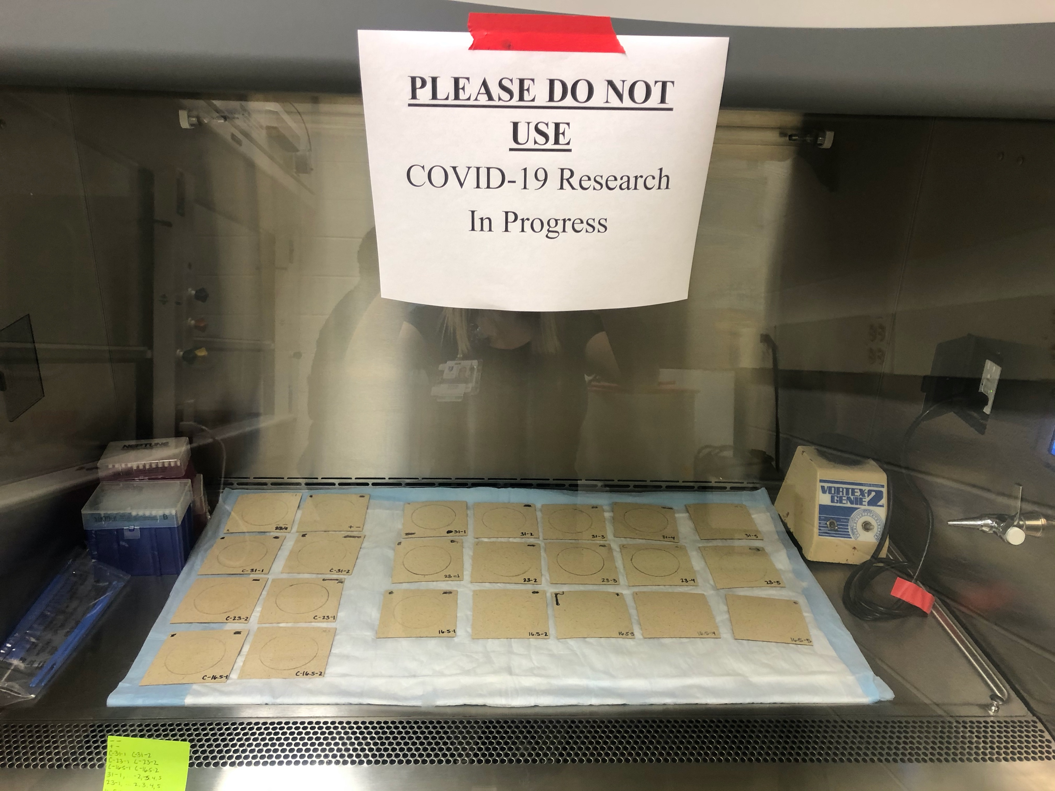
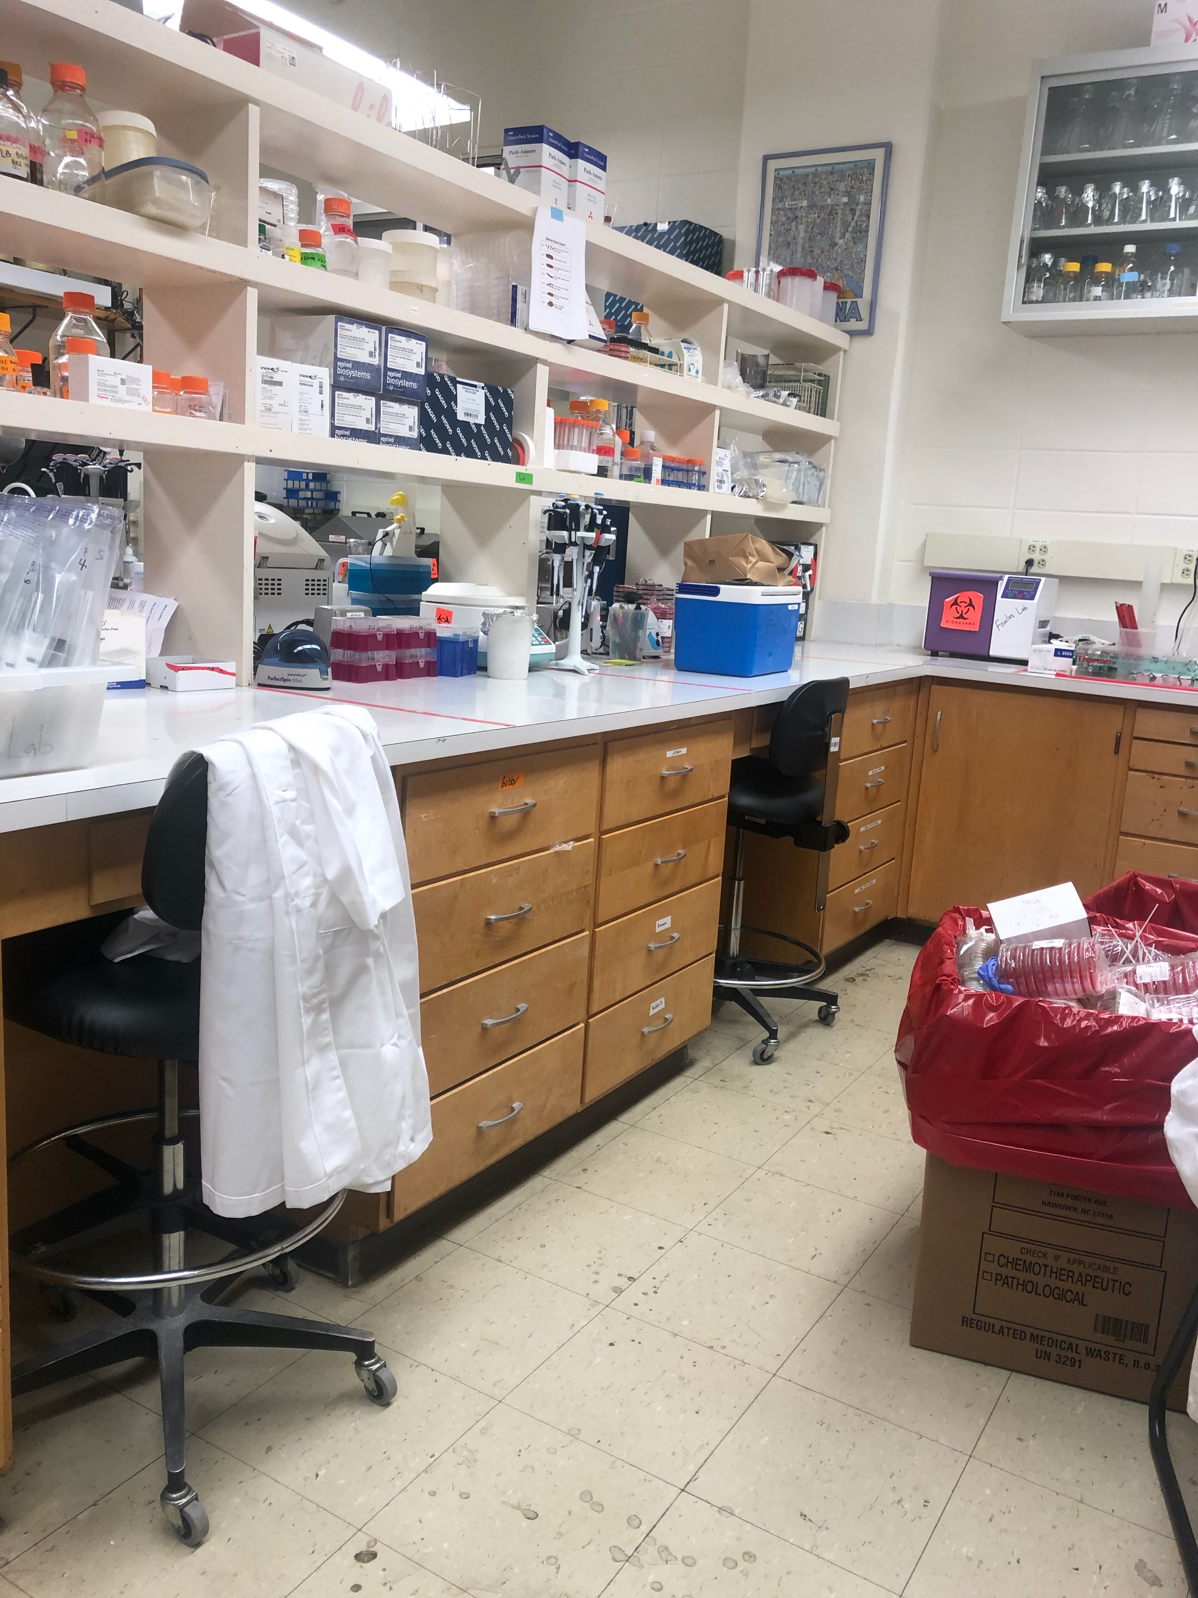
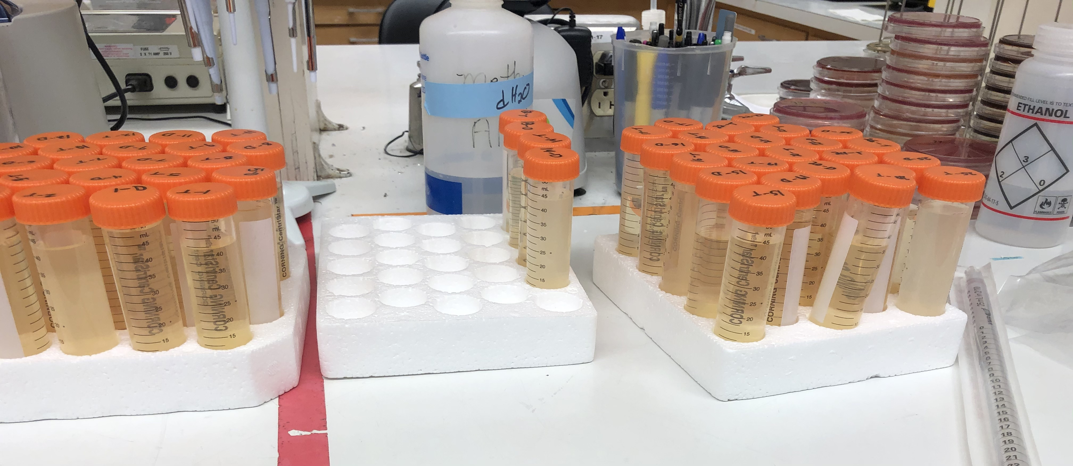
Applied Field Placement: Duke University School of Medicine, Division of Infectious Diseases
Amanda Graves, MPH 6905
Amanda Graves
Department of Public Health
East Carolina University
Greenville, North Carolina 27858
252.722.5913
gravesa20@students.ecu.edu
INTRODUCTION
MPH COMPETENCIES
I had the honor of being an intern at Duke University School of Medicine in the Division of Infectious Disease. My preceptor for this experience was Dr. Deverick Anderson, MD, MPH, and my mentor for day-to-day tasks and operations was Bobby Warren, MPS.
Epidemiology competencies:
Critically evaluate epidemiologic literature by applying methods of epidemiology to interpret research results and findings.
  Conducted literature review and interpreted results and findings of many SARS-CoV-2 environmental contamination studies
Identify and implement appropriate study design, recruitment, data collection, and analysis methods to address an identified public health problem.
  Involved in multiple studies, specifically the oxivir residue study as I was able to be involved from the beginning to the end.
MPH competencies:
Apply epidemiological methods to the breadth of settings and situations in public health practice.
  Involved in multiple projects that involved the application of epidemiological methods of research
Select quantitative and qualitative data collection methods appropriate for a given public health context.
  Assisted with various studies that involved several methods of data collection, which helped me gain experience in many types of data collection
Analyze quantitative and qualitative data using biostatistics, informatics, computer-based programming and software, as appropriate.
  Used statistical software to analyze the data we collected for several abstracts
Interpret results of data analysis for public health research, policy or practice for public health and health care systems.
  The oxivir residue and SARS-CoV-2 study helped to interpret results for public health research, and I will continue to by remaining involved in the project
MAJOR PROJECT OUTCOMES
SARS-CoV-2 Environmental Contamination:
Assisted with sample collection of positive patient rooms, lab procedures for RNA extraction, RT-PCR, and cell culture. Included as a co-author for this abstract submitted to IDWeek for helping with Table 1 for the article by conducting statistical analysis in SAS.
CRE in sinks in new bed tower at Duke University Hospital:
Assisted with sample collection of the sinks in the new bed tower to look for various bacteria, lab procedures of placing the specimen on media to look for growth, subculturing the specimens for further processing. Through this project, conducting PCR, and creating gels to analyze the various morphologies. Included as a co-author for the abstract for generating Table 1 for the article by conducting statistical analysis in SAS.
C. Difficile environmental contamination in positive patient rooms:
Assisted with sample collection from C. diff positive patient rooms, the lab procedures, and conducting ribotyping PCR and gel creations for the C. diff samples.
Oxivir residue salt disinfection efficacy against SARS-CoV-2:
Tasked with leading this project with the guidance of the lab staff to conduct this experimental study in the lab and writing the manuscript for possible publication. Once one experimental cycle was completed and we tried to run statistical analysis on the results, we decided it may be best to continue to conduct the experiment to collect more results for a more accurate conclusion. I will continue to work with them on this project.
PRODUCTS
Literature review matrix on SARS-CoV-2 environmental contamination in healthcare settings
  Conducted literature review to gain a better understanding of the projects I was going to be involved in, as well as assist in research to include in the publication
Data analysis for Table 1 in two abstracts for submission to IDWeek
  Conducted statistical analysis for Table 1 to be included in two abstracts by utilizing SAS
Co-author for two abstracts for publication
  For contributing statistical analysis for the abstracts
Standard operation of procedures for various studies
  Generated multiple SOPs for various projects, such as Oxivir residue and SARS-CoV-2, Gram Staining, N95 mask study with SARS-CoV-2
ACKNOWLEDGEMENTS
I would like to thank Dr. Dev Anderson for taking me on as one of the first interns in the program. Also, Bobby Warren for the guidance and mentorship he provided me during my experience at Duke. Finally, Aaron Barrett for taking the time to teach me the lab procedures and various SOPs. I will forever be grateful for this experience.

