Slide 1
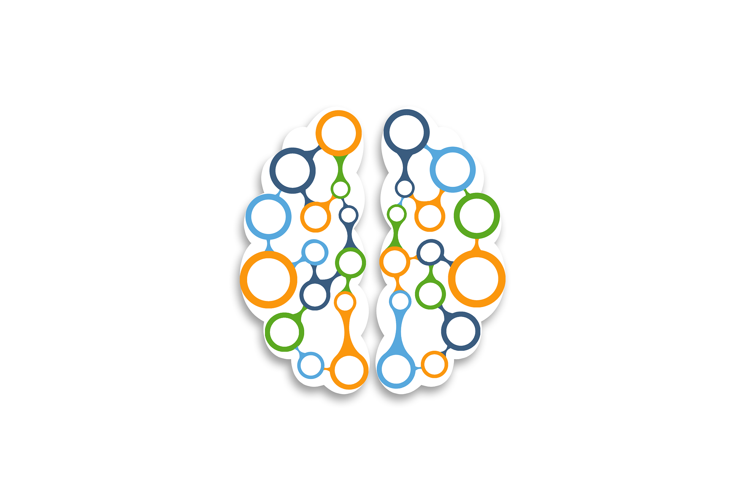
UDL: Putting it All Together
UDL Assumptions
Expert Learner
Learning Sciences

Slide 2
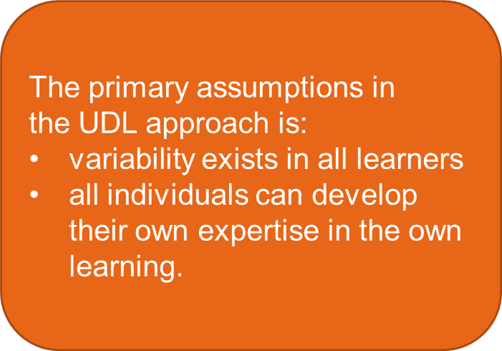

UDL: Bringing it All Together
UDL Assumptions
Expert Learner
Learning Sciences

Slide 3
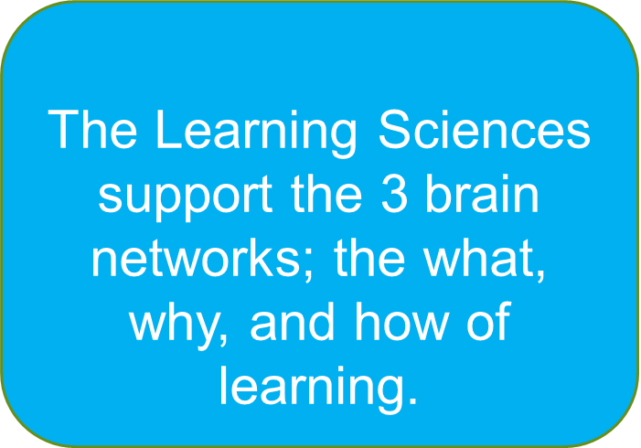
UDL: Bringing it All Together
UDL Assumptions
Expert Learner
Learning Sciences

Slide 4
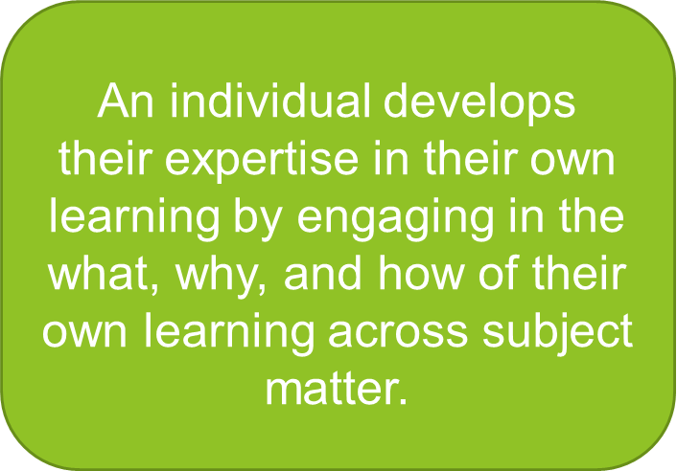

UDL: Bringing it All Together
UDL Assumptions
Expert Learner
Learning Sciences

