Slide 1
UDL Inspired project
UDL – Inspired Project Guide
“Until Learning Has No Limits” (Cast.org)

Slide 2
module outcomes achieved
Explain UDL’s scientific underpinnings, core principles, and how they are related to the variability of learning.
1
Apply UDL principles to course design, instructional materials, and assessments.
2
Examine how the UDL framework addresses systematic barriers in the learning environment.
3

Slide 3
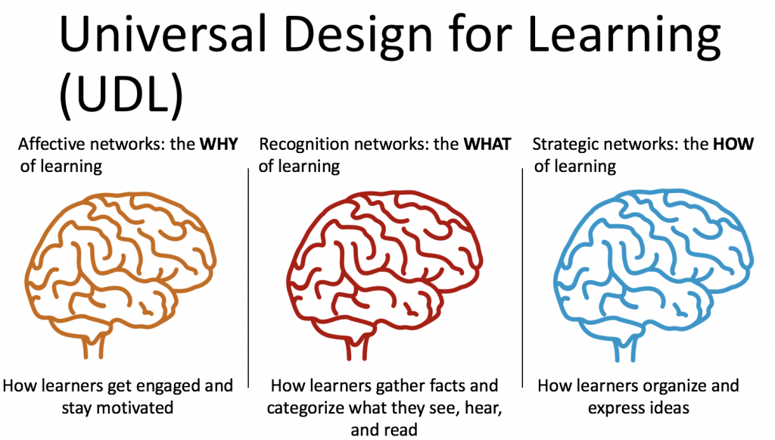
Layout of the UDL Framework
https://udlguidelines.cast.org/
This Photo by Unknown Author is licensed under CC BY-NC-ND

Slide 4
Deliverables
1. Create Two Artifacts:
Instructional Material: This is the item used to teach your students a concept. Examples are graphic organizer, textbook, video, podcast, etc.…
Assessment: This is the item used to measure what the student has learned, such as a quiz/test/worksheet.
Learning Activity: This is an activity used to reinforce course information. Examples are group discussion, practice quiz, self report survey, poll, etc…
2. Include the Project Alignment Form for each artifact.
Syllabus: Consider choosing one or two sections of your syllabus to incorporate UDL principles. Examples are policies concerning grading, attendance, or make-up work.

Slide 5
UDL Alignment Form
UDL Guideline Alignment Form
UDL Checkpoint: List by number and provide artifact description | Evidence of Alignment (Explain how checkpoint is aligned)
Course: Introduction to Educational Psychology Artifact: ☐Aspect of Syllabus ☒Learning Activity ☐Instructional Material ☐Assessment | 8 unit case studies are completed by end of the semester. Developing a rubric to evaluate these case studies will benefit the students. Other teaching/learning practices related to the case study assignment is included.
1. Checkpoint 6.1: Guide Appropriate Goal-Setting Provide models or examples of the process and product of goal-setting. Post goals, objectives, and schedules in an obvious place | One of the first in-class activities we do is a case study. Students read through the case study and answer several assess questions. Students use the rubric to grade each other. This serves as practice for the remaining case studies completed in the course, 8 in total. A course schedule is provided with the syllabus indicating due dates for all 8 case studies. Notifications to students’ cell phones are sent to remind students of deadlines via D2L. (I will provide time during first class to help student set this up in their D2L account.) Alignment of course goals to case study will be communicated in weekly announcement of the case study deadline.

