Slide 1

Value Based Care and Contracting
Date

Slide 2
Agenda/Class Outline
What is value-based care?
Payer Contracting for Healthcare Providers
Value Based Care
  Alternative Payment Models
  Measures & Ratings
Data Analytics Applications
Technology Applications
Homework Assignment

Slide 3
Value Based Care
The move from fee-for-service to value

Slide 4
What is Value Based Care?
Payment method(s) where positive outcomes of a healthcare provider are rewarded, and negative outcomes are penalized
This is a move away from traditional volume-based payment (fee-for-service)
Requires significant investment and knowledge regarding:
  Understanding contracts with payers
  Real time data on costs, care practices and patient results
  Analytics to track and measure results and ensure success

Slide 5
Payer Contracting
Healthcare provider’s perspective

Slide 6
Healthcare Payers and Health Plans
Healthcare payers finance the payment for the majority of health services
They collect premiums from their members in exchange for paying for members’ medical services
  The premiums are used to pay for medical services, cover any administrative expenses of the payer, and profit
Payers are required by the Affordable Care Act to spend 80 to 85% of premiums on medical services (MLR – Medical Loss Ratio)
To keep costs as low as possible, payers negotiate contracts with providers

Slide 7
Provider Contracting
Payers contract with many providers, from hospitals and health systems to individual doctors and specialists
This group of preferred providers is known as the payer’s “network”
  Payers may require or incent members to use these providers in exchange for discounts on services

Slide 8
Contract Considerations
List and Scope of Services Covered
Fee Schedules
Procedural Requirements
  Claims Submission Timing for Reimbursement
  Denial/Dispute Processing
  Terms and Renewals/Renegotiations
Unilateral Amendments

Slide 9
Best Practices
Contract Management System
Standard Contract Template
Fee Schedule Analysis and Comparisons
Stakeholder Team (Administrators, Financial Experts, Clinicians)

Slide 10
Provider Contracts
Example
Cost vs payment
Variance in payments by payer
Using information for negotiation and cost reduction efforts

Slide 11
Value Based Care
The quest for lower cost higher quality care

Slide 12
Value Based Contracts
Increasing costs and quality issues have driven the push towards value based (or alternative payment) models
  Payers found their profit margins decreasing
  Employers were paying more for their employees’ care, and not all increases can be passed on directly to the employee
  Government increase in spending for healthcare has forced the creation of new payment models and methods

Slide 13
Mandatory Medicare Payment Models
Value Based Purchasing Program (VBP)
Hospital Acquired Condition (HAC) Reduction Program
Hospital Readmissions Reduction Program (HRRP)
Sample HRRP measures for PA hospitals
CMS Innovation Center Homepage | CMS Innovation Center

Slide 14
Examples of Other Payment Models
Pay for Performance
Bundled Payments
Shared Savings
Shared Risk
Capitation

Slide 15
The Importance of Proper Coding
Scenario 1
Patient has surgery to repair a hip fracture
Patient experiences blood loss and low blood pressure
2 Units of blood are ordered when patient’s hemoglobin level drops (12.6 to 7.6) after surgery
Documentation lacks diagnosis for acute blood loss anemia to support the clinical situation
Scenario 2
Documentation review (either manual or through software) identifies a documentation deficiency for acute blood loss anemia
CDI staff queries the attending physician, who confirms the diagnosis and updates the documentation
Documentation is updated to reflect the correct diagnosis
DRG
482
DRG Weight
1.6692
Severity of Illness: 1
Payment
$10,849
DRG
481
DRG Weight
2.0501
Severity of Illness: 2
Payment
$13,325

Slide 16
Evaluating and Measuring Success
CMS has developed many quality measures to evaluate health plan and provider performance:
HEDIS (Healthcare Effectiveness Data and Information Set) Measures – compare effectiveness of providers and health plans based on activities and services – 70+ measures (Appendix B of reading material)
CAHPS (Consumer Assessment of Healthcare Providers and Systems) – consumer satisfaction ratings
Medicare STARS Ratings

Slide 17

Example Healthplan Ratings
https://healthinsuranceratings.ncqa.org/2019/search/Commercial/PA

Slide 18
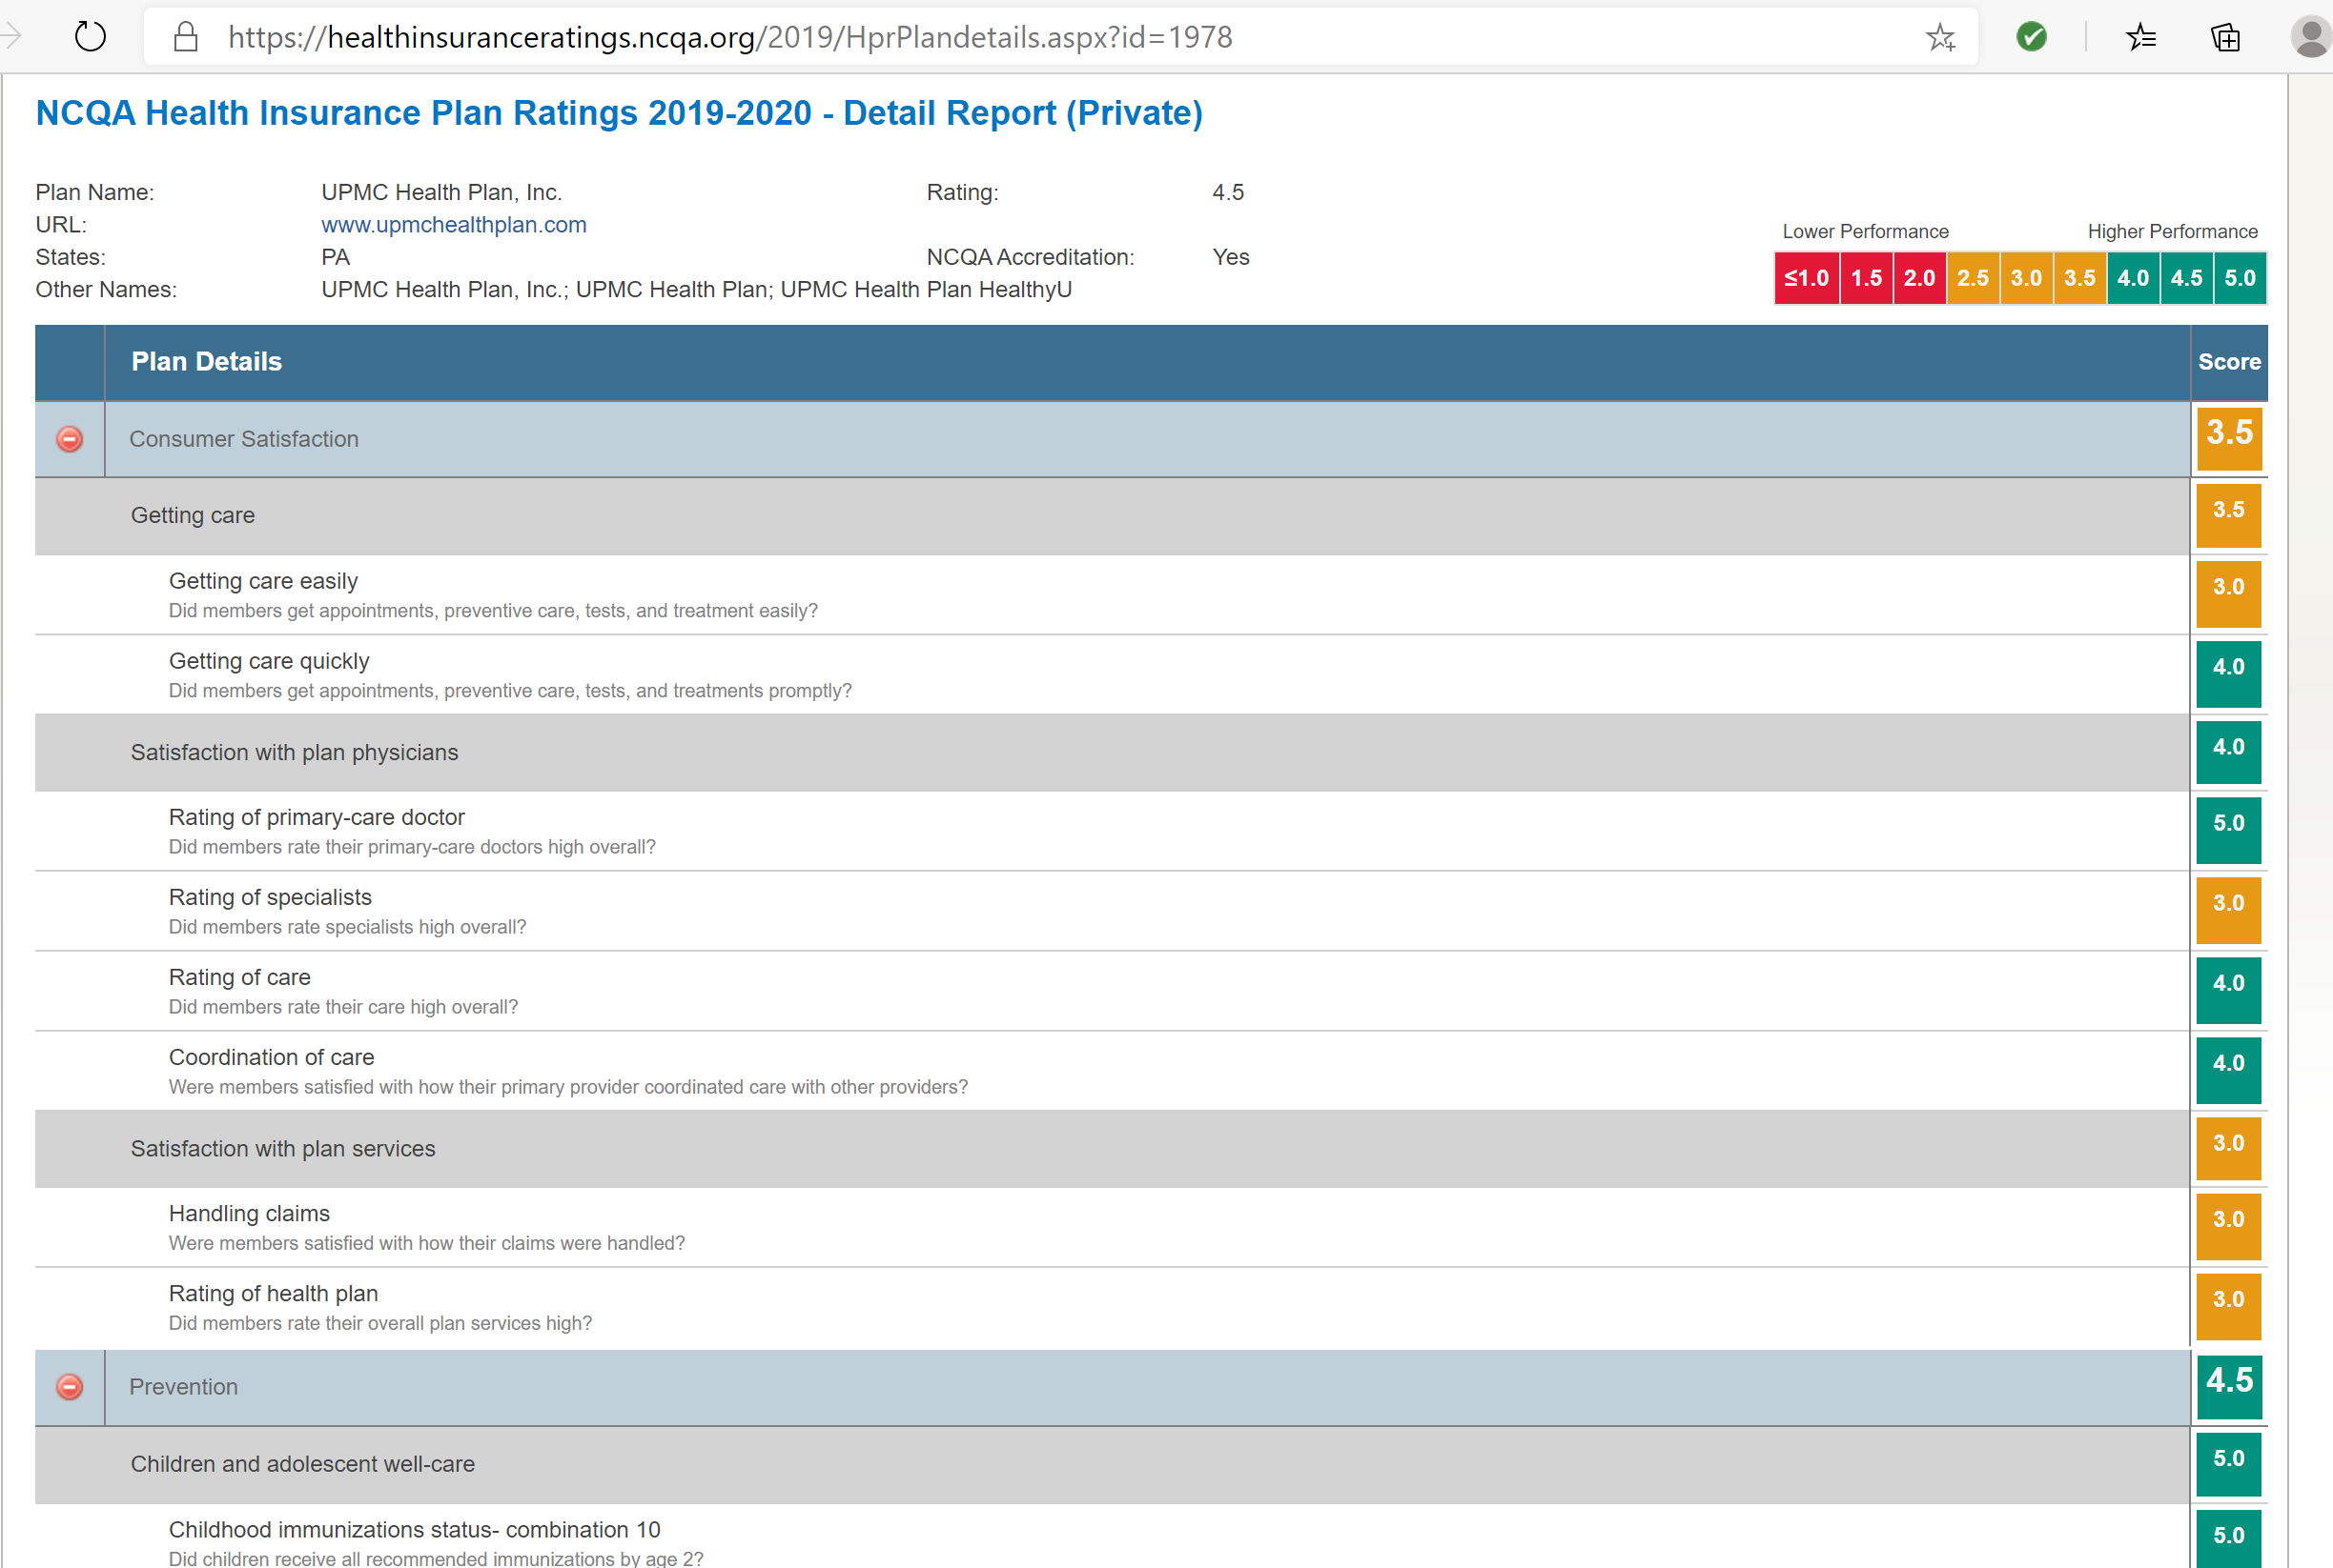
https://healthinsuranceratings.ncqa.org/2019/HprPlandetails.aspx?id=1978

Slide 19
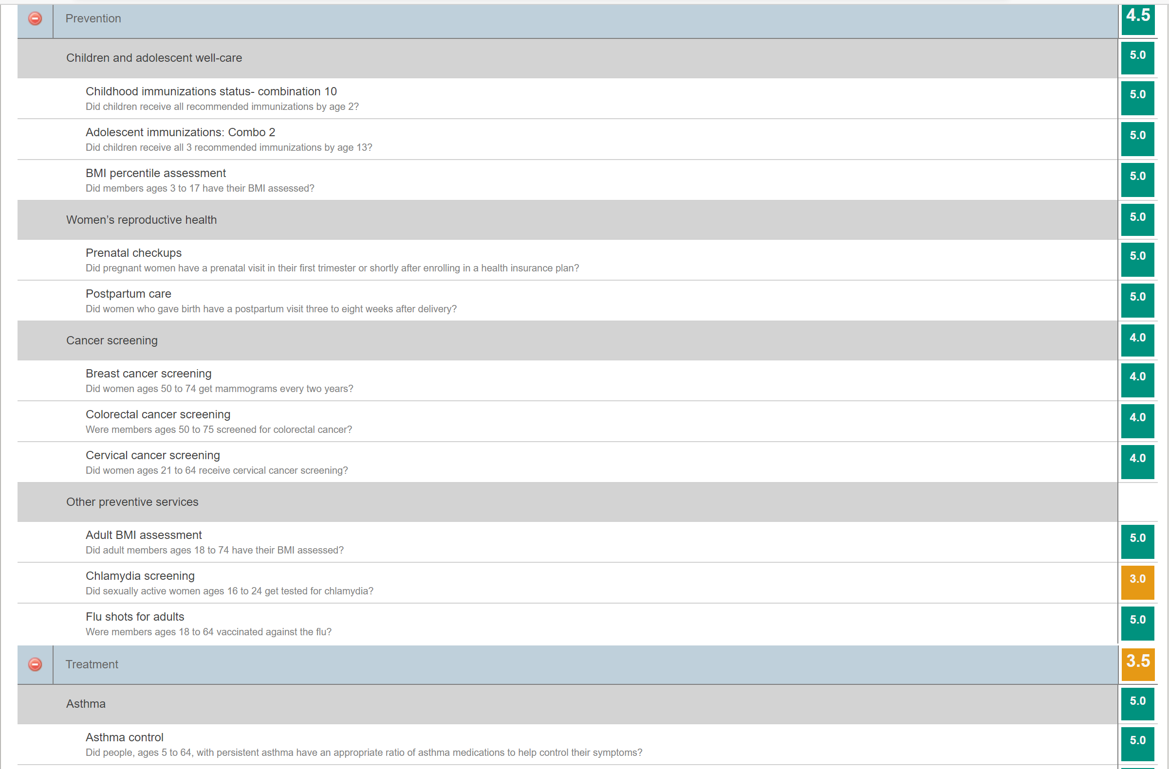
https://healthinsuranceratings.ncqa.org/2019/HprPlandetails.aspx?id=1978

Slide 20
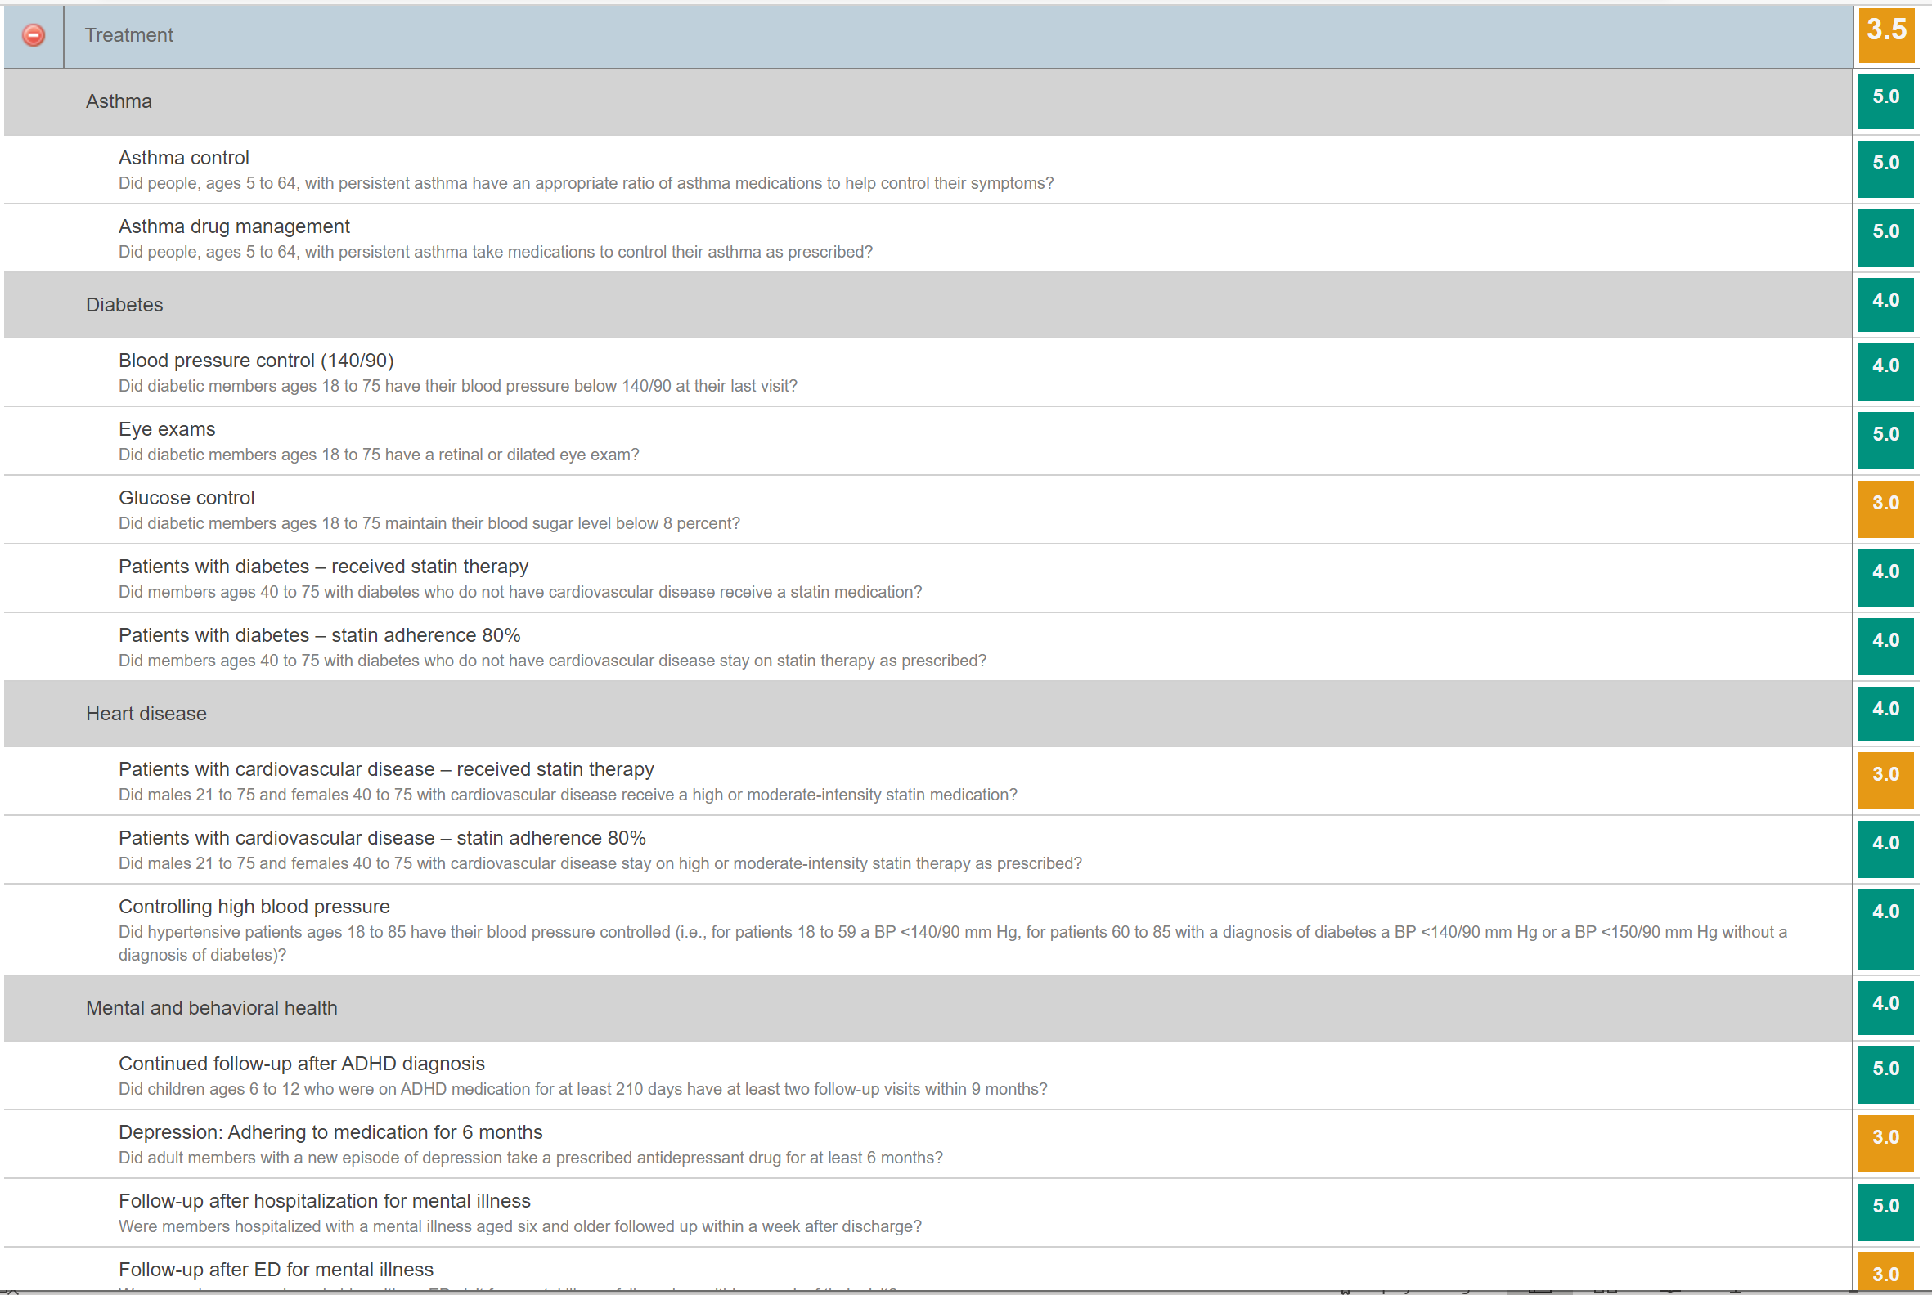
https://healthinsuranceratings.ncqa.org/2019/HprPlandetails.aspx?id=1978

Slide 21

https://healthinsuranceratings.ncqa.org/2019/HprPlandetails.aspx?id=1978

Slide 22
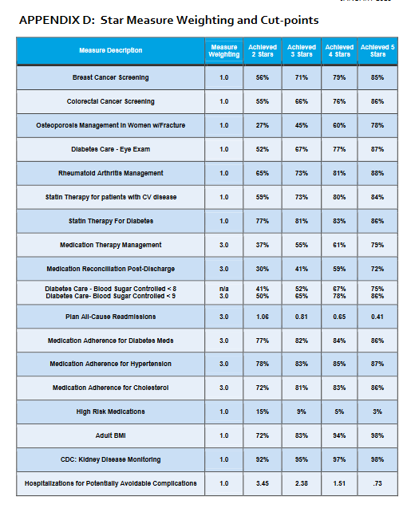
Medicare
Star Measures

Slide 23
Example: Star Quality Ratings
A physician practice has had the following prevention measures for the last 3 years:
Observations:
Two of the three measures are in decline
The average of the rating has remained between 3 and 4, and dropping in the last year
There is opportunity for improvement
What actions would you suggest?

Slide 24
Data Analytics
Using data to improve health

Slide 25
Social Determinants of Health
Social determinants of health can provide insights into healthcare needs
Payers and providers can focus on specific populations and develop strategies and tactics to improve health
Examples:
  Target and encourage healthy behaviors, such as exercise (gym membership discounts), eliminating tobacco use (smoking cessation programs) through discounts and free benefits
  Identify at-risk populations, such as Type 2 Diabetics. Connect with them to ensure proper care is being given, and resources made available
  Provide transportation options (Uber and Lyft vouchers) to assist low-income members for office visits, prescription refills, and healthy food options

Slide 26
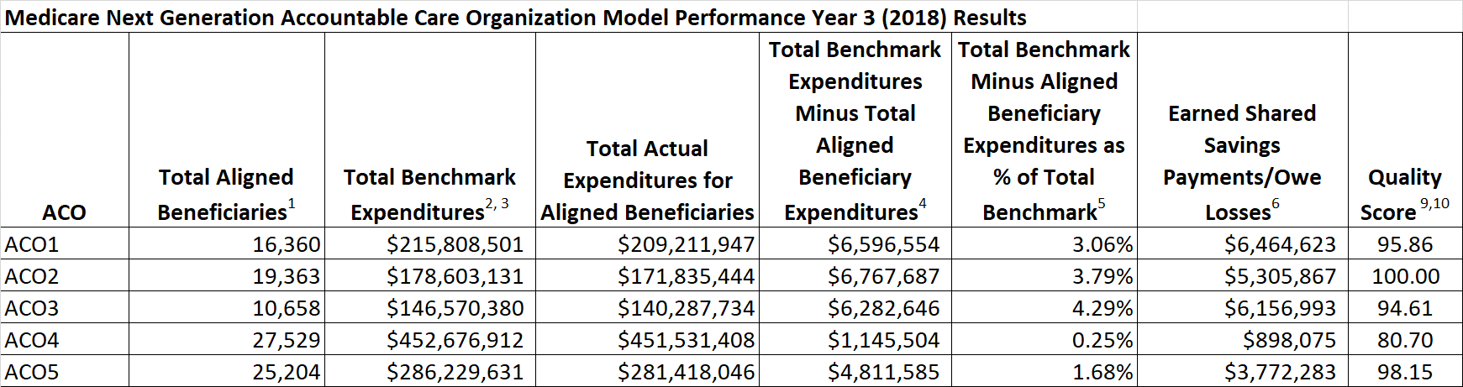
Accountable Care Organizations (ACOs)
Group of providers that work together to coordinate care for their patients
Goal is to improve the quality of care, reduce costs and improve the health of the participants
Providers must collect and report data (cost, quality, etc.), which may result in rewards or penalties
Reporting and results closely monitored by CMS
All of these ACOs performed below benchmarks so they received some of the shared savings.

Slide 27
ACO Sample Utilization & Quality Measures*
Utilization Measures
Total cost of care
Inpatient admissions per 1,000 beneficiaries
Unnecessary inpatient and ED use
Readmission rates or avoidable readmissions
Percentage of patients with office visits within 7 days of discharge from an acute hospital stay
Percentage of patients without an office visit during the year
Quality Measures
Annual wellness visits
ACO #6 - CAHPS: Shared decision making
ACO #14 – Preventative care and screening: flu vaccine
ACO #19 – Colorectal cancer screening
ACO #20 – Breast cancer screening
ACO #28 – Controlling high blood pressure
Appendix E of the reading material lists additional ACO quality measures.

Slide 28
Patient Centered Medical Home Program
Primary care-based healthcare model
Access and Continuity - Provide the care patients need—anytime, anywhere.
Planned Care and Population Health - Use technology to be proactive about managing patients’ chronic conditions.
Care Management - Identify which patients need additional support from the care team and provide those services.
Patient and Caregiver Engagement - Encourage patient participation and shared decision making.
Comprehensiveness and Coordination - Build relationships and coordinate care across the medical neighborhood.

Slide 29
Technology Applications
Supporting the value-based care initiatives

Slide 30
Applying Technology
Telehealth
Remote monitoring
Artificial intelligence
Care management and outreach
  Identify high risk patients (chronic conditions, behavioral health issues)
  Develop action plans for care
  Contact for regular screenings and immunizations

Slide 31
Homework Assignment
Using the excel file provided (“NextGenACOModel-Financial Results Example.xlsx”):
Based on Note 6 (Column H, explained in cell B54), how many ACOs will have losses to pay back to CMS?
Calculate the cost per beneficiary per ACO (Total actual expenditures/Total aligned beneficiaries). Are there significant differences between P4R vs P4P (P4R are first year ACOs and P4P are already established) in cost? What do you notice about the quality ratings between the two groups?
The various ACO measures (Columns L through AP) are defined in the attached document. Select one of the measures and review the quality ratings. Review other factors (cost, number of beneficiaries, etc.) and determine if there is any relationship between the rating you selected and other factors.

Slide 32
Summary
Value based care is being used to reduce healthcare costs and improve quality
Providers face significant challenges particularly if they cannot measure and monitor costs vs. the revenue they receive under value based contracts
CMS and payers continue to develop new cost models and quality measures that need to be understood and monitored
Data analytics and technology are needed to better understand and benefits of value based care

