Slide 1

Revenue Cycle in Healthcare
Date

Slide 2
Agenda/Class Outline
Revenue Cycle Stages
Costing Systems & Billing
Monitoring & Reporting Systems
In class revenue cycle problem
Denials Management
Other Best Practices
Video
Homework Assignment

Slide 3
Revenue Cycle
Stages

Slide 4
Typical Provider Revenue Cycle

Slide 5
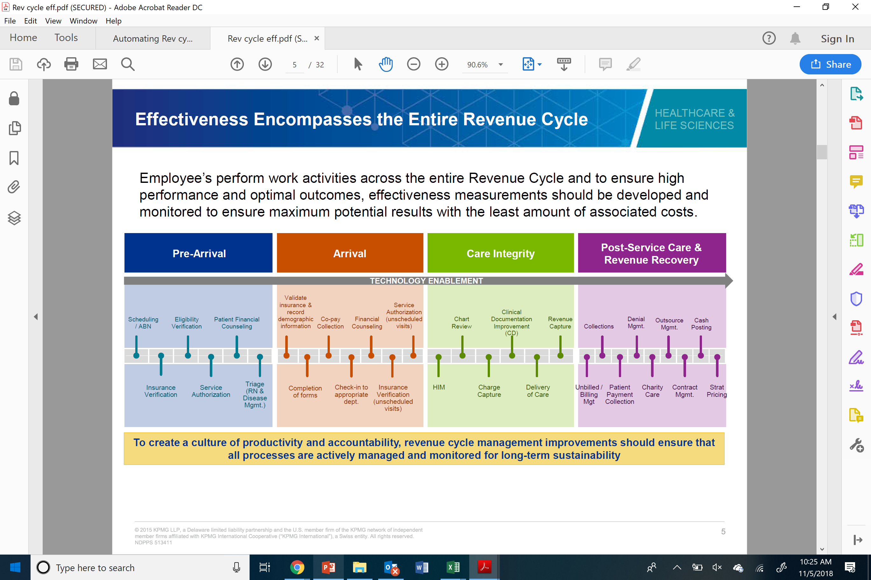
Four Stages of the Revenue Cycle
There are four main areas of the revenue cycle where key activities can help or hinder the collection process:

Slide 6
Pre-Arrival
Scheduling – timed to ensure the patient is able to arrive on time and prepared
Insurance verification/eligibility verification - Completing the key information collection and verification prior to patient arrival can ward off last minute problems and conflicts
Prior authorization – Payer agreement on necessity of procedure or care
Patient financial counseling – early identification of potential payment risks

Slide 7
Arrival
Final insurance verification/eligibility verification
Patient completes any required forms
Provider collects co-payments if applicable
Patient financial counseling – confirmation (and resolution) of any potential issues

Slide 8
Care Integrity
Charge capture for supplies and services
Proper coding and documentation
    Use of correct codes and timely completion of documentation ensures revenue integrity and cash flow
    Non-compliance to coding standards has significant risk to the organization and may yield reduced reimbursement or other sanctions
  HIM – Health Information Management – includes coders and auditors, which are high cost labor – they are two of the most expensive salaried positions within the revenue cycle
  Backlog in coding and coding related denials can yield cash deceleration

Slide 9
Post Service Care & Revenue Recovery
Charge master pricing
Billing Management – Billing occurs when the provider submits a statement of charges to the payer for reimbursement
Collections/payment receipt and posting – use of clearing houses to help proofread and process claims
Self pay/charity/indigent care
Payer contract management – continued move from fee for service to value-based arrangements
Denials management – a comprehensive effort to prevent prospective denials, effectively appeal & resolve retrospective denials, and enable reporting to track and monitor payor rejections and denial write-offs

Slide 11
Provider Costing Systems
Determining the amount to bill

Slide 12
Chargemaster
Listing of billable services and supplies along with the price to be billed
Based on actual costs with a markup
Pricing is used as a starting point in negotiations with providers (“list price”)
Self-pay patients are billed the full amount

Slide 13
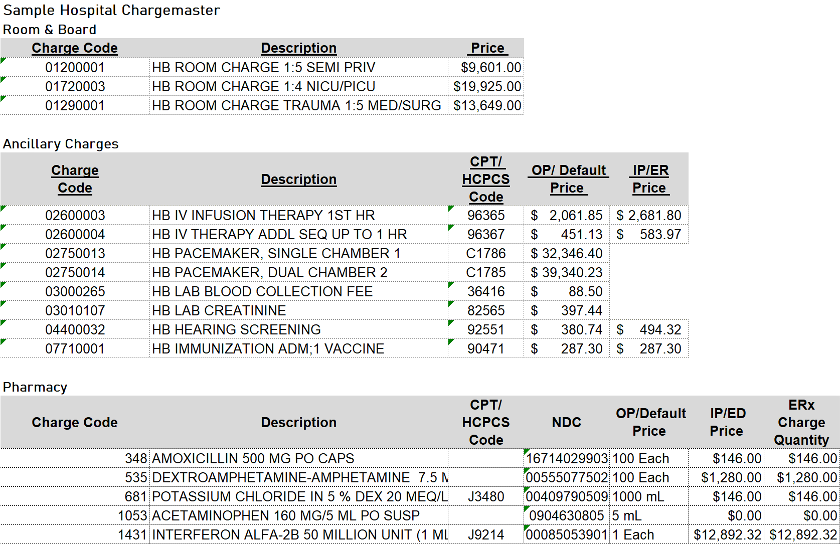
Sample Chargemaster Extract

Slide 14
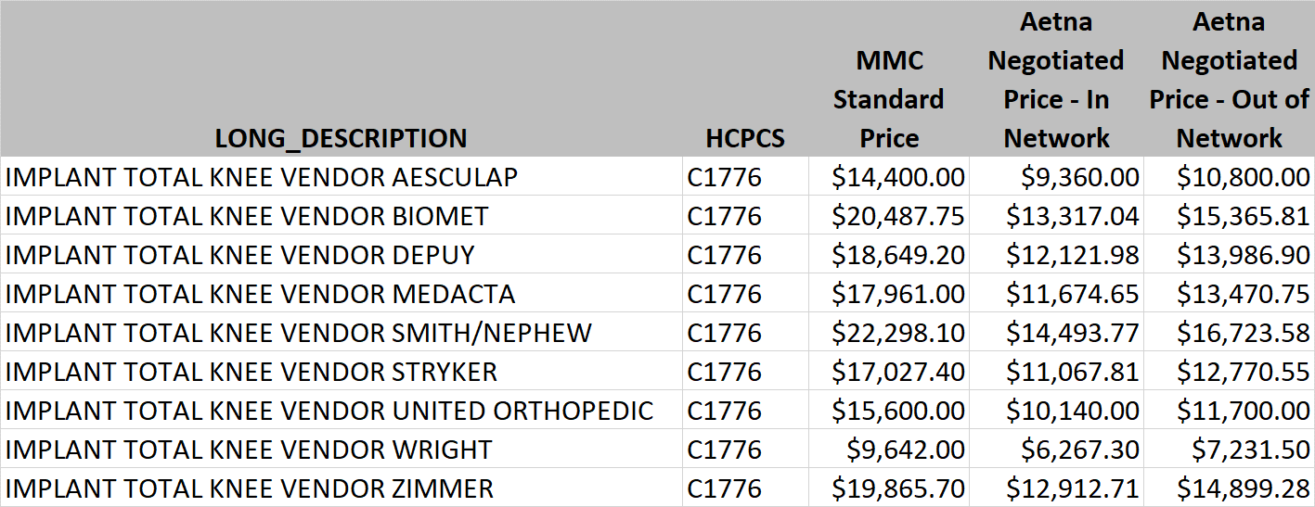
Example Payer Negotiated Pricing
In this example, Aetna contract states they will pay 65% of standard charge for in-network patients, and 75% of standard for out of network patients.

Slide 15
Price Transparency
Effort to make consumers aware of price before scheduling
CMS Ruling in response to Trump Executive Order
300 Common “shoppable” services to be listed
Would require providers to post negotiated contract pricing

Slide 16
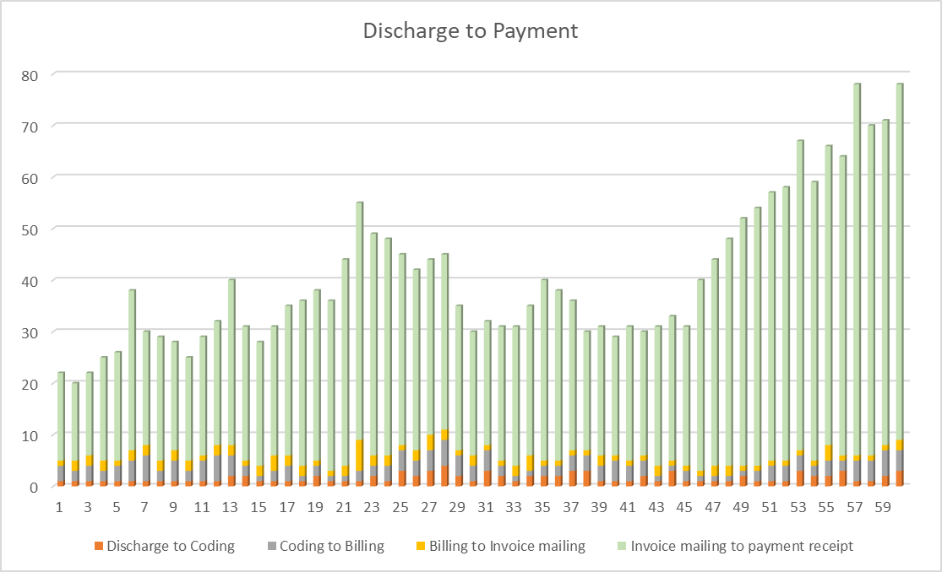
Revenue Cycle Analytics Exercise
A same day surgery center began collecting data on its discharge to payment processing and found the following in the first 60 days of collection (actual data can be found in accompanying spreadsheet).
Based on this data, and linear programming, what would you anticipate the next month’s results to be?
If you were an industrial engineer observing this practice, what ideas would you have for process improvement?

Slide 17
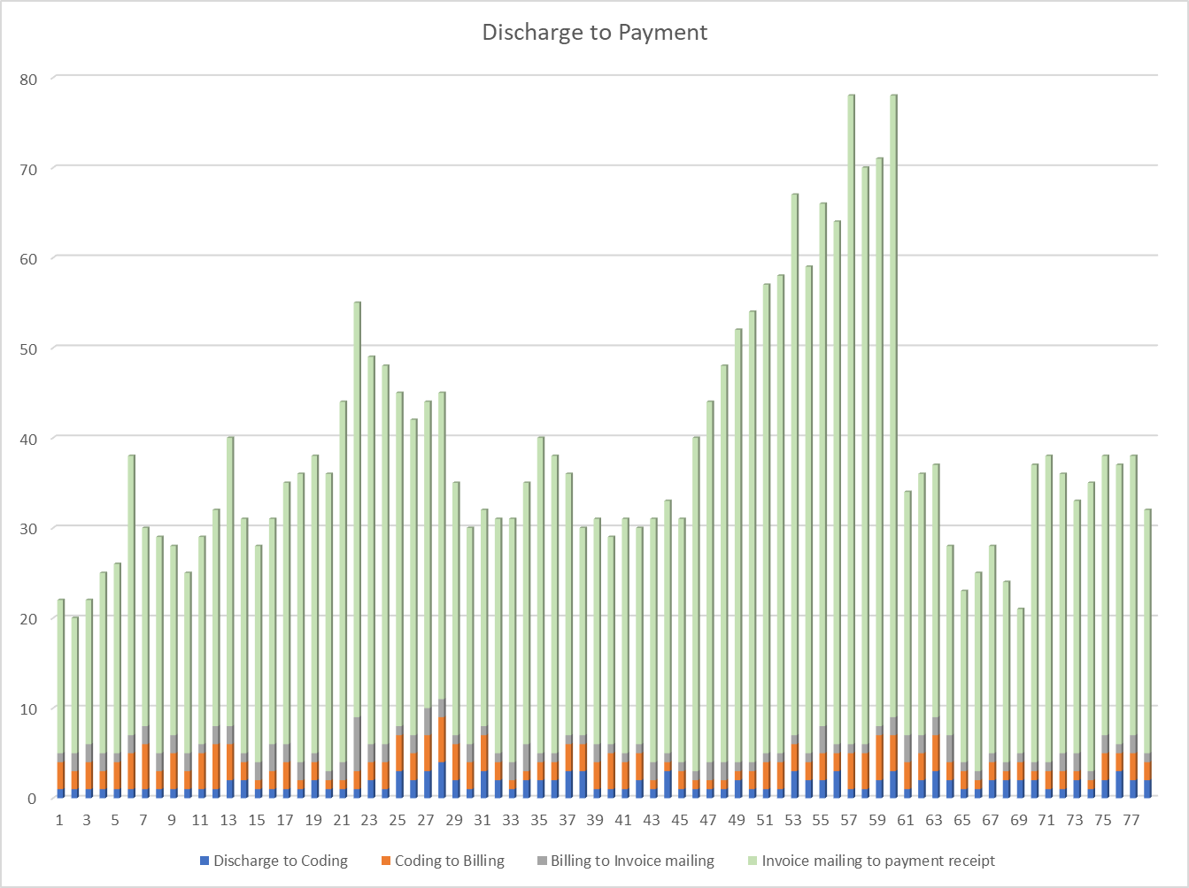
Revenue Cycle Analytics Exercise (continued)
The same day surgery center implemented some of your recommendations and collected data for the next 18 days.
Based on this data, and linear programming, what would you predict for the future? What other recommendations would you make?

Slide 18
Monitoring & Reporting Systems
Key performance indicators (Kpis)

Slide 19
Payment Collection & Processing
Payment Aging Report

Slide 20
Key Performance Indicators
It is important to collect and measure key processes to identify areas for further attention and improvement. A few examples include:
Net patients accounts receivable
= Average daily net patient service revenue
Average number of days in accounts receivable
  Indicates the average time for a claim to be paid
  Target 40 to 45 days for a hospital/health system
Example: A Chicago hospital charged an average of $10M per month for the last 12 months and has a total of $15M in Accounts Receivable for the same time period. The average days in A/R is:
$15,000,000__
= ($10M * 12) / 365 = 45 days

Slide 21
Cash collected as a percentage of net revenue
  Best practice is 95% or better
Example: The same hospital collected $8.5M last month against the $10M in charges. The percent cash collected is:
Denials rate
  Best practice is below 2% of claims filed
Example: The hospital filed 191,195 claims and received 5,542 denials. The denials rate is:
Cash collected in a period
= Net revenue for the period
$8,500,000
= $10,000,000 = 85%
Number of claims denied
= Total claims filed
5,542__
= 191,195 = 2.9%

Slide 22
Other KPIs
Discharged Not Final Billed (DFNB)
Final Billed but Not Submitted to Payer (FBNS)
Cost to Collect
Write Offs/Bad Debt
Point of Service Cash/Co-payment Collection Rate

Slide 23
KPI Example
A California hospital collected the following data from the prior fiscal year:
What is the days in Accounts Receivable?
  How does it compare to best practice?
What is the percent bad debt?
  How does it compare to best practice?

Slide 24
Days in A/R
= $57,127,000/($489,504,000/365) = 42.6
Best practice is 40 to 45 days, so this hospital is performing withing that range.
% Bad Debt
= $10,934,000/$489,504,000 = 2.2%
Best practice is below 2% - this hospital is just above that, so they should take a closer look at their bad debt. Is it trending up or down? If going down, that is a positive indicator but if going up, they should look at some of the revenue cycle processes involving patient payment counseling.

Slide 25
Other Metrics and Measures
Insurance verification (%) at time of admission (inpatient, outpatient)
Average patient wait time for registration/appointment
Patient no-show rates
Denials overturned rate
Inpatient/Outpatient charts coded per day

Slide 26
Insurance Verification Reporting Discussion
How would you compare the week to week results?
What suggestions would you have for improvement?

Slide 27
Denials Management

Slide 28
What are denials?
Formal notice by a payer to a provider that a filed claim will not be paid, or may be paid at a lower amount than requested (underpayment)
Clean claims ratio – percent of claims paid on initial submission
  Providers’ target is 95% or better clean claims ratio
Rework of claims is costly and negatively impacts cash flow

Slide 29
Categorizing Denials
Technical denials – Claims denied due to some type of administrative error.
Medical denials – Claims denied for medical necessity reasons.
Partial payments or discrepancies (typically underpayment) – Typically caused by contract misinterpretation or coding errors.
Claim suspensions – The claim is placed “on hold” pending a review by the payer. The payer will not process and make payment until the reviews are completed.
Late payments – Payment takes longer than anticipated

Slide 30
Managing Denials
Conducting root cause analysis – why was the claim denied?
  Duplicate claim filed
  Service not covered by patient’s plan
  Patient not covered by plan
  Incorrect or incomplete information
  Pre-certification or pre-authorization not obtained
  Service not medically necessary
  Untimely filing (past deadline to submit)
  Diagnosis incorrect or inconsistent with documentation

Slide 31
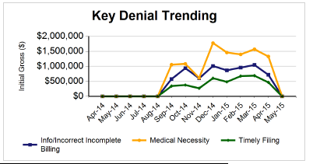
Denials Trend Analysis
Look for trends to identify process improvement opportunities
Segregate data by type of denial or by payer to identify opportunities for improvement

Slide 32
Denials Trending Exercise
A 7-hospital healthcare system collected the last 12 months denials information by type of denial and payer. Review the data by payer and reason and suggest next steps for further analysis and improvement.

Slide 33
RAC Audits
Process where CMS audits claims submitted by providers
CMS hires Recovery Auditor Contractors (RACs) who are paid on a contingency basis (a portion of the recovered claims dollars) to identify and correct any improper payments
CMS uses this data to avoid future improper payments on claims

Slide 34
Other Best Practices

Slide 35
Automating the Revenue Cycle
Cost estimator tools
Patient portals
Tele-health
Artificial intelligence
Claims management and business intelligence tools
Workflow automation
Blockchain technology

Slide 36
Training and Job Aids
People skills
Technology training
Analytical skills
Understanding of payer contract terms and conditions
Job aids – checklists, help desks, computer prompts

Slide 37
Cross-functional Teams
Assemble the right team members
Clearly define the team’s goal
Communicate clearly and often
Conduct periodic check-ins
Celebrate successes – even if they are small

Slide 38

The Future of Revenue Cycle

Slide 39
Summary
Revenue cycle is how the provider realizes revenue from the services provided to patients
Inefficiencies in the processes can negatively impact the provider’s financial health
Analytics can improve the dollars collected and timeliness of collections

Slide 40
Homework Assignment

