Slide 1

Ultra-Processed Food Exposure and Adverse Health Outcomes-Should We Be Eating Ultra-Processed Foods in America?
By: Blair Rexing

Slide 2
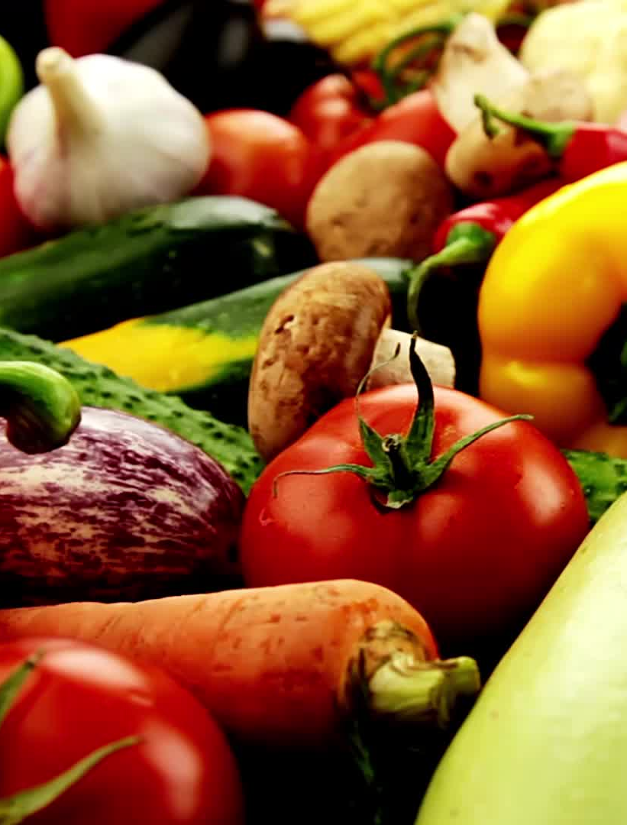
Problem Statement:
Ultra-Processed foods are so prevalent in America today. UPFs are so convenient and readily available in America. We need to make them in more limited amounts as they are not good for our overall health and nutrition. Ultra-processed foods have become the new normal in America as they are convenient, and Americans are busy and do not always take the time to cook and plan nutritious meals. They are also cheap and an easy choice for many families in America. What is the solution to this issue?

Slide 3
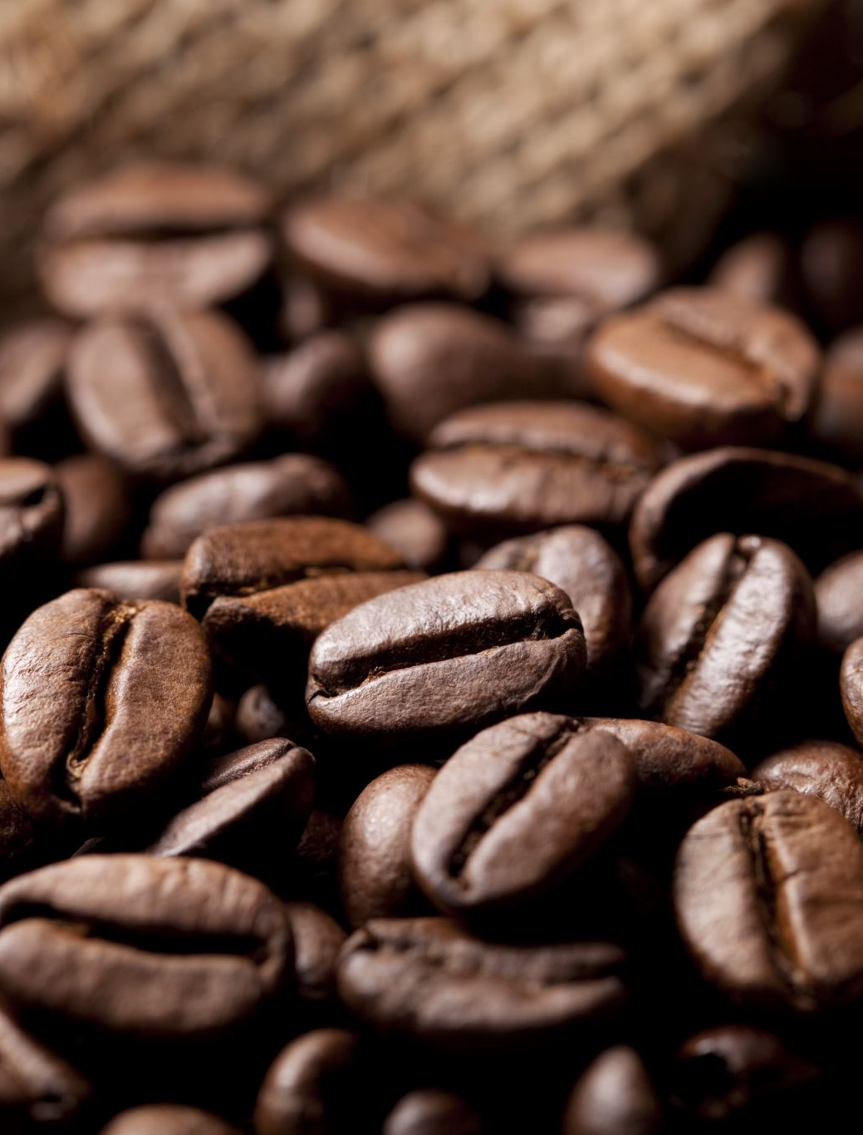
History:
Pre-industrial revolution: people fermented, salted, dried, and smoked foods to help them last a long time.
Late 18th to Early 19th Century: Mass productions of dairy, grain, and meat began.
Canning also became popular.
1930s instant foods and coffee as well as packaged baked goods became popular.
WWII sped up the process so that soldiers could have instant meals that lasted for a long time like powdered eggs and ready-to-eat meals.

Slide 4
History:
Today’s Ultra-processed Foods (UPFs) emerged in the 1980s.
Mostly used in convenience foods and snacks.
Also includes synthetic additives, colors, artificial sweeteners, and flavor enhancers.
People who opposed ultra-processed foods back then were labelled food pseudoscientists or food faddists.
Carlos Monteiro and his team at the University of Sao Paulo in Brazil created NOVA in 2010. NOVA is a food classification system that categorizes food products based on the extent of industrial processing.

Slide 5
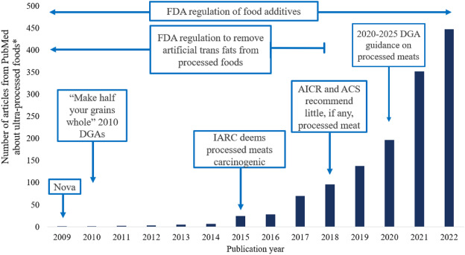
A UPF Roadmap:
“Perspective: A Research Roadmap about Ultra-Processed Foods and Human Health for the United States Food System: Proceedings from an Interdisciplinary, Multi-Stakeholder Workshop.” “Advances in Nutrition An International Review Journal”. https://advances.nutrition.org/article/S2161-8313%2823%2901378-9/fulltext
6 March, 2025

Slide 6
Political:
The commercial determinants of health (CDOH) are the “strategies and approaches used by the private sector to promote products and choices that are detrimental to health”.
Governments, civil society groups and public health practitioners need to work together to build long-term global networks and social movements with diverse skillsets to mitigate the harms associated with Big Food.
Taxation has been a major policy used to discourage consumption of UPFs including SSBs and high-energy dense packaged foods.
Many countries lack clear policies of regulating UPFs, including the U.S.

Slide 7
Scientific:
Using data from the National Health And Nutrition Examination Survey III (NHANES III), previous researchers found that frequent consumption of ultra-processed foods was associated with greater chances of all cause mortality in U.S. adults, but little research has focused on factors that can impact ultra-processed food consumption, such as food environment.
The NOVA classification has a purpose to to classify foods according to the extent and purpose of their industrial processing if any (1). The NOVA categorizes foods into four groups: Group 1 - in natural or minimally processed foods; Group 2 - processed culinary ingredients; Group 3 - processed foods; and Group 4 - ultra processed foods (UPFs). UPFs refer to those certain foods that contain at least one item within their ingredients that is characteristic of the NOVA ultra-processed food group, i.e., food substances that are never or rarely used in cooking - such as cosmetic food additives, different types of sugars, and modified oils, which allow shelf-life extension and may give the product other sensory properties.
Studies have shown that increased intake of UPFs leads to increased risk of cardiovascular disease. A study involving 200,000 U.S. adults revealed that people who had a high intake of UPFs had a 17% greater risk of cardiovascular disease.

Slide 8

Scientific:
Research shows that a correlation between high UPF consumption and greater mortality rates.
  Higher intake of UPFs relate to a higher risk of stroke and cognitive decline.
  Higher rates of metabolic disorders like obesity, hypertension, and hypertriglyceridemia are correlated to high UPF intakes.
  There is also a strong correlation between mental health and high intake of UPFs. These mental health issues include anxiety, depression, etc.

Slide 9
Legal Issues:
Legislation introduced in the 118th Congress would amend federal labeling requirements and/or require reassessment of federal policies on the use of certain ingredients and additives in U.S. food products. Separately, the Food and Drug Administration (FDA) is considering updates to its existing nutrition labeling requirements. The executive branch is also considering other product labeling changes.
Separately, the executive branch could consider whether to take actions related to certain FDA authorities. FDA could assess whether to retain, remove, or amend its GRAS (Generally Recognized as Safe) determination for certain food ingredients or additives.
Not all UPFs are labeled with front-of package labeling which could reduce the amount of UPFs purchased and consumed.
UPFs are used a lot to target children using cartoons and characters or labeling.
Some companies fail to disclose health risks which is a major legal issues.

Slide 10
Religious Beliefs:
The NOVA food classification was used to identify UPFs. Associations between religion and daily consumption were identified using risk analysis.
Both Muslim and Christian schoolchildren had a high consumption of UPFs. Regarding the potential impact of religion on the consumption of UPF, we observed that Muslim schoolchildren consumed three to four times more UPF than Christian schoolchildren.
“Or do you not know that your body is a temple of the Holy Spirit within you, whom you have from God? You are not your own, for you were bought with a price. So glorify God with your body.” -1 Corinthians 6:19-20
This verse from the Christian Bible talks about how God made your body a temple and you need to nourish it and take care of it with healthy and nourishing foods.

Slide 11
Ethical Questions:
What public health issues come from UPFs?
-Increased chronic diseases like obesity, cardiovascular diseases, diabetes, etc.
-Marketing for UPFs aim at vulnerable populations like children, low-income communities, and areas with limited access to nutritional education.
What kind of false advertisements?
-Misleading health claims and bright and fun packaging.
-May not provide all ingredients in the UPF.

Slide 12
More Ethical Questions:
What Economic Issues Come from UPFs?
-May stifle local food systems and local producers.
-May choose to make a profit over the health of people.
What Environmental Impacts are caused by UPFs?
-A lot of UPFs contain palm oil, soy, corn, etc. These products can lead to deforestation, greenhouse gas emissions, and biodiversity loss.
-The heavy use of plastics can lead to environmental degradation.

Slide 13
Cultural Habits:
UPFs in different cultures varies greatly.
Americans have a very busy culture so quick and convenient foods like UPFs are very popular in the U.S.
Other countries maintain traditional diets which contain lower intakes of UPFs.
Adults in Canada from six different ethnic minority groups showed a higher quality of a diet and consumed less UPFs than white adults.
Globalization and Urbanization also affects intakes of UPFs in many countries.
In certain regions like the Pacific Islands, urbanization has affected their traditional diets to more processed, packaged, and imported foods leading to a ride in obesity in these countries.

Slide 14
Institutional Agencies:
Many food service industries serve UPFs such as ready-to-eat condiments, beverages, and desserts.
The NOVA classification system uses qualitative recommendations for ingredients in foods in the U.S.
Government agencies have a major impact on the marketing and consumption of UPFs in America.
U.S. Dietary Guidelines have faced criticism for being persuaded by food manufacturers and special interest groups, leading to recommendations that may not align with scientific research.
Institutional food services such as schools and hospitals, often add UPFs into their menus to help lower costs and save time with food preparation.

Slide 15
Institutional Impacts:
A major challenge with UPFs is that they are extremely globalized around the world.
Research shows that the UPF industry, UPF manufacturers, and co-dependent corporations and industries actively lobby key food system decision makers.
Around the world, responses to UPFs have been focused on the individual changing their diet rather than a systematic food system transition.
UPFs have many institutional impacts including public health, education and nutrition standards, regulatory policies, and economic structures.

Slide 16
Pros of UPFs:
Pros:
Frozen, pre-chopped and canned ingredients save time in the kitchen. Some processed and fortified foods also provide essential nutrients that might be difficult to obtain in busy households or those with limited budgets. Processing can retain or even enhance nutrient content.
Traditional/easy with busy schedules
Taste good and are addictive
Cheap
Highly Advertised

Slide 17
Cons of UPFs:
High levels of sugar, fats, and salt
Lead to chronic diseases
Increased Risks of Cancer
Lacks Nutrients
Can lead to obesity

Slide 18
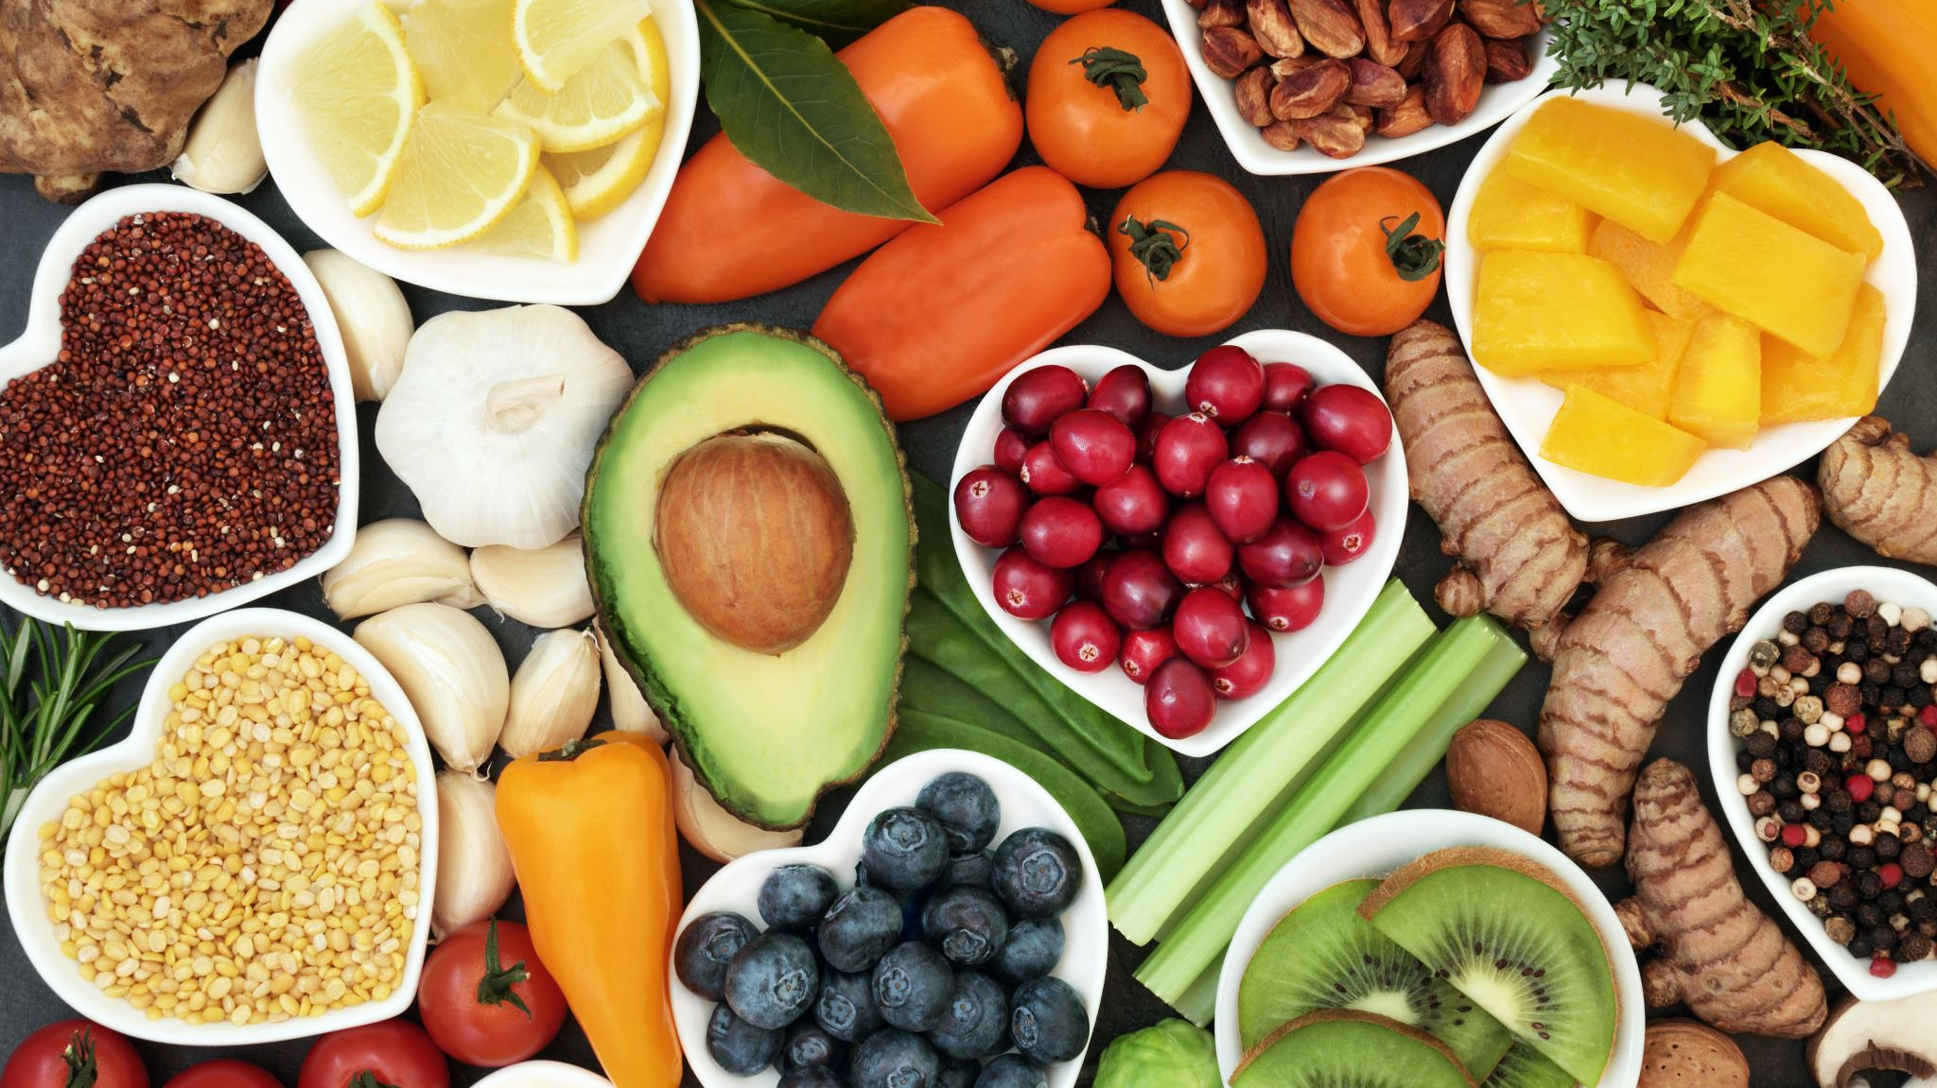
Problem Statement Re-stated:
Ultra-processed foods have become extremely prevalent in America. They are tasty, cheap, convenient, and addictive. What is a solution to making whole foods more available in America?

Slide 19
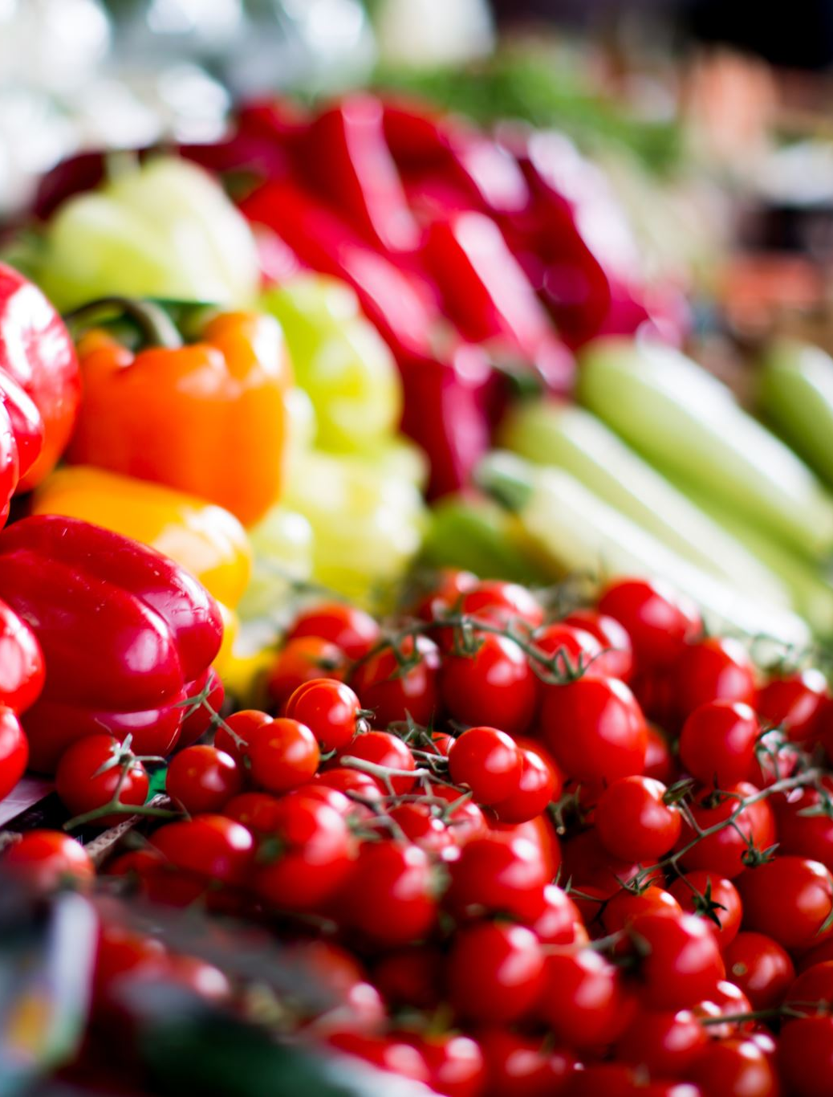
My Solutions:
My solutions to lowering the amount of UPFs in the U.S.:
1.) To expand nutritious markets to more places especially food deserts.
2.) Making nutrition incentive programs for low-income families, so that by offering financial incentives for buying more whole foods, they will be more apt to buying these foods.
3.) Promoting school nutrition policies and promoting less processed foods in school lunches.
4.) Promoting more urban farms and community gardens in urban areas so that people who live in these places are still able to access whole foods that are fresh and locally grown.

Slide 20

Class Activity:
Can everyone thing back to what you ate yesterday?
Take a sheet of paper and write down each food you ate.
Which of these foods were ultra-processed?
If you consumed any ultra-processed foods, what could you substitute as a better option?

Slide 21
References:
Dietitian, V. T. (n.d.). Ultra-processed foods. British Heart Foundation. https://www.bhf.org.uk/informationsupport/heart-matters-magazine/news/behind-the-headlines/ultra-processed-foods
3 March, 2025
Food rationing on the World War II Home Front (U.S. National Park Service). (n.d.). https://www.nps.gov/articles/000/food-rationing-on-the-world-war-ii-home-front.htm
https://www.nps.gov/articles/000/food-rationing-on-the-world-war-ii-home-front.htm
10 April, 2025

Slide 22
References Continued:
Popkin BM, Barquera S, Corvalan C, Hofman KJ, Monteiro C, Ng SW, Swart EC, Taillie LS. Towards unified and impactful policies to reduce ultra-processed food consumption and promote healthier eating. Lancet Diabetes Endocrinol. 2021 Jul;9(7):462-470. doi: 10.1016/S2213-8587(21)00078-4. Epub 2021 Apr 15. PMID: 33865500; PMCID: PMC8217149. https://pmc.ncbi.nlm.nih.gov/articles/PMC8217149/
6 March, 2025
Moodie R, Bennett E, Kwong EJL, Santos TM, Pratiwi L, Williams J, Baker P. Ultra-Processed Profits: The Political Economy of Countering the Global Spread of Ultra-Processed Foods - A Synthesis Review on the Market and Political Practices of Transnational Food Corporations and Strategic Public Health Responses. Int J Health Policy Manag. 2021 Dec 1;10(12):968-982. doi: 10.34172/ijhpm.2021.45. PMID: 34124866; PMCID: PMC9309965. https://pmc.ncbi.nlm.nih.gov/articles/PMC9309965/
4 Marrch, 2025

Slide 23
More References:
Grandy, B. J. (2023). Food environment as a moderator in the relationship between ultra-processed food intake and mortality in the united states (Order No. 30250721). Available from Health Research Premium Collection. (2778644907). Retrieved from https://univsouthin.idm.oclc.org/login?qurl=https%3A%2F%2Fwww.proquest.com%2Fdissertations-theses%2Ffood-environment-as-moderator-relationship%2Fdocview%2F2778644907%2Fse-2%3Faccountid%3D14752
4 March, 2025
Budson, A. E., MD. (2024, June 17). Ultra-processed foods? Just say no. Harvard Health. https://www.health.harvard.edu/blog/ultra-processed-foods-just-say-no-202406173051 Budson, A. E., MD. (2024, June 17).
12 April, 2025
:”Ultra-Processed Foods (UPF): Background and Policy Issues”. “Congressional Research Service”. https://crsreports.congress.gov/product/pdf/IF/IF12826/2
22 Nov. 2024
4 March, 202501/2025. Mohatar-Barba M, González-Jiménez E, López-Olivares M, Fernández-Aparicio Á, Schmidt-RioValle J, Enrique-Mirón C. Cross-Sectional Study on the Influence of Religion on the Consumption of Ultra-Processed Food in Spanish Schoolchildren in North Africa. Nutrients. 2025 Jan 11;17(2):251. doi: 10.3390/nu17020251. PMID: 39861381; PMCID: PMC11767561.
https://pmc.ncbi.nlm.nih.gov/articles/PMC11767561/
3 March, 2025
Yates J, Kadiyala S, Deeney M, Carriedo A, Gillespie S, Heindel JJ, Maffini MV, Martin O, Monteiro CA, Scheringer M, Touvier M, Muncke J. A toxic relationship: ultra-processed foods & plastics. Global Health. 2024 Oct 24;20(1):74. doi: 10.1186/s12992-024-01078-0. PMID: 39449069; PMCID: PMC11500473. https://pubmed.ncbi.nlm.nih.gov/39449069/ 24 October, 2024

Slide 24
References Continued:
Hosseinpour-Niazi, S., Niknam, M., Amiri, P., Mirmiran, P., Ainy, E., Izadi, N., Gaeini, Z., & Azizi, F. (2024). The association between ultra-processed food consumption and health-related quality of life differs across lifestyle and socioeconomic strata. BMC Public Health, 24(1). https://doi.org/10.1186/s12889-024-19351-7 https://bmcpublichealth.biomedcentral.com/articles/10.1186/s12889-024-19351-7
22 July, 2024
Steele, Eurídice Martínez.Khandpur, Neha. The impact of acculturation to the US environment on the dietary share of ultra-processed foods among US adults. ScienceDirect. https://www.sciencedirect.com/science/article/abs/pii/S0091743520302851?utm_source=chatgpt.com
Dec. 2020
14 April, 2025
Olstad DL, Nejatinamini S, Blanchet R, Moubarac JC, Polsky J, Vanderlee L, Livingstone KM, Hosseini Pozveh S. Protecting traditional cultural food practices: Trends in diet quality and intake of ultra-processed foods by Indigenous status and race/ethnicity among a nationally representative sample of adults in Canada. SSM Popul Health. 2023 Aug 22;24:101496. doi: 10.1016/j.ssmph.2023.101496. PMID: 37701069; PMCID: PMC10493595. https://pubmed.ncbi.nlm.nih.gov/37701069/
14 April, 2025

Slide 25
References…
Ultra-processed foods in institutional food services: what are diners eating? (n.d.-c). https://www.alanrevista.org/ediciones/2023/1/art-2/ https://www.alanrevista.org/ediciones/2023/1/art-2/
14 Dec., 2022
14 April, 2025
Ultra-processed foods in institutional food services: what are diners eating? (n.d.-b). https://www.alanrevista.org/ediciones/2023/1/art-2/
5 March, 2025
14 April, 2025
Slater, S., Lawrence, M., Wood, B., Serodio, P., & Baker, P. (2024). Corporate interest groups and their implications for global food governance: mapping and analysing the global corporate influence network of the transnational ultra-processed food industry. Globalization and Health, 20(1). https://doi.org/10.1186/s12992-024-01020-4
5 March, 2025
14 April, 2025
Popli, N. (2024, December 6). The power RFK Jr. would have over food. TIME. https://time.com/7200323/rfk-jr-hhs-food-nutrition-health/ https://www.scribbr.com/citation/generator/folders/67k9R8cUZwcKwJ7kWsz0ku/lists/6RFWudTLFVlb1e5q1HJE53/
6 Dec., 2024
14 April, 2025

