Slide 1

C Street Parking Proposal
Jane Student
Fall 2021

Slide 2
Agenda
Current parking situation
Proposed employee parking passes
Proposed allocation of existing parking spaces
Current marking for parking designations
Q & A

Slide 3
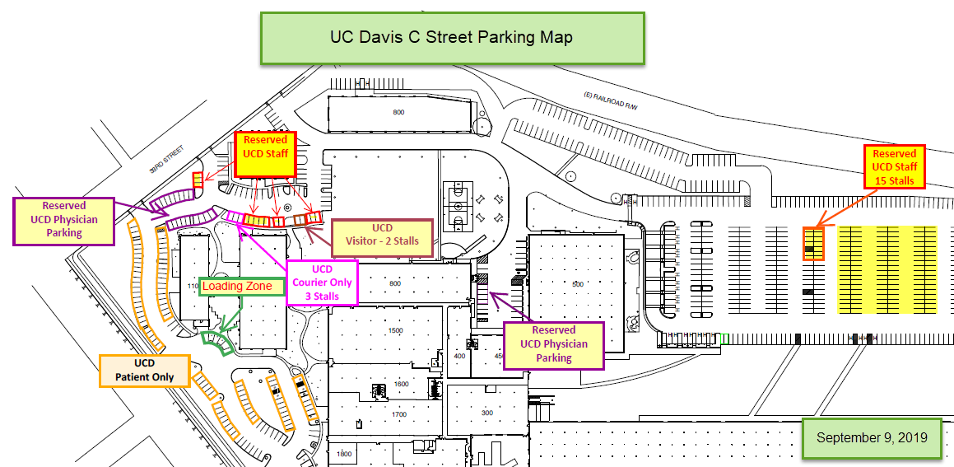
Figure 1. UC Davis C Street Parking Map
Notes:
The UC Davis C Street parking map will be used to show current state of allocated parking for patients, employees and physicians. This visual will be used to identity the various spots located throughout the C Street business complex. It is a high-level view of all the different marked UCD parking locations. It will be used in the proposal, in the overview section, as a way for the audience to have a visual of where each group of people can/should park.

Slide 4
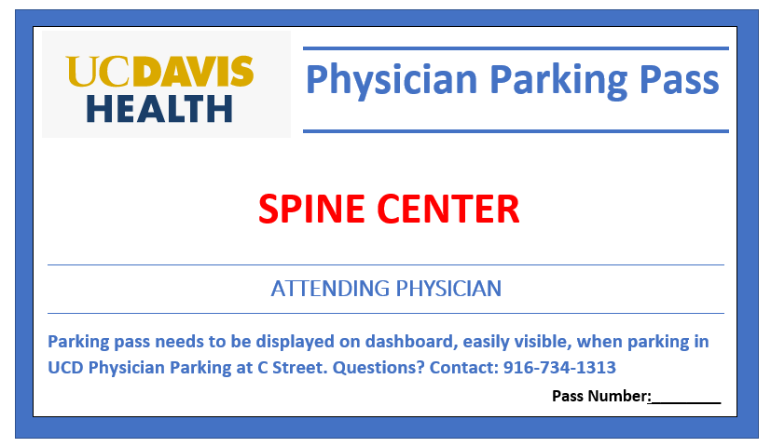
Figure 2. Sample UCD C Street Physician Parking Pass
Notes:
An issue regarding C Street parking is employees, residents and fellows parking in physician parking spots. Part of my proposal will include ways to ensure physician parking on C Street is only used by our attending physicians. Figure 2 will be used when I discuss the physician parking issue and will support my proposal for all attending physicians, who would like to park in a physician assigned parking spot, be issued and use their assigned parking pass. This will help management identify cars parked in unauthorized parking spots.

Slide 5
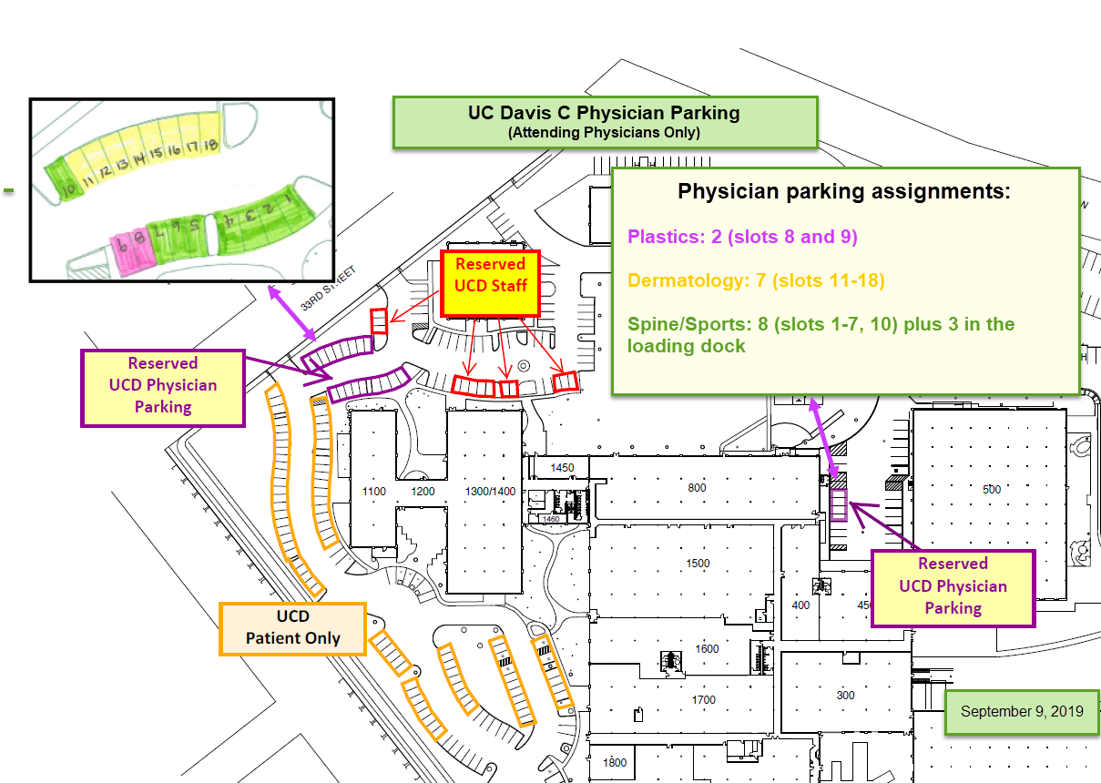
Figure 3. Proposed Allocation of Parking Spaces
Notes:
Figure 3 is similar to Figure 1; however, Figure 3 focuses on physician parking spots. The visual shows more information on the allocation of physician spots by department and their location. This figure will also be used when discussing the issue with physician parking spots and will support the suggestion of implementing parking passes for attending physicians to be used when parking in an assigned UCD physician parking spot.

Slide 6
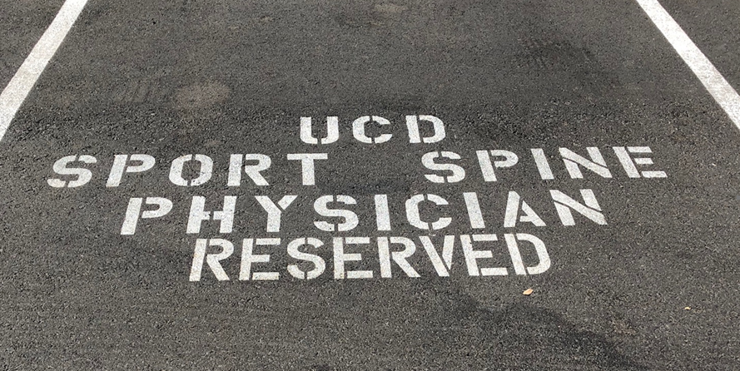

Figure 4. Current marked parking spots. (Photos courtesy of Jane Student)
F4a. Example of a Physician marked spot F4b. Example of a UCD Staff marked spot
Notes:
An issue regarding C Street parking is employees, residents and fellows parking in physician parking spots. Part of my proposal will include ways to ensure physician parking on C Street is only used by our attending physicians. Figure 2 will be used when I discuss the physician parking issue and will support my proposal for all attending physicians, who would like to park in a physician assigned parking spot, be issued and use their assigned parking pass. This will help management identify cars parked in unauthorized parking spots.

Slide 7

thanks!
ANY QUESTIONS?

