Slide 1

Lady (IN)Justice
What should Lady Justice really look like? A mini-lesson in the symbolisms of the criminal justice system

Slide 2
History of lady justice
Origin, symbols & their meaning

Slide 3
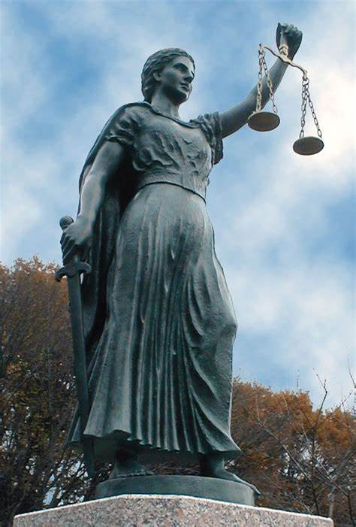
Themis, Goddess of Justice
Ancient Greece
Similarities
Differences

Slide 4
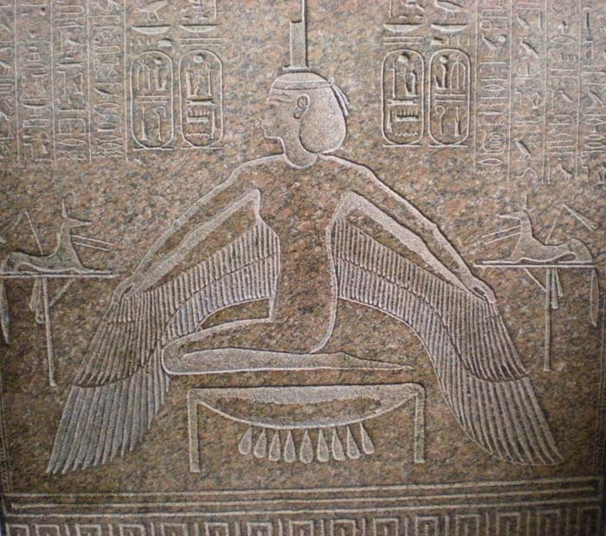
Ma’at , Goddess of truth, justice, harmony & balance
Ancient Egypt
Similarities
Differences

Slide 5
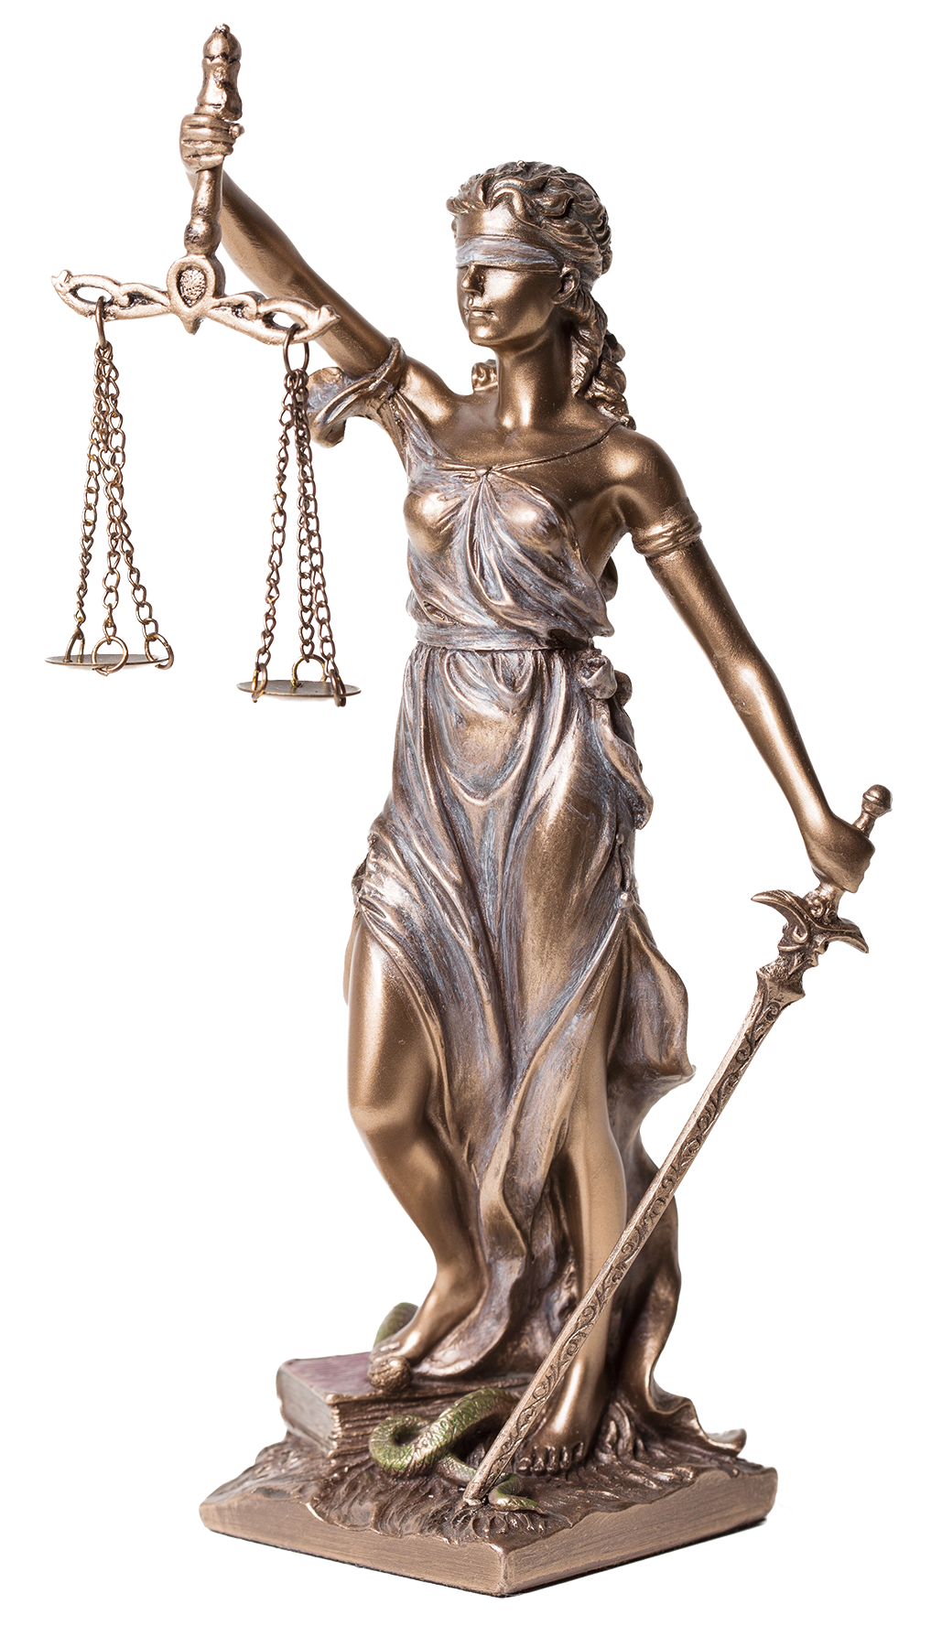
Lady Justice
Elements of the Modern Version
  The Sword
  The Blindfold
  The Weighing Scale
  The Toga
  The Snake
  The Book

Slide 6
The Sword
Authority
Swift and Final

Slide 7
The Blindfold
Objectivity and impartial
Non-judgmental
Fairness

Slide 8
The Scale
Reason
Balance
Weighing of evidence

Slide 9
The Toga
Responsibility
Clean
Well kempt

Slide 10
The Snake
Evil

Slide 11
The Book
Knowledge

Slide 12
Knowing what you know
It is now YOUR turn

