Slide 1
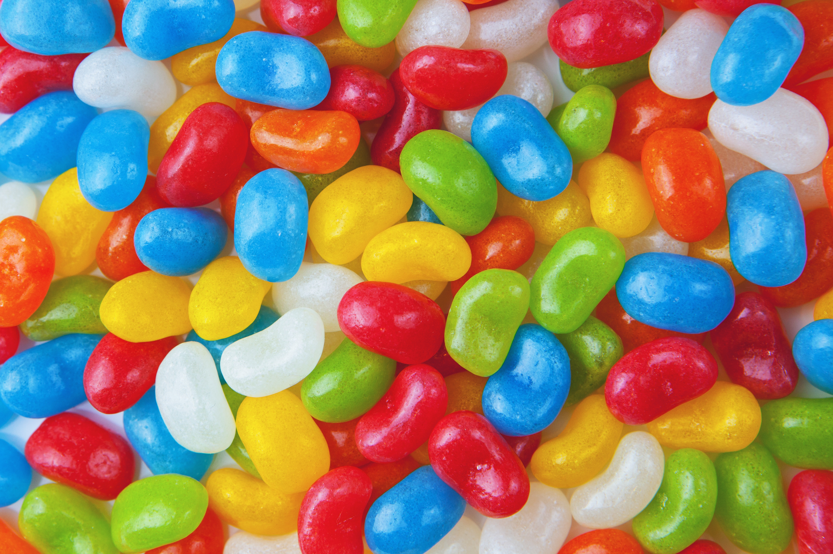
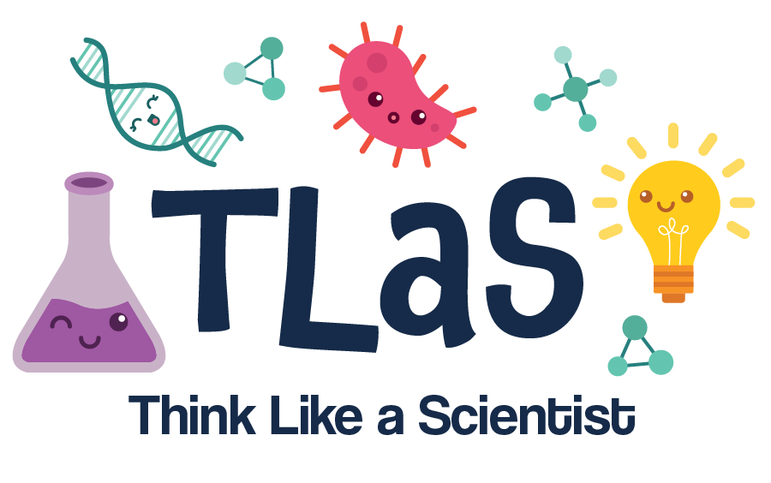
This work is licensed under a Creative Commons Attribution-NonCommercial-ShareAlike 4.0 International License
This Week’s Experiment: Jellybean Taste Test!
This work is licensed under a Creative Commons Attribution-NonCommercial-ShareAlike 4.0 International License

Slide 2

How do we taste our food?
…with our mouths!

Slide 3

How do we taste our food?
…with our mouths! …. but also…. with our noses!

Slide 4
This Week’s Experiment: Jellybean Taste Test!
Listen carefully as the volunteer scientists read the directions
Follow the instructions
Volunteer scientists will ask for your observations and thoughts at the end
Have fun!

Slide 5
What do we need?
Materials:
Jellybeans, with a flavor key
A blindfold (or facemask that can be used as a blindfold)
A mouth
A nose

Slide 6
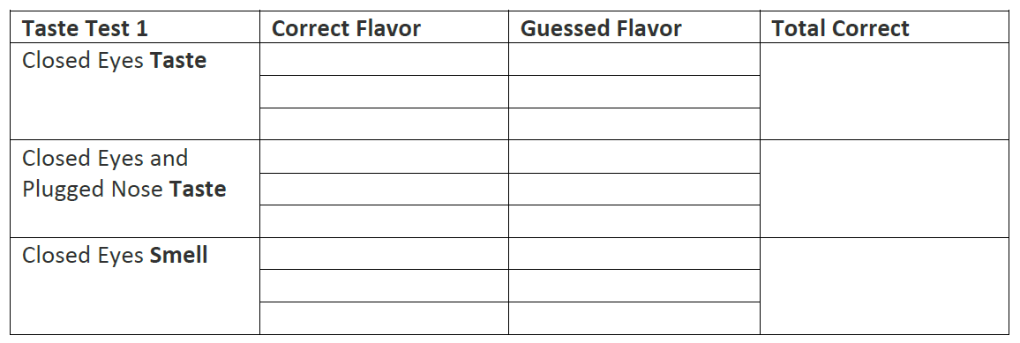
Record your findings…

Slide 7
What did we find out?

Slide 8
What did we find out?
Figuring out the flavor of the jelly bean is much easier when you can use both your mouth AND your nose together!
Because you mouth has taste buds and your nose has lots of things called ‘receptors’ that grab odor molecules that send information to your brain to help you figure out what you are eating

Slide 9
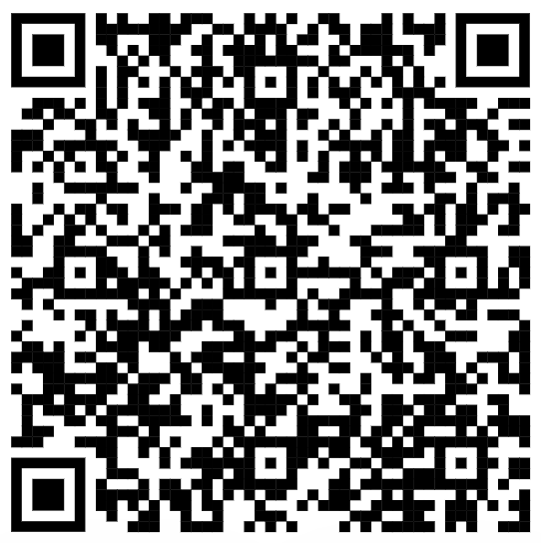
Scan the QR code above to visit our YouTube
channel for more great experiments!
Please visit our website for videos, experiment ideas and resources!
http://www.tlasprogram.wordpress.com

