Slide 1
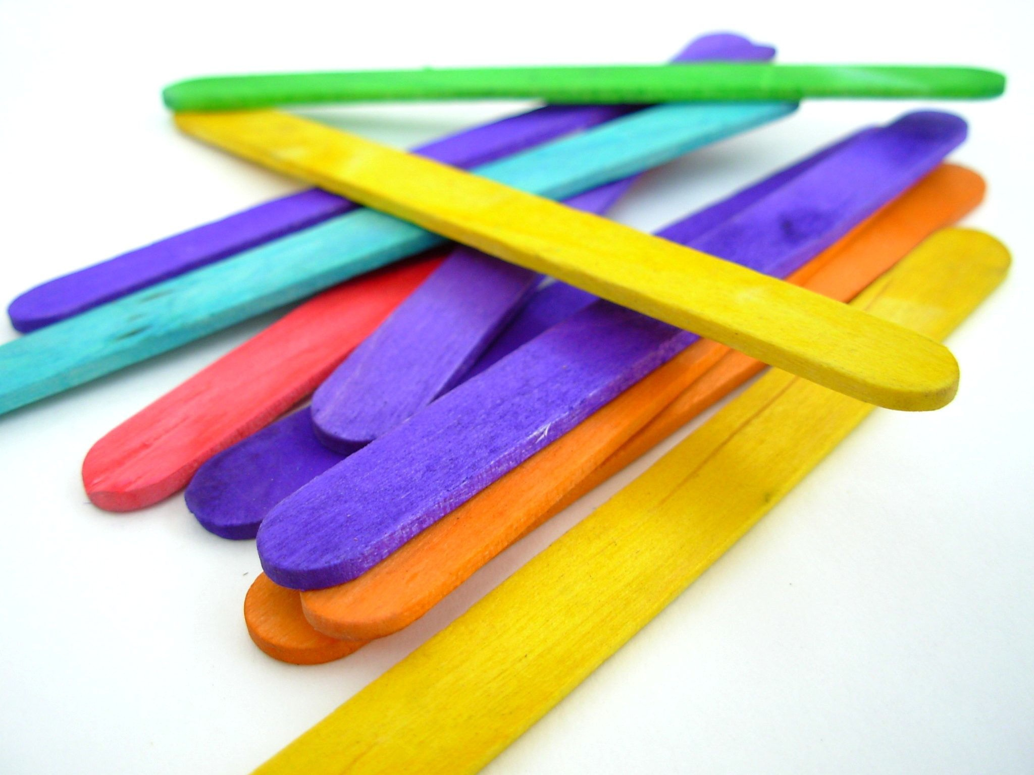

This work is licensed under a Creative Commons Attribution-NonCommercial-ShareAlike 4.0 International License
This Week’s Experiment: Exploding Popsicle Sticks!
This work is licensed under a Creative Commons Attribution-NonCommercial-ShareAlike 4.0 International License

Slide 2
Potential and Kinetic Energy
Do you ever wonder how a battery can provide energy or why a pulled rubber band will bounce back? This is because there are different kinds of energy.
In this experiment, we will recreate the storage and release of energy using everyday objects. We will build and hold ‘potential energy’ by locking popsicle sticks into different shapes and patterns.

Slide 3
This Week’s Experiment: Exploding Popsicle Sticks!
Listen carefully as the volunteer scientists read the directions
Follow the instructions
Volunteer scientists will ask for your observations and thoughts at the end
Have fun!

Slide 4
What did we find out?

Slide 5
What did we find out?
When you weave the popsicle sticks together into a ninja star you will notice tension building up in the sticks as they bend!
When you throw the star, the potential energy will be released as kinetic energy, which propels the sticks to “explode”!

Slide 6
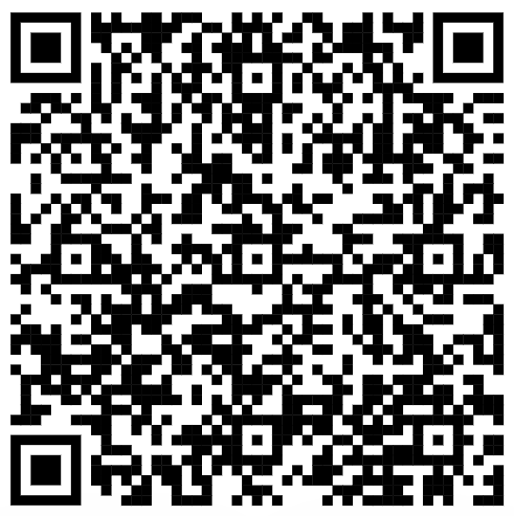
Scan the QR code above to visit our YouTube
channel for more great experiments!
Please visit our website for videos, experiment ideas and resources!
http://www.tlasprogram.wordpress.com

