Slide 1
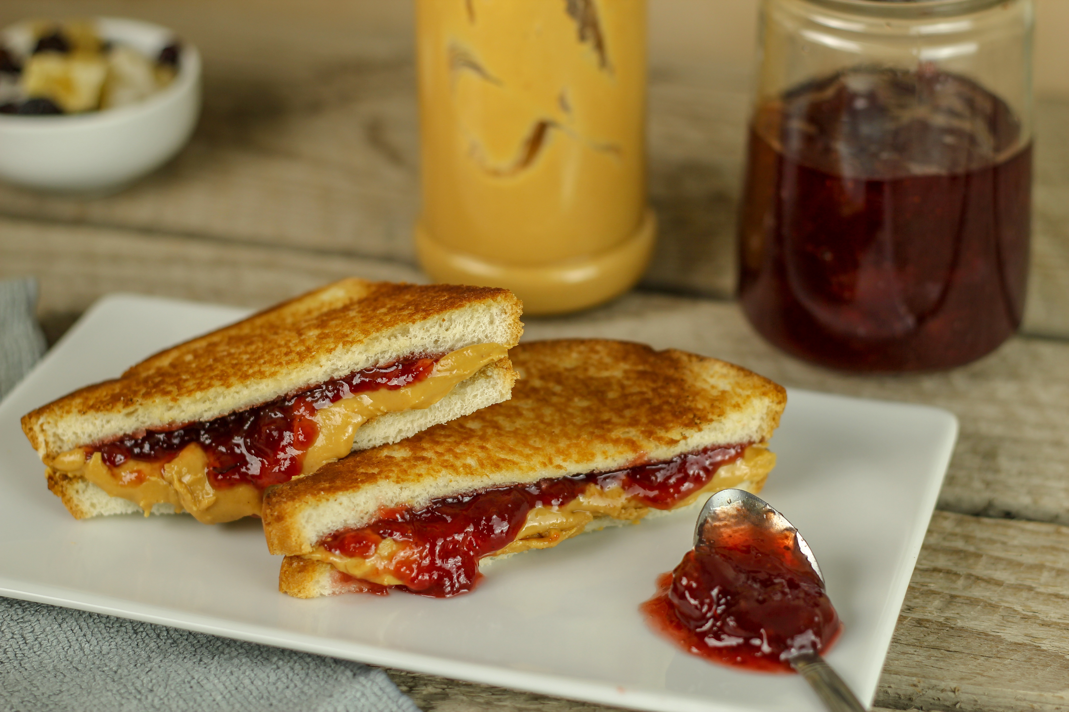

This work is licensed under a Creative Commons Attribution-NonCommercial-ShareAlike 4.0 International License
This Week’s Experiment: Crazy Sandwich!
This work is licensed under a Creative Commons Attribution-NonCommercial-ShareAlike 4.0 International License

Slide 2
This Week’s Experiment: Crazy Sandwich!
Listen carefully as the volunteer scientists read the directions
Follow the instructions
Volunteer scientists will ask for your observations and thoughts at the end
Have fun!

Slide 3
Let’s try to write a reproducible procedure…
Instructions:
Work with your a partner at your table to write instructions to make a gummy worm and jelly sandwich!
Volunteer scientists can help with spelling/grammar, but not the steps…
5 minutes to complete
When time is up, give the volunteers the instructions. They cannot ask questions, and students cannot help!

Slide 4
What did we find out?

Slide 5
What did we find out?
Writing a protocol (recipe) that results in a perfect sandwich is hard to do!
You have to write down every single detail for your partner to understand exactly how to make the perfect (crazy) jelly and gummy worm sandwich!

Slide 6
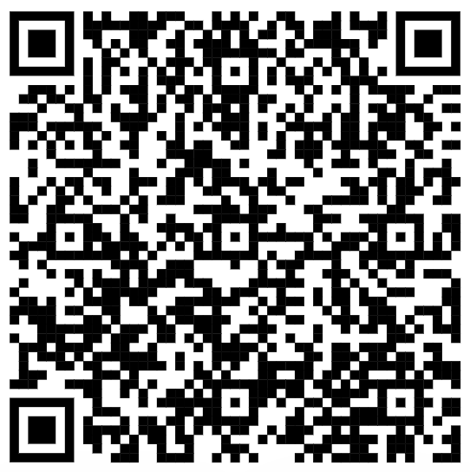
Scan the QR code above to visit our YouTube
channel for more great experiments!
Please visit our website for videos, experiment ideas and resources!
http://www.tlasprogram.wordpress.com

