Slide 1
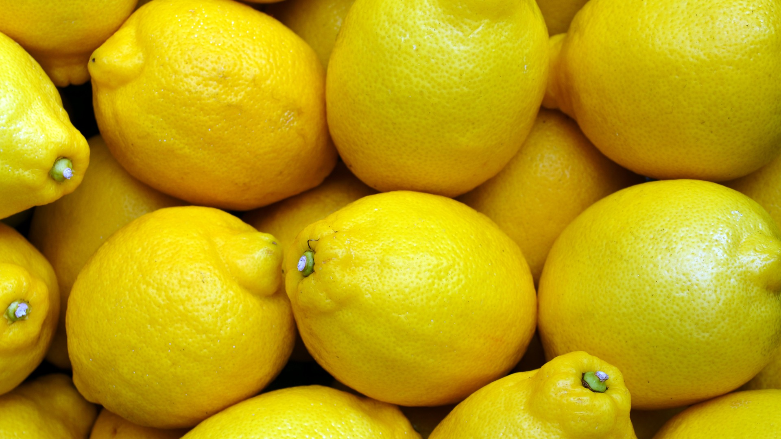

This work is licensed under a Creative Commons Attribution-NonCommercial-ShareAlike 4.0 International License
This Week’s Experiment: Lemon Volcanoes!
This work is licensed under a Creative Commons Attribution-NonCommercial-ShareAlike 4.0 International License

Slide 2
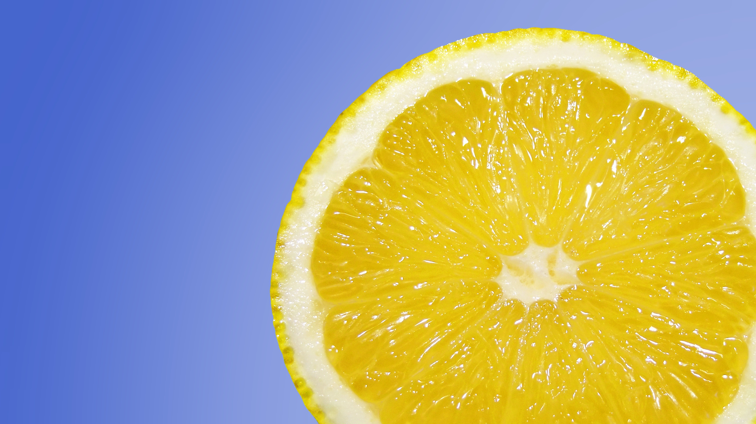
Acids and Bases
If you have ever eaten a lemon, you know the juice inside is sour! This is because lemon juice contains a lot of acid. Baking soda, which is also used in this experiment, is a base.
When acids and bases come together, they react and release bubbles, which creates lots of bubbling and fizzing as they escape.
In this experiment, we will investigate the chemical reaction that happens when the acid in the lemon juice meets the base of baking soda.

Slide 3
This Week’s Experiment: Lemon Volcanoes!
Listen carefully as the volunteer scientists read the directions
Follow the instructions
Volunteer scientists will ask for your observations and thoughts at the end
Have fun!

Slide 4
What do we need?
  Materials:
Lemon (cut in half – ask for help from an adult)
A plate (for the lemon)
A cup or bowl (for the lemon juice)
Baking soda
Spoon
OPTIONAL: food coloring (don’t spill!)

Slide 5
What did we find out?

Slide 6
What did we find out?
When you added the lemon juice (which contains acid) to the baking soda on top of the lemon, it caused a chemical reaction that resulted in the release of air – you made bubbles!

Slide 7
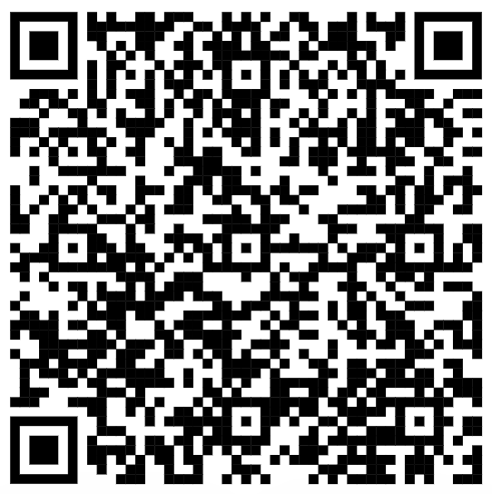
Scan the QR code above to visit our YouTube
channel for more great experiments!
Please visit our website for videos, experiment ideas and resources!
http://www.tlasprogram.wordpress.com

