Slide 1
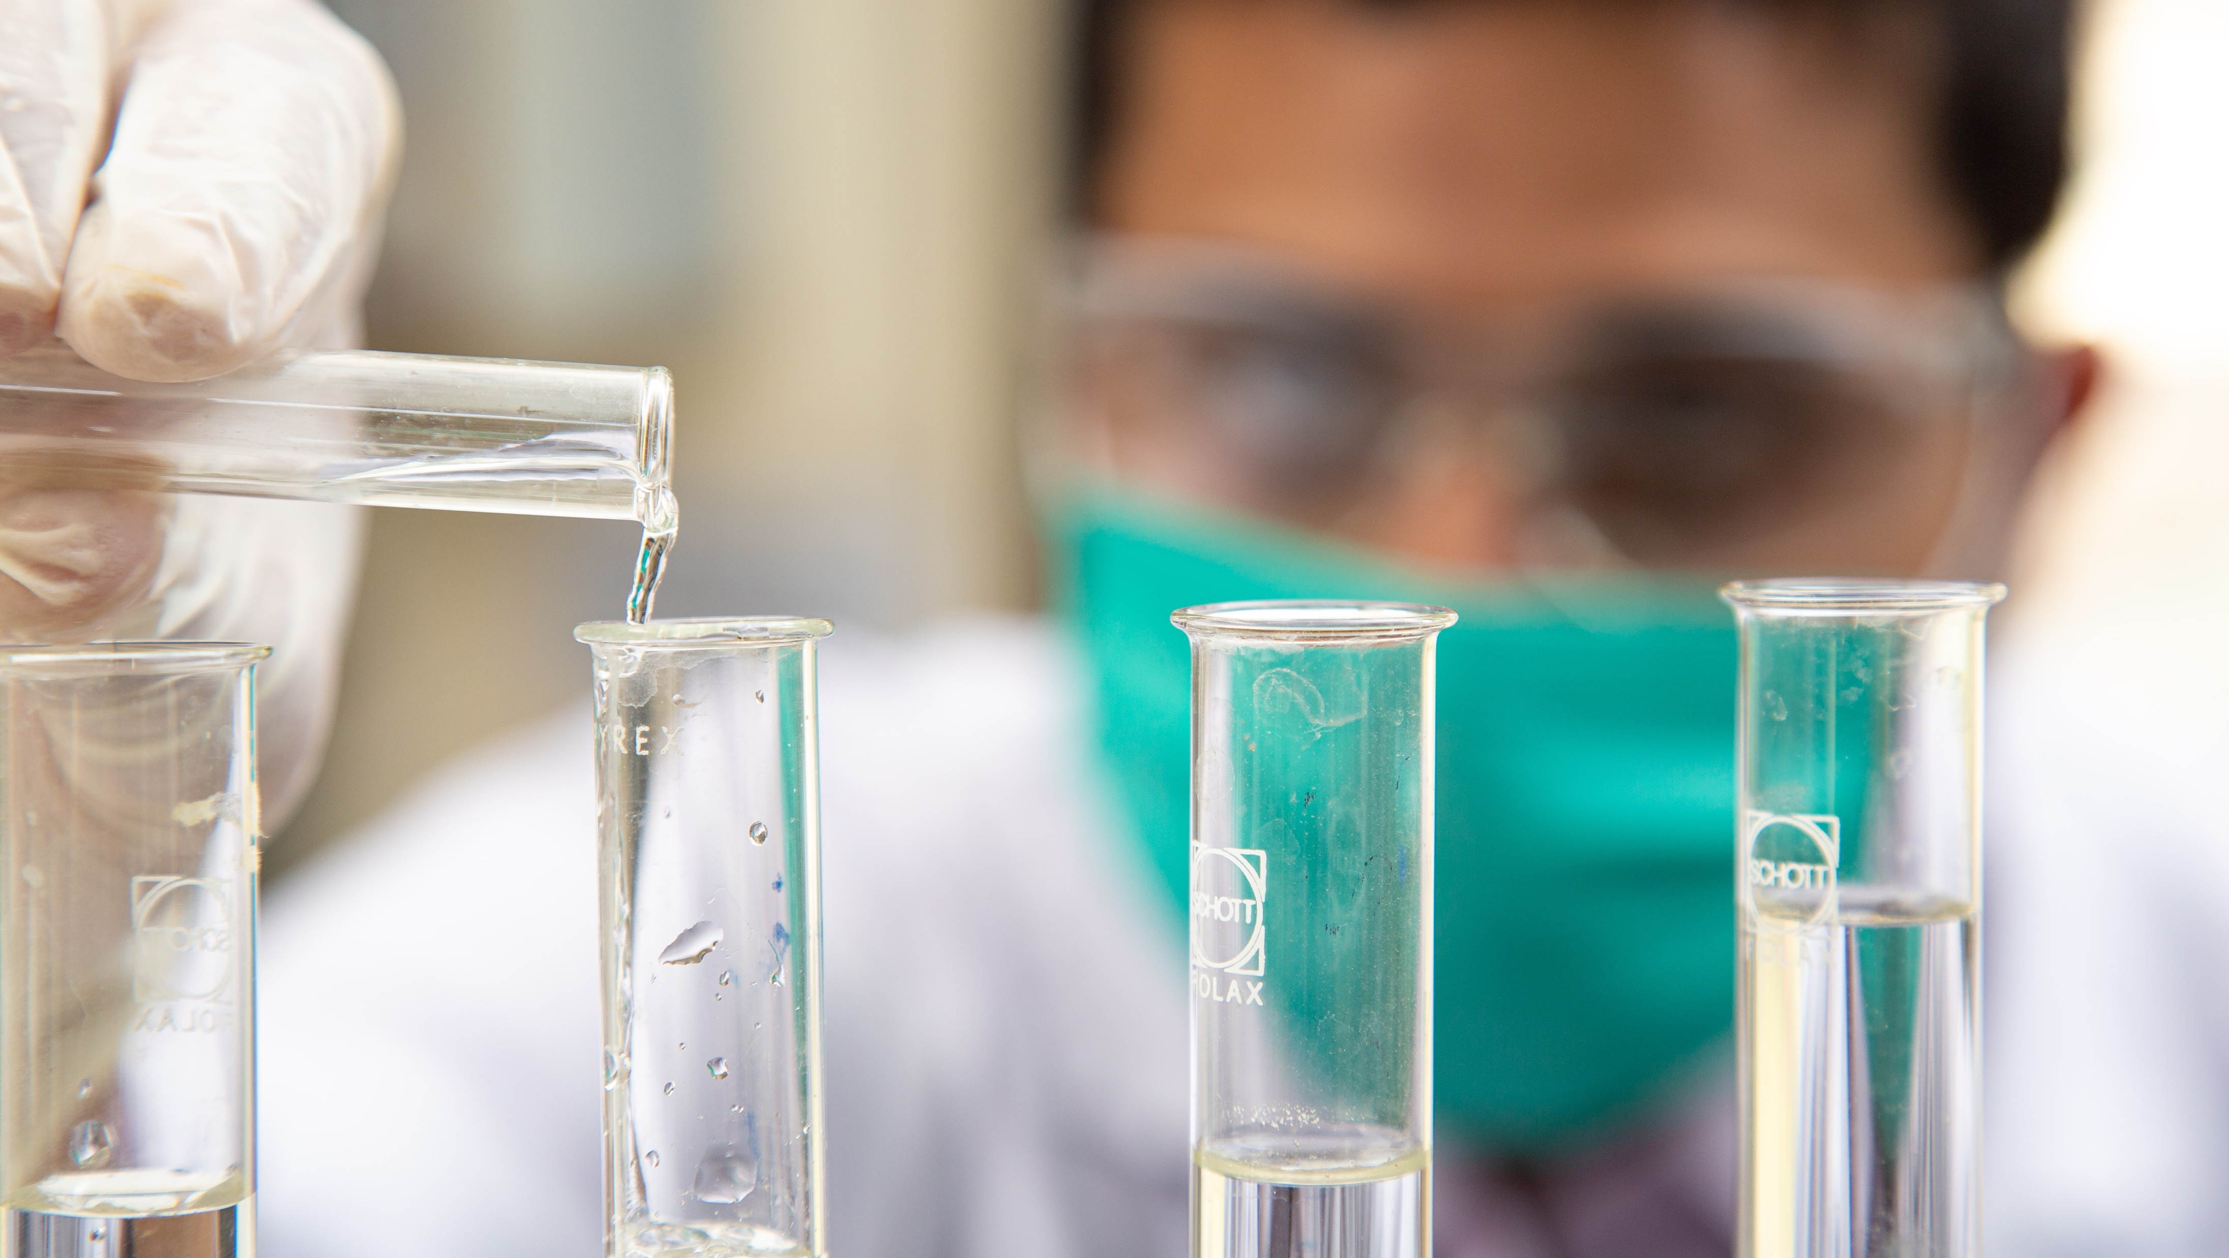
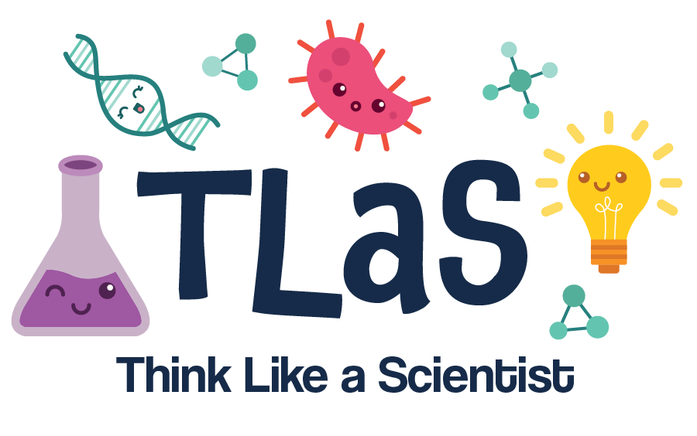
Meet the Scientists!
This work is licensed under a Creative Commons Attribution-NonCommercial-ShareAlike 4.0 International License

Slide 2
Nametags…
Fold your paper into a triangle
Put your name in big letters so it is easy to read
Pick some of the items below to draw next to your name:
  Favorite food
  Favorite hobby
  Favorite sport
  Favorite book or movie
If you finish early, share your nametag with your table!

Slide 3
Meet the CU Medical Campus Scientists…
Listen to each scientist talk about their work.
Raise your hand to show us that you have a question!
Notes:
“Science is really a way of looking at the world—REALLY looking—and then coming up with explanations for why things are as they are. An explanation is accepted as a good scientific theory if it helps scientists correctly predict how nature will behave in the future.” –SciJinks NOAA

Slide 4
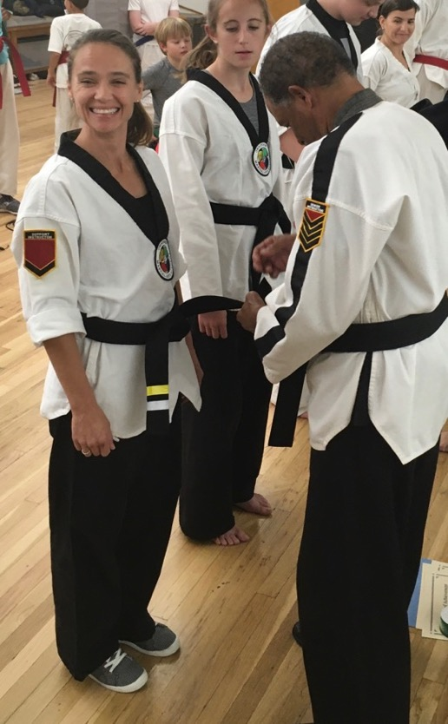
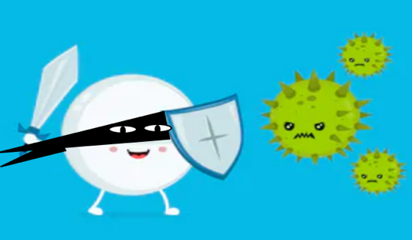
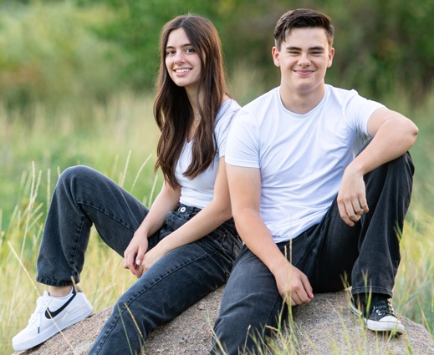
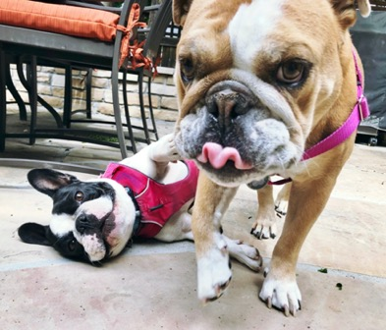
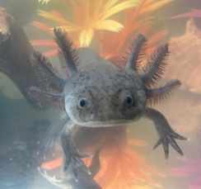
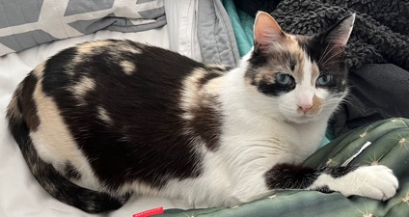
Aimee Bernard
I am a scientist who studies our immune system - the cells in our bodies that defend us from germs
Our immune cells move through our blood every day, all day long to find and destroy germs
Immune cells find the germs and act like ninjas that fight and destroy the germs to keep us healthy!
EXAMPLE – SEE NOTES
I am also a mom – I have 2 kids, 2 dogs, 1 cat, and 1 axolotl
germs
IMMUNINJA
immune cell
NINJA
Lulu
AJ
I am also a ninja! I am a second degree black belt in Tae Kwon Do
Mulan
Toothless
Notes:
EXAMPLE SLIDE – have your volunteers make slides to show who they are both in their scientific careers and also outside of them! The goal is to show students the different ways you can be a scientist. ☺

Slide 5
So, what is science, anyway?

Slide 6
So, what is science, anyway?
Science is the study of the world around us.
Scientists learn about their subject by observing, describing, and experimenting!

Slide 7

Have you ever asked a question about the world around you?
If you have, raise your hand!
We will ask you what kind of questions you have about the world around you.

Slide 8
So, how many types of science are there!?!?

Slide 9
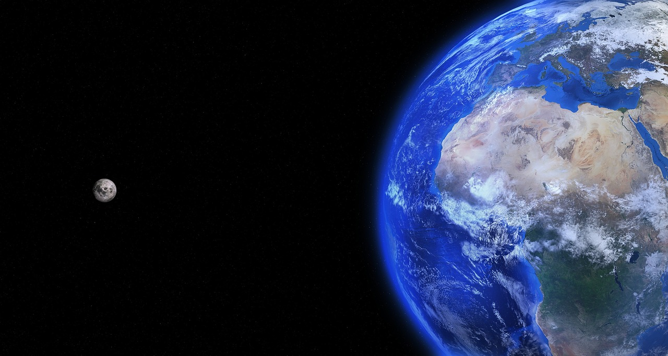
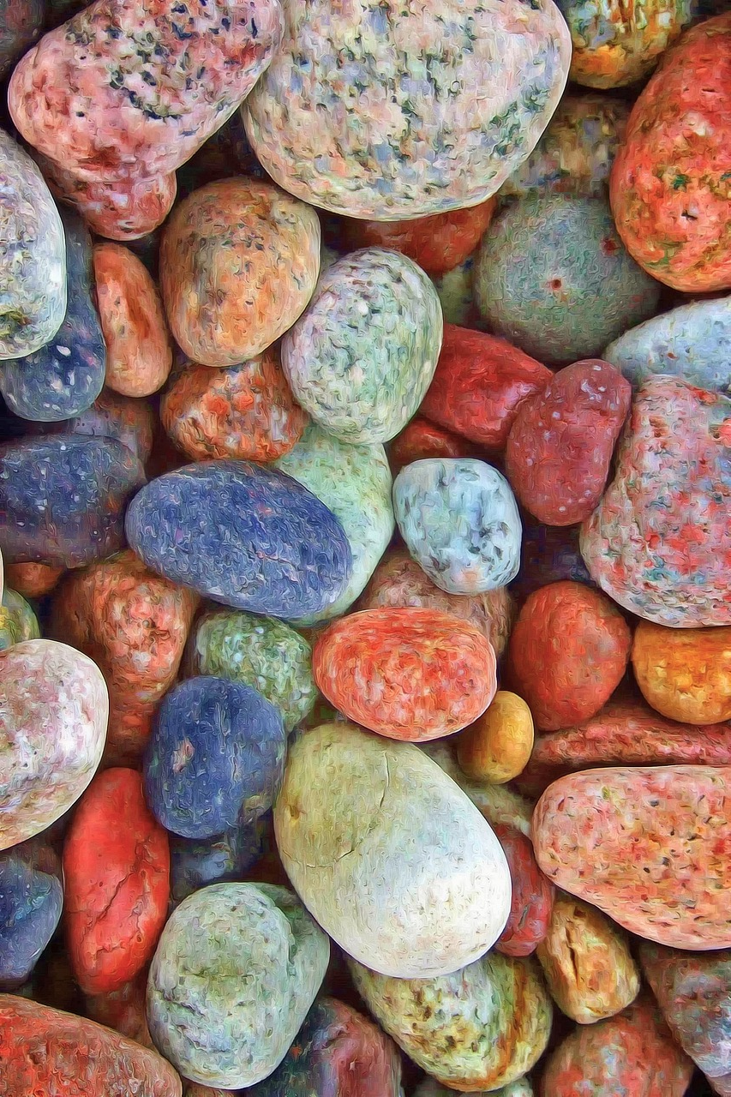
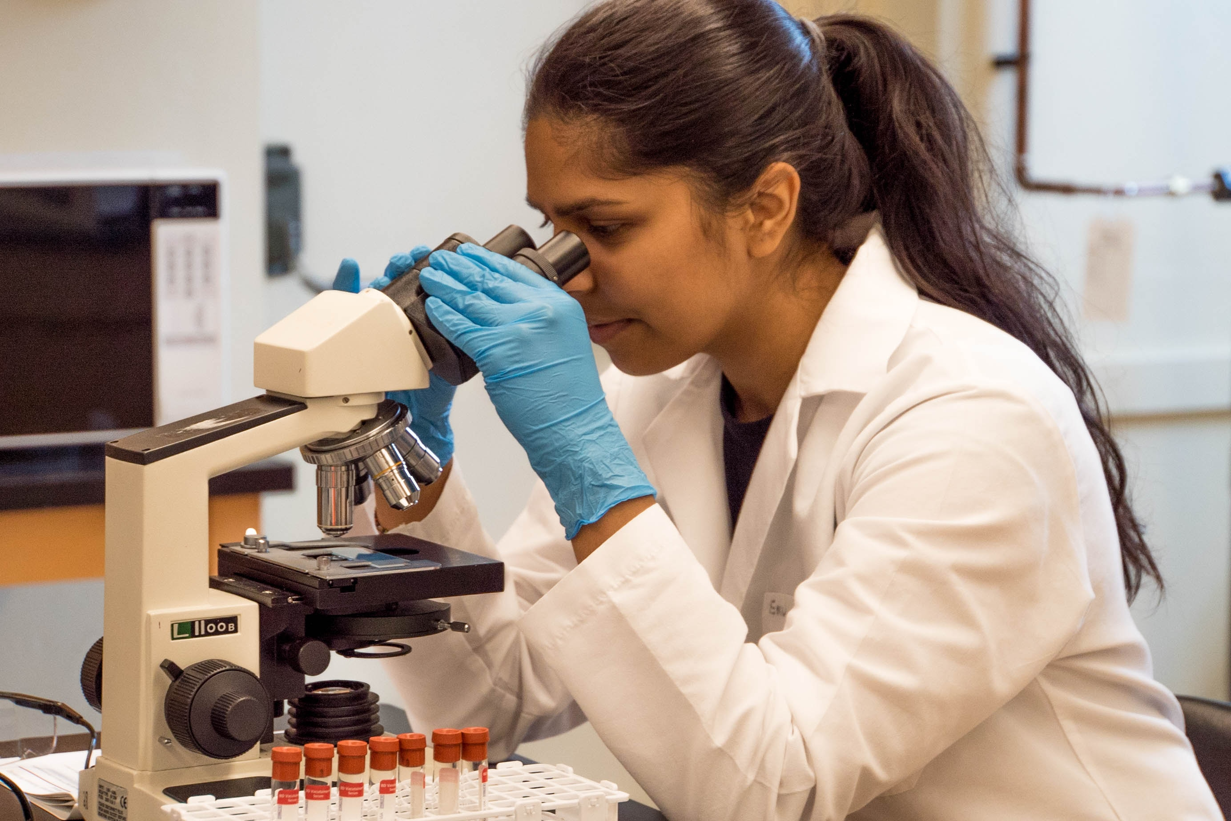
There are SO many types of science!
Astronomy – study of outer space
Physics – study of matter and energy
Chemistry – study of chemicals/elements
Geology – study of the earth and rocks
Biology – study of life
…and much more!

Slide 10
Science is also…
An organized way to answer any question using data to learn new things about the world

Slide 11

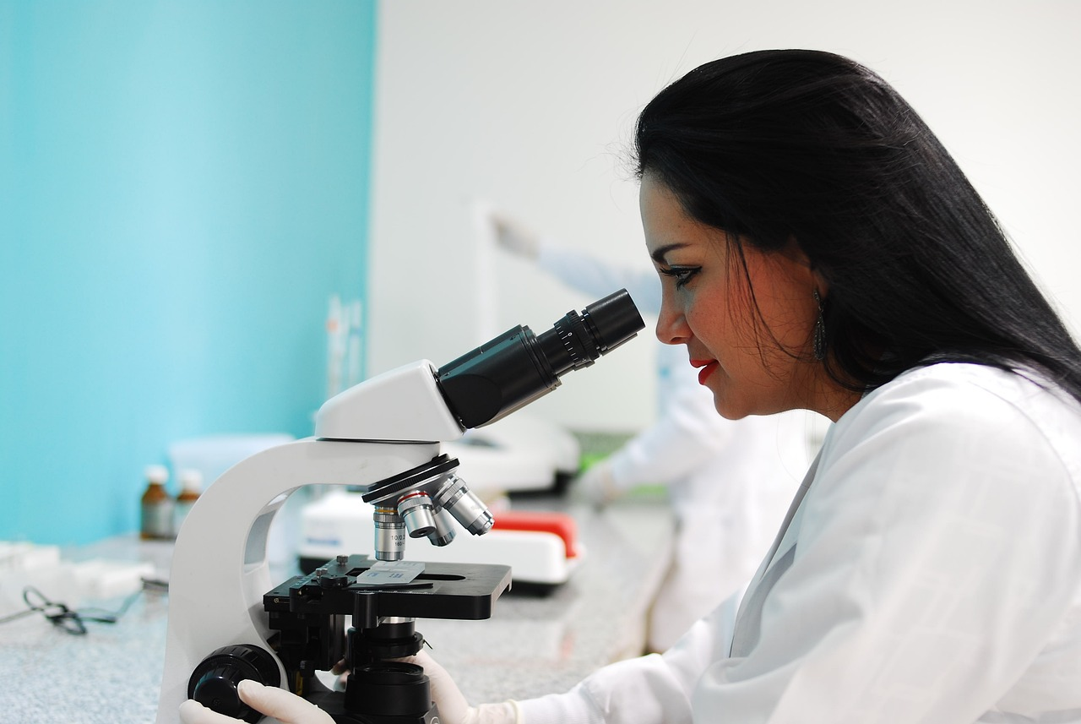
What is DATA?
Data is numbers or other observations like photographs taken with a microscope.
Data is not an opinion, an idea, or a story!

Slide 12

Let’s play a game… is it DATA or NOT?
BEFORE WE LOOK AT THE NEXT SLIDE…
All of you will have 1 minute to think about the answer.
Raise your hands when we ask to show us you have an answer!

Slide 13

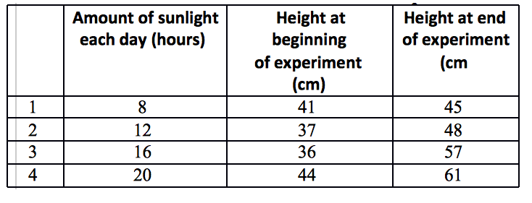
Is it data? How do you know?
2
3
4
1
REMEMBER…
Young scientists will have 1 minute to think about it.
Raise your hand when you have an answer and wait to be called on!

