Slide 1

Experiment Design
This work is licensed under a Creative Commons Attribution-NonCommercial-ShareAlike 4.0 International License

Slide 2
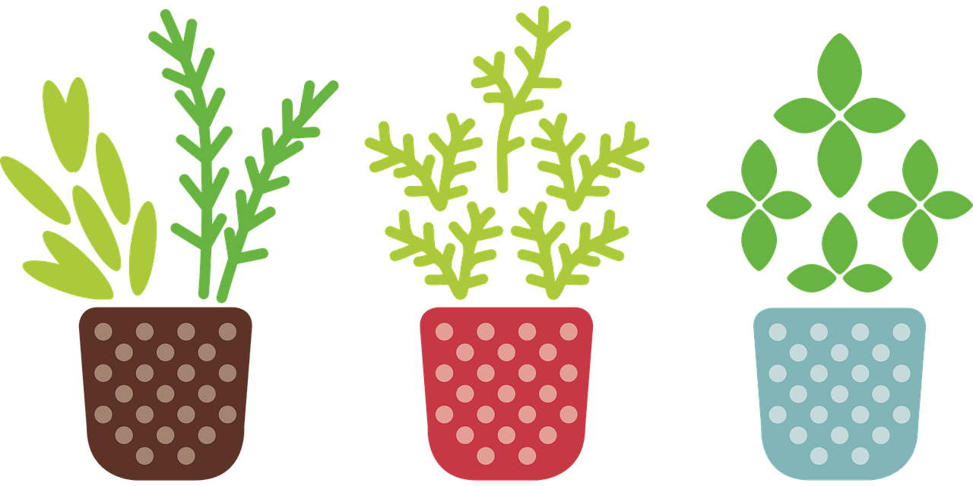
A quick review of the scientific method…
1. Observation leads to a question:
  Example: Plants seem to grow best outside
  Keep it simple!
2. Do some research
3. Make a hypothesis
  If….. Then….. Because
4. Design an experiment
  This is what we will do today!

Slide 3

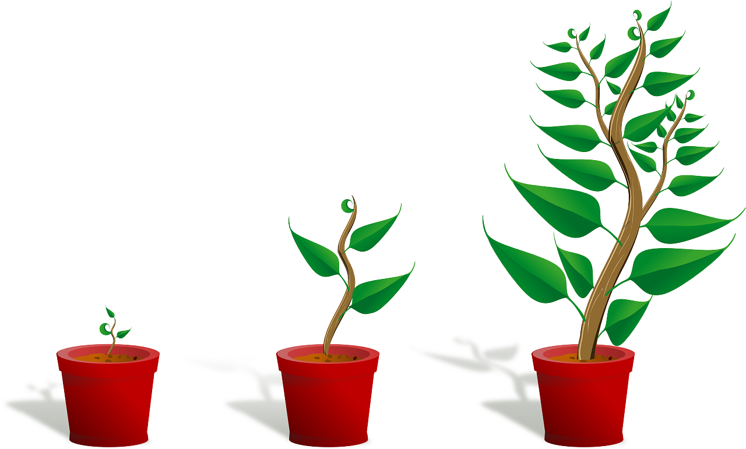
Reviewing what a HYPOTHESIS is
A hypothesis is an educated guess! It is what you think will happen.
A common format is “ If… then… because…”
  If a plant grows in sunlight,
  then it will grow faster than a plant with no sunlight
  because the plant needs energy to grow

Slide 4
Experiments need control groups!
  Control group: group that does not get the treatment, so we can compare – NO SUNLIGHT
Experimental group: group that gets the treatment we are trying to test -- SUNLIGHT

Slide 5
Identify the control vs the experimental groups…
Read the hypothesis on the next slide.
Ask for help from the volunteer scientists if you need it
1 minute to be ready…
Discuss at your table:
  What is the control group?
  What is the experimental group?

Slide 6
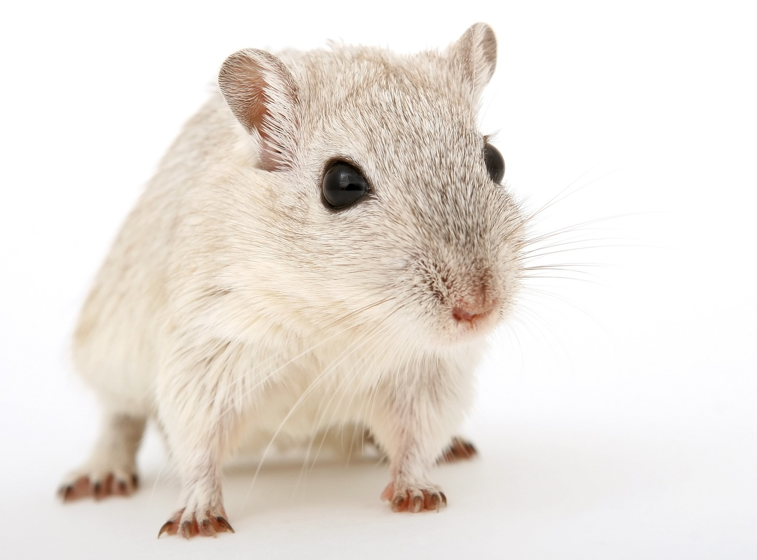

Hypothesis:
If hamsters drink coffee,
then they will run faster on their wheel,
because they will have more energy.
Raise your hands to answer:
What would the control group be?
Talk with your table for 30 seconds…
Notes:
LEAD TEACHER – DON’T go to the next slide until the young scientists have talked at their tables and you have heard a few answers (1 from each table) – with raised hands

Slide 7
Hypothesis:
If hamsters drink coffee,
then they will run faster on their wheel,
because they will have more energy.
Control group
Group that does not get the treatment, so we can compare
Experimental group
Group that gets the treatment we are trying to test
Notes:
A good experiment starts with really good instructions

Slide 8
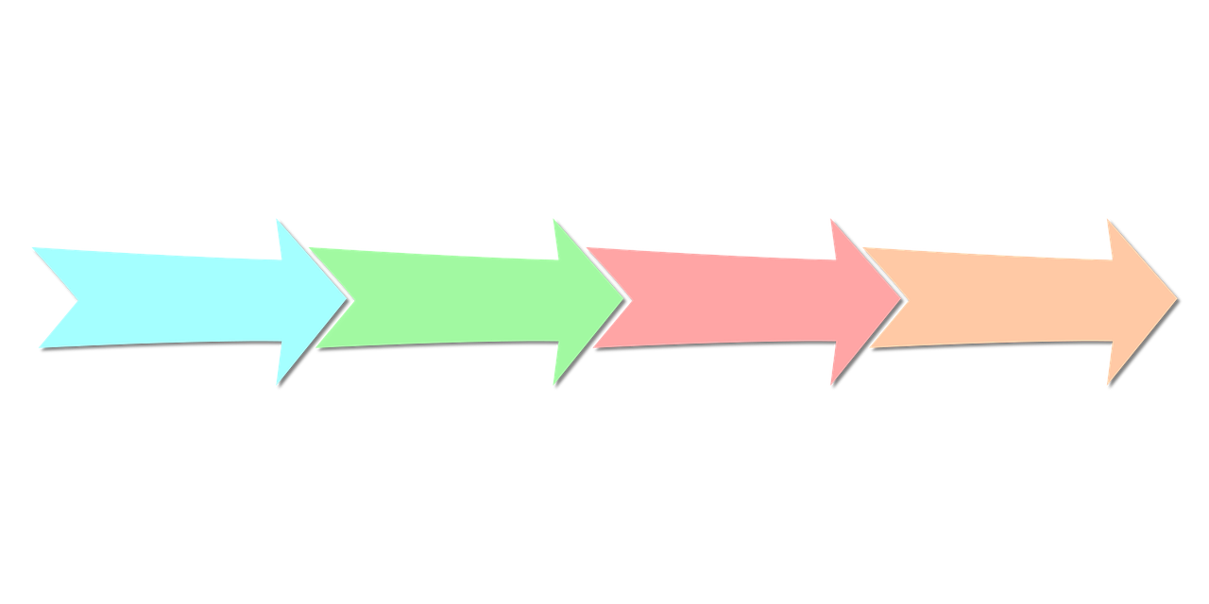
How to make a procedure
List the materials
Create numbered step-by-step directions for conducting the experiment
  Draw pictures!
  Add details
  Add even more details!
1
2
3
4

Slide 9
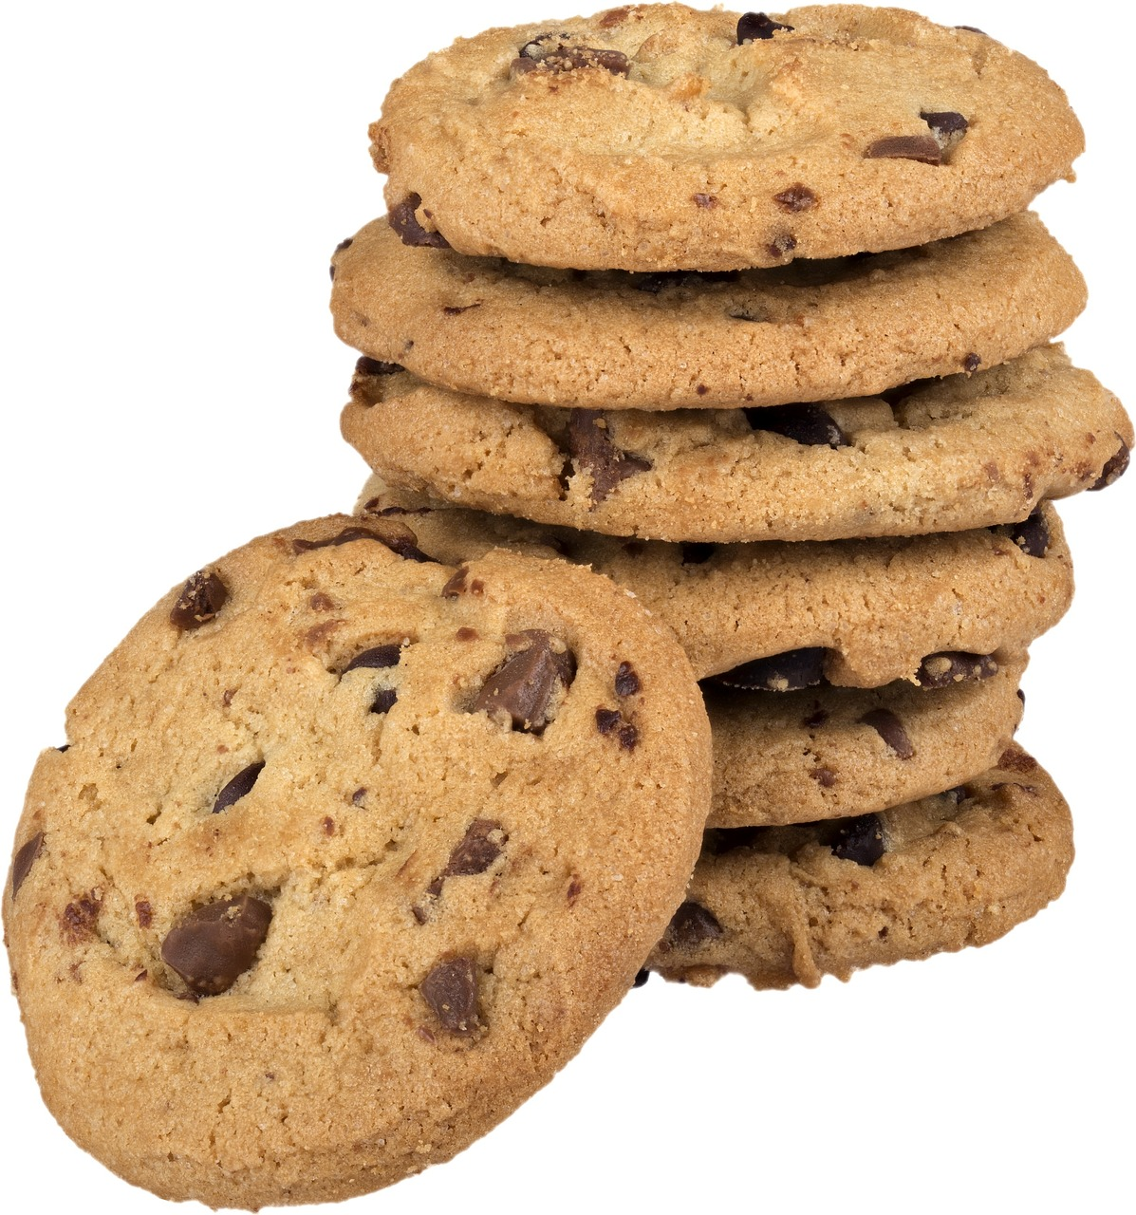
How do scientists write good directions for experiments?
Scientists directions need to be reproducible.
This means that another scientist can read the instructions and do the experiment in exactly the same way.
It’s like a recipe to make the same thing the same way each time!
A good example is baking cookies – a chef writes a reproducible recipe so that your cookies taste the same every time you bake them!

