Slide 1


Creativity, Collaboration & Science Communication!
This work is licensed under a Creative Commons Attribution-NonCommercial-ShareAlike 4.0 International License

Slide 2
Things we will do today…
Fill out a TLaS class survey
Finish your posters – be ready to present at 4:10pm
Present your posters – show off your work – to classmates, friends, and family
Roll call for special snacks and certificates
Keep thinking like a scientist!!!

Slide 3
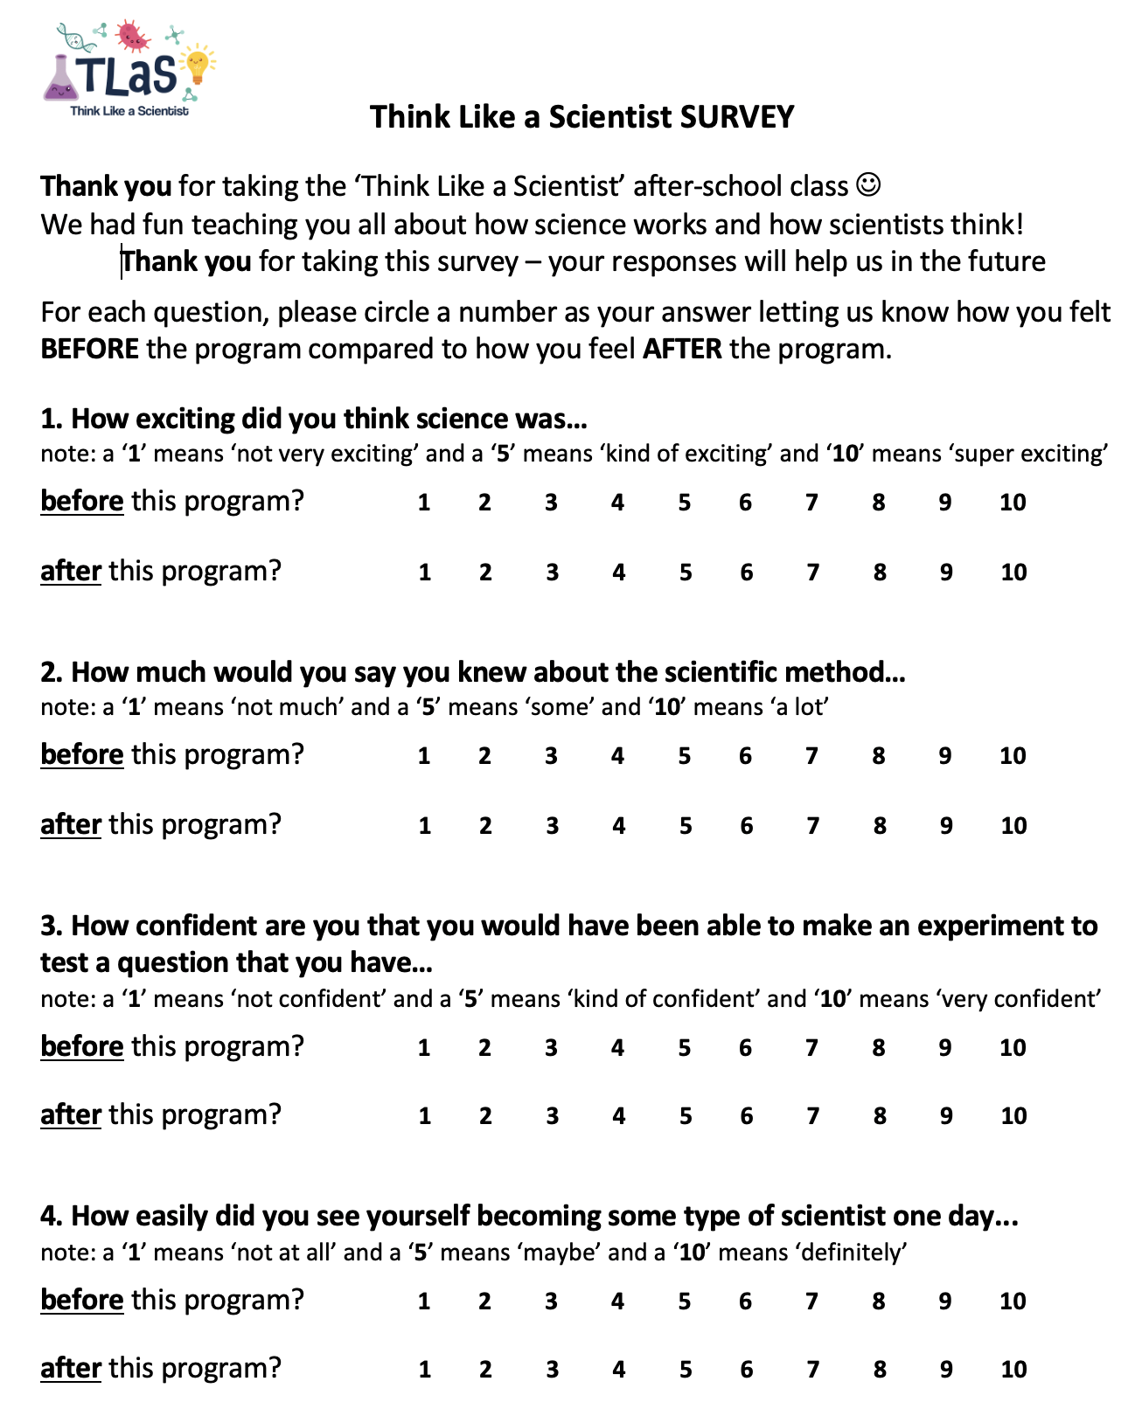
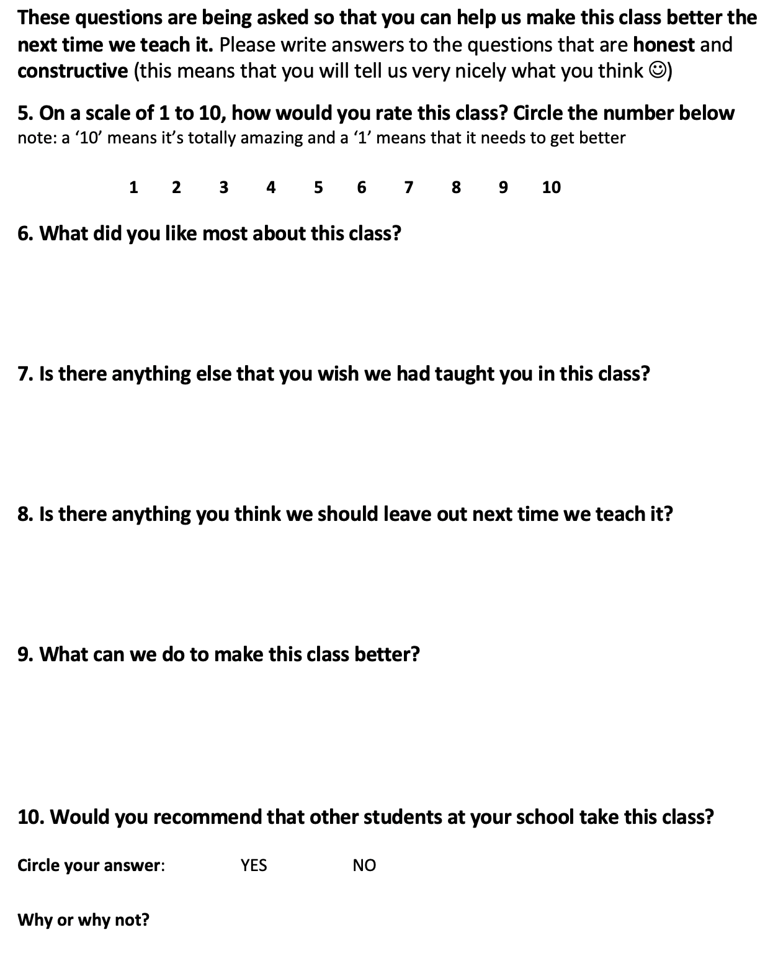

Slide 4
Celebration of SCIENCE!
Think Like a Scientist after-school program
is having a last day of class CELEBRATION
on Tuesday, May 10 from 4:00-5:00pm
Family and friends are welcome to attend! Please come to our celebration!
- - - - - - - - - - - - - - - - -
El programa de Think Like a Scientist (Piensa Como Cientifica) te invita a nuestra celebracion conmomerando el ultimo dia de clases este 10 de Mayo de las 4:00-5:00pm
Invitamos a los padres de familia y amigos a que nos acompanen a esta celebracion!

