Slide 1
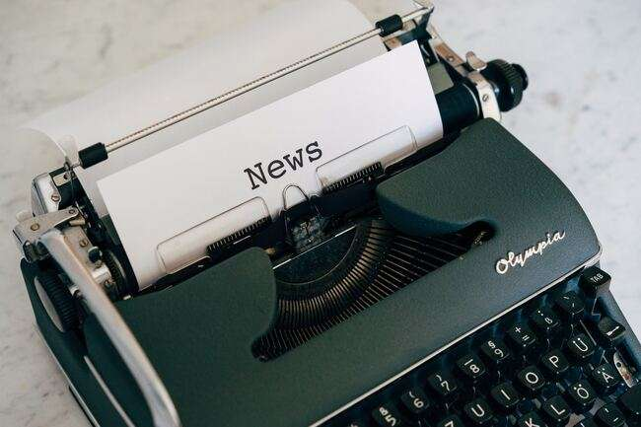

Spotting Fake News
This work is licensed under a Creative Commons Attribution-NonCommercial-ShareAlike 4.0 International License

Slide 2


BREAKING NEWS!
Listen to the article while the scientist reads.
Ask the volunteer to explain any words or sentences that are confusing…
If you have a question, wait until the end of the reading and raise your hand!

Slide 3
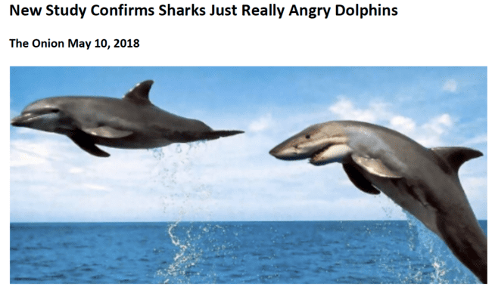

Slide 4
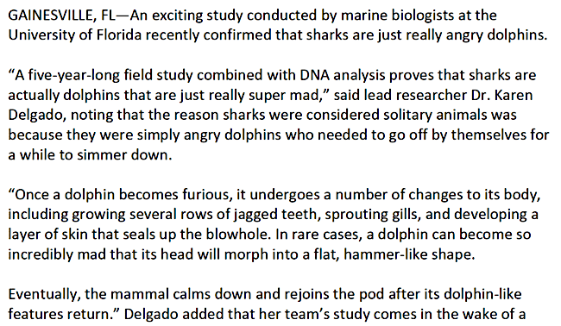

Slide 5
What is FAKE NEWS?
A story that is not accurate – it’s false – and is created to get attention or mislead readers!

Slide 6
FAKE NEWS…
Think about the questions on the right. Take 1-2 minutes to think about the ‘breaking news’ story you just heard.
Raise your hand if you have an answer to the questions!
Did you think this story was fake news or real news?
What sentence (or part of the story) made you think this story was fake news or real news?

Slide 7
Why does it matter if news is fake?
Fake news spreads wrong information and confuses the public
Fake news makes the real facts harder to find
Using false information for your research or homework will make your work incorrect 😐

Slide 8
How to fight fake news!
Write down these 4 questions so that you can use them in the rest of the activities.
Does the article share the source of their information?
Who wrote the article? Is she or he an expert? Do they know a lot about the topic of the article?
Where did it come from?
Does the article make you feel strong emotions?

Slide 9
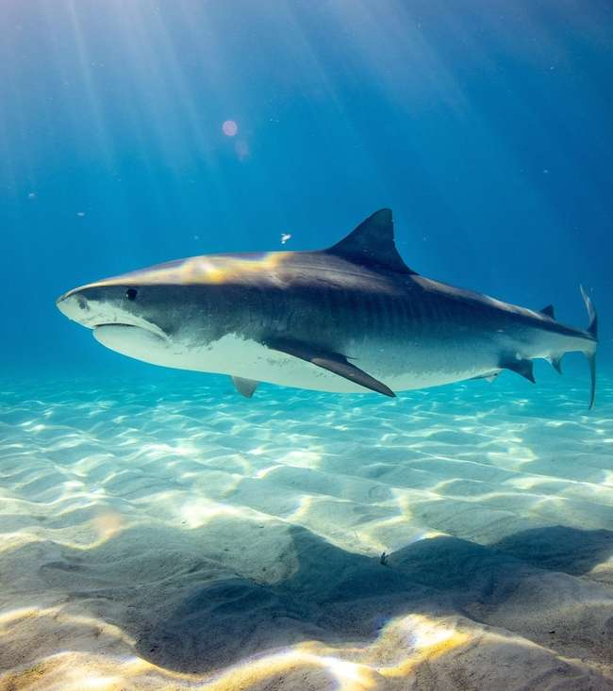
Question 1: Does the article give sources?
Sources: where the information in the article came from
Trustworthy news articles will have multiple, reliable sources that are given in the article
Fake news will make statements with no sources!

Slide 10
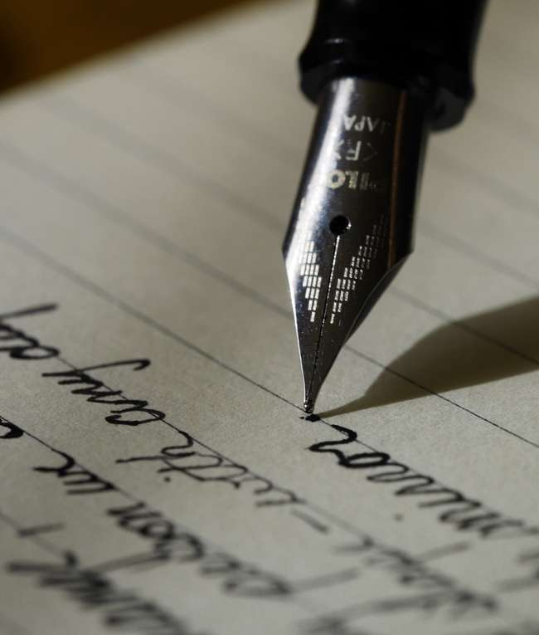
Question 2: Who wrote it?
Make sure the article has a named author
Check the author’s biography and/or social media pages
Is the author knowledgeable on the article subject?

Slide 11
Question 3: Where was the article published?
Published means that information is made available by the media (newspapers, magazines, and websites) to the public.
Trustworthy news is published by places with a history of fact-checking
Reliable articles can be best found directly from a newspaper or news website
News shared on social media is not always true. In fact, a lot of it is not true! Be careful!

Slide 12

Question 4: How does it make you feel?
Does it cause a strong emotional reaction?
Does it feel like it is trying to convince you of something?
A trustworthy article should give you the information and let you decide how to feel about it
Fake news tries to make you feel strong emotions instead of giving good evidence

Slide 13
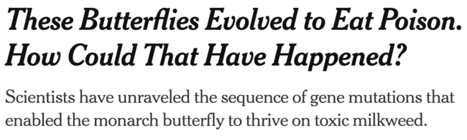
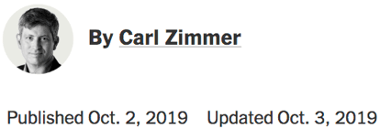

Example Article
Before we begin, keep in mind:
Raise your hand to answer questions.
Check your notes if you are not sure.
Keep your answer in your head until called on so everyone can think of their own answer
New York Times

Slide 14
Example Article
Where does the article come from?
Is it a reputable source?
Does the article list an author?
Is the author knowledgeable?
Keep your answer in your head until called on so everyone can think of their own answer!
New York Times
Notes:
Corporate may be above the level of this crowd - maybe say ‘companies that give them money’ or ads for people to become exposed to certain products, just like on TV
Bio - you may need to explain this term as well

Slide 15

Back to our original article… fake or real?
Let’s review the ‘Sharks are Angry Dolphins’ article using the 4 questions we talked about earlier… Do you remember the 4 questions?
Take 1-2 minutes to think about the story.
Maybe we could ask a volunteer scientist to research the author!

Slide 16
Back to our original article… fake or real?
Now what do you think about the article:
New Study Confirms Sharks are Just Really Angry Dolphins??
4 questions – fake or real?
Does the article share the source of their information?
Who wrote the article? Is she or he an expert? Do they know a lot about the topic of the article?
Where did it come from?
Does the article make you feel strong emotions?
…. Do you think it’s real or fake?

