Slide 1

Creativity, Collaboration & Science Communication!
This work is licensed under a Creative Commons Attribution-NonCommercial-ShareAlike 4.0 International License

Slide 2

Science is COLLABORATIVE…
Collaboration means working together – it’s teamwork!
Scientists spend a lot of time talking to other scientists to get help and new ideas
Lots of brains thinking and working together is better than one!

Slide 3

Science is COLLABORATIVE…
What are a few reasons you can think of that makes it important for scientists to be collaborative (work together)?
Raise your hand!

Slide 4
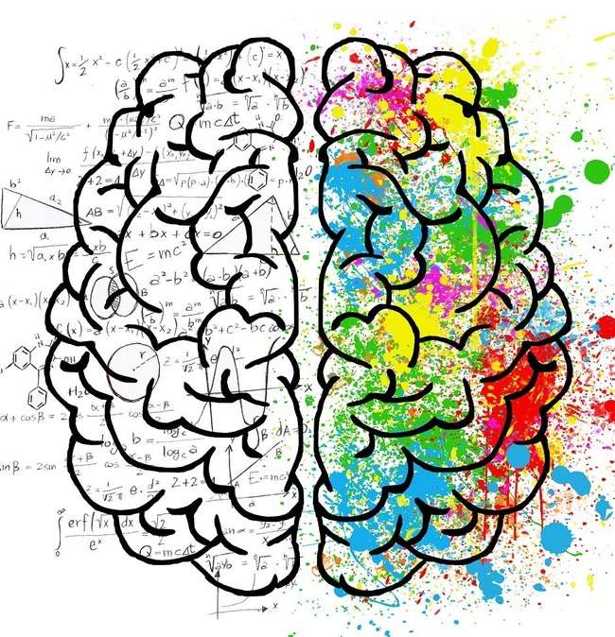
Science is CREATIVE…
What does it mean to be creative?
What are a few reasons you can think of that makes it important for scientists to be creative (new ideas)?
Raise your hand!

Slide 5

Science is CREATIVE…
The only way to make a new discovery is to try something that has never been done before
Scientists need to think of new ways – new experiments – to answer questions every day!
Scientists can’t be afraid to think outside the box – new ideas!

Slide 6
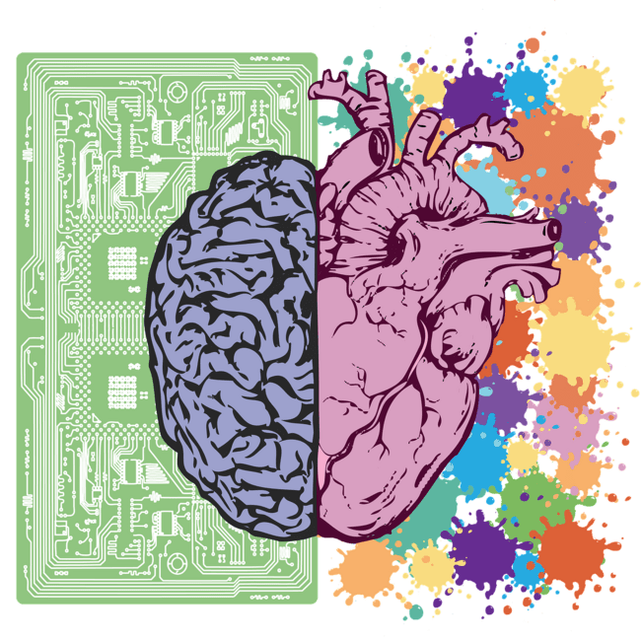
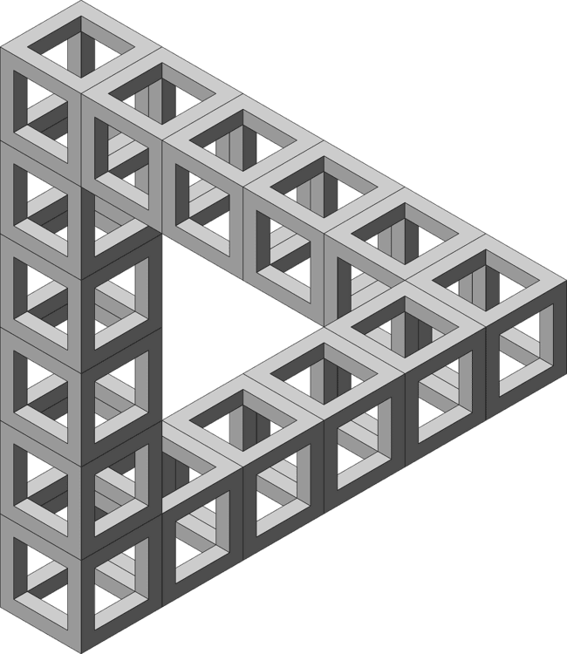

Creativity is About Seeing Things Differently
(taking on a new perspective)
Let’s talk about the pictures below - what do you see?
Raise your hand to be called on!

Slide 7
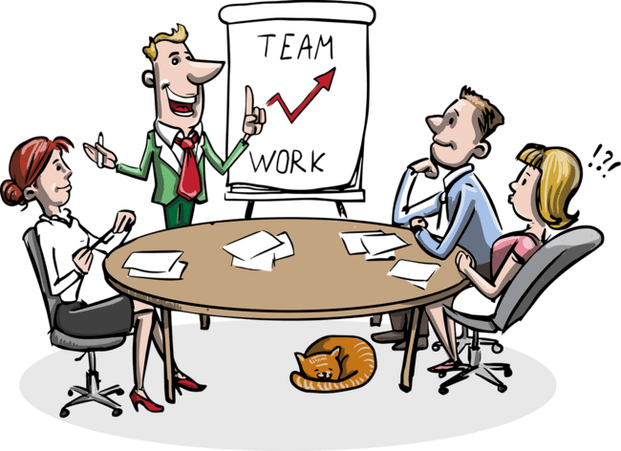
Why do you think it is important for scientists to tell other scientists about their research?
SCIENCE COMMUNICATION
- telling other people about science research -

Slide 8

Why do you think it is important for scientists to tell people in the general public (people who are not scientists) about their research?
SCIENCE COMMUNICATION
- telling other people about science research -

Slide 9

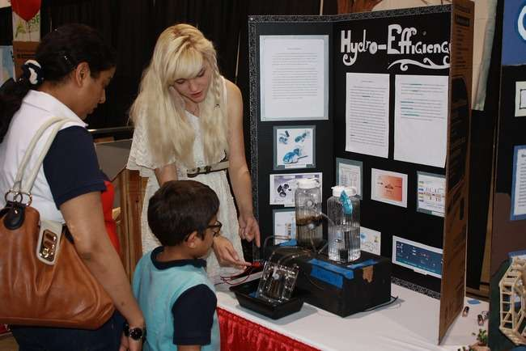
Scientists make posters to tell people about what they do.
These posters help scientists tell people about their research.

Slide 10
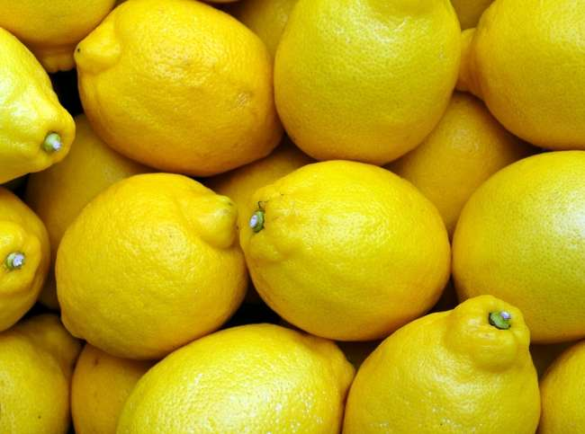
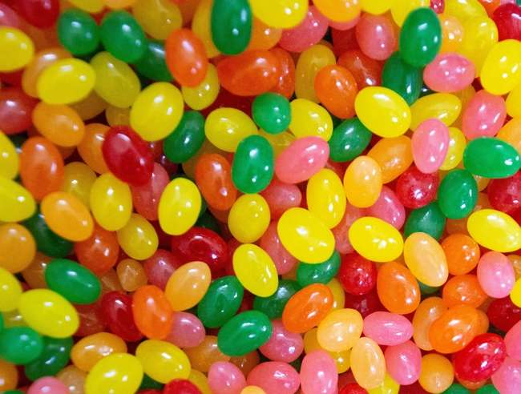
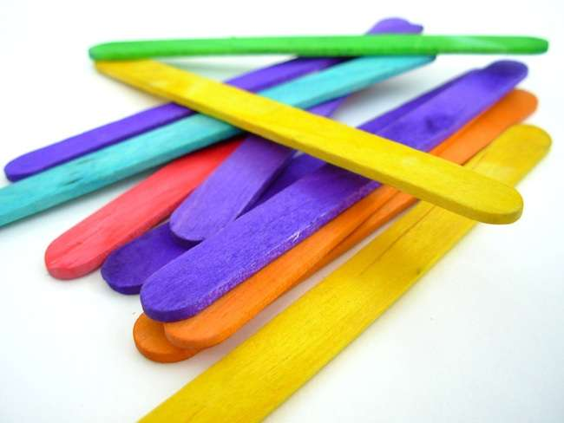
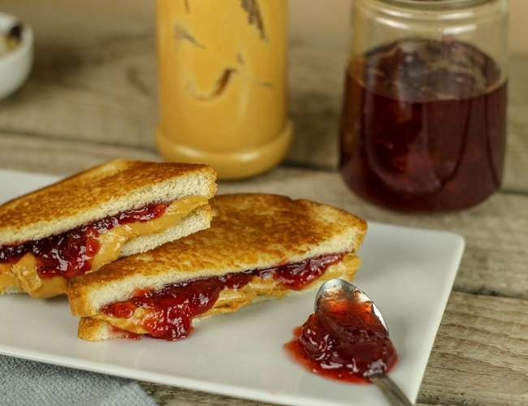
Today, YOU are going to make a poster about your favorite TLaS experiment!
Jellybean Taste Test
Lemon Volcanoes
Crazy Sandwich
Exploding Popsicle Sticks

Slide 11
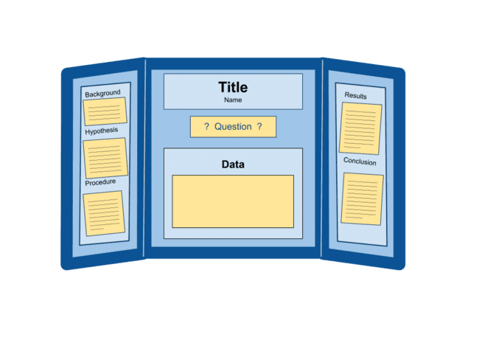
Important Parts of a Poster…
Title & Your Name
Question
Background
Hypothesis
Materials & Procedure
Data (graphs, drawings, pictures)
Results
Conclusions

