Slide 1


The Scientific Method
This work is licensed under a Creative Commons Attribution-NonCommercial-ShareAlike 4.0 International License

Slide 2
Peeking into the Lab…
The next slide will have pictures of science laboratories – the places where scientists work.
For the next slide, think about:
  What items do you recognize?
  Why do you think we need these items in the lab?
  What items do you not recognize?
  If you had to guess, what do they do?
WAIT to be called on to share!

Slide 3
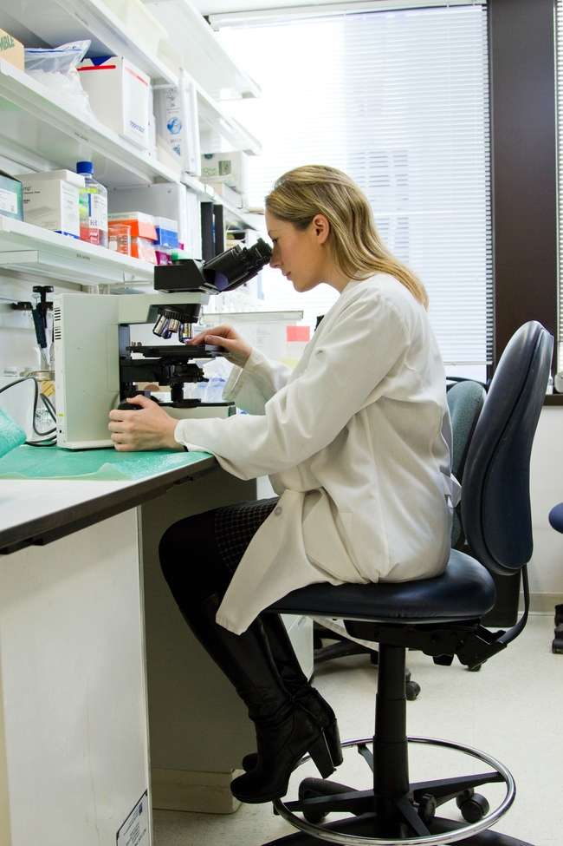
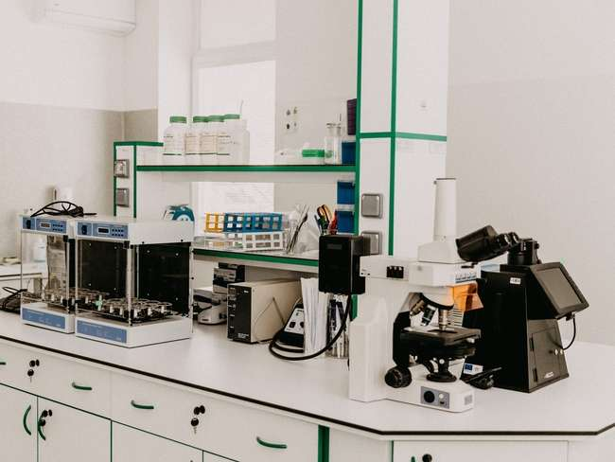
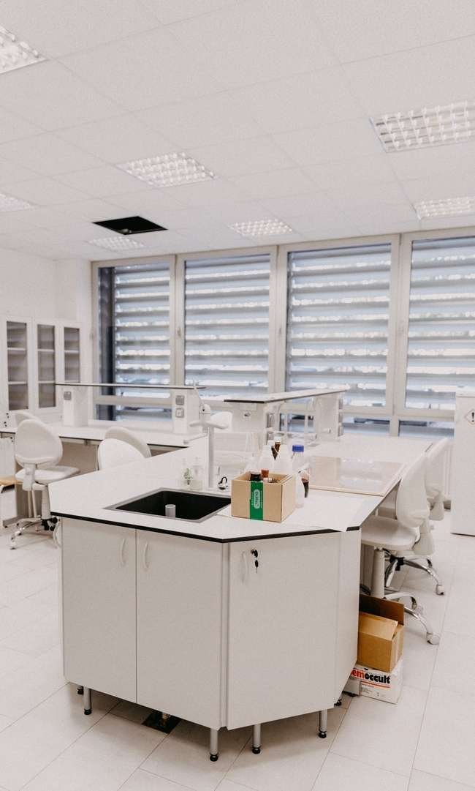
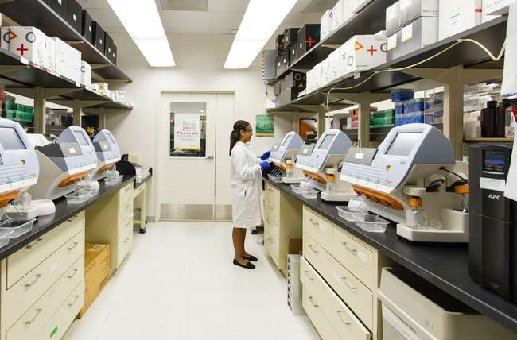

Slide 4
An Introduction to the Scientific Method
For the next several slides, follow along.
Raise your hand if you have a question!
Today is an introduction! Do not worry if you miss something because we will talk about the scientific method over and over during this after-school program!

Slide 5
Step 1. Ask a Question
Step 2. Research
Step 3. Hypothesize
Step 4. Experiment
Step 5. Analyze
Step 6. Conclude

Slide 6


Step 1: Ask a Question
What do you want to learn?
Example:
Does a plant grow better using water or orange juice?

Slide 7

Step 2: Research
Read and learn about your question.
Look for books or trustworthy sources of information on the internet!

Slide 8

Step 3: Hypothesize
Create a testable explanation for an observation!

Slide 9
Let’s make a hypothesis.
Think about this for 1-2 minutes.
We will ask for volunteers to share answers!
Questions:
Will a plant grow better with water or juice?
Why do you think so?

Slide 10
Turn it in to a hypothesis…
If _______________,
  (which one will be better?)
Then ____________,
  (how will it affect growth?)
Because __________.
  (why do you think so?)
Work together at your table to turn your idea into a hypothesis. You can ask the volunteer scientists for help!
Take 3 minutes to have an answer.
Volunteers share out!

Slide 11
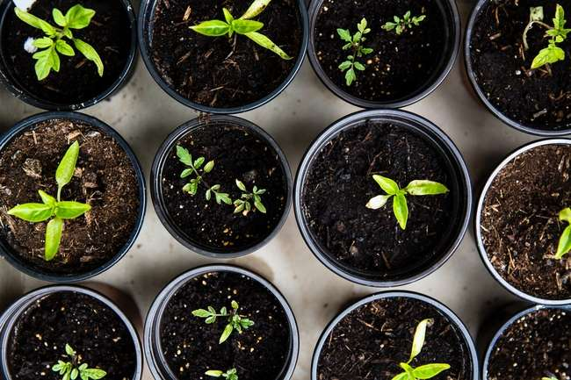
Step 4: Experiment
Follow ordered steps to test a hypothesis.
1. Add dirt to the pot
2. Poke a hole and add the seed
3. Cover the seed with dirt
4. Add water, juice, or nothing (as a control) on top of the seed
5. Observe
6. Measure, take notes and photos each day

Slide 12


Step 5: Analyze
Look for patterns in the data.
Summarize data and make tables, bar graphs, line graphs, etc.

Slide 13

Step 6: Conclusion
Tell everyone what you learned from your data.

