Slide 1

Your Course Name
First Day of Class
Your Community College Name
ACCT 100/Course Abbreviation
Instructor Name
This Photo by Unknown Author is licensed under CC BY
Notes:
OER First Day of Class Powerpoint by Elizabeth Spica is licensed under a Creative Commons Attribution 4.0 International License.

Slide 2
Insert Textbook Name
Log On
Log on to our course site to access the book.
Download
Download the textbook PDF for FREE and add it to any and all devices. Contact campus tech support for help with downloading.
Access any time, anywhere!
The PDF lets you access the textbook online or offline, from any device.
Insert Cover Image
(link image to OER Commons site if available)
Notes:
This slide introduces students to the required textbook, how to access it, and that it can be read online or offline.
Students are free to print one page or the entire book through any means available (Through the library, local copy service, personal printer, etc) – printing is not a requirement.

Slide 3
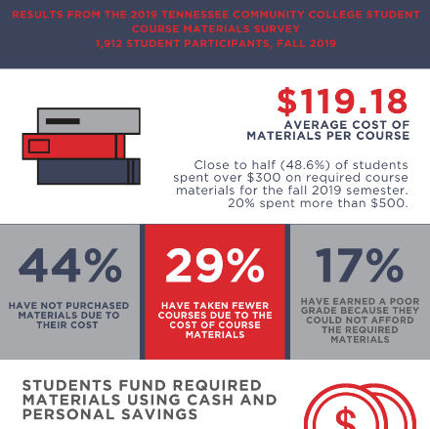
This textbook is FREE.
“Open Educational Resources (OER) are teaching, learning, and research materials that are either (a) in the public domain or (b) licensed in a manner that provides everyone with free and perpetual permission to engage in the 5R activities [retain, reuse, revise, remix, redistribute].“
creativecommons.org
Notes:
A team of faculty across the state created this textbook for you in response to reports from students that the cost of textbooks was a problem.
We know that students in Tennessee are avoiding buying textbooks, taking fewer courses, earning poor grades, and even avoiding certain majors because of the high costs of textbooks. We also know that students are largely funding these purchases with personal savings and student loans. One 2018 report noted that, nationwide each year, “$3 billion of federal student aid goes to pay for textbooks.“
To help remedy these problems, TBR sponsored a group of faculty to come together and create a textbook specific to this course using freely available, openly licensed educational resources, or OER. Instead of a traditional textbook whose content is copyrighted, these learning materials are licensed for free use and sharing. The content experts who have vetted this content created this textbook to perfectly align with the topics we’ll cover this semester, and it’s the use of OER that allows them to be free to you.
SOURCES:
Spica, E. (2020). PERC Report Infographic: 2019 Tennessee Community College Student Course Materials Survey. Knoxville, TN: University of Tennessee Knoxville Postsecondary Education Research Center. Retrieved from perc.utk.edu/reports. CC BY 4.0 International license.
Vitez, K. (2018, March 7). Student Government Leaders Unite in Call for Federal Open Textbook Grant Program. Student PIRGs. https://studentpirgs.org/news/sp/student-government-leaders-unite-call-federal-open-textbook-grant-program

Slide 4

OER are Unique!
(see David Wiley, 5Rs, opencontent.org/definition)
Retain | make, own, download, and control a copy
Revise | edit, adapt, and modify
Remix | combine with other material to create something new
Reuse | use your original, revised, or remixed copy publicly
Redistribute | share your original, revised, or remixed copy
CC Logo by Creative Commons is licensed under CC BY-NC
Notes:
(This optional slide talks about how OER differ through the lens of David Wiley’s 5R permissions, opencontent.org/definition)
The CC-license is what enables us to do all of this. CC stands for Creative Commons license, and it’s different from the C license we’re used to seeing that is a Copyright license. In contrast to traditional copyright, Creative Commons licensed material legally enforces the sharing of that material. A CC license is used when an author wants to give other people the right to share, use, and build upon a work that they (the author) have created.
OER differ from traditionally copyrighted material because you can:
Retain – make, own, download, and control a copy of the resource.
Reuse – use your original, revised, or remixed copy of the resource publicly (website, presentation, class)
Revise – edit, adapt, and modify your copy of the resource. Translate and adapt for your own purposes
Remix – combine your original or revised copy of the resource with other material to create something new
Redistribute – share copies of your original, revised, or remixed copy of the resource with others. Post online, give to friends, give to fellow students.

Slide 5

OER Saves You Money & Helps You Learn
Studies show that students in courses where Open Educational Resources are in use perform just as well if not better than students in courses with traditional textbooks.
Hilton III, J. (2016). Open educational resources and college textbook choices: A review of research on efficacy and perceptions. Educational Technology Research & Development, 64(4), 573–590. https://doi.org/10.1007/s11423-016-9434-9
This Photo by Unknown Author is licensed under CC BY-NC
Notes:
Basically, the textbook we’re using this semester will not only save you money, but it can also help you learn. Research shows that students in courses where OER are in use perform just as well if not better as students taking courses with expensive textbooks.

Slide 6
Your OER Textbook
Day One Access – download the PDF for free TODAY.
Read any time, anywhere, from any device, online or offline
Print whatever you want, whenever you want, only if you want
Content specific to the learning outcomes and topics of our course
This Photo by Unknown Author is licensed under CC BY
Notes:
OER can help you learn because you can get the textbook for free on day one, read it online or offline, keep it on as many devices as you want, print whatever parts you want (or no parts if you don’t want). Best of all, you can know that the content was specifically selected by a group of faculty experts to align with the specific topics and outcomes of our course. If it’s in the textbook, you need to know it.

