Slide 1


Positioning HBCUs for hotspots and Digital Equity funding

Slide 2
Agenda
Welcome and introductions
Session goals
  Orient to T-Mobile Project 10Million program
    Free hotspots
    Five-years of free unlimited broadband access – even if a student starts their enrollment one minute before HS graduation, they still get 5 years free broadband
    For households with 1+ child qualifing for free/reduced lunch
    Two ways households can benefit
      Family applies here
      K12 school system applies for all eligible households – 1 hotspot for family – click on “I’m a school administrator” here

Slide 3
How can HBCU students benefit?
Who’s eligible at HBCUs?
  Alums with lower-income school age children
  Current students with lower-income school age children
  Lower-income HS students in early college/TRIO programs with your HBCU
Discussion:
  What key folks at the HBCU should be mobilized to get tens of thousands of families to benefit? (e.g., financial aid and admissions, TRIO…?)
  What materials/links do you want NCDE provide for them?
  Next steps: should we promote follow-up webinar(s) with these key HBCU staff and partners?

Slide 4
Time Permitting: more digital equity related resources HBCUs can leverage
Orient state HBCU leaders to federal funding that has been awarded for
    Broadband (“BEAD”)
    “Competitive” digital equity grants for other recipients
    Connecting Minority Communities grants – see also this very useful map
  Orient HBCU leaders to opportunities to tap “digital equity capacity” funds that states have just received and need to disburse soon (to avoid rescission)
  National webinar(s) for HBCU colleagues?
    Educating your state broadband office re essential role HBCUs can play
      Ensuring voice & agency for covered populations
      Helping local groups serving covered populations submit bids for state capacity funding
      HBCUs and their school and community partners applying for state capacity funding
      Fostering national role for HBCUs distributing devices w/inclusion resources & digital skill training

Slide 5
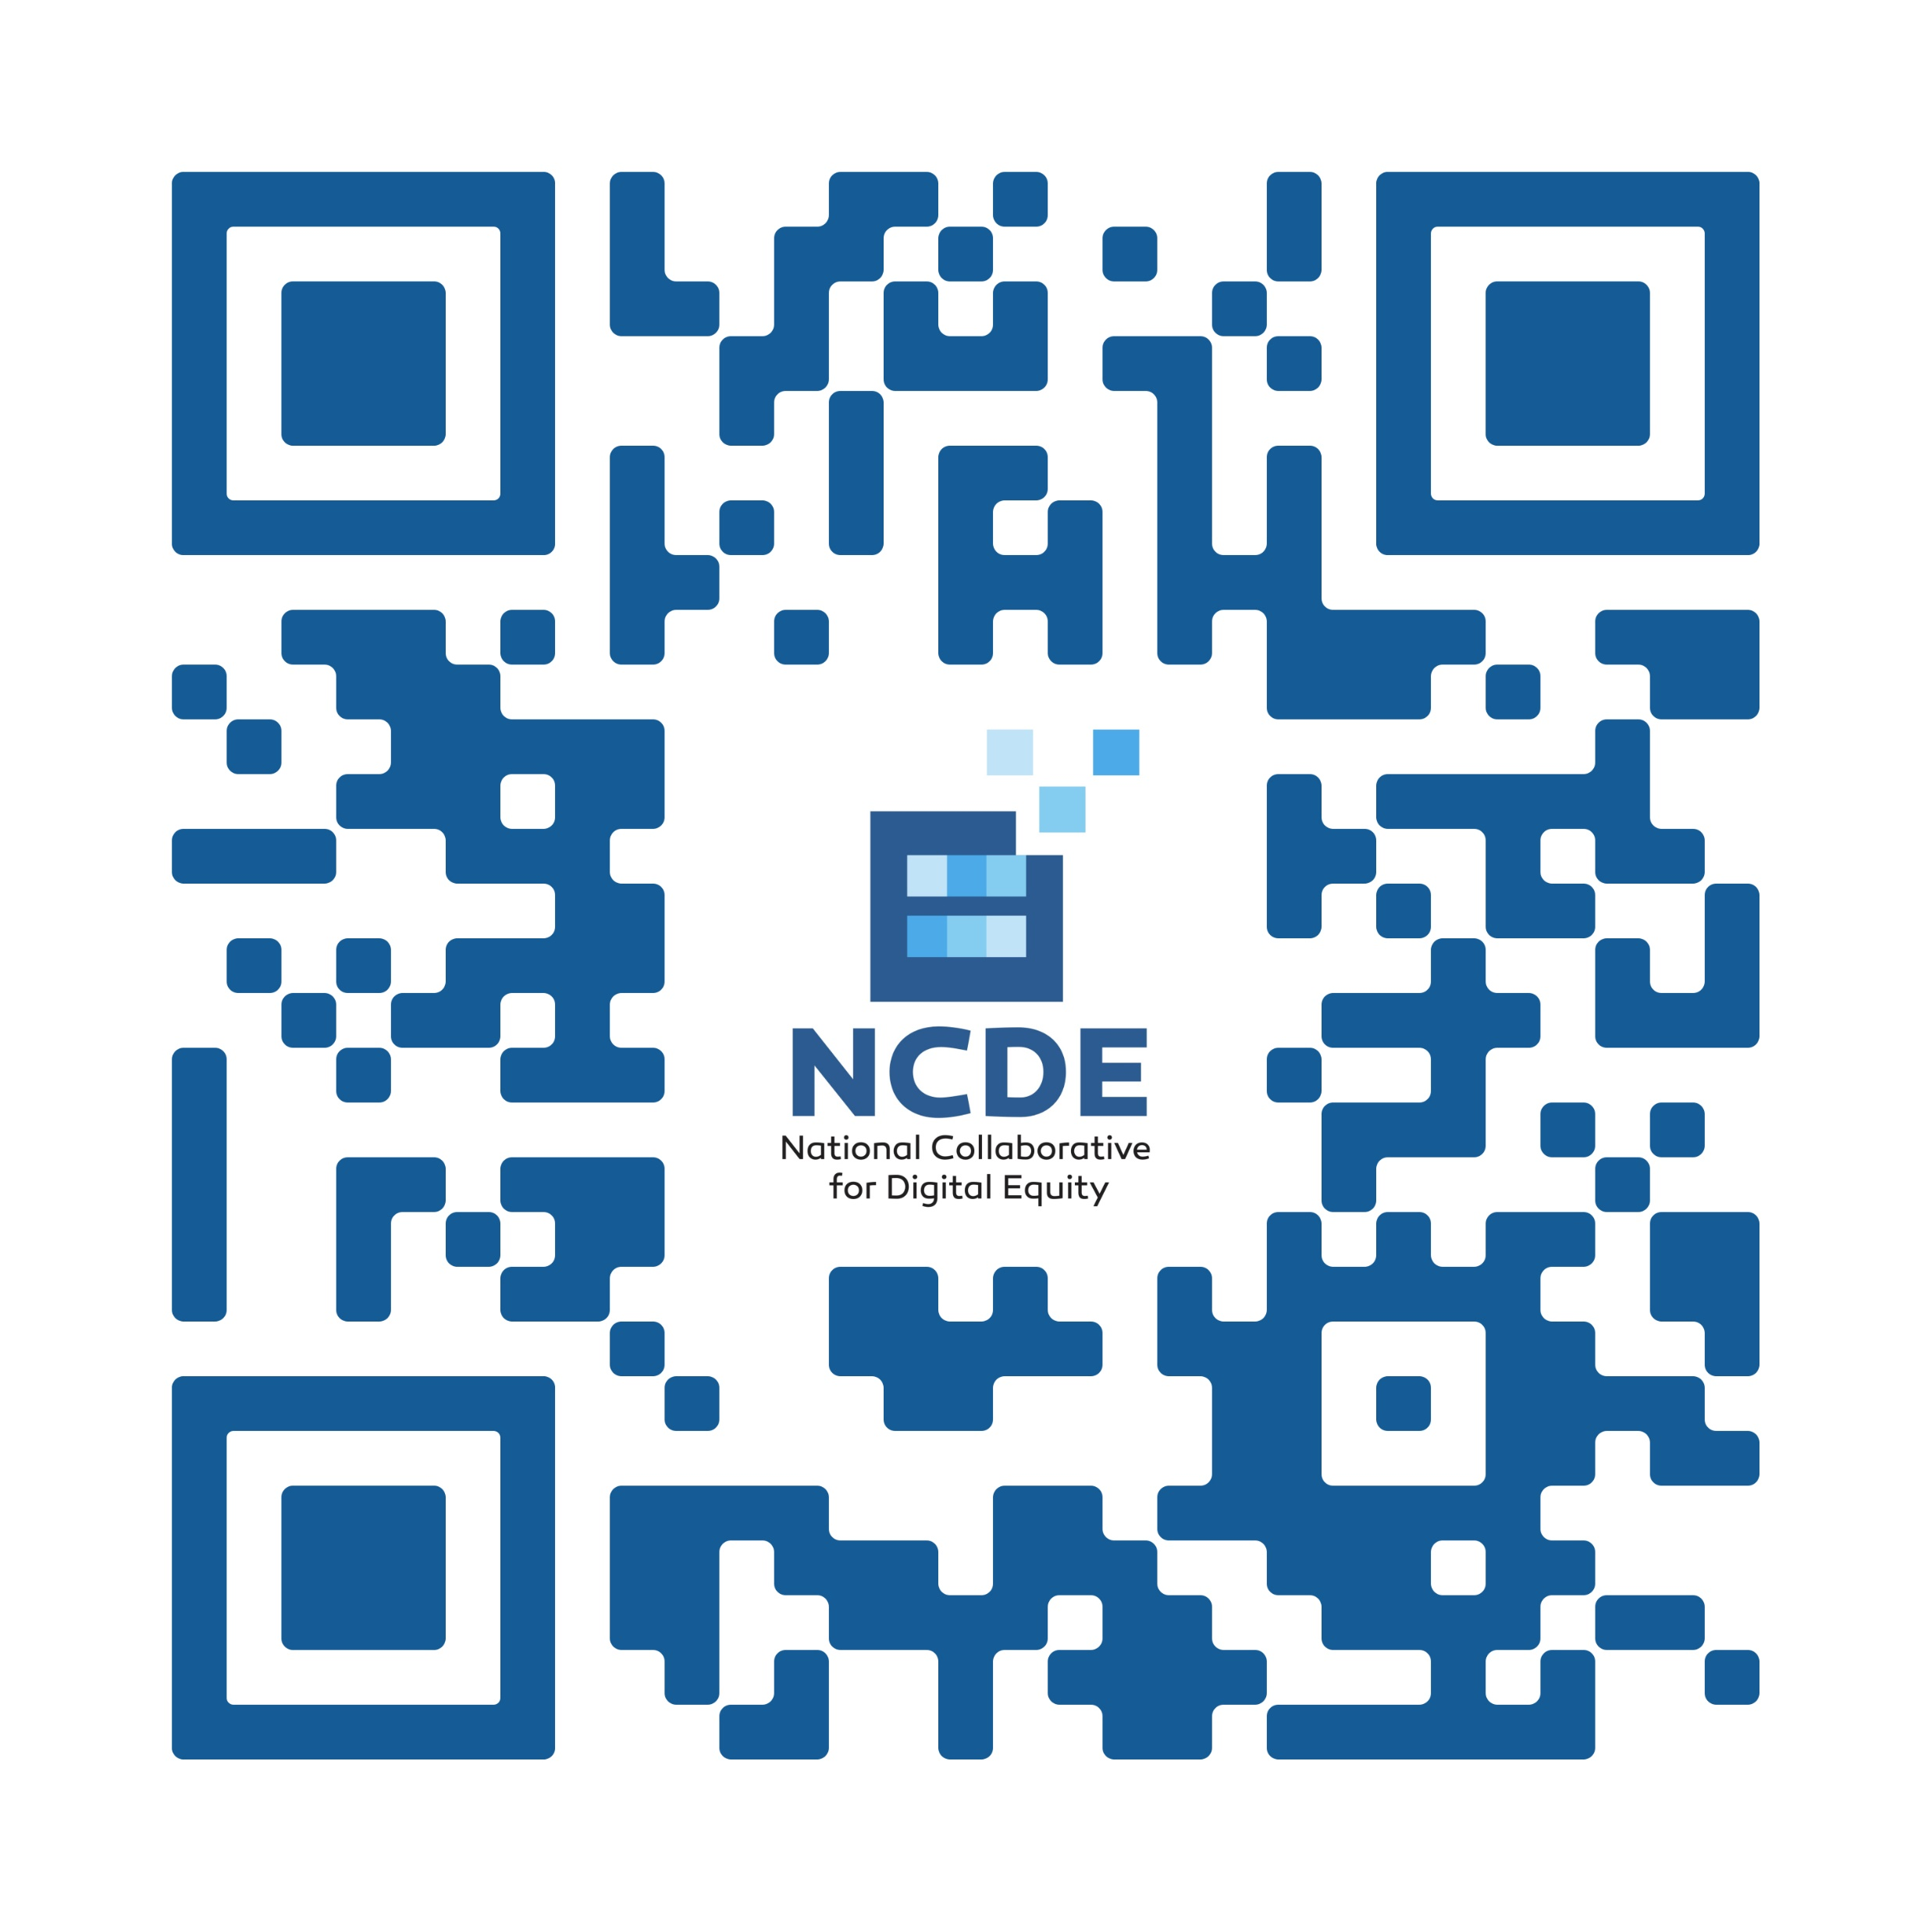
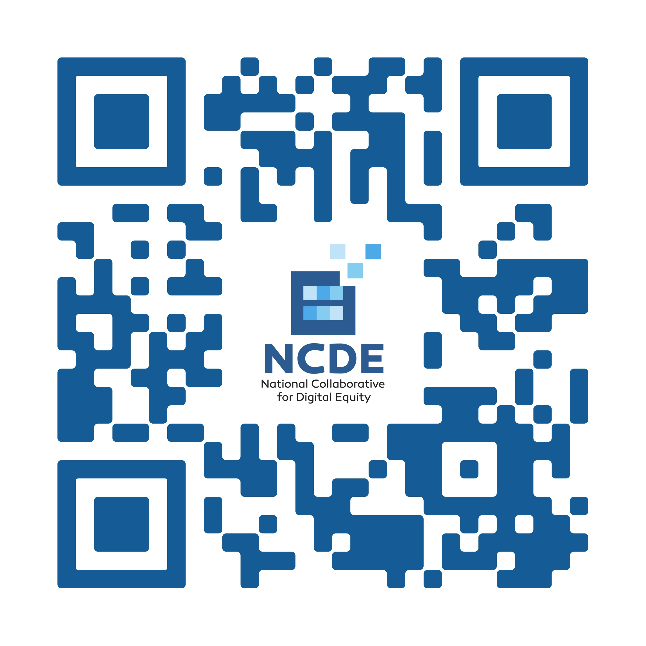

Dr. Robert McLaughlin
Jenelle Leonard
NCDE Website

