Slide 1
ALS 2022/3
HIST 5840 - Proseminar: Theorizing Colonial Imperialism in Africa
Tiffany F. Jones, tjones@csusb.edu,
Total Savings: $119.17

Slide 2
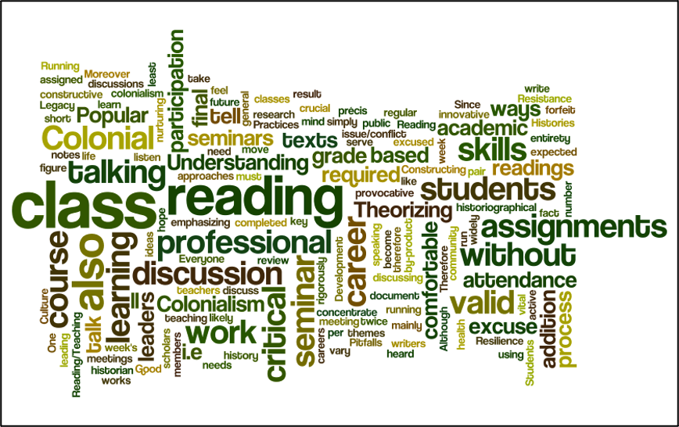
Course Description
This course focuses on intensive reading and historiography and examines the ways in which historians research, write, debate, and contextualize history of colonial encounters and imperialism in Africa. Students examine key issues/themes in history through the historiography of colonialism in Africa (and the world) and obtain intensive skills in the way in which history is constructed, manipulated, and defined. It relies on students reading about half to one book a week.

Slide 3
Course Breakdown
Course is offered numerous times a semester and a requirement for every history student before graduation
Usual enrollment: 15 students in each section
Spring, 2023 enrollment: 15 students
Students run discussions on texts so need access.

Slide 4
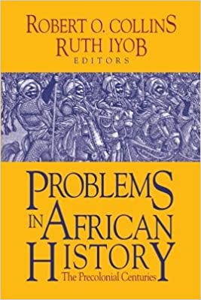
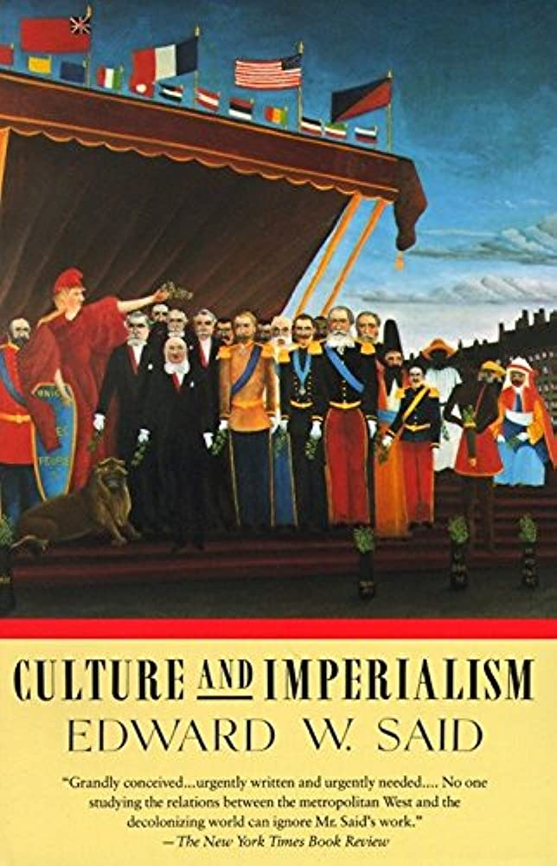
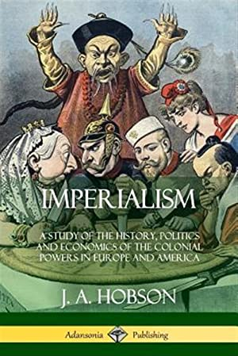
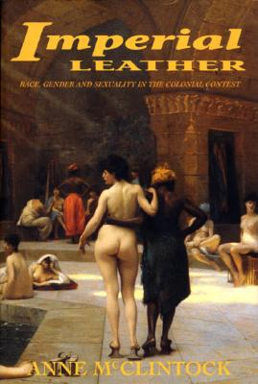
2021/22 Previous Texts Costs
  JA Hobson, Imperialism: A Study of the History, Politics and Economic of the Colonial Powers in Europe and America (2018)
  Robert O. Collins, Problems in African History
  Edward Said, Culture and Imperialism
  Ann McClintock, Imperial Leather
  Excerpts from other texts - did not assign full texts to try keep costs low.

Slide 5

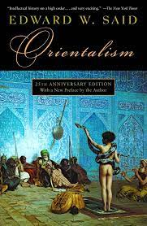
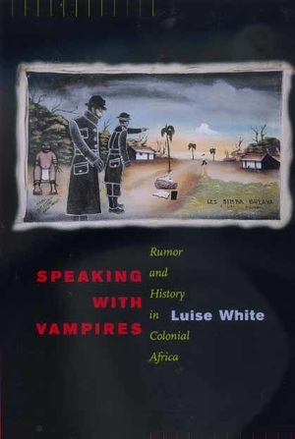
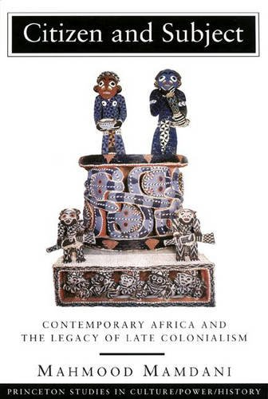
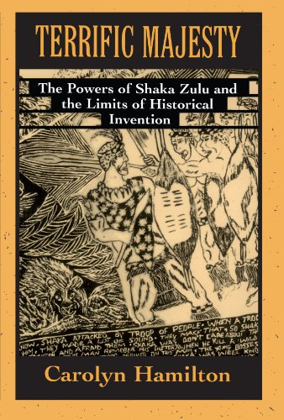
Adopted Library eTexts for 2022/3
  Benedict Anderson, Imagined Communities: Reflections on the Origin and Spread of Nationalism (Verso, 2006)
  Carolyn Hamilton, Terrific Majesty: The Powers of Shaka Zulu and the Limits of Historical Inventions (Harvard University Press, 1998)
  Mahmood Mamdani, Citizen and Subject: Contemporary Africa and the Legacy of Late Colonialism (Princeton University Press, 1996)
  Edward Said, Orientalism (Vintage, 1994)
  Luise White, Speaking with Vampires: Rumor and History in Colonial Africa (University of California Press, 2000)

Slide 6
Final Thoughts
Spring 2023
Zero Cost to Students Savings $119.17
Course engagement has increased - students are able to hit the ground running right away and begin reading earlier if possible
Students are now reading full texts (not just excerpts from different texts)
Zero cost to students means all students have quick access. No longer waiting for texts to arrive. Many expressed thanks for no cost texts.
Students tend to use library databases more for book reviews as they are accessing the books through the library site.
Course is still ongoing, but at present it seems as if student engagement with texts are up. A few students still prefer hard copies and are purchasing them, but they are choosing which texts they now want to personally own.

